Slide 1









Heavy rainfall:
10th - 12th of November 2022
Valencian Community
Jorge Suárez (S+EM)

Slide 2
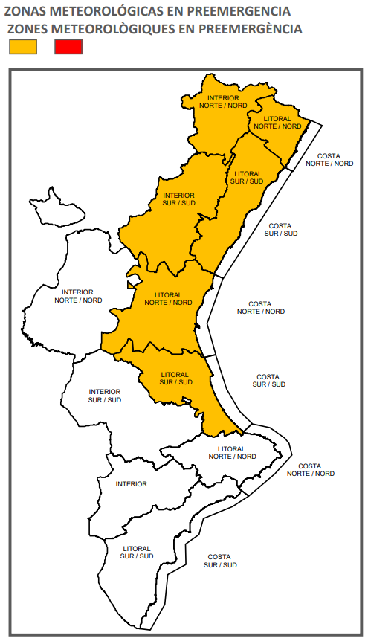
Timeline
09/11/22 Emergency Coordination Centre of the Valencian Community (CCE) issues the first warnings to the population and agencies based on the information received by the Spanish State Meteorological Agency (AEMET). (Yellow level)
10/11/22 CCE declares state of Pre-emergency for rainfall in coast of the provinces of Castellon and Valencia, which is later updated in the interior of Castellon

Slide 3
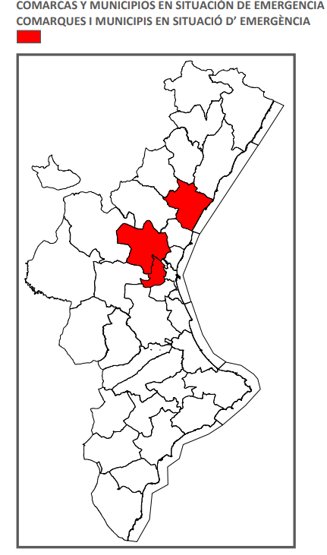
12/11/22 Because intensity of the rains and the effect on the population its declared state if Emergency in the councils of L'Horta Oest and later in Camp de Turia (both in Valencia) and in La Plana Baixa (Castellón)
14/11/22 End all emergency situations

Slide 4
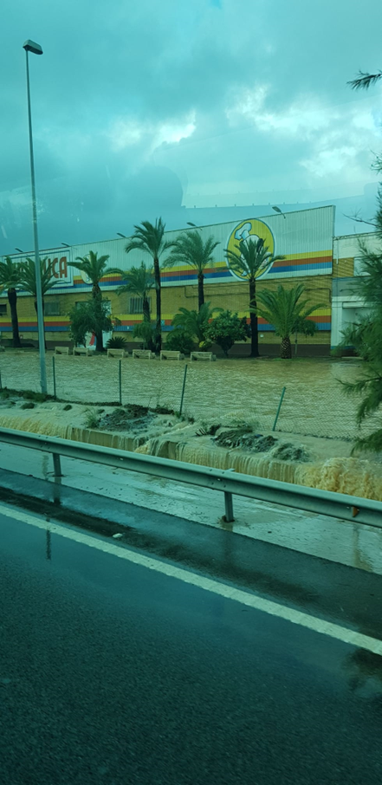
Civil protection incidents
Rescue services managed a total of 200 services mainly related to: water drains, façade cleaning and tree falls
Power cuts in many towns in the metropolitan area of Valencia
On the morning of the 12th, Valencia Airport was closed due to accumulation of water on the runway
Closure of numerous roads including the left lane of the A·3
Shuts in train network and metro lines

Slide 5
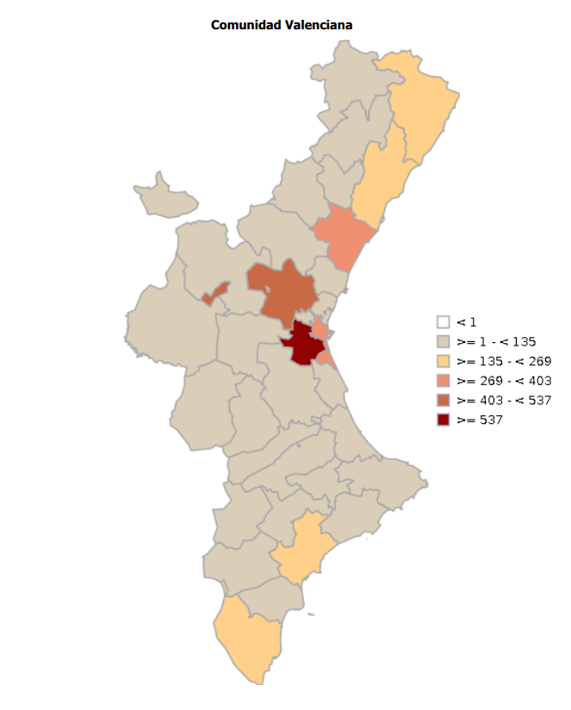
The 112 received a total of 3,081 calls (2,136 incidents)

Slide 6
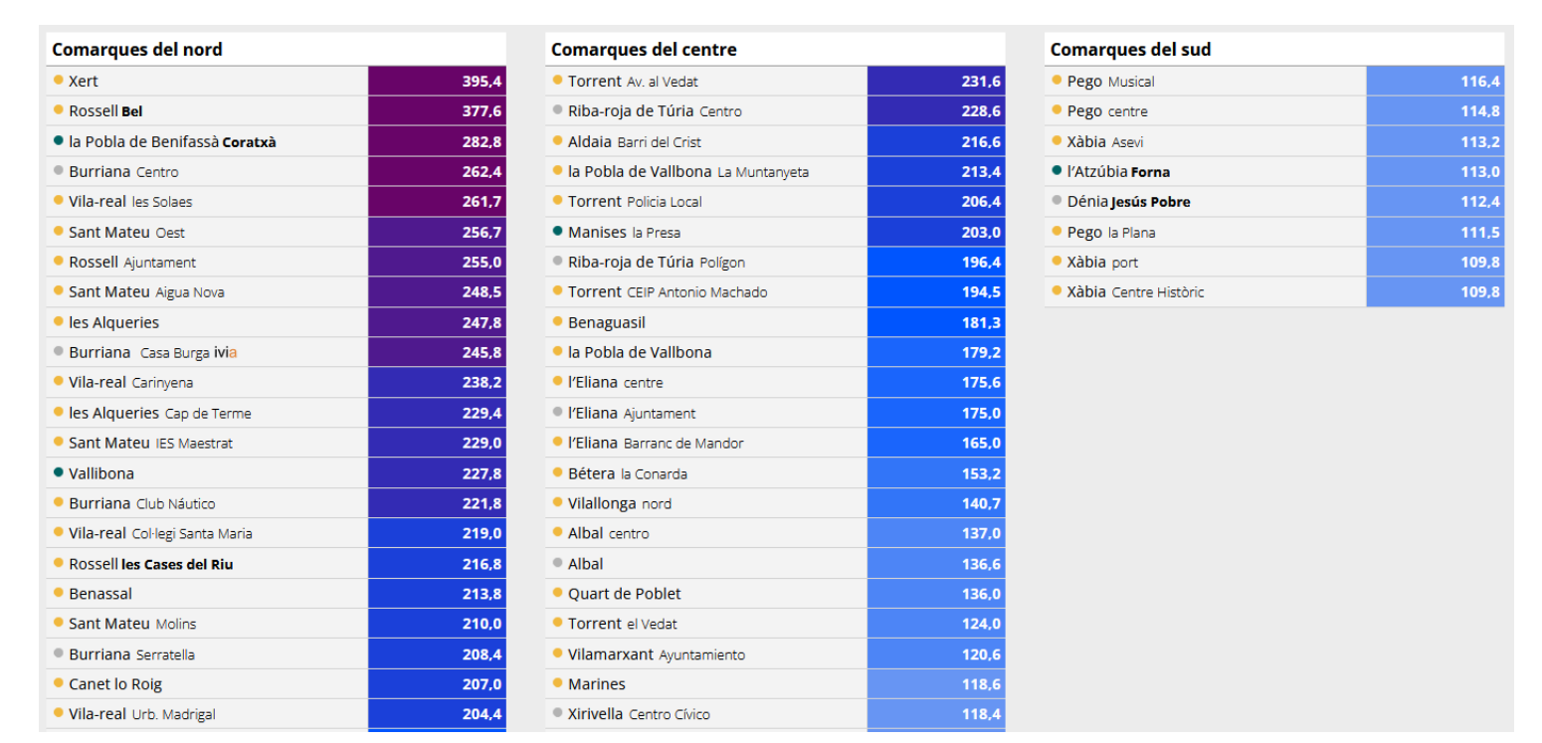
rainfall

Slide 7
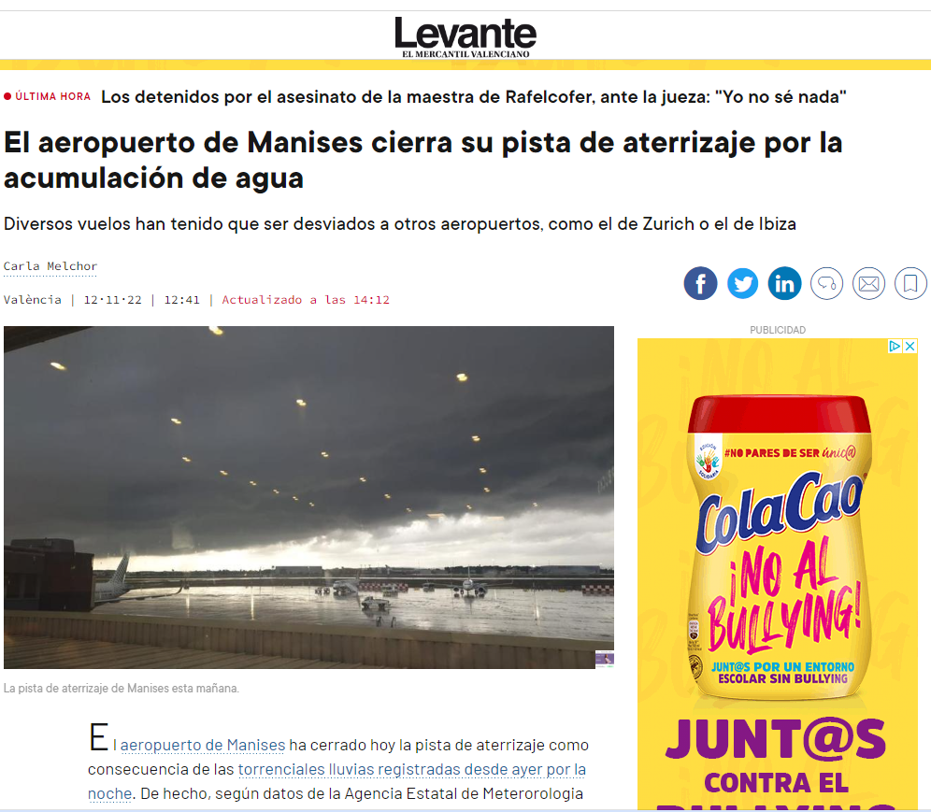

Social Media
X

Slide 8
MANISES 10th -12th Nov 2022
EXAMPLE OF FLASH FLOOD IMPACT OVER THE RIVER, AND URBAN AREAS AND SUB-CACHTMENTS
NATIONAL PERSPECTIVE:
AEMET ALERTS
EFAS INFORMATION
How to use Edera Platform?
Rosa Torres (DGPCE)

Slide 9

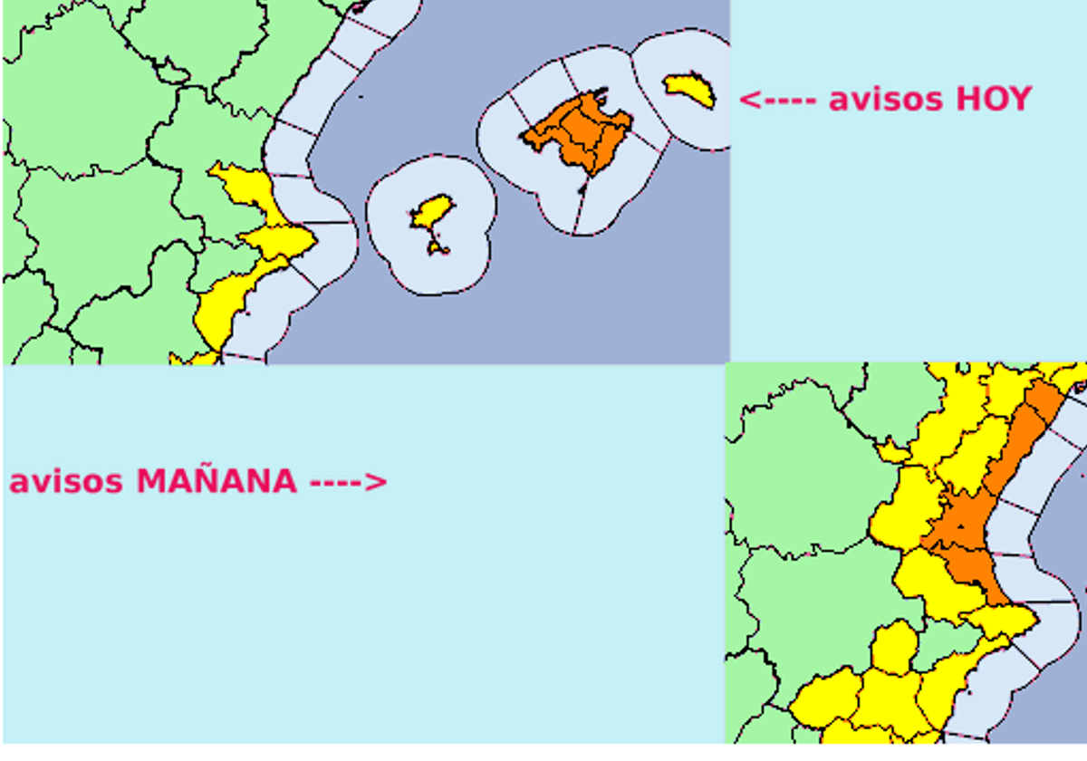
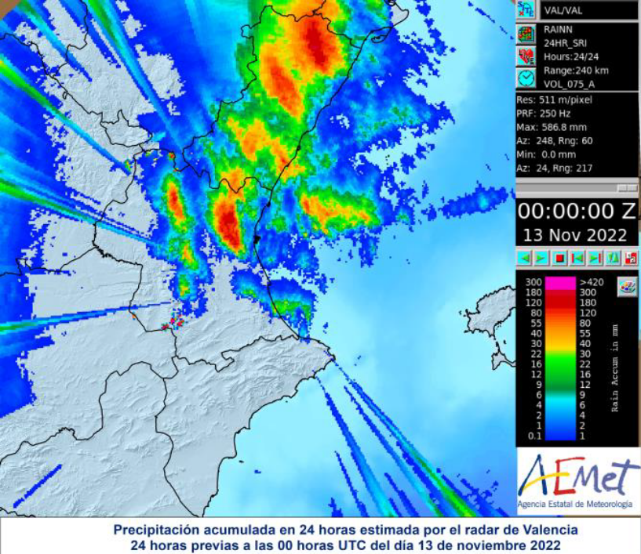
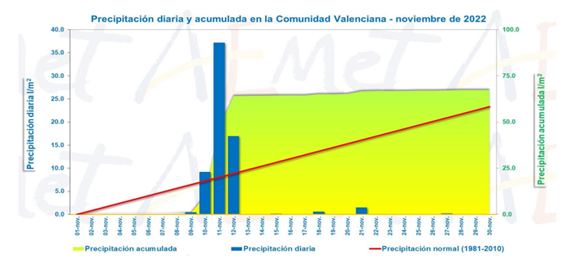

OFICIAL Summary of the episode:
OFICIAL WARNINGS
AEMET ALERTS
AND ACCUMULATION
INFORMATION
Radar information

Slide 10
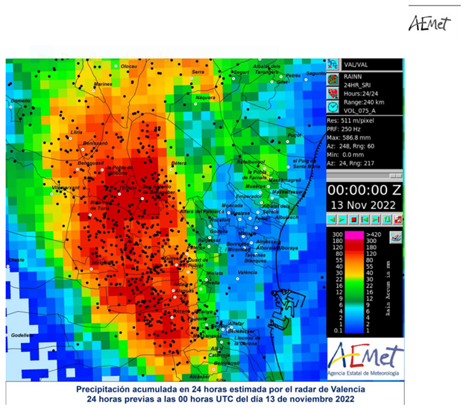
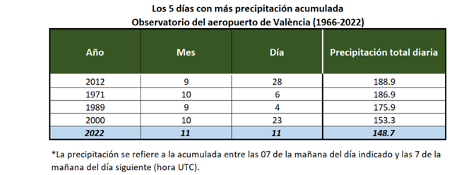
OFICIAL Summary of the episode:
Heavy rainfall forecast 10th to 12th November.
Precipitations up to 122 l/m2 in 12 hours and 66 in 1/h 122 l/m2 in 12 hours and 66 in 1/h around metropolitan Valencia area and Manises Airport.(Urban Area)
Heavy storms with lightning and hail
Also heavy rain (100 l/m) on Jucar basin.

Slide 11
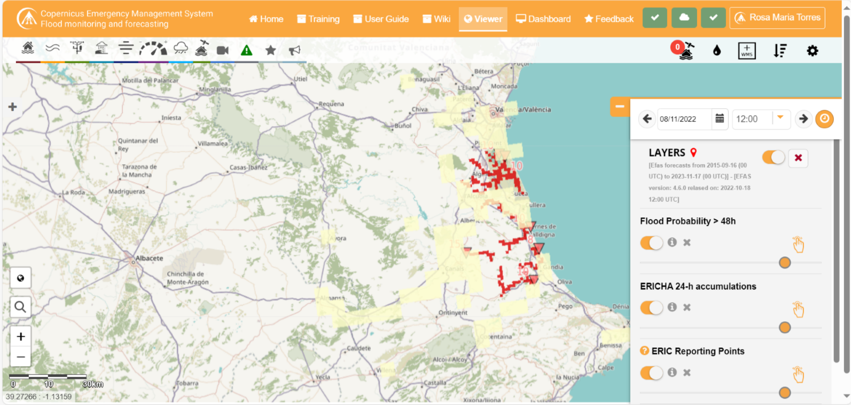
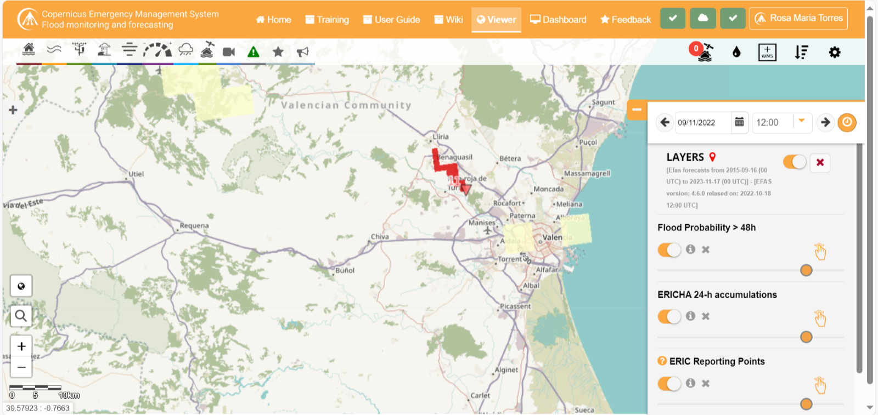
EFAS INFORMATION: Flood probability 24 h.- Ericha acumulation- Eric point 08/11/2022

Slide 12
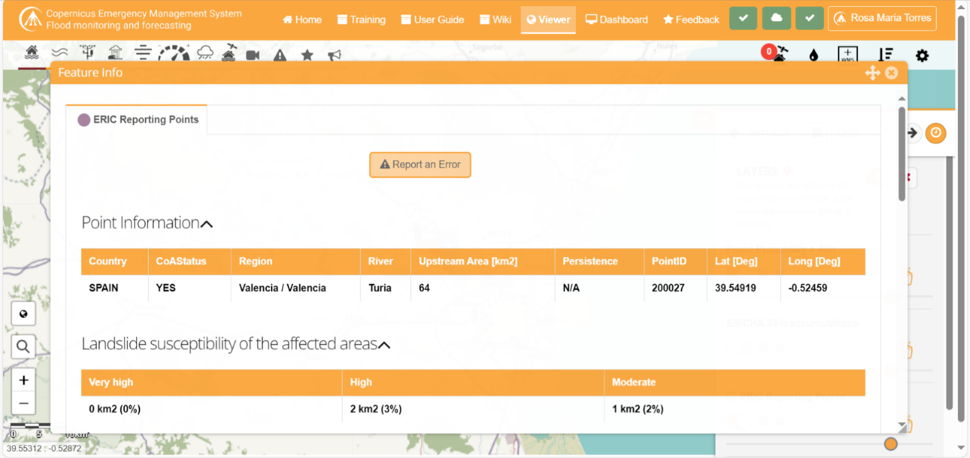
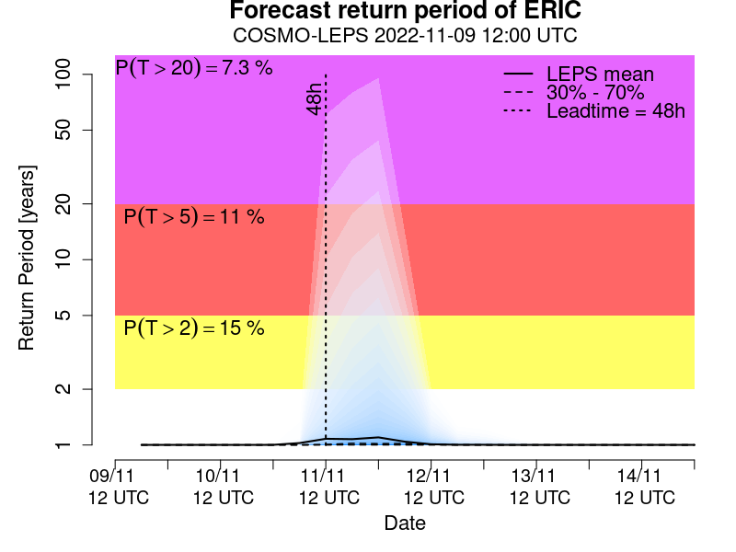
EFAS INFORMATION:

Slide 13

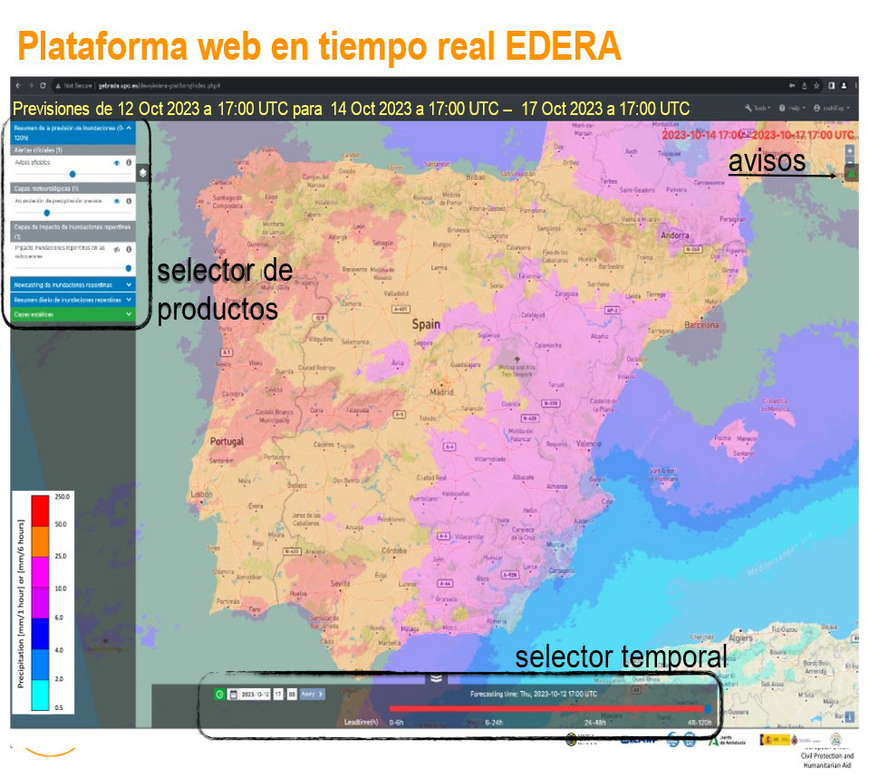
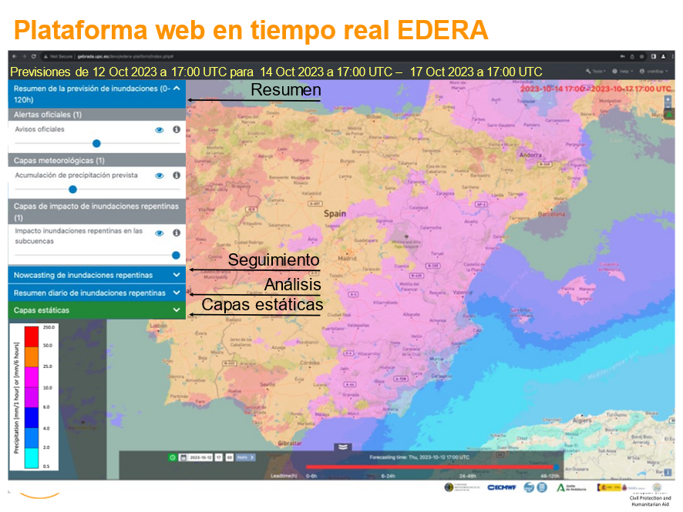

What can we find in Edera during and after the event?
A) 3 groups of dinamic layers:
Forecast summary: 0 - 120 h
Storms and Animated flash flood nowcasting
Daily summary.
B) Statics layers: exposure, return period..

Slide 14
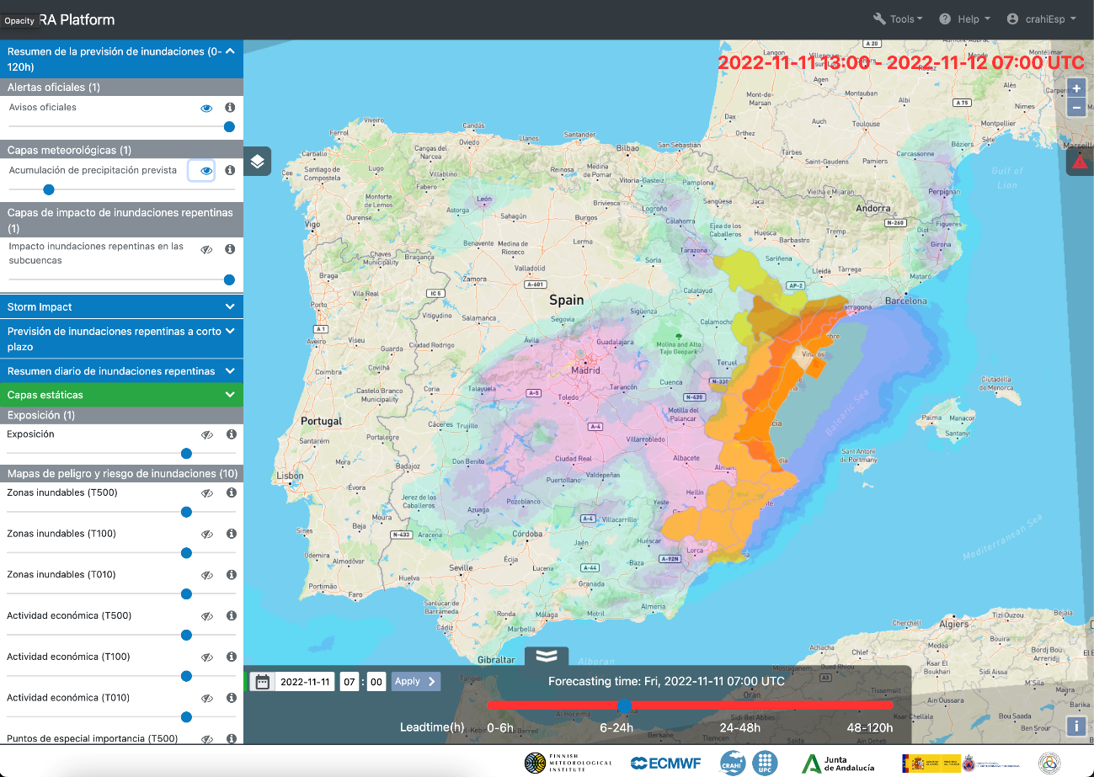
MANISES (VALENCIA): 10th -11th November 2022

Slide 15
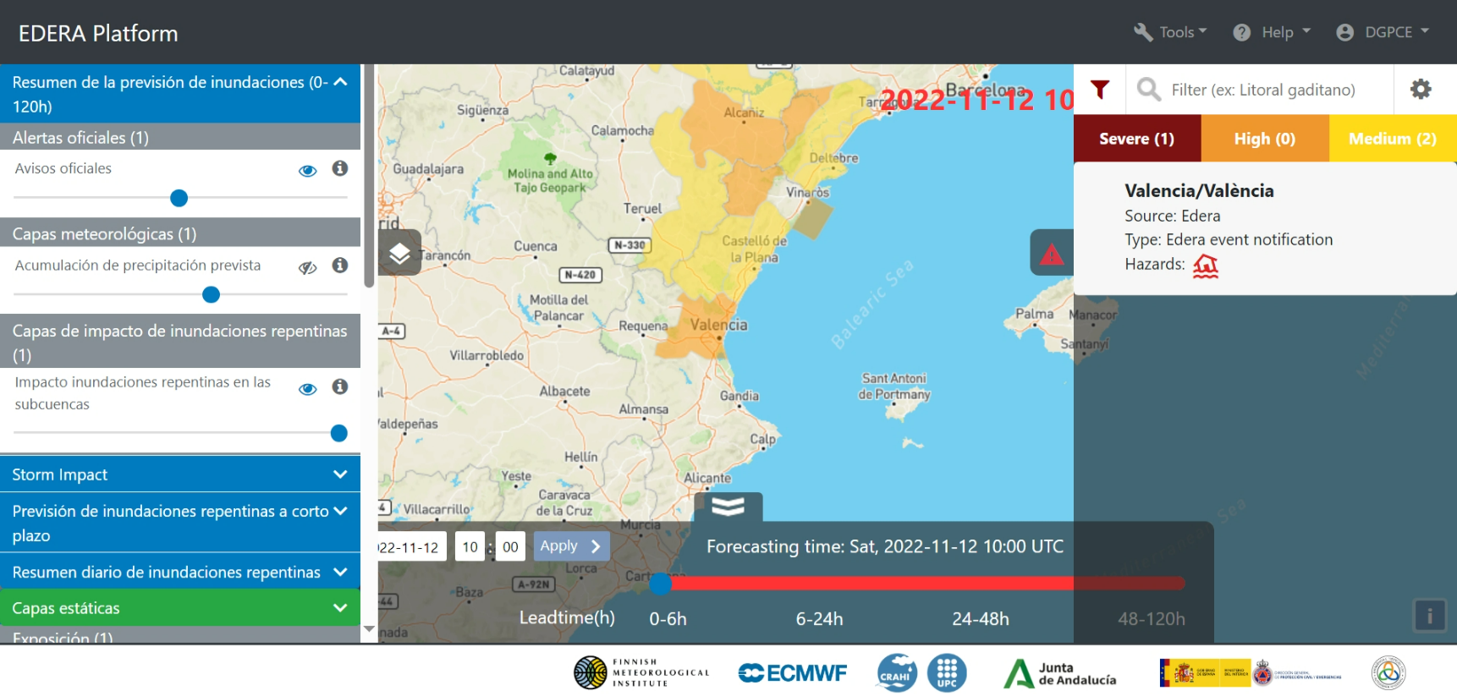
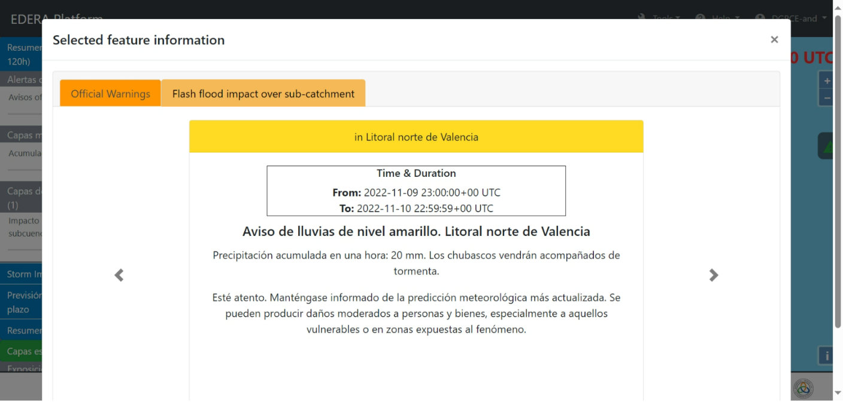
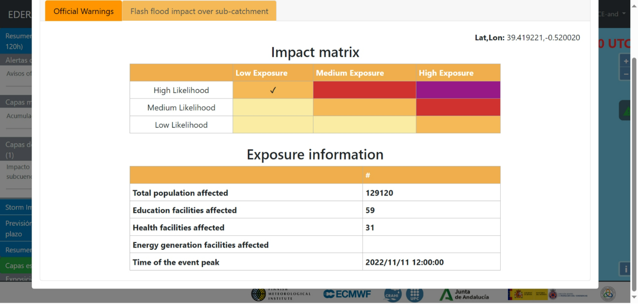
A) FORECAST 0-120 h.
Oficial warning (AEMET)
Flood Impact over sub cachtment (EFAS)
EDERA notificacion

Slide 16
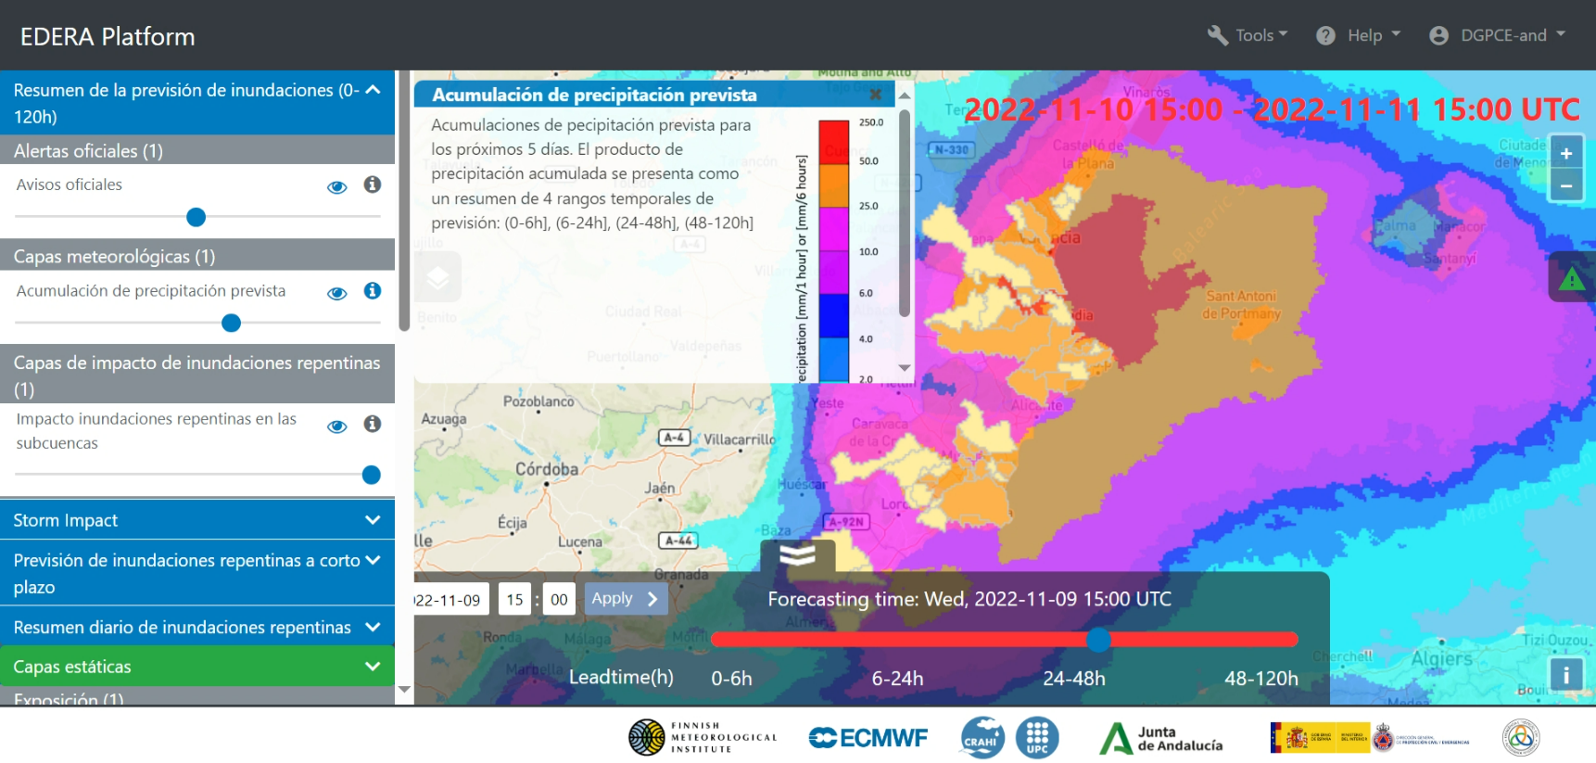
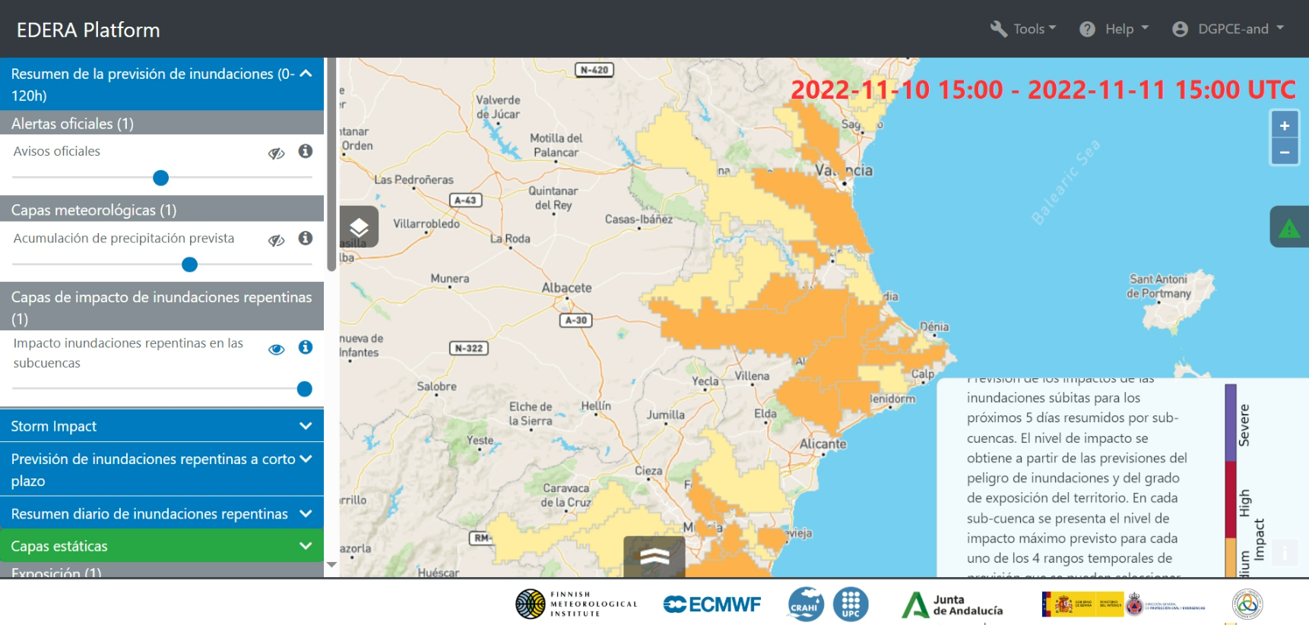
Seamless precipitation accumulation
Flash flood impact over subcatchment

Slide 17
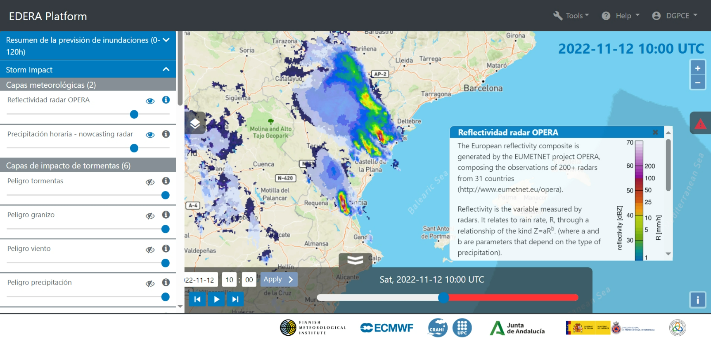
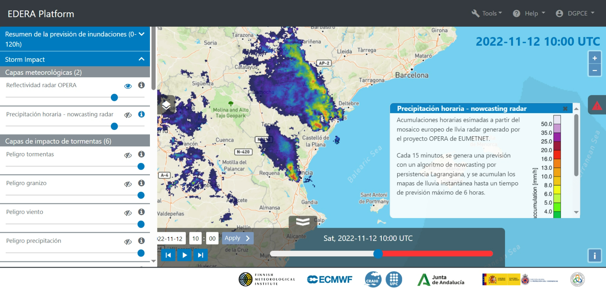
B) STORMS

Slide 18
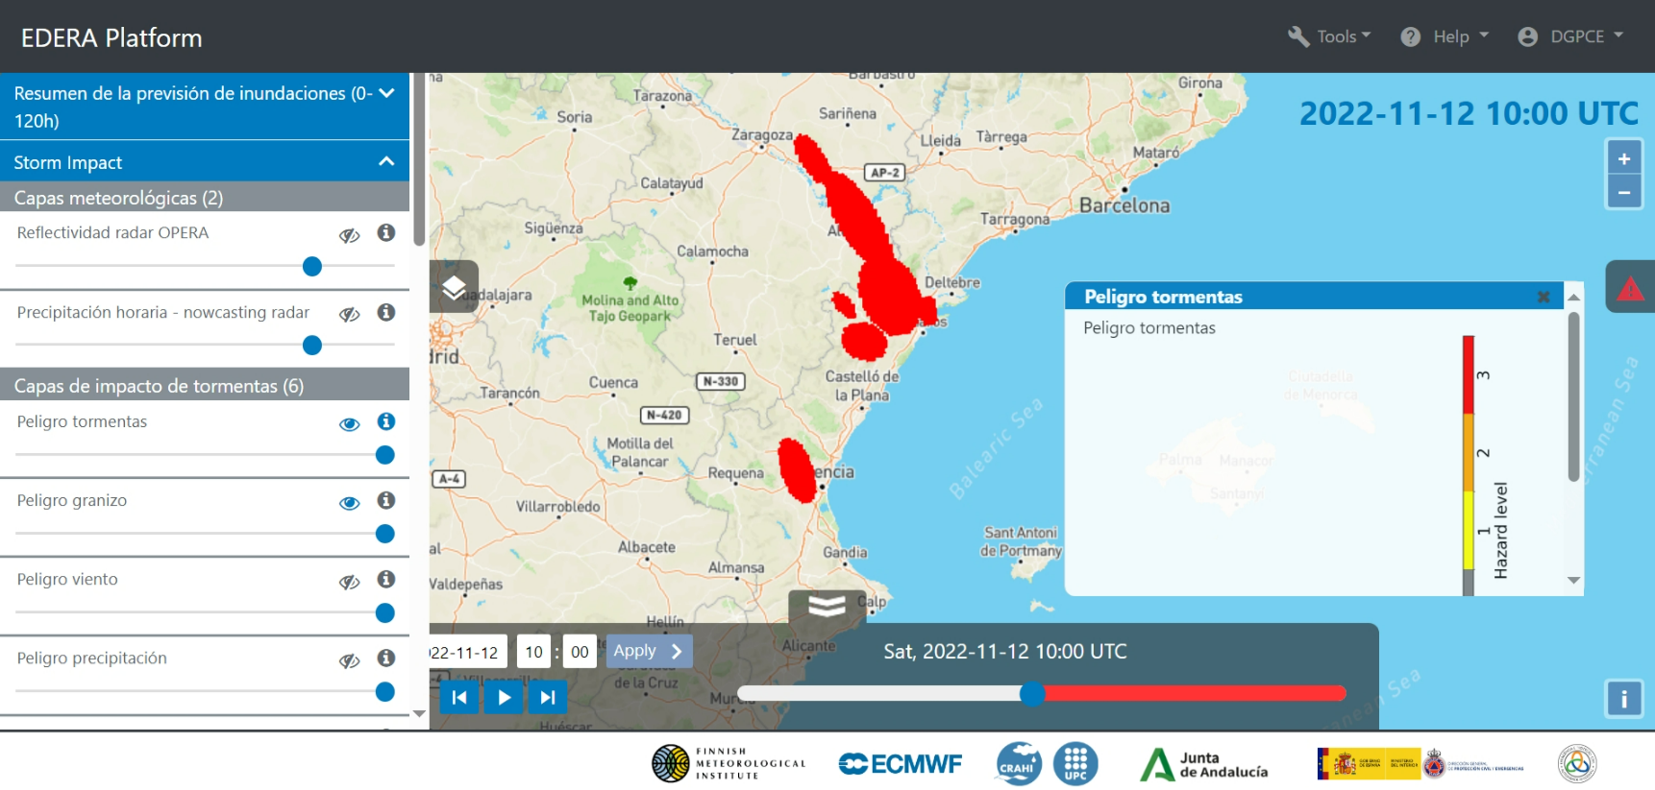
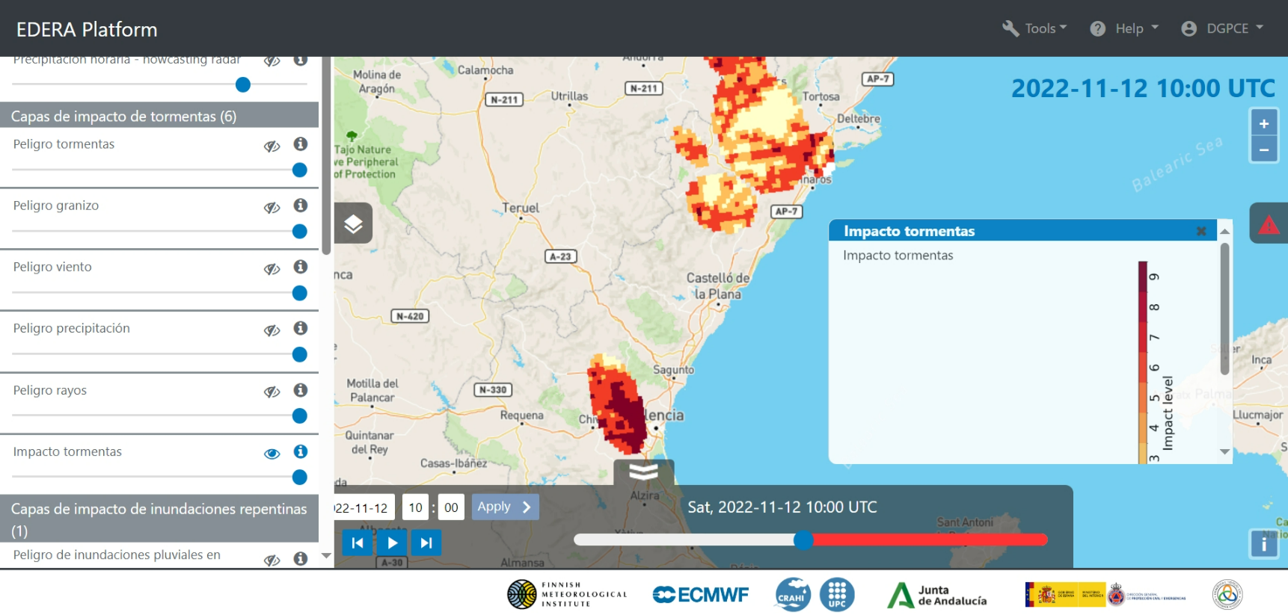
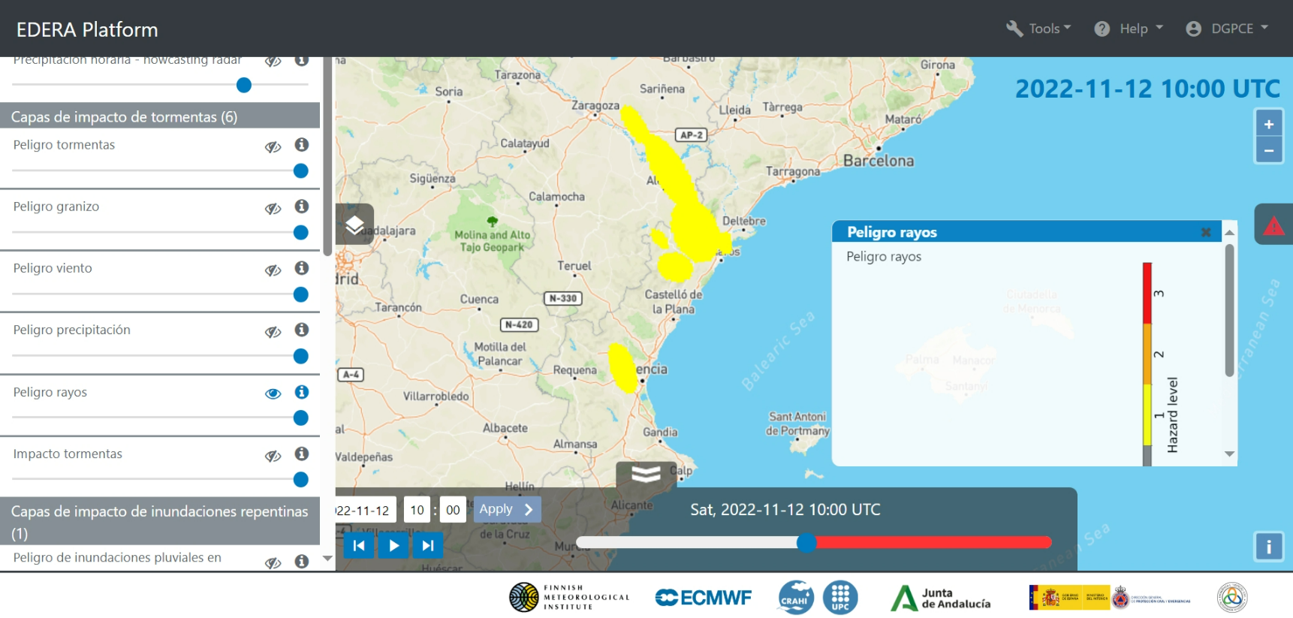
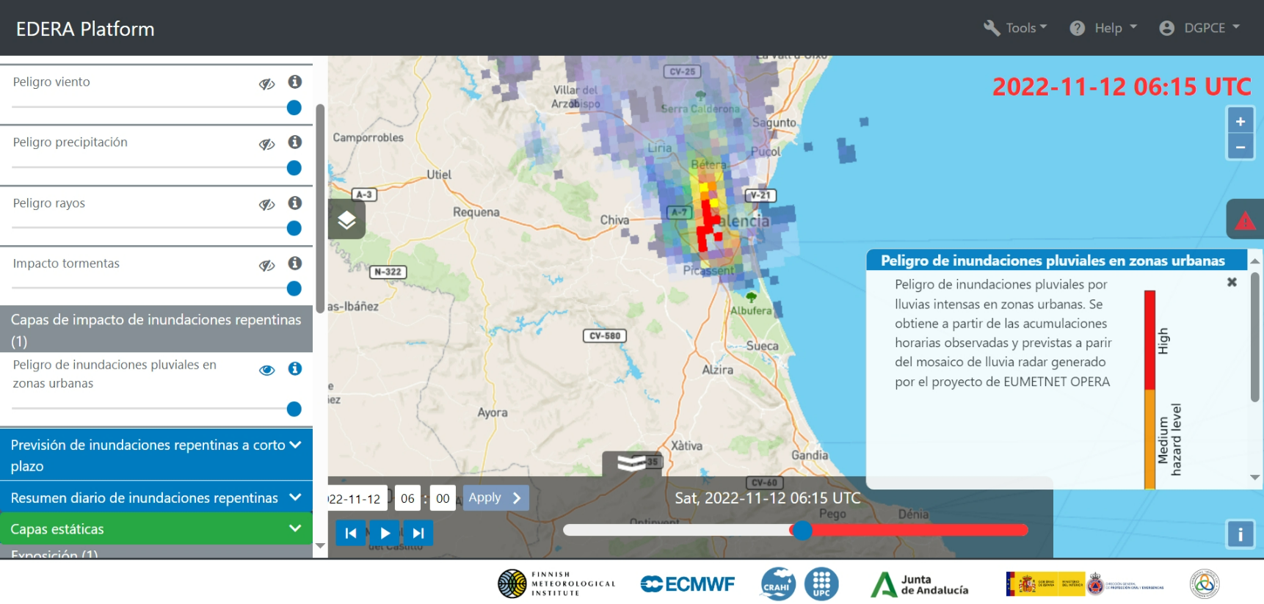
STORM, Lighting and hail hazards

Slide 19
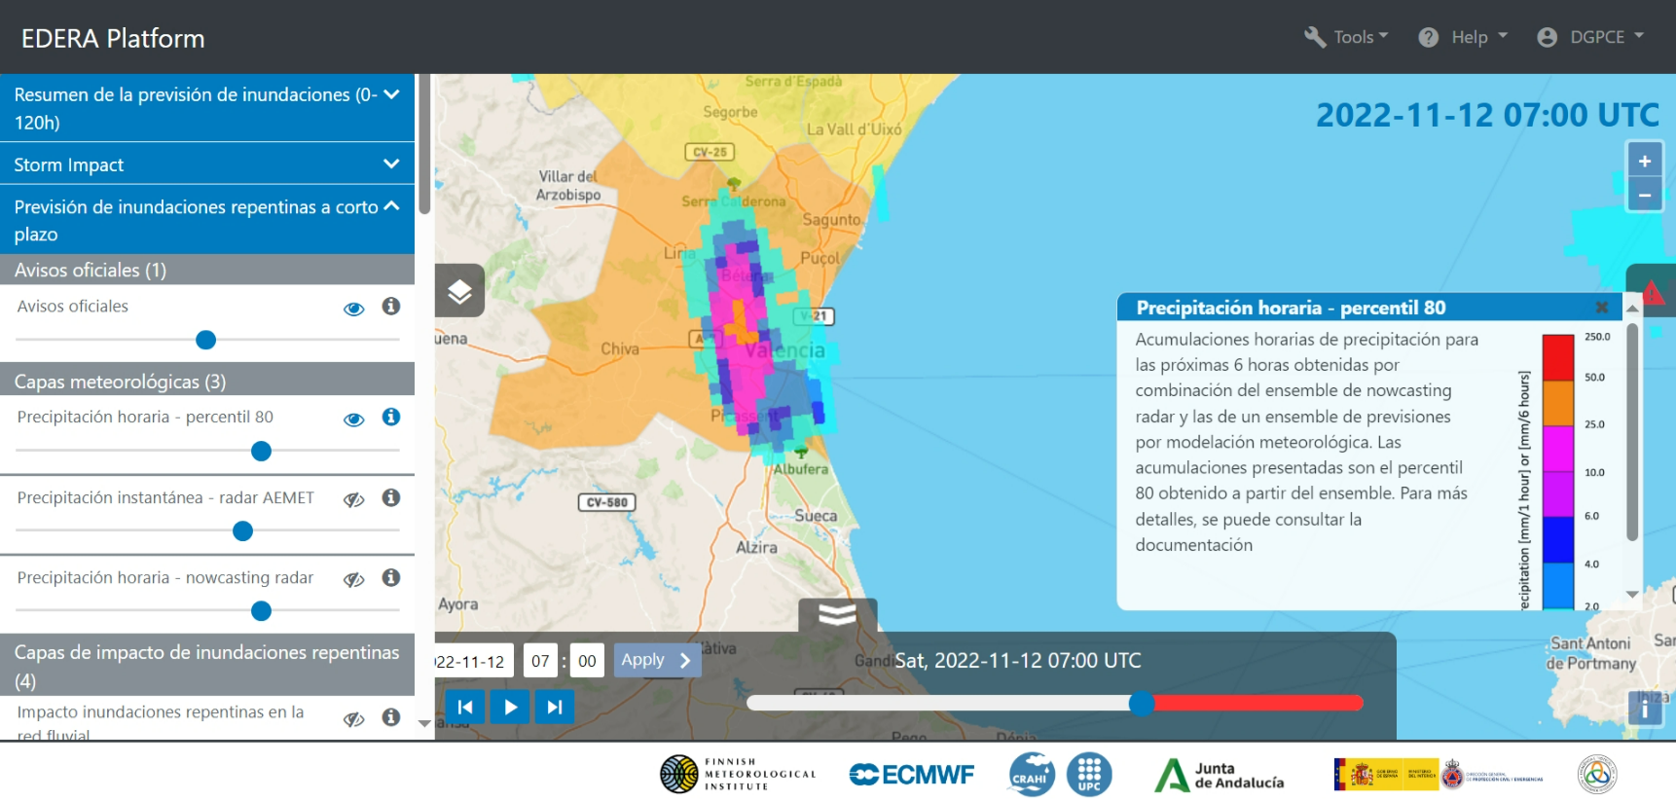
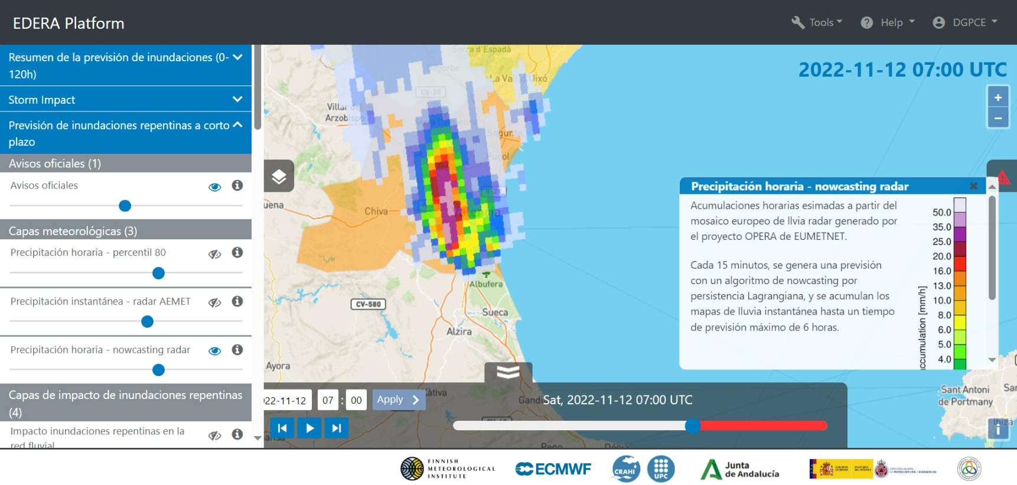
C) ANIMATED NOWCASTING. 1.- Hourly precipitation

Slide 20
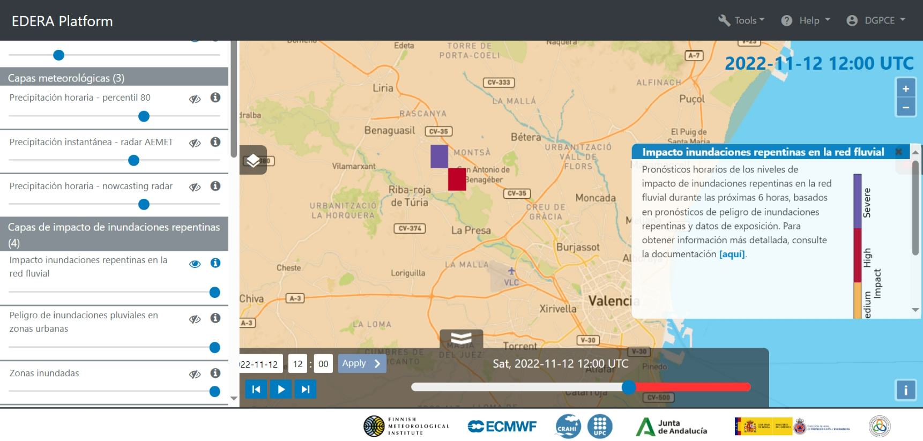
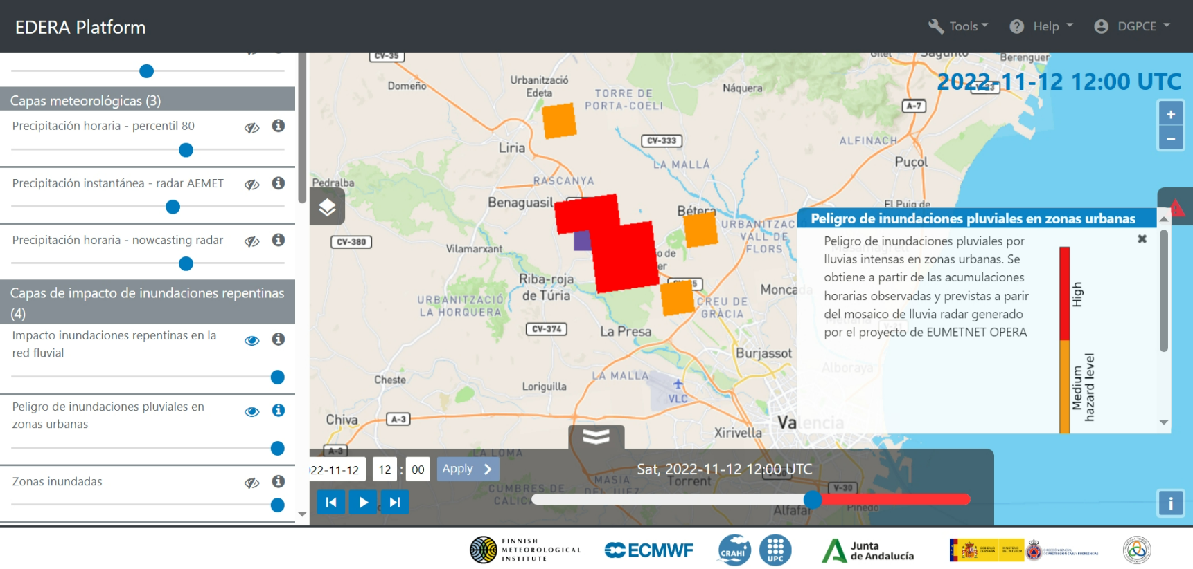
C) 2.-IMPACT (I)
Flash flood impact over the river
Pluvial flood Hazard in urban area

Slide 21
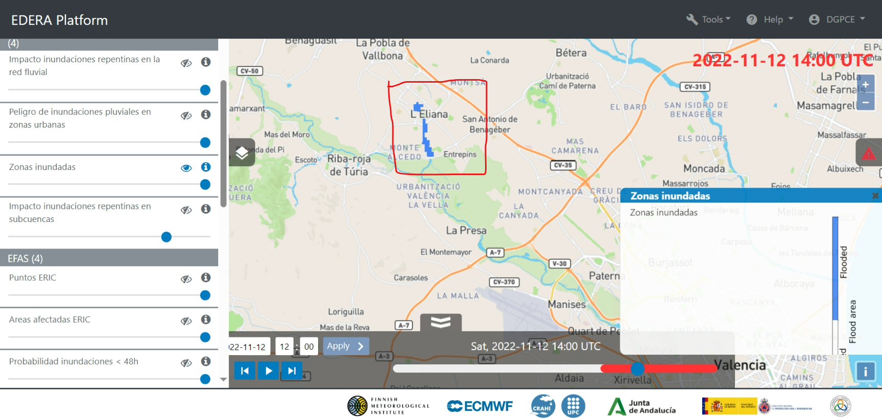
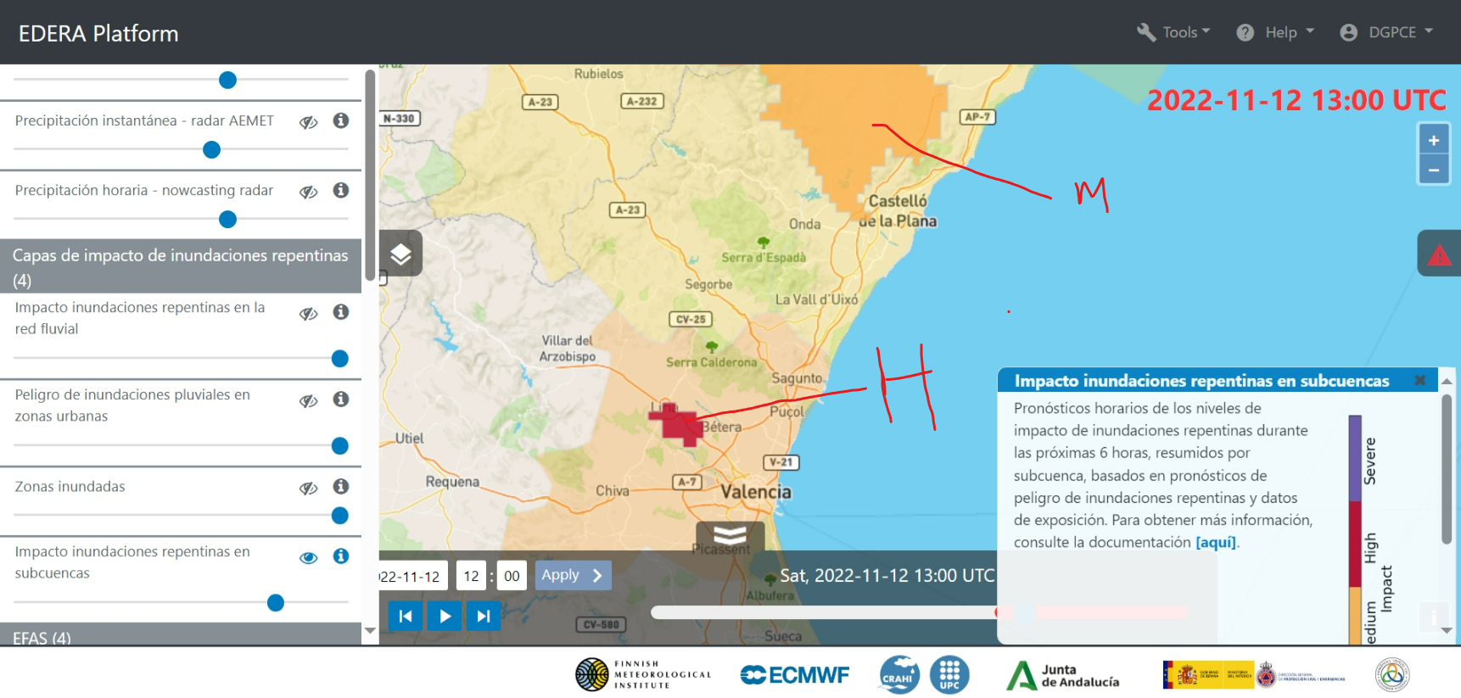
C) 2.- IMPACT (II)
Flooded Area
Flood Impact over sub-cachtment

Slide 22
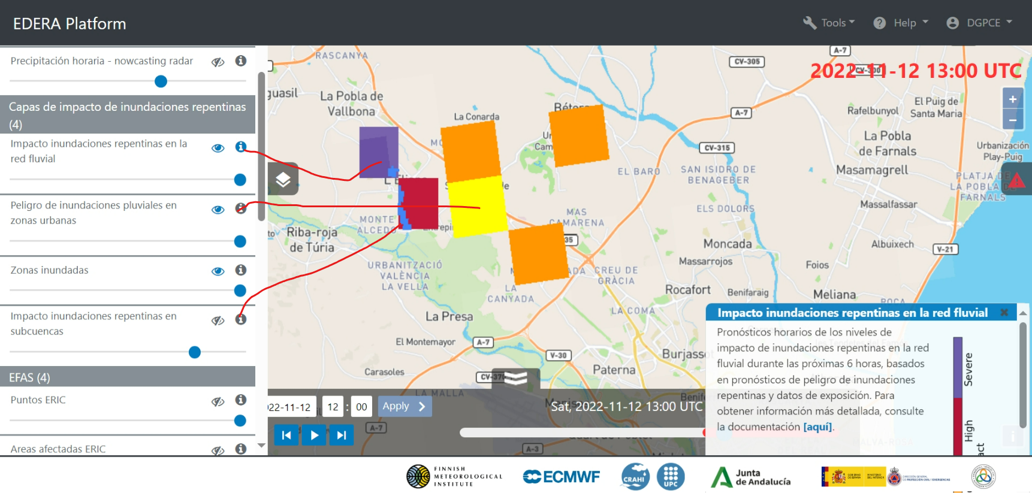
C) ANIMATED NOWCASTING: 2. Impact SUMMARY

Slide 23
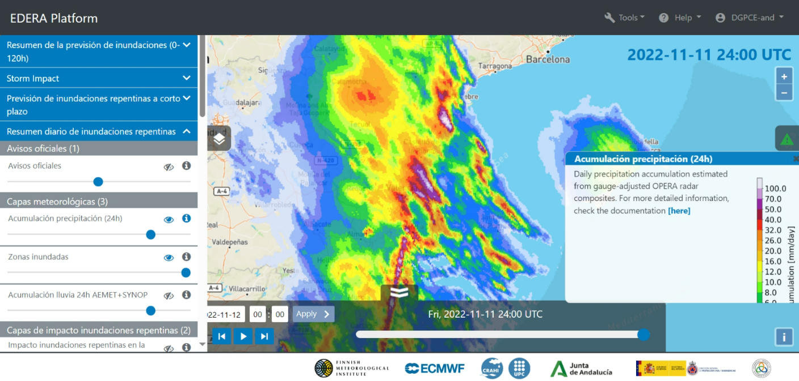
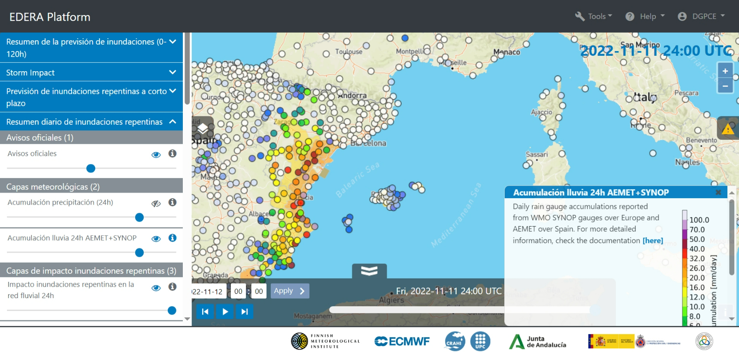
D) DAILY summary- 11 November 2024
Rain accumulation OPERA radar
Rain accumulation AEMET radar

Slide 24
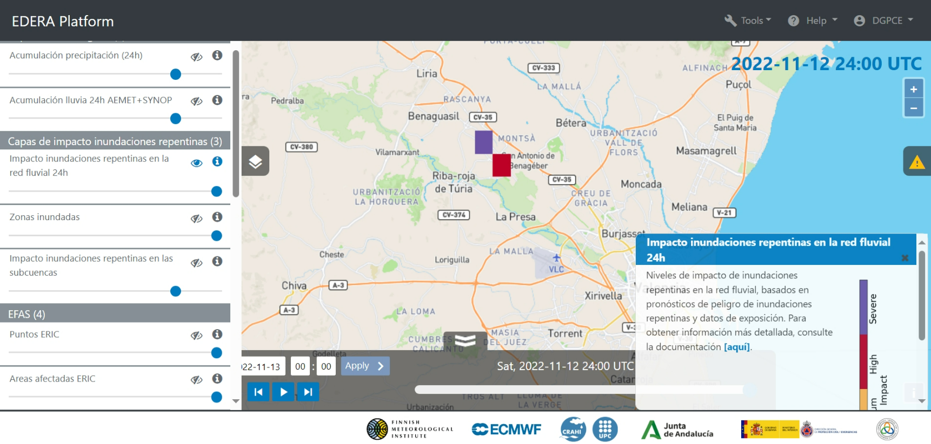
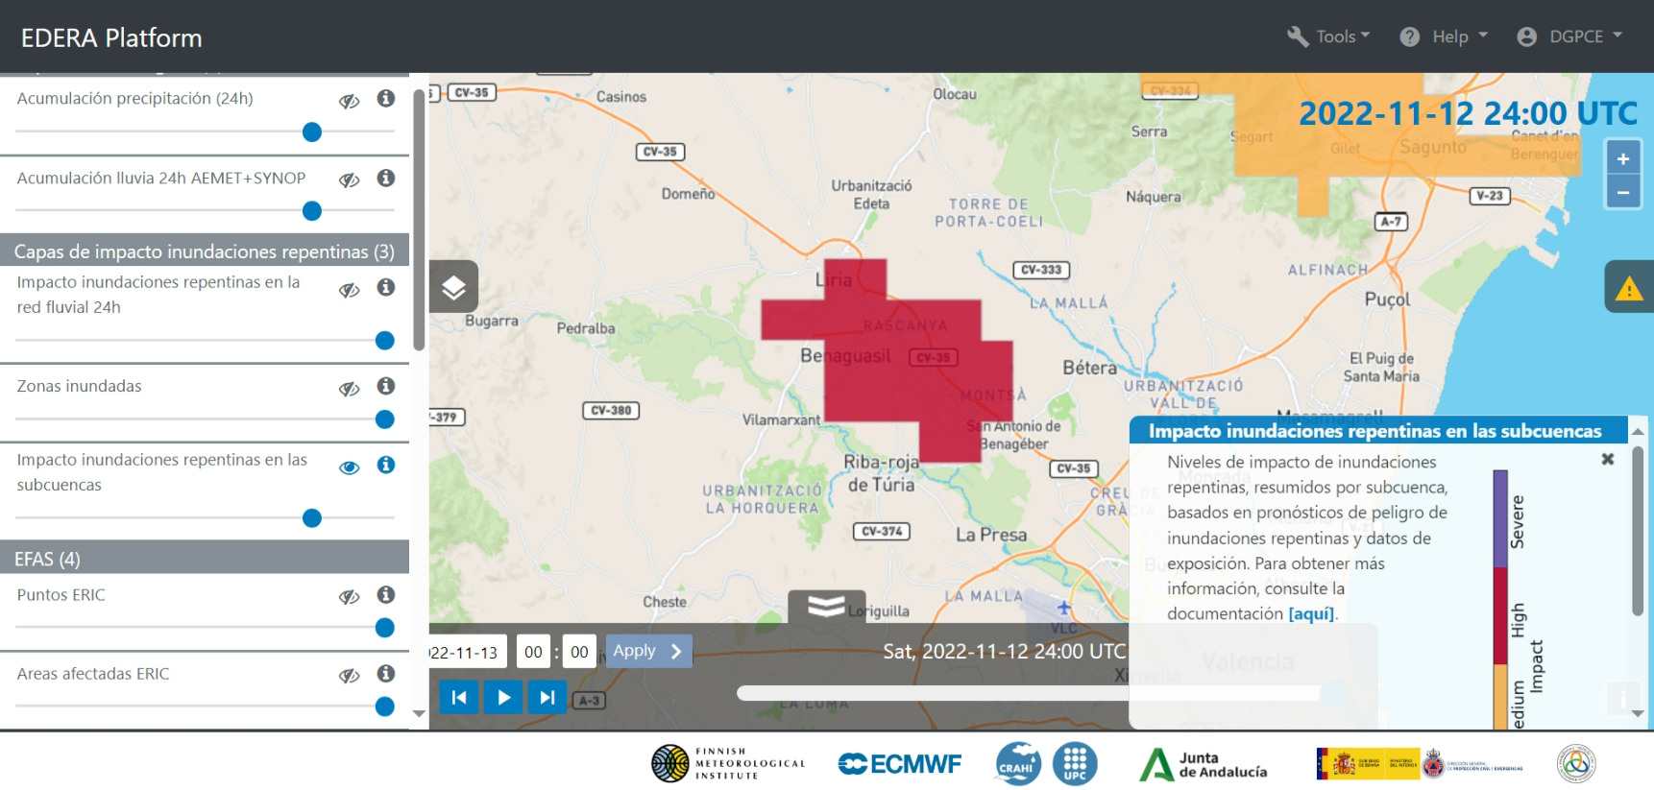
D) DAILY summary- 11 November 2024
Flash flood impact over the river
Flood Impact over sub-cachtment

