Slide 1

INLINE project
Integrated pan-European rainfall and floods impact forecasts for cooperation in emergency management
Marc Berenguer (UPC), 3 Nov 2026, Brussels

Slide 2
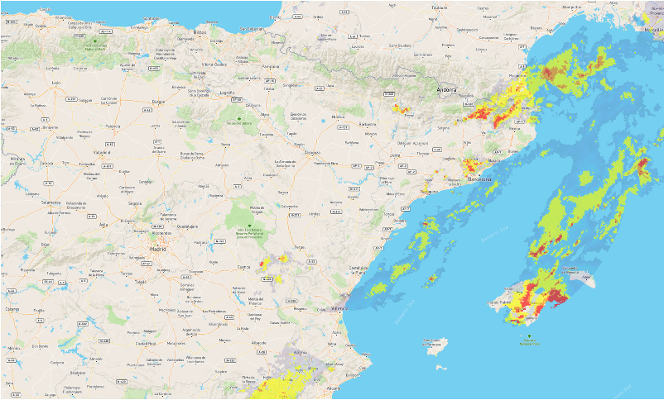
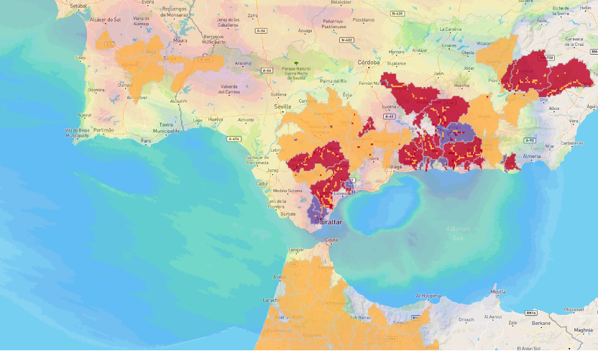


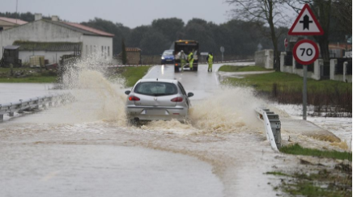
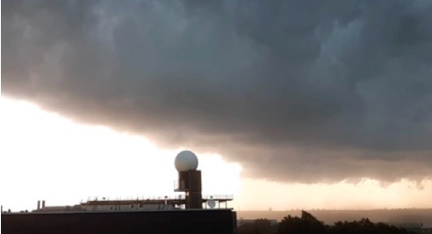
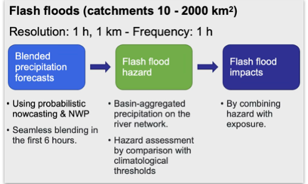
Main objective
Advance on the capabilities of EWS with tools to anticipate the impacts caused by storms, heavy rain and floods, to support the decision-making workflows of various levels of Civil Protection Agencies (CPAs), including their coordination and cooperation.
European-wide forecasts for storms, heavy rain and flash floods
Storm impact nowcasting (0-3h)
Flash flood impacts (0-120 h)
Heavy rainfall, hail, lightning
Based on radar nowcasting & ML
European-wide exposure
More adapted to end-user needs:
Flexible notifications
Integration of high-res exposure & vulnerability datasets.
Improved hazard & impact assessment through the use of AI.

Slide 3



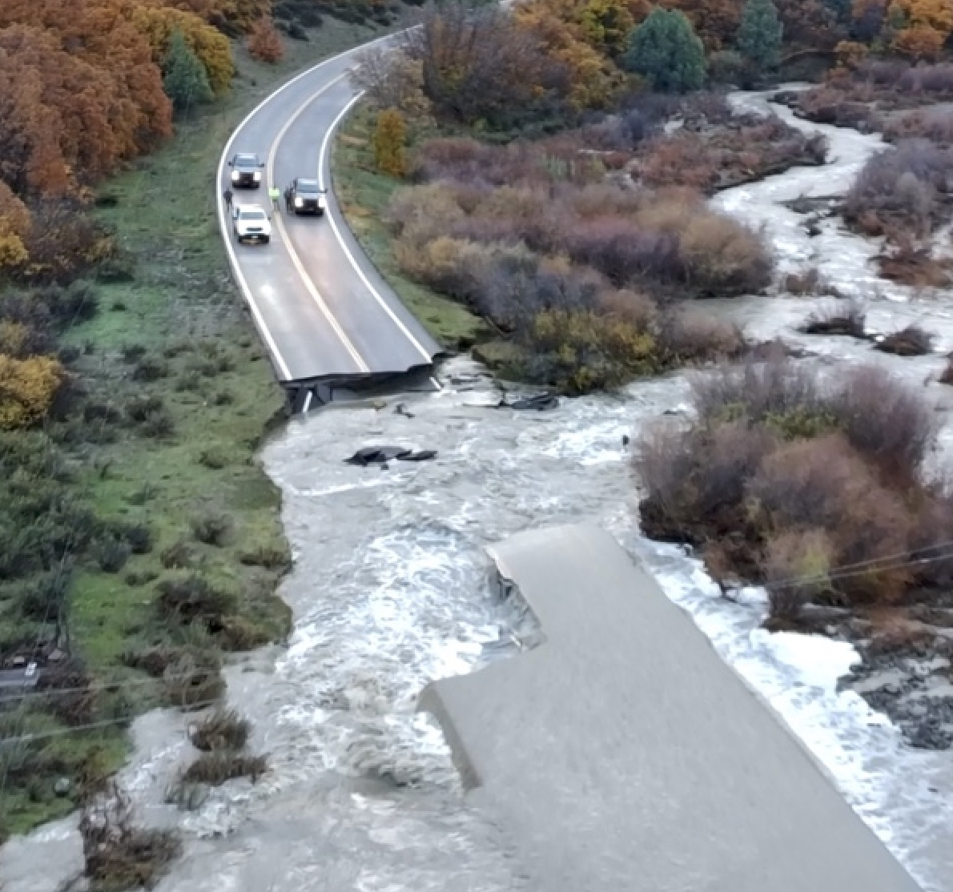

Real-time impact forecasting for CPAs
Combining hazard and impact forecasts, official warnings and exposure and vulnerability datasets for compound impact forecasting to support coordination and cooperation of CPAs.
Hydrometeorological forecasts
Convective storms
Floods, flash floods & debris flows
Exposure & vulnerability
Official NHMs warnings.
Gauge-adjusted OPERA QPE.
Probabilistic rainfall forecasts.
Storm hazard nowcasts.
  Hail.
  Wind gusts.
  Heavy rain.
  Lightning.
Storm impact nowcasts.
Pluvial flood nowcasts.
FF hazard forecasts.
FF impact forecasts.
EFAS flood forecasts.
EFAS rapid risk assessment.
Other flow observations & forecasts.
Combined exposure map:
  Population density.
  Transportation networks.
  Energy, health, education infrastructures.
Flood hazard maps.
Critical points in flood areas.
Integrated through user-specific notifications

Slide 4
INLINE demonstration
In real time (September 2025 – November 2026).

Slide 5
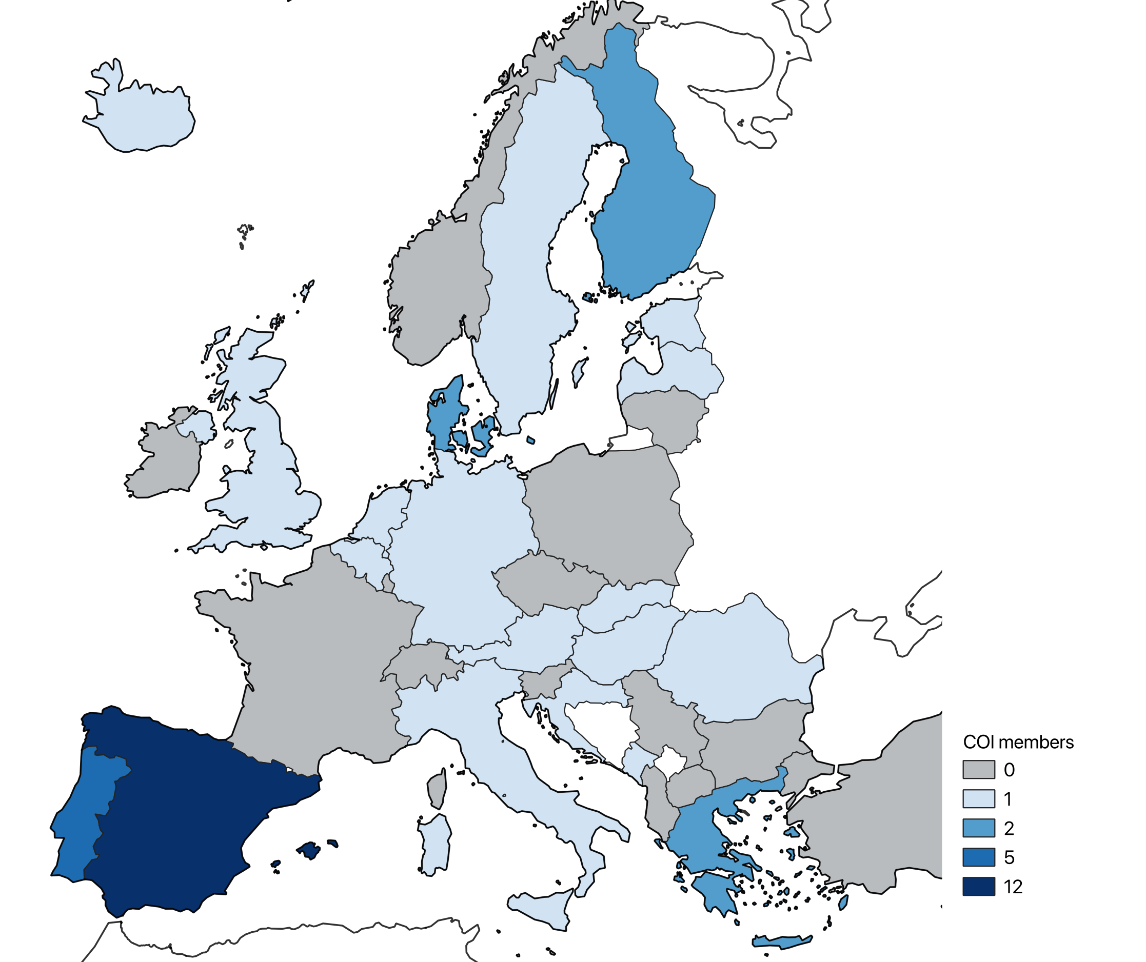
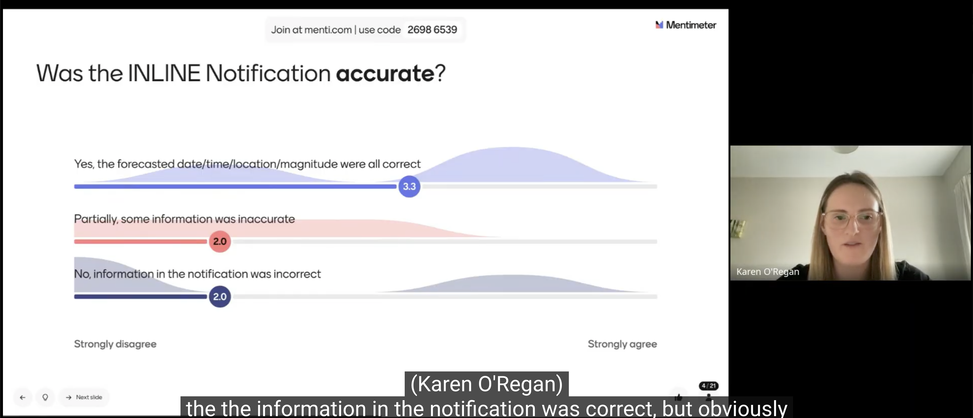
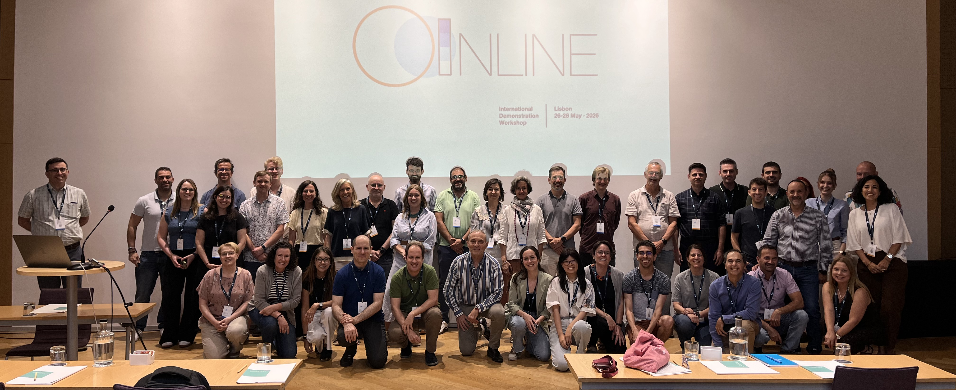
INLINE demonstration
INLINE COMMUNITY OF INTEREST
In real time (September 2025 – November 2026).
With the participation of an INLINE Community of Interest
  50+ organizations from 20+ countries.
  Access to products in real time.
  Online training (upcoming sessions: 19 Nov 2026, 21 Jan 2027).
  Feedback regarding the configurations.
  Participation in the evaluation.

Slide 6
INLINE demonstration
In real time (September 2025 – November 2026).
With the participation of an INLINE Community of Interest.
Access to the products in real time through
  WMS/API
  INLINE web-based platform
Trigger of user-specific automatic messages:
  Regional domain and sub-division
  Products
  Thresholds
  Frequency
  Integration of local products/information (exposure, vulnerability, observations…)

Slide 7
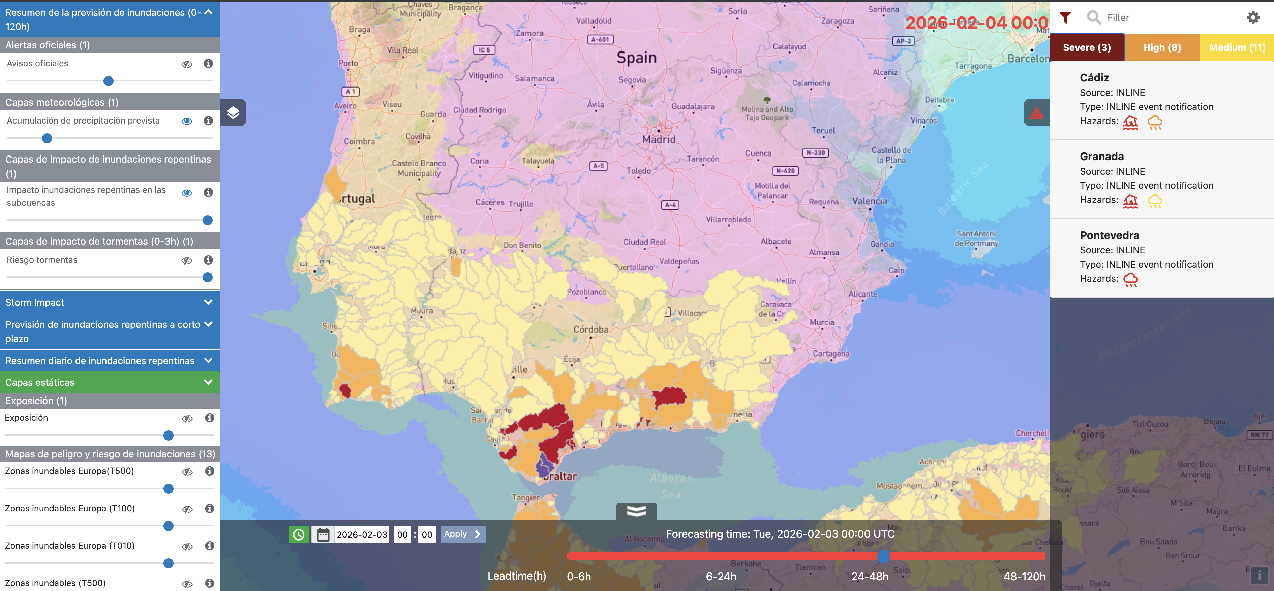

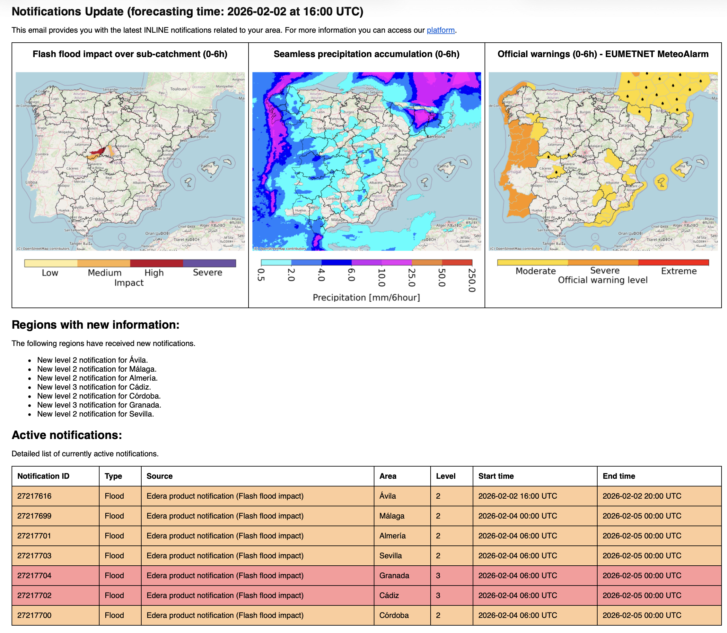
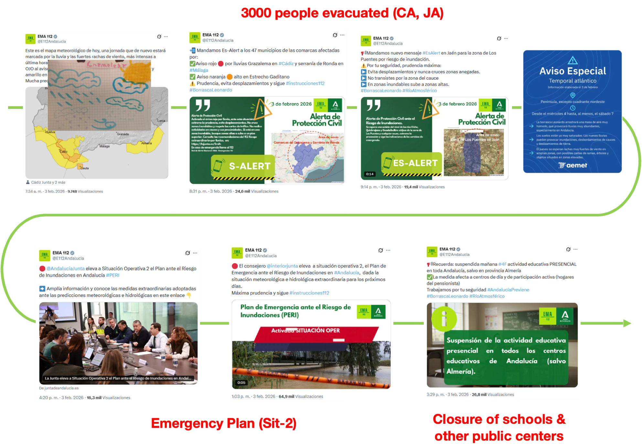
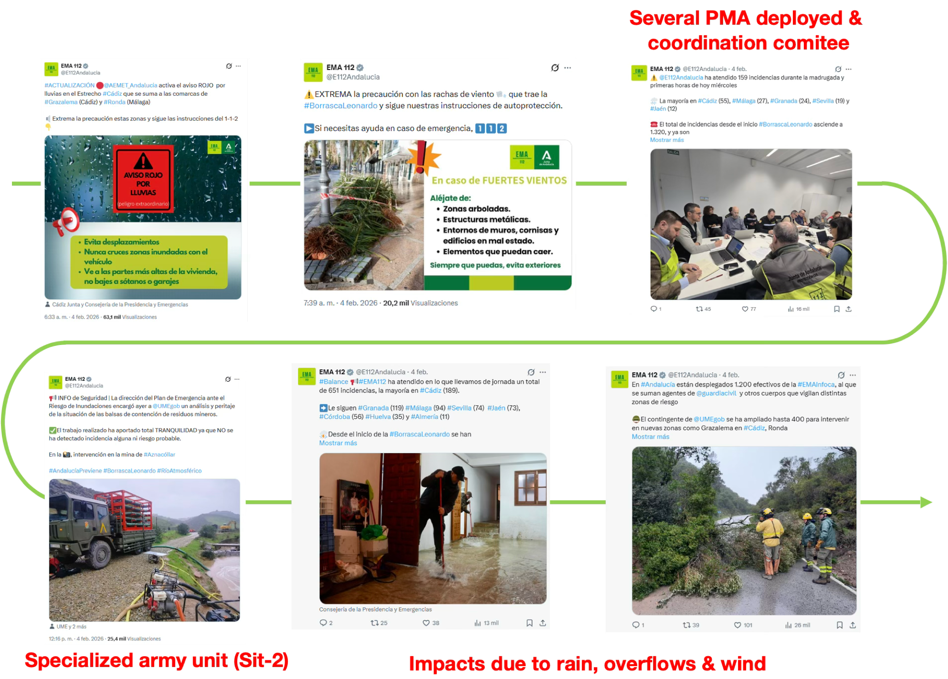

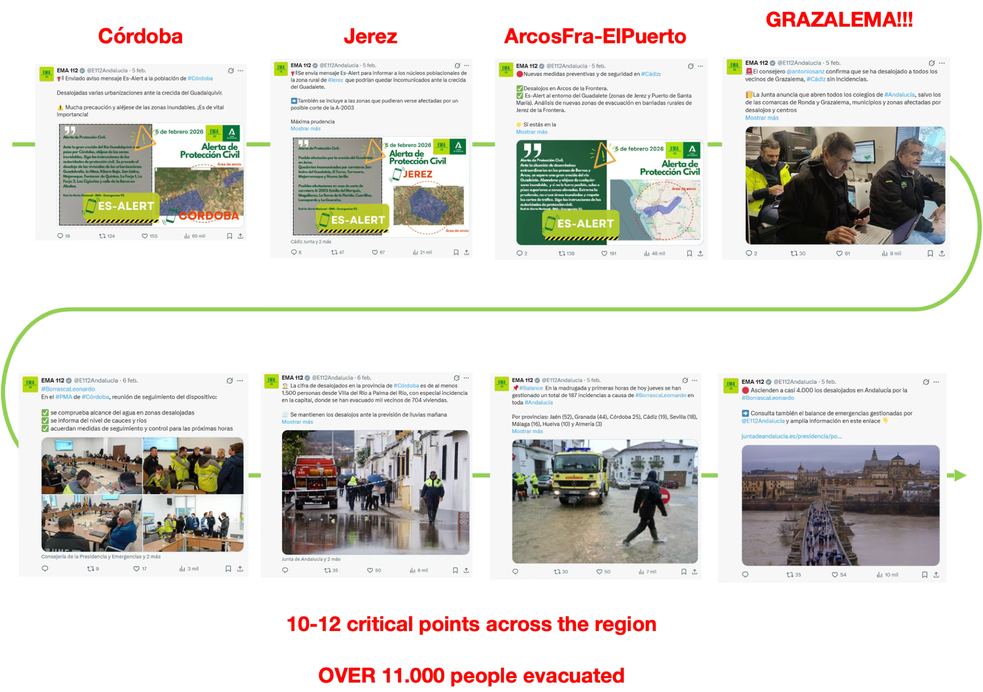

Andalusia, ES: 03-07 February 2026
Almost 12.000 incidents in total (112 incidents)
Over 11.000 people evacuated
More than 150 roads blocked
1 casualty
03 Feb
04-05 Feb
06-07 Feb

Slide 8
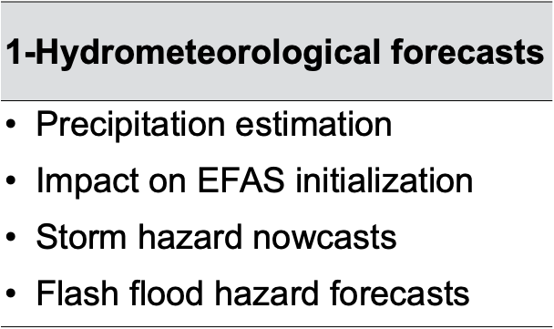
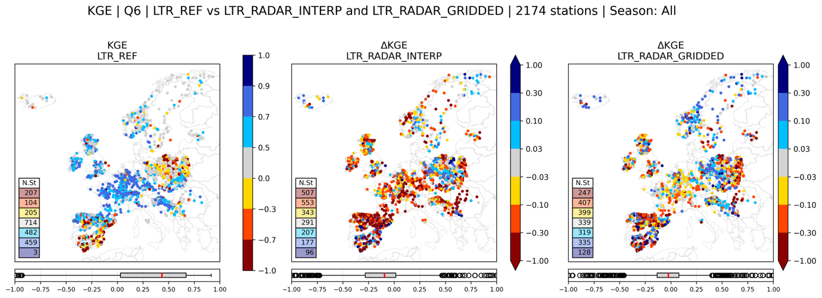

Multi-criteria evaluation of INLINE developments
Real-time demonstration with end users (access to products and notifications).
Extended to the INLINE CoI (50+ organisations from 20+ countries).
KG efficiency (2174 stations)
KGE improvement
Gauges meteo
Radar gridded

Slide 9
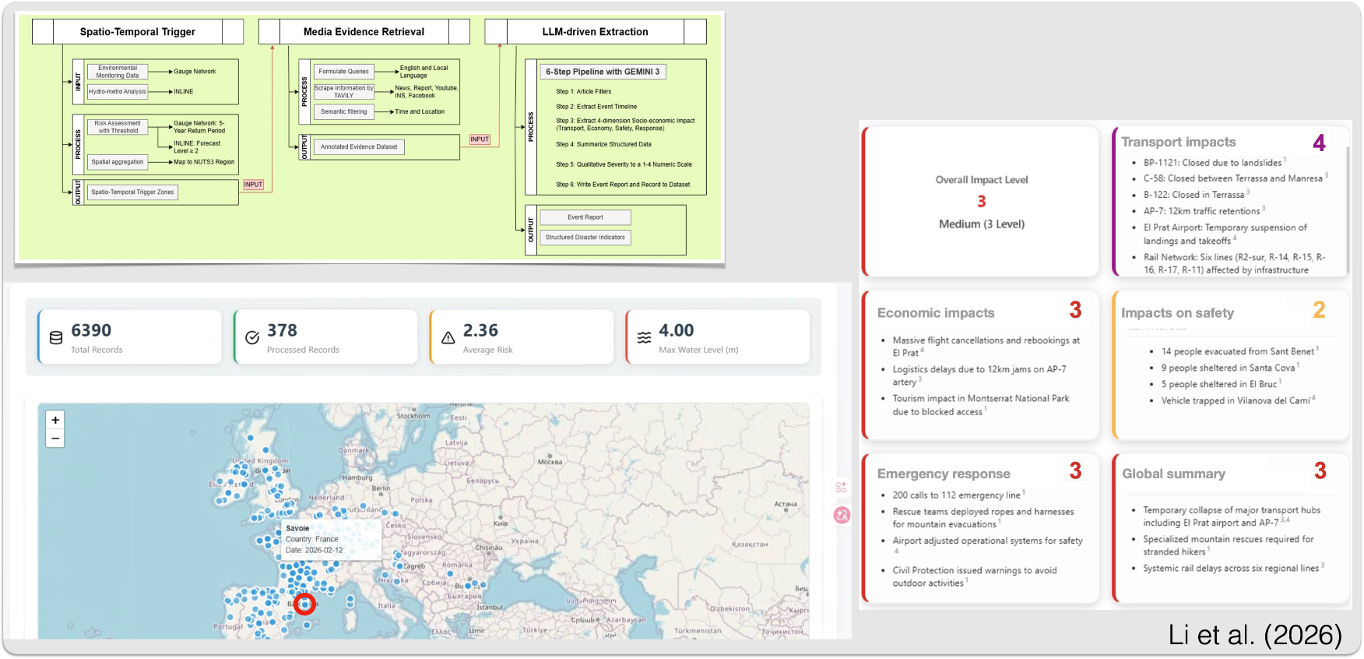
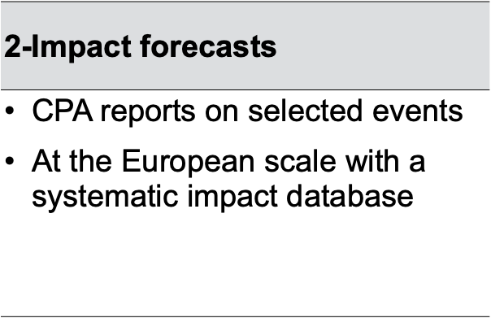
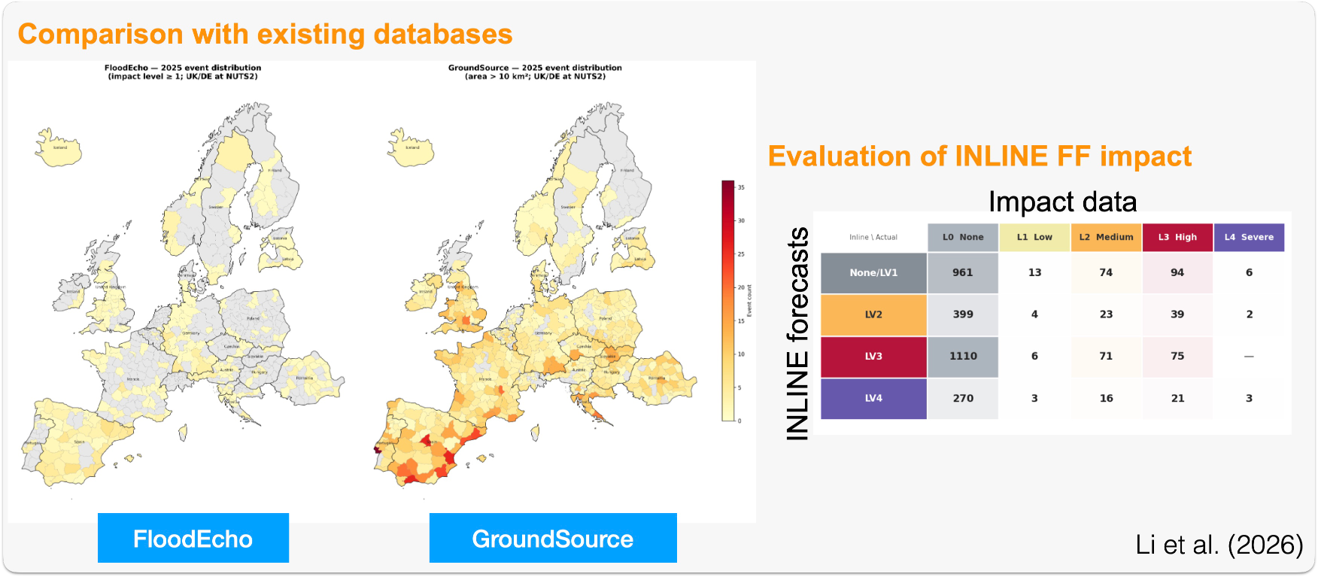

Multi-criteria evaluation of INLINE developments
Real-time demonstration with end users (access to products and notifications).
Extended to the INLINE CoI (50+ organisations from 20+ countries).
FloodEcho

Slide 10
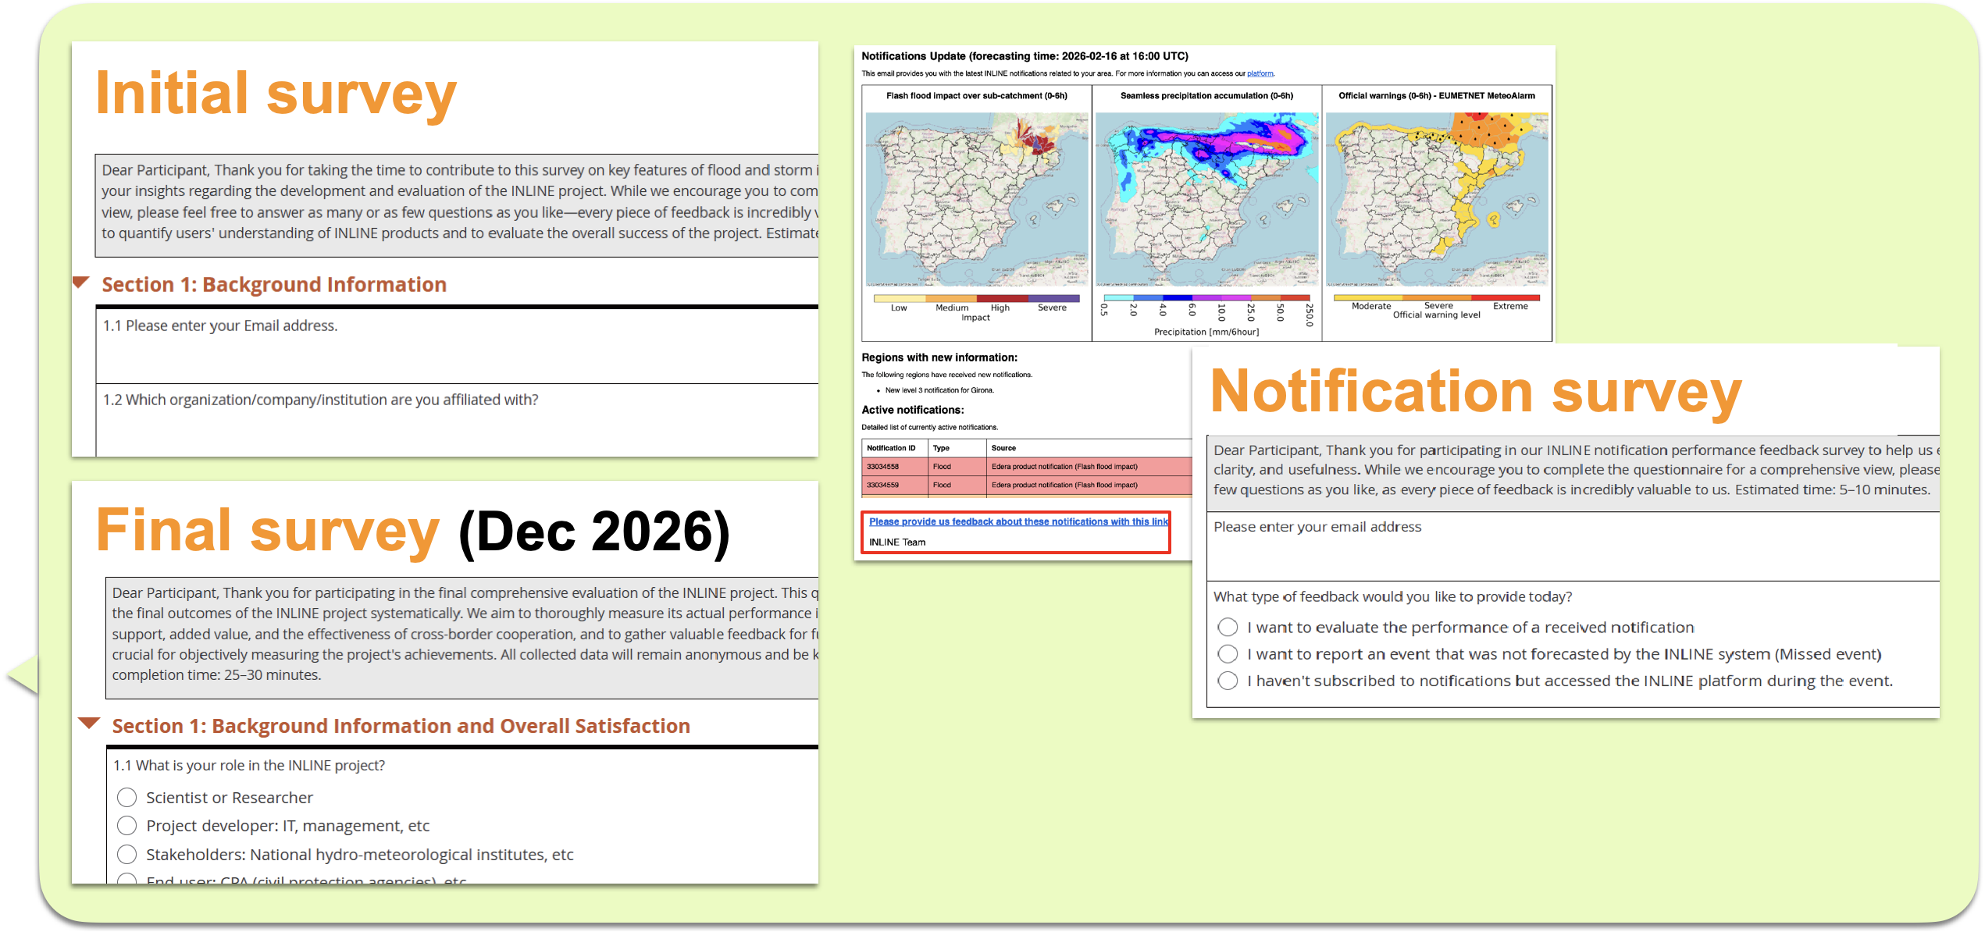
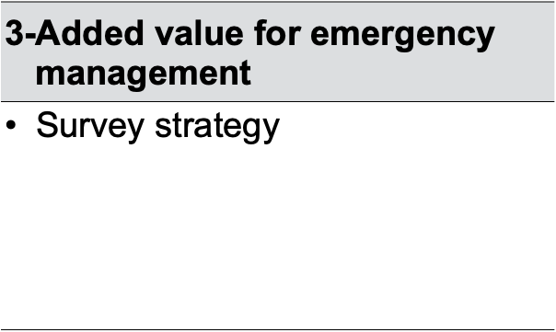
Multi-criteria evaluation of INLINE developments
Real-time demonstration with end users (access to products and notifications).
Extended to the INLINE CoI (50+ organisations from 20+ countries).

Slide 11
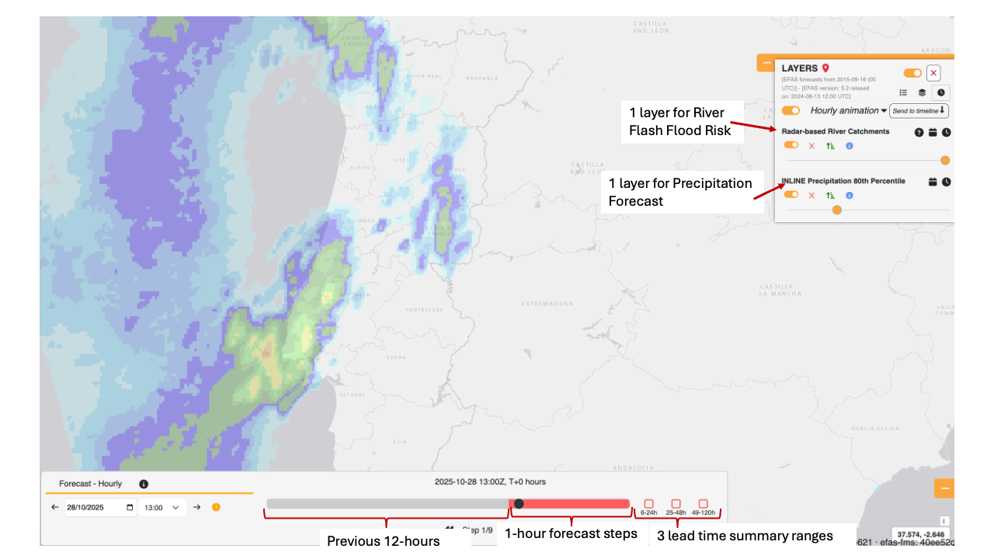
Sustainability of INLINE results
Integration in CEMS Floods – EFAS
1 product for flash flood impact across all lead times.
Performance improvement
Available beyond 5 days in the past.

Slide 12

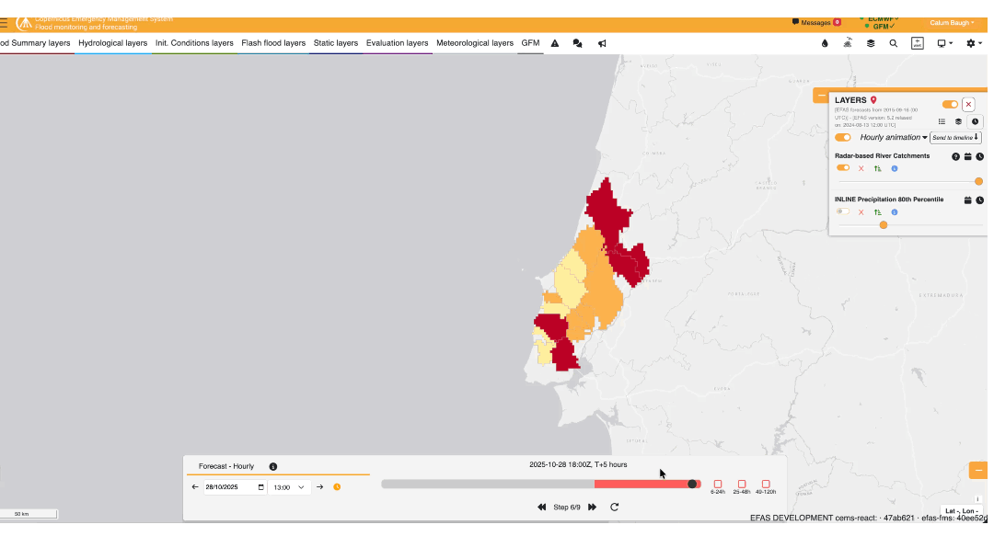
Sustainability of INLINE results
Integration in CEMS Floods – EFAS
1 product for flash flood impact across all lead times.
Performance improvement
Available beyond 5 days in the past.
Improved visualization: River catchments + river network displayed when zoomed in for more detail.

Slide 13
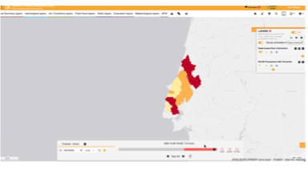
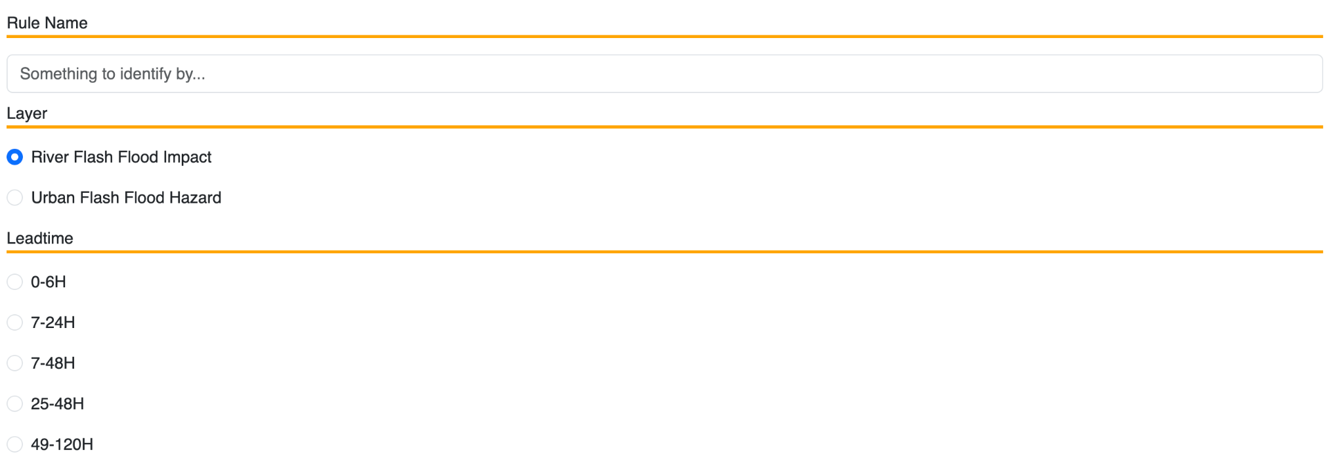
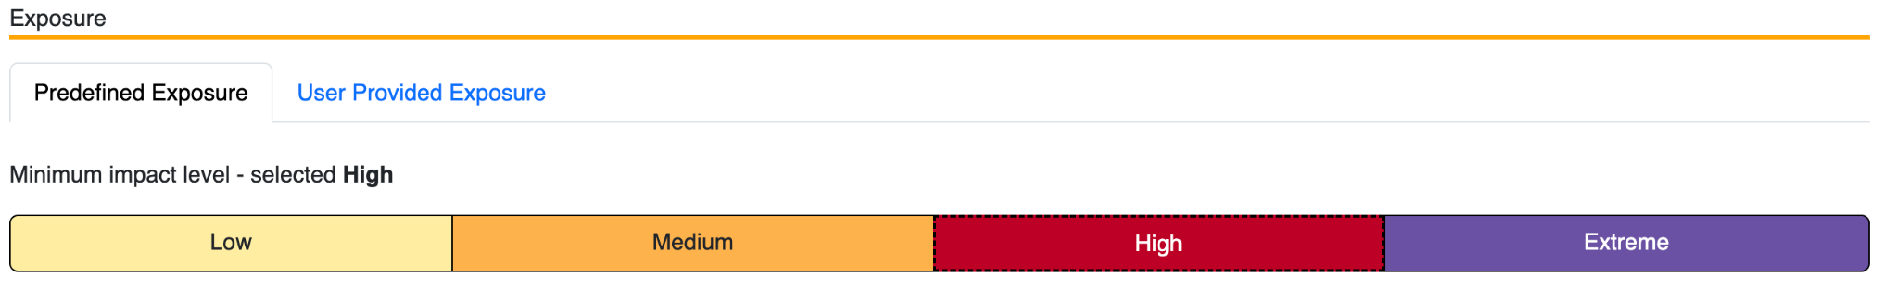
Sustainability of INLINE results
Integration in CEMS Floods – EFAS
1 product for flash flood impact across all lead times.
Performance improvement
Available beyond 5 days in the past.
Improved visualization: River catchments + river network displayed when zoomed in for more detail.
More adapted to end-user needs:
  Implemented as an experimental service
  Configurable notifications
  Possibility to integrate end-user’s vulnerability/exposure datasets

Slide 14
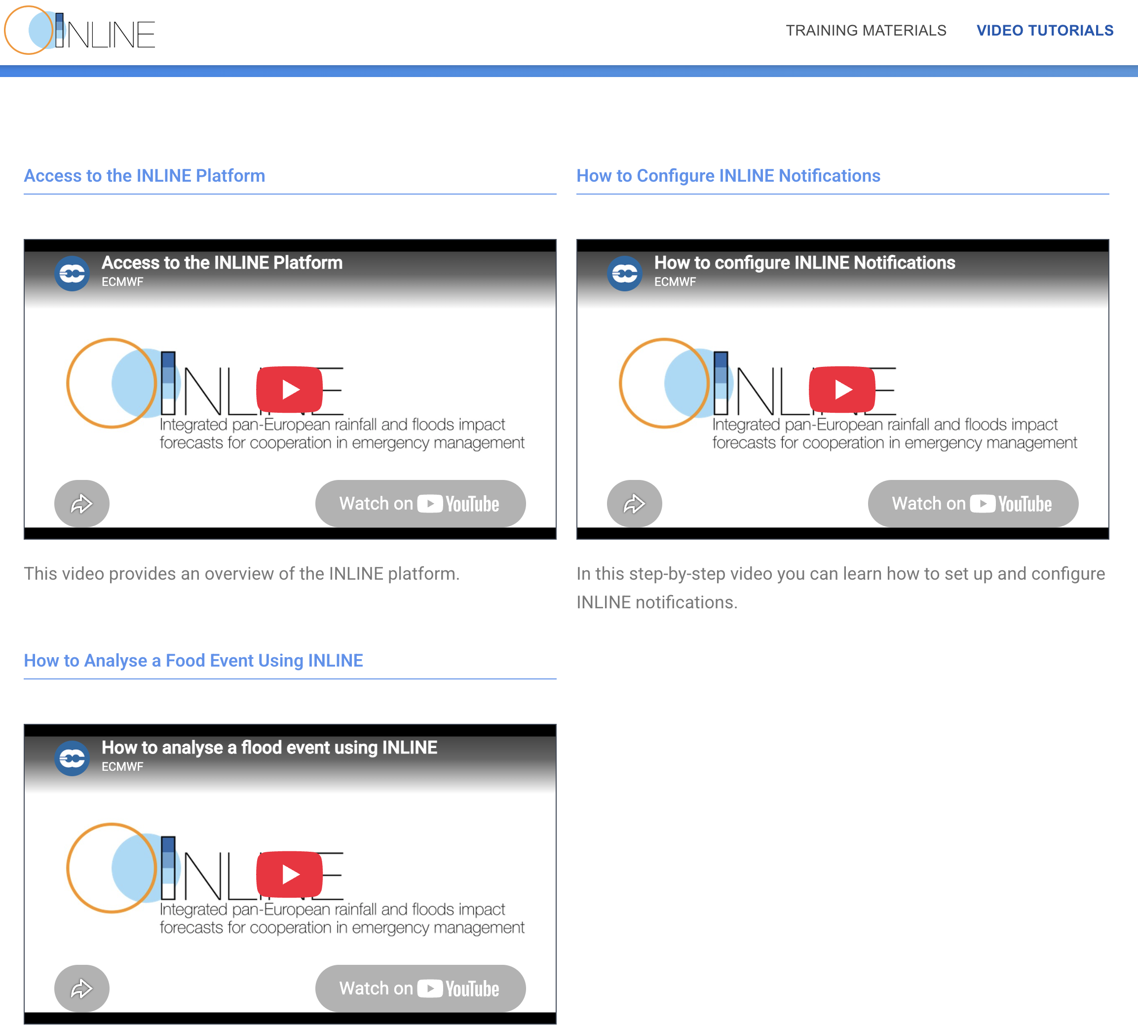
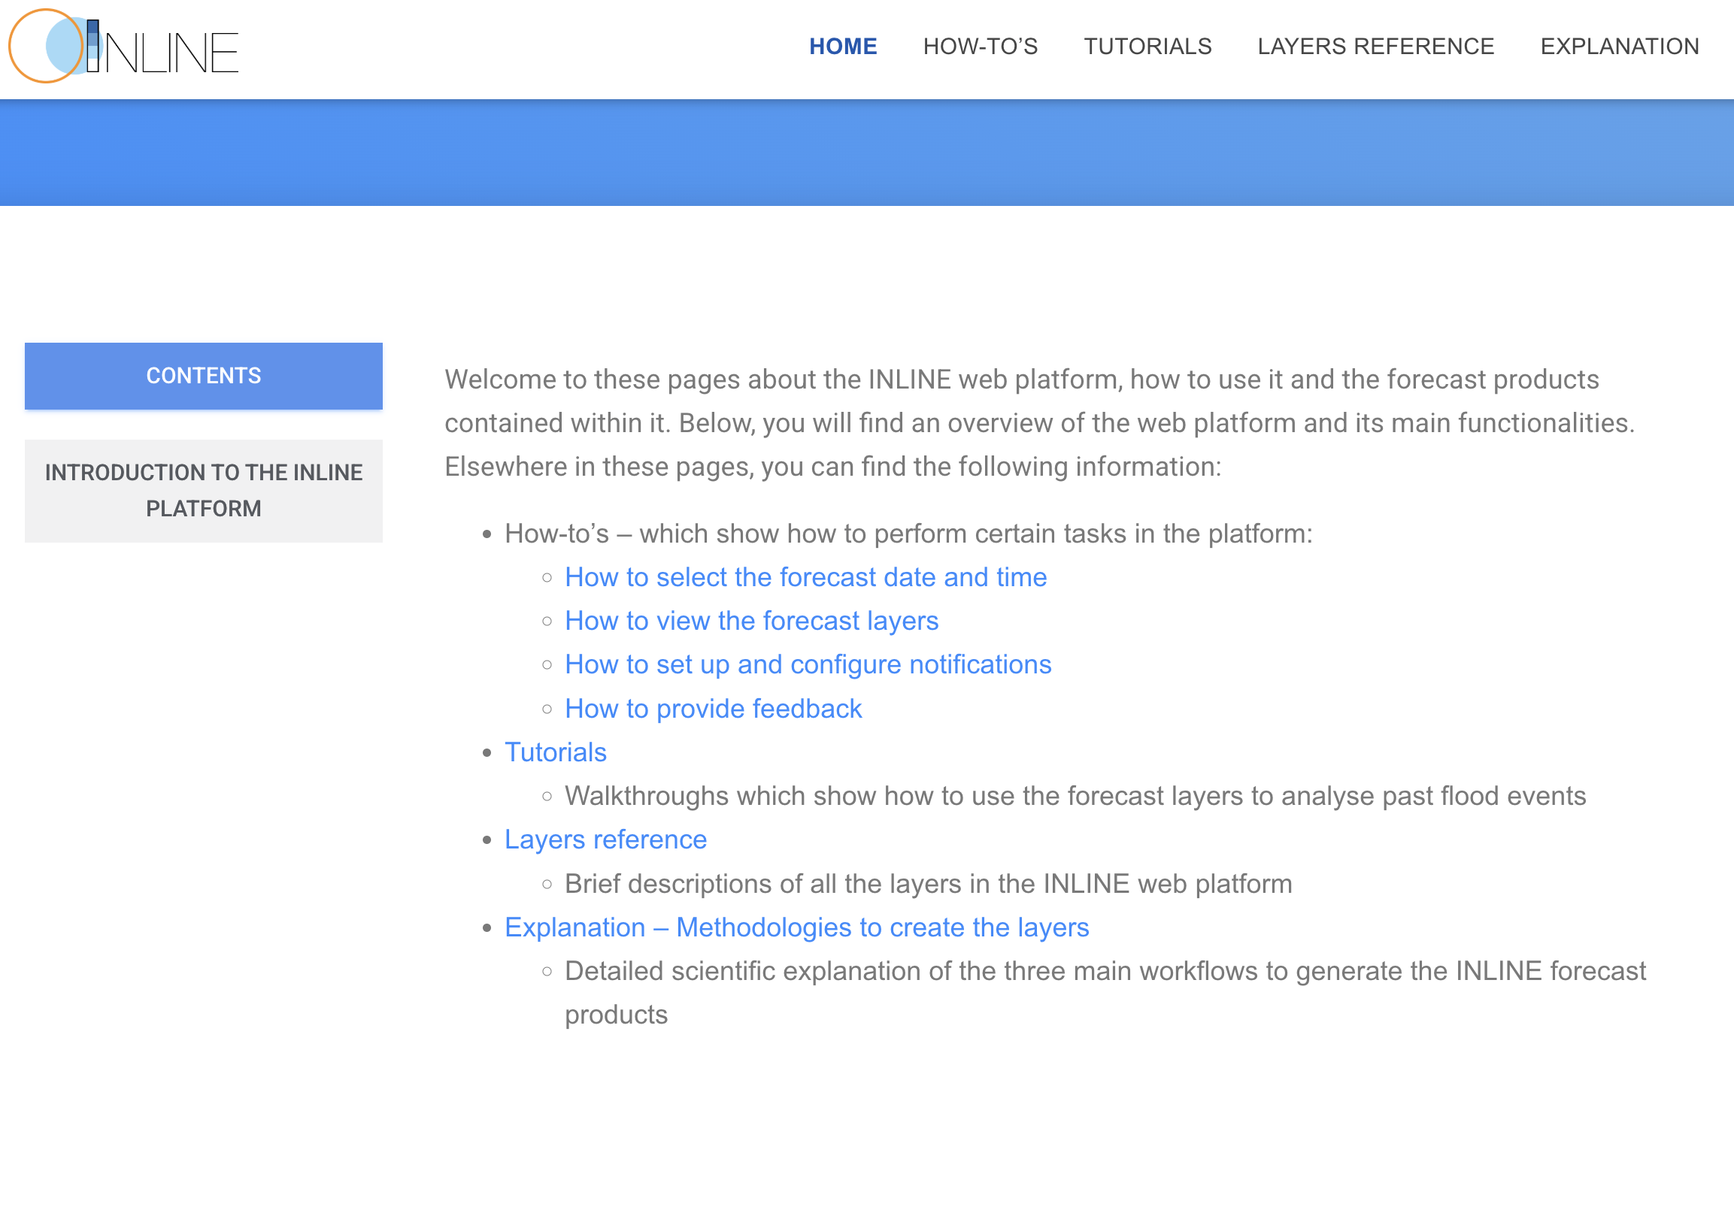
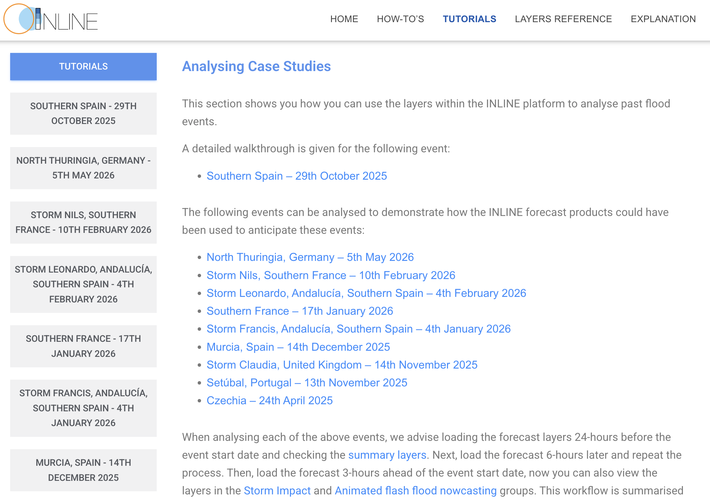
Sustainability of INLINE results
Integration in CEMS Floods – EFAS
INLINE CoI & training materials
Trained community and support materials providing guidance on the use of INLINE developments accessible through EFAS.

Slide 15
Sustainability of INLINE results
Integration in CEMS Floods – EFAS
INLINE CoI & training materials
INLINE-EU proposal
Improved impact forecasts using AI and higher-resolution exposure/vulnerability datasets.
Extension to landslide hazards.
Integrate flash flood impact products into ERCC and improved Copernicus flood notifications.
Promote adoption and foster exchange among stakeholders of the INLINE Community of Interest.

Slide 16







  INLINE project
Integrated pan-European rainfall and floods impact forecasts for cooperation in emergency management
© INLINE Consortium, 2026. Author: Marc Berenguer
  Join the INLINE CoI:

