Slide 1
INLINE - WP3 Meeting
July 2, 2025

Slide 2
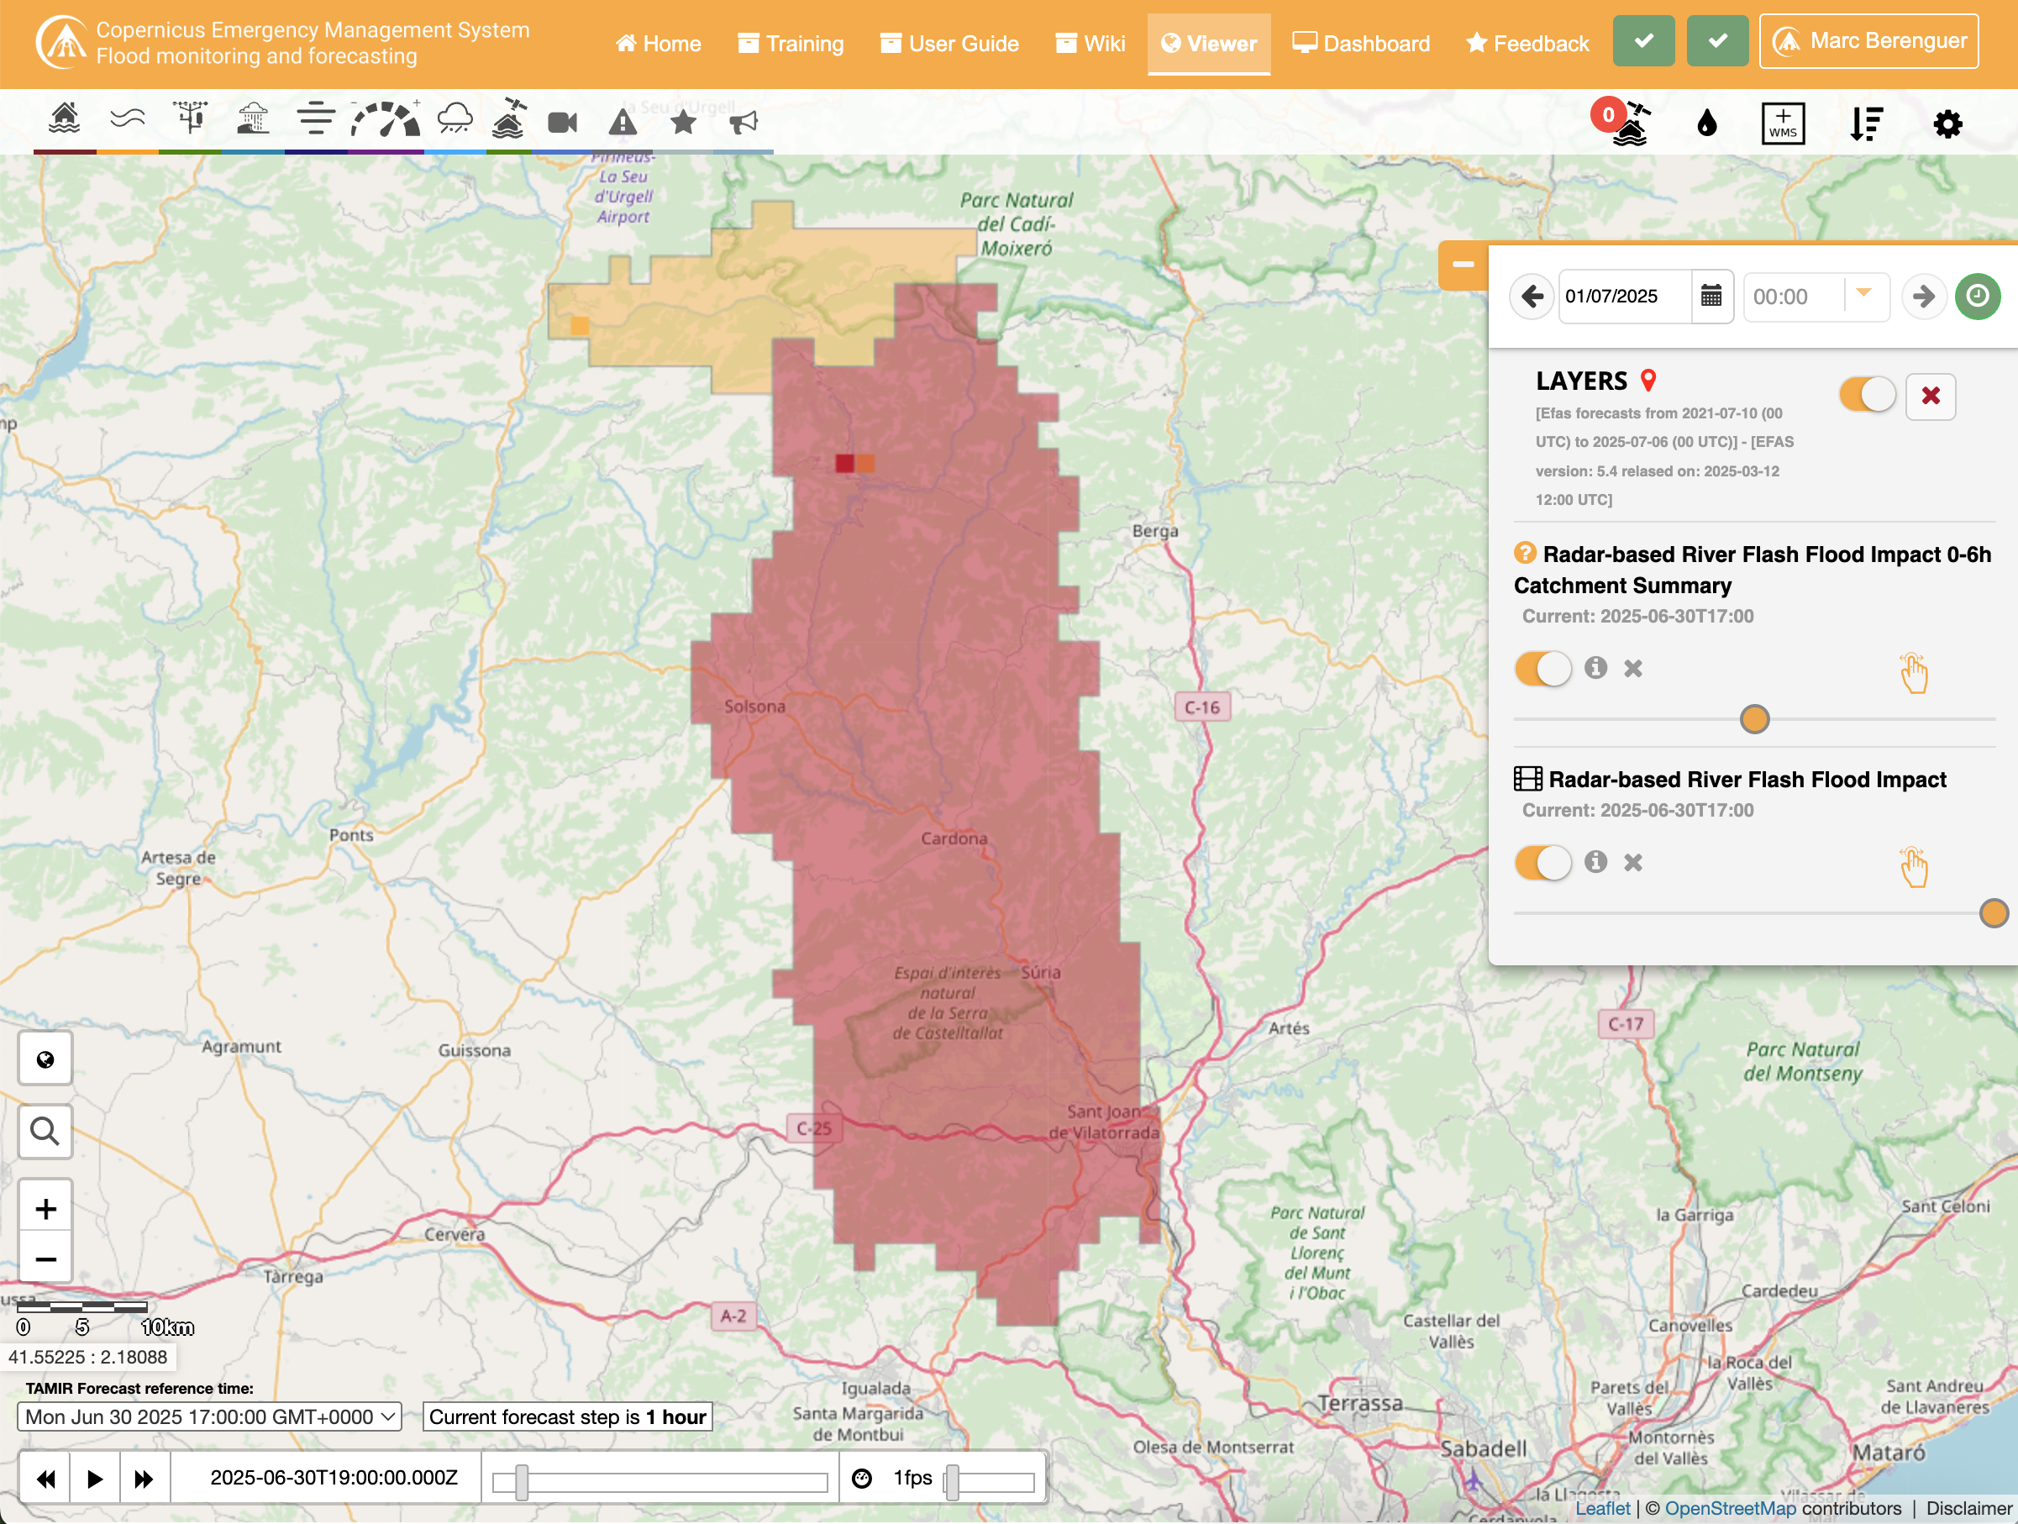
2025-06-30 17:00 - How it should work
  In the river network and over Sub-Catchments, it should be the same
  Example in Catalonia (north of Barcelona)

Slide 3
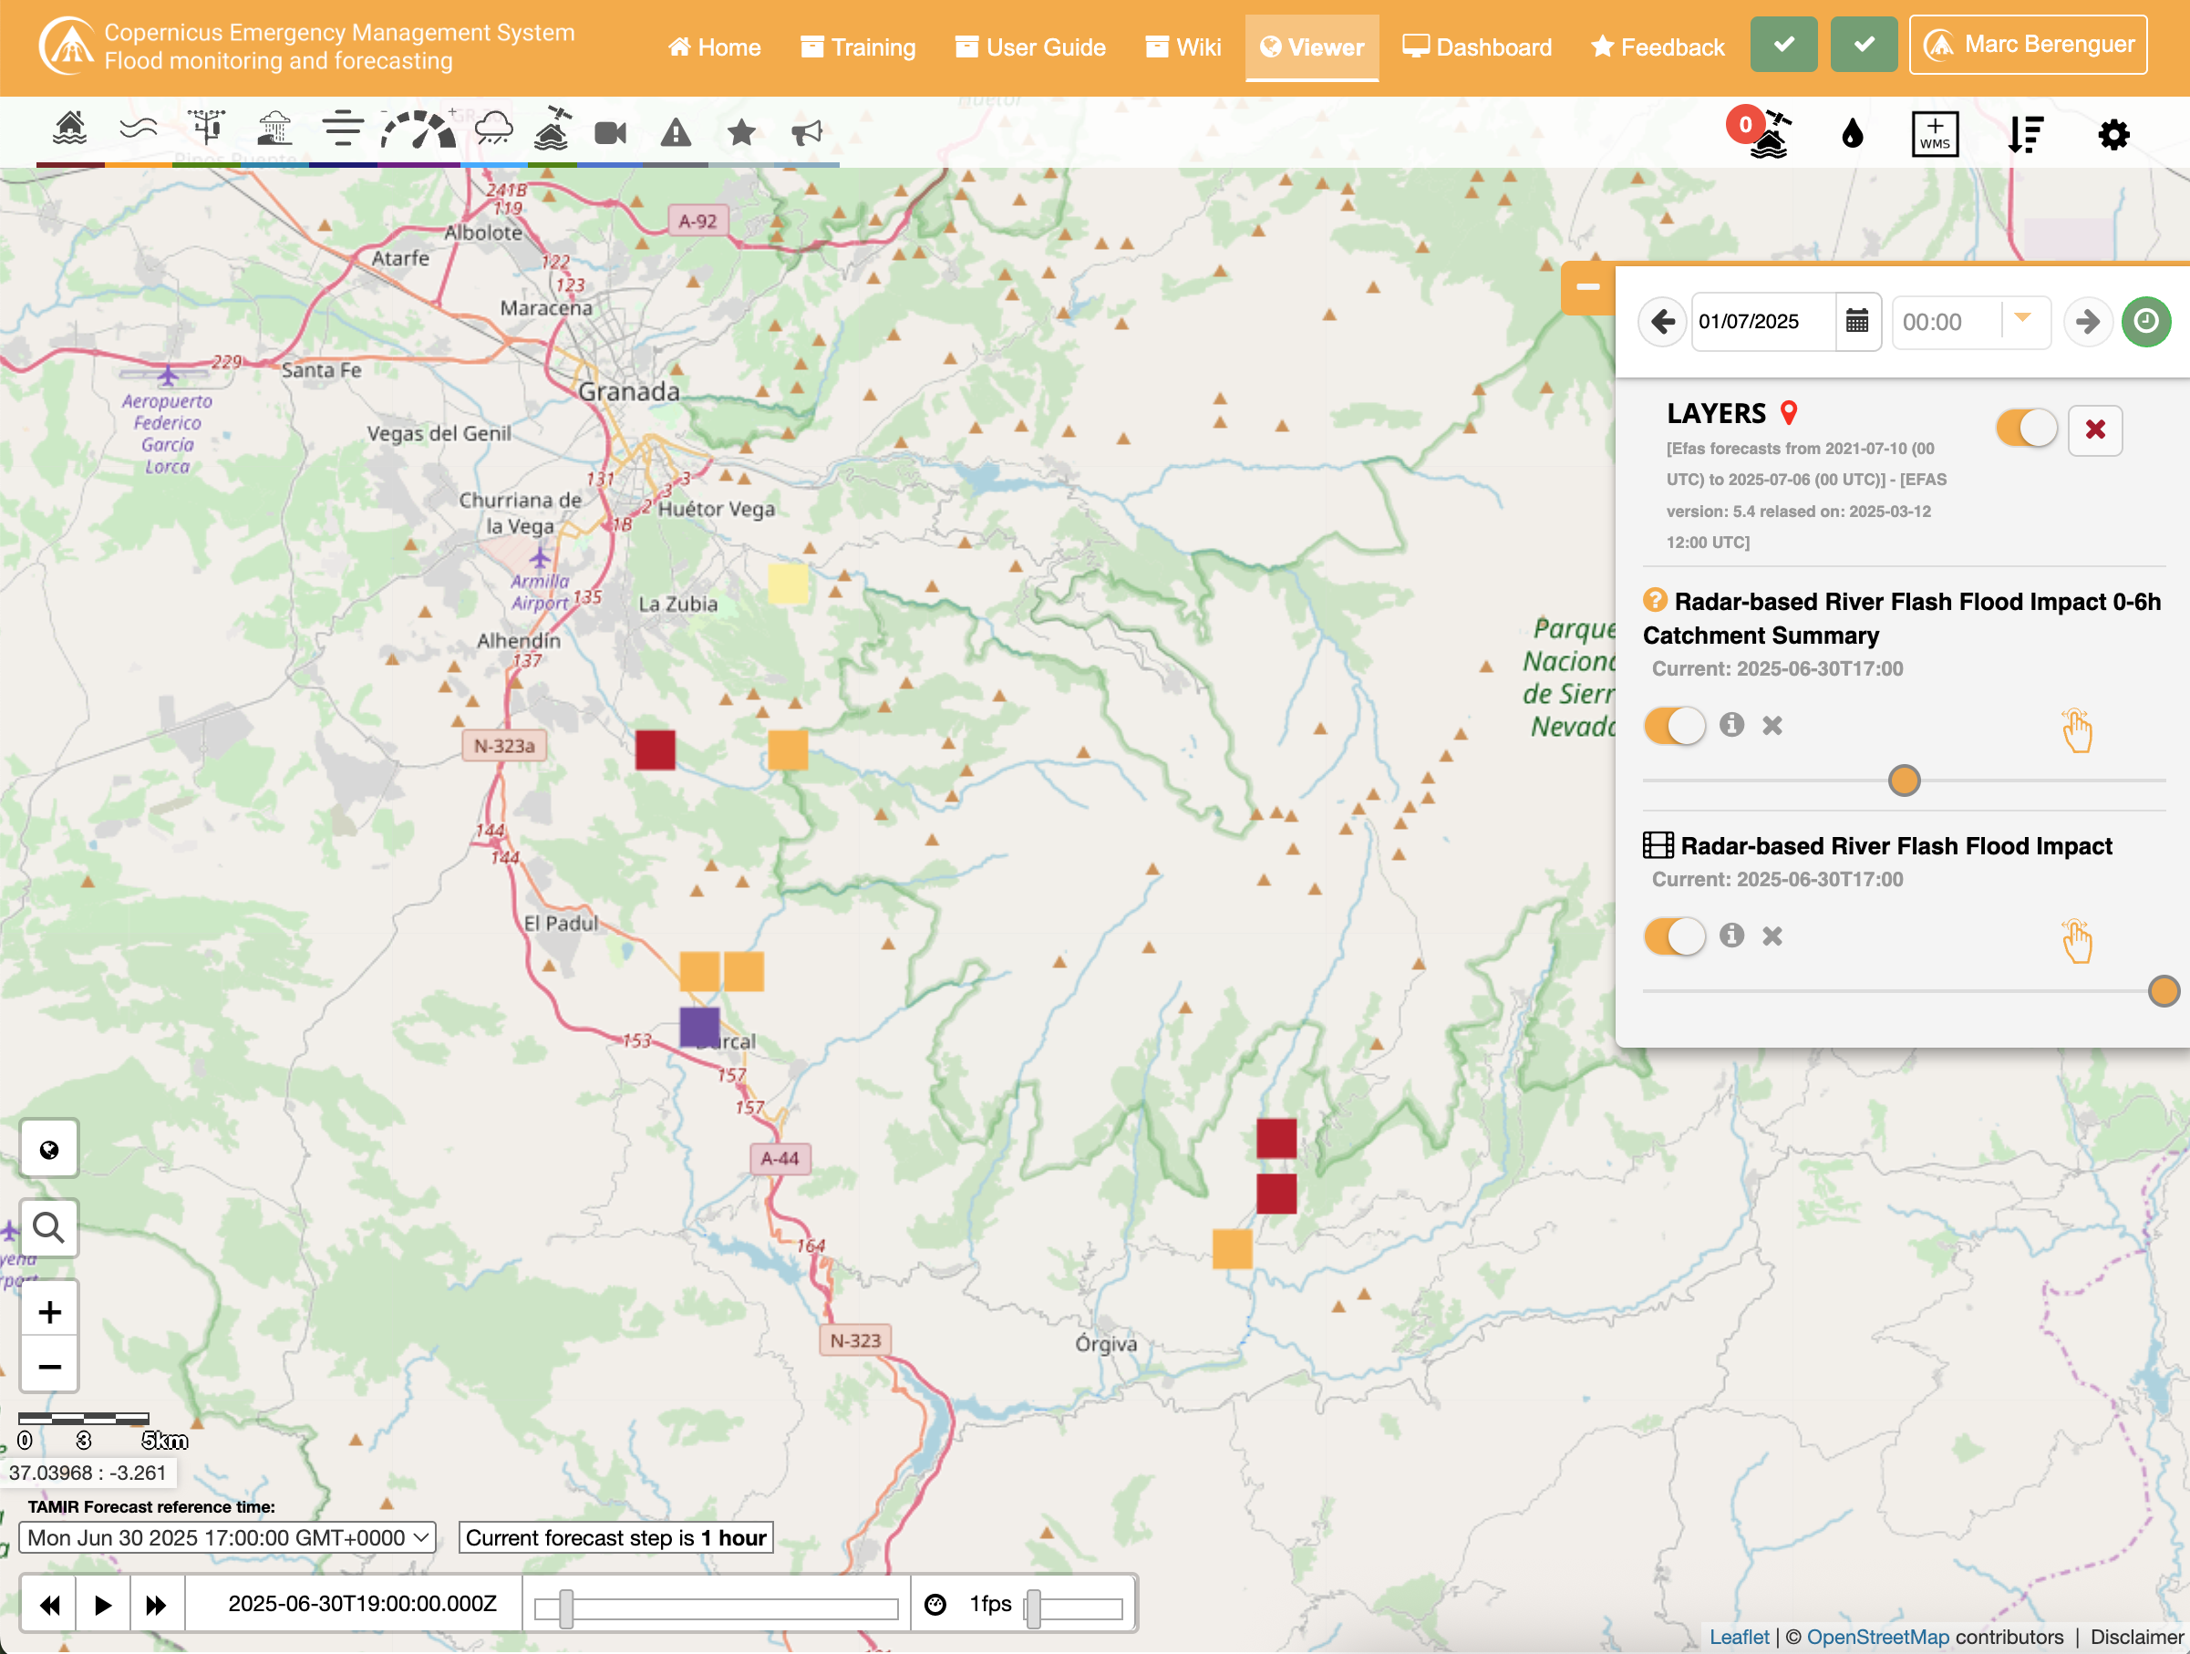
2025-06-30 17:00 - Inconsistency in Andalusia (photo)
  Both the river network and over Sub-Catchments are shown
  Aggregation is not shown
  Same time-step as the previous example

Slide 4
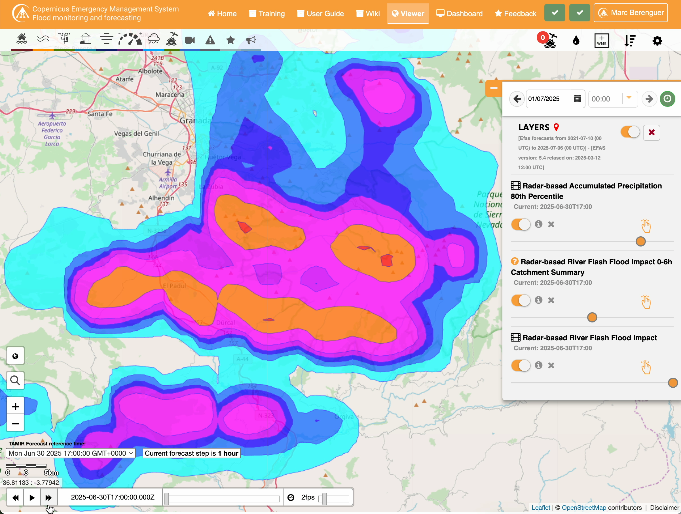
2025-06-30 17:00 - Inconsistency in Andalusia (video)
  Both the river network and over Sub-Catchments are shown
  Aggregation is never shown
  River network has appears intermittently, but there is no precipitation

Slide 5
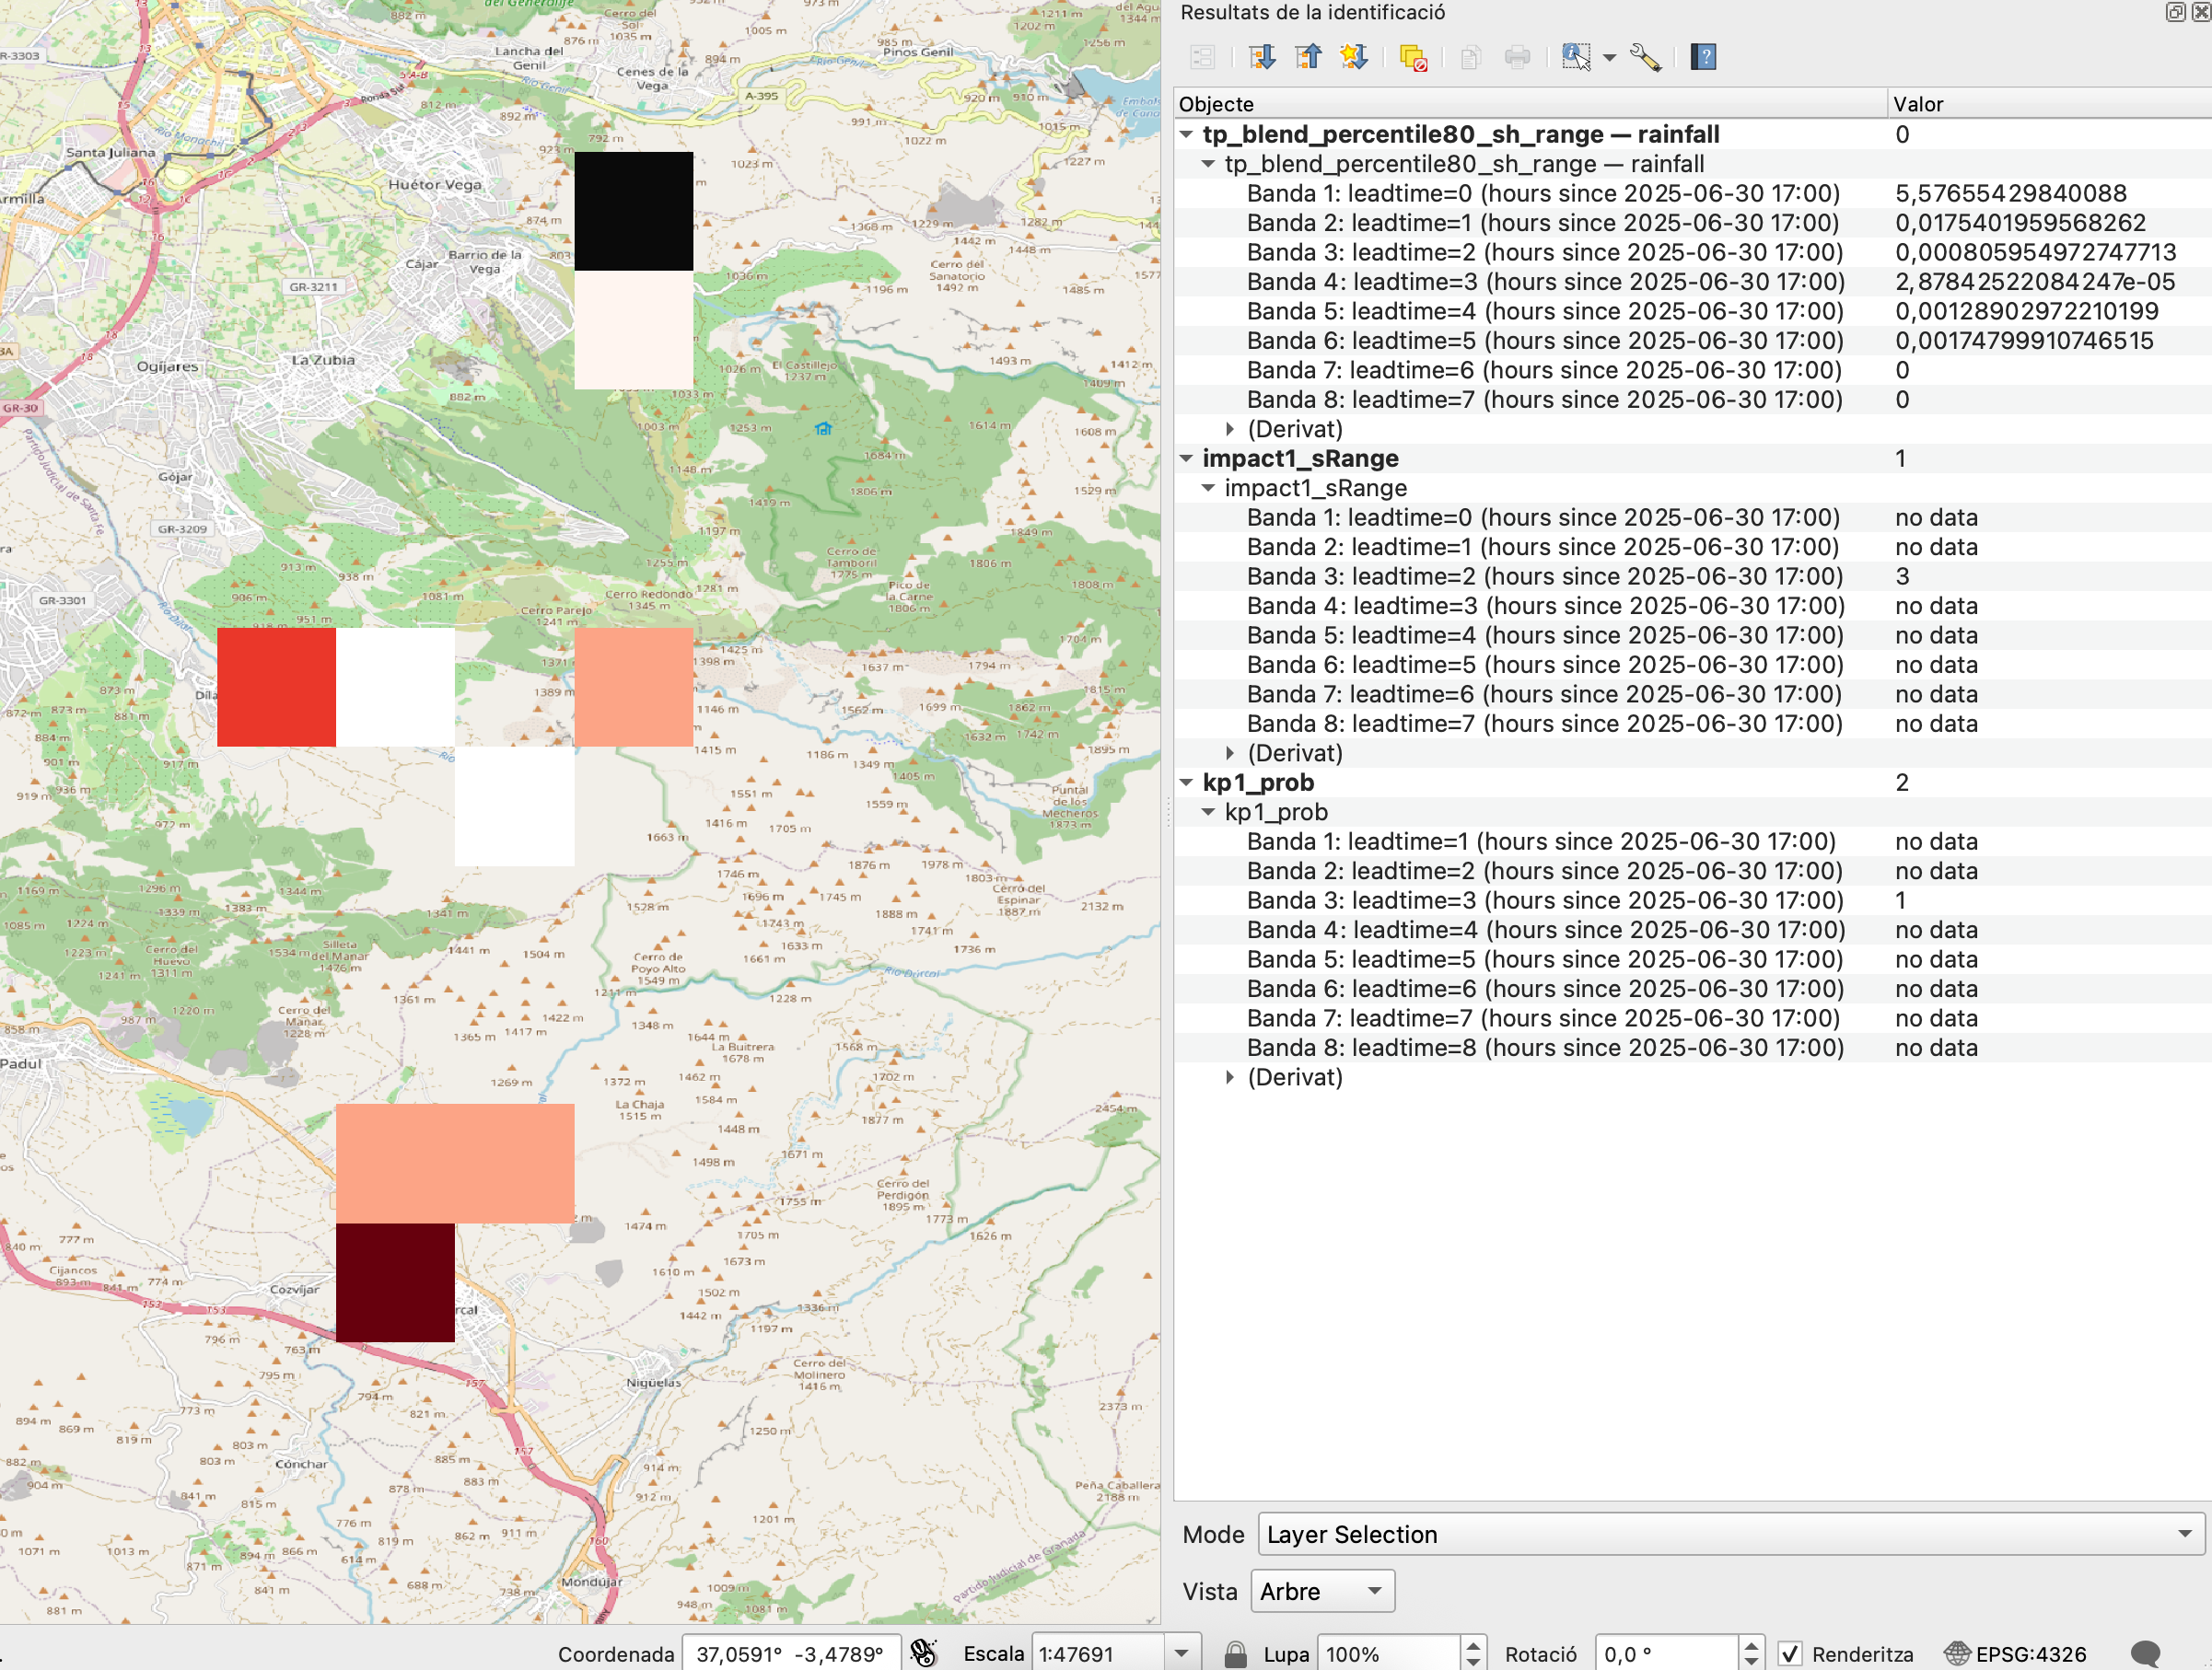
2025-06-30 17:00 - Different leadtime in raw data
  KP1 has Band 3: Leadtime 3 hours
  Impact1 has Band 3: Leadtime 2 hours

