Slide 1
Summer Events
05-08 August 2026
Austria + Hungary

Slide 2
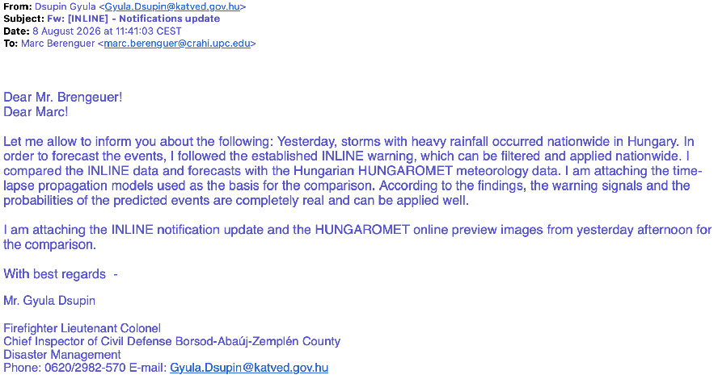
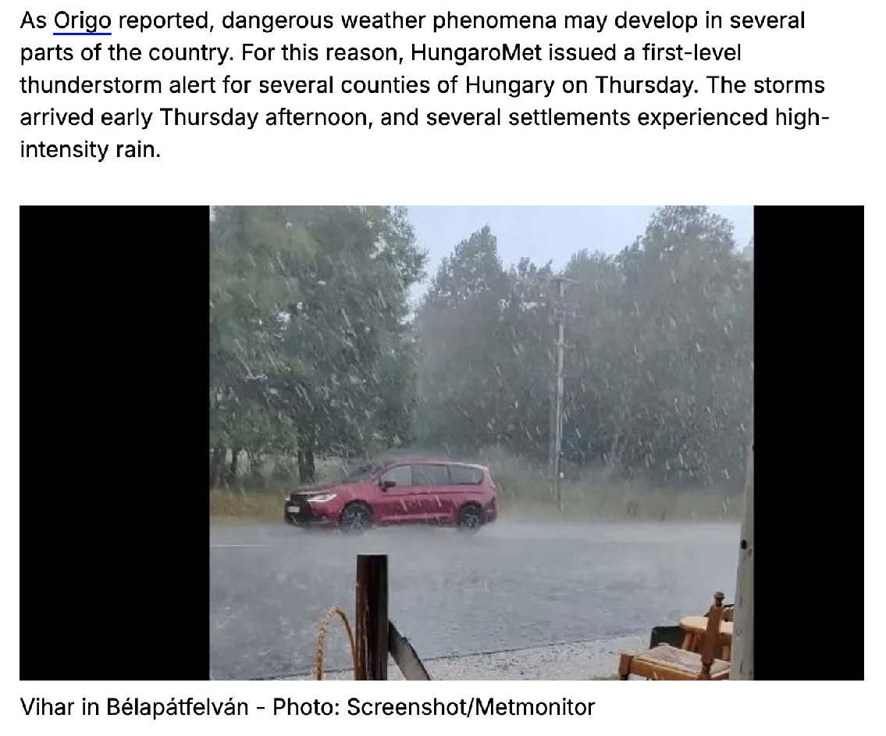
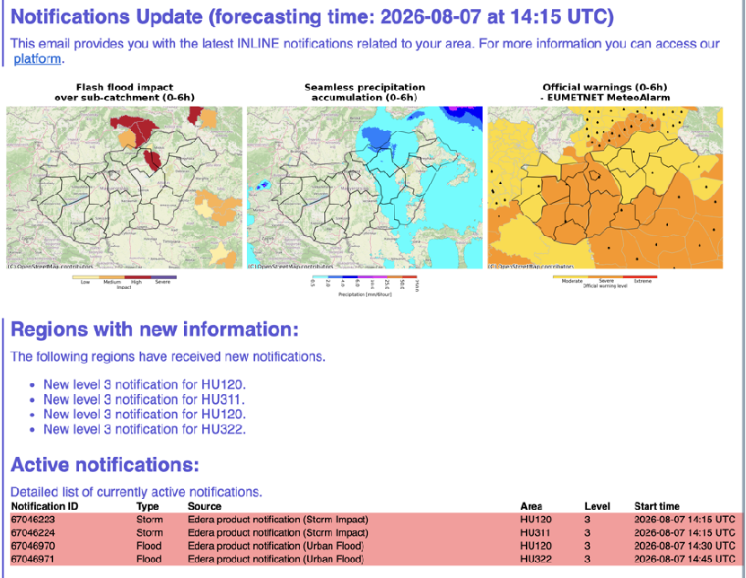
Austria + Hungary (05-08 August 2026)
Hungary
Feedback from Mr. Gyula Dsupin
https://www.origo.hu/itthon/2026/08/vihar-hidegfront-eso-video#google_vignette

Slide 3
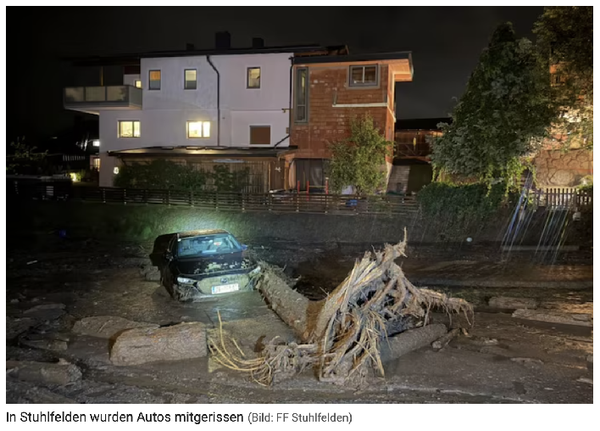
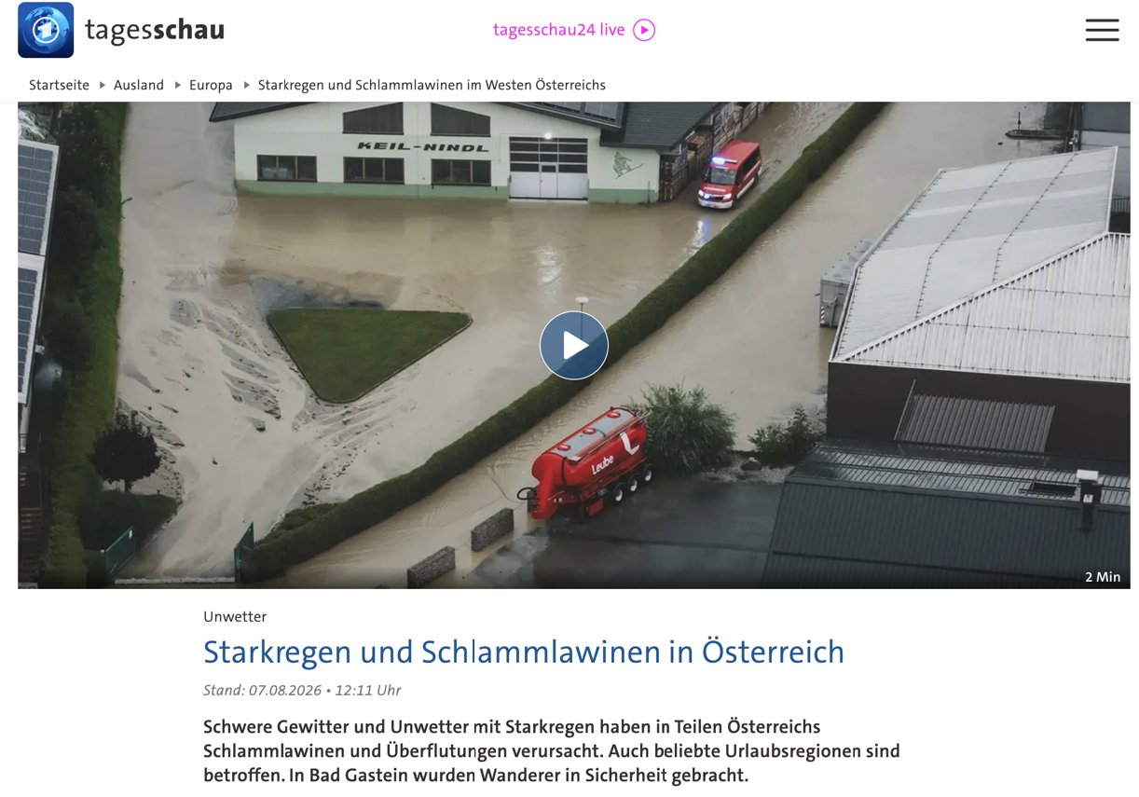
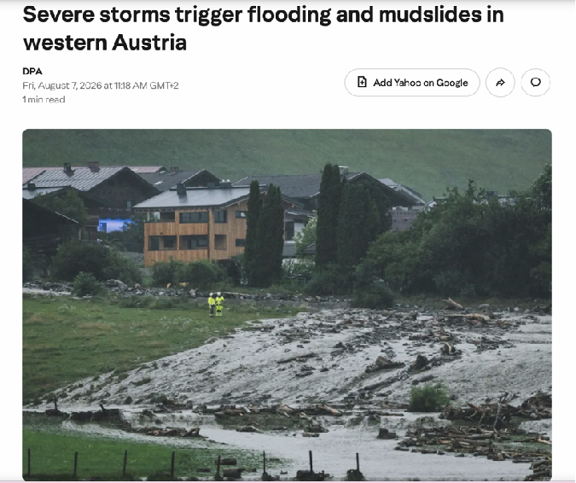
Austria + Hungary (05-08 August 2026)
Austria
https://www.krone.at/4247119
https://www.tagesschau.de/ausland/europa/oesterreich-starkregen-schlammlawinen-100.html
https://www.yahoo.com/news/weather-news/articles/severe-storms-trigger-flooding-mudslides-091832831.html

Slide 4
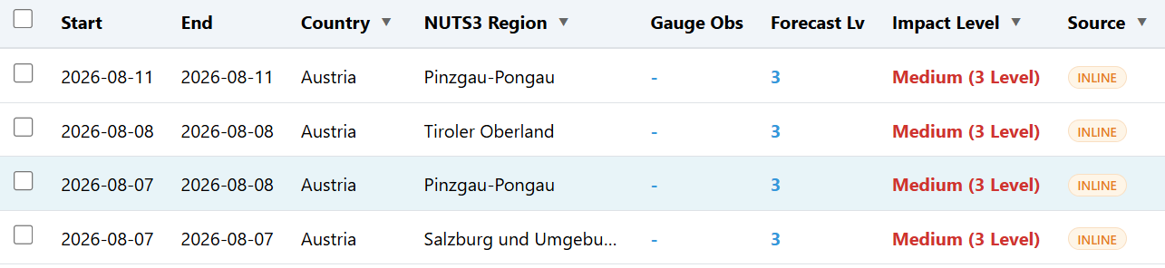
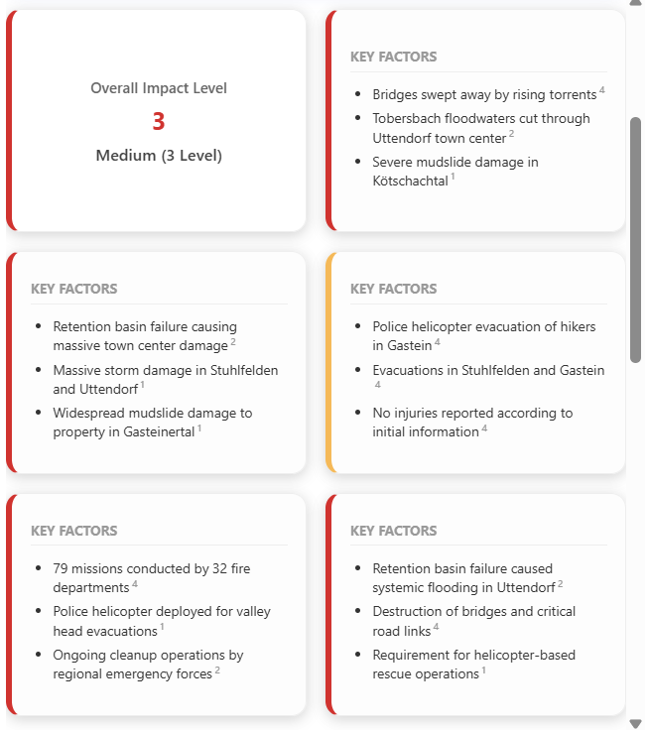
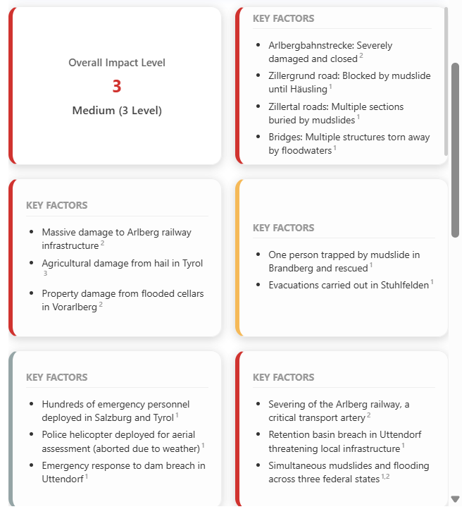
Austria + Hungary (05-08 August 2026)
Pinzgau-Pongau
Tiroler oberland

Slide 5
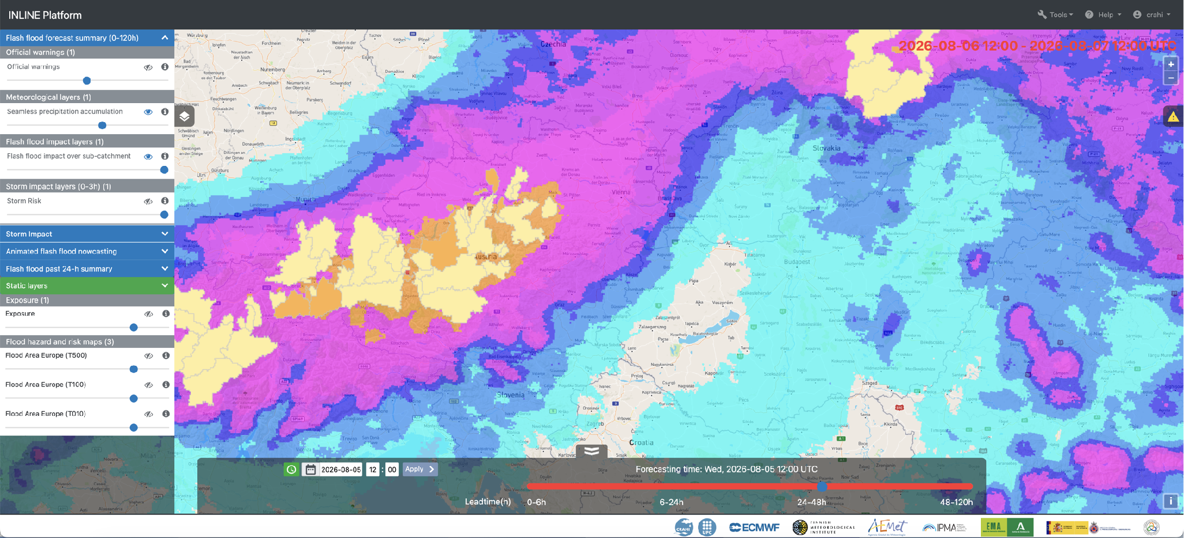
Austria + Hungary (04-08 August 2026)
Forecast at 05 August 2026 12:00 UTC
Impact starts 24 hours later
For 06 August 2026 12:00 UTC to 07 August 12:00 UTC

Slide 6
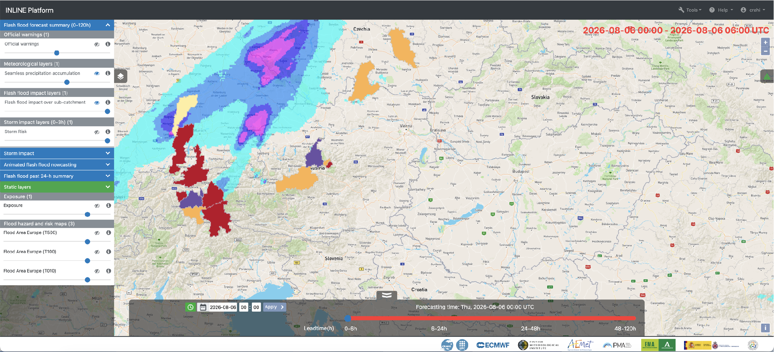
Austria + Hungary (04-08 August 2026)
Impact comes earlier
06 August 2026 00:00 UTC

Slide 7
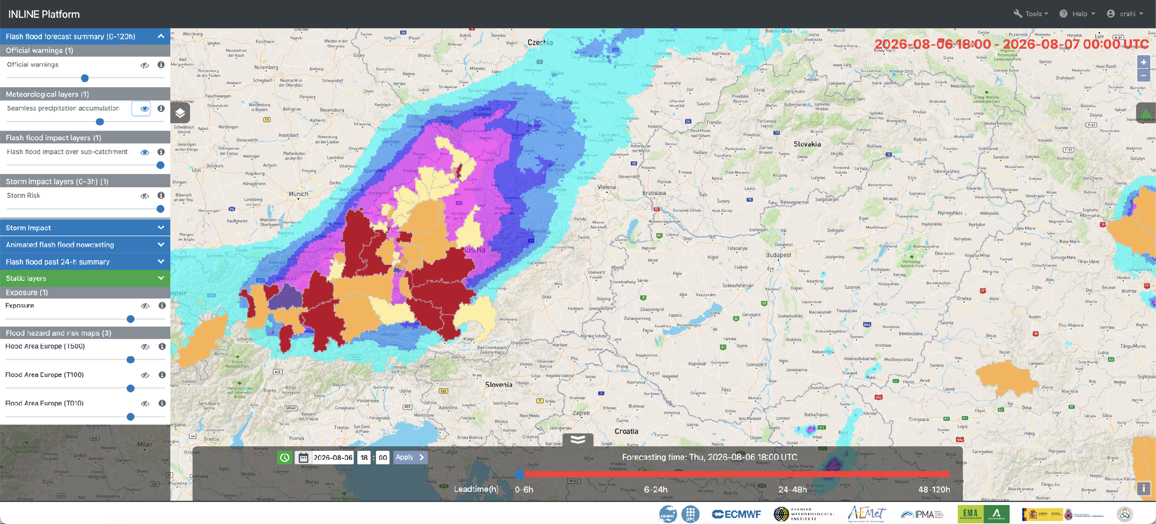
Austria + Hungary (04-08 August 2026)
06 August 2026 18:00 UTC

Slide 8
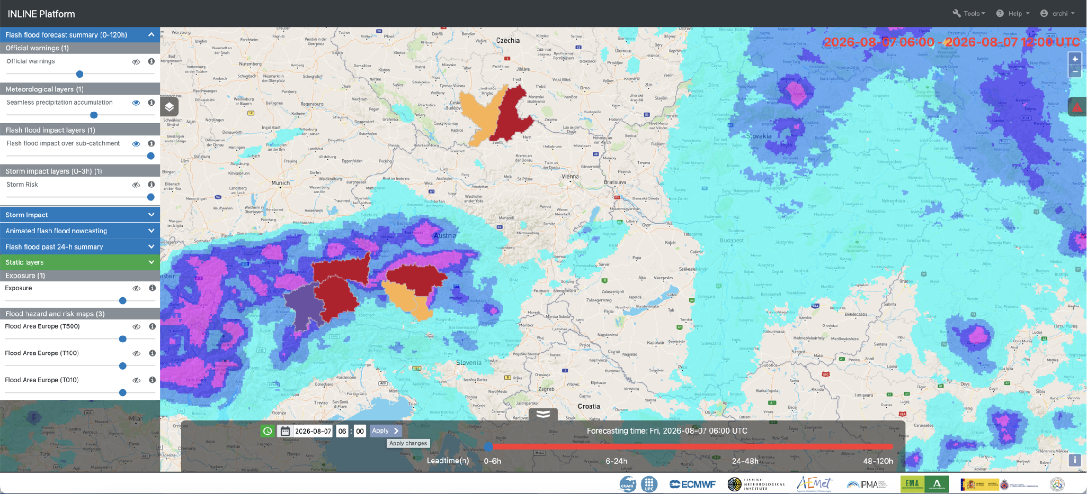
Austria + Hungary (04-08 August 2026)
Rainfall moved to Hungary
07 August 2026 06:00 UTC

Slide 9
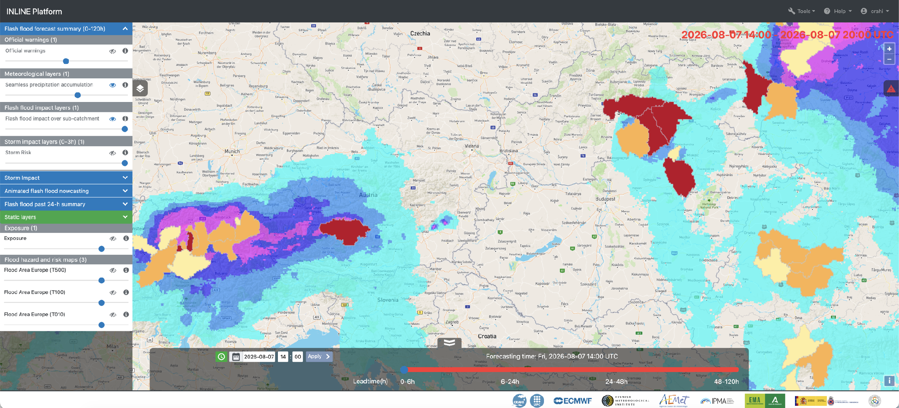
Austria + Hungary (04-08 August 2026)
07 August 2026 14:00 UTC

Slide 10
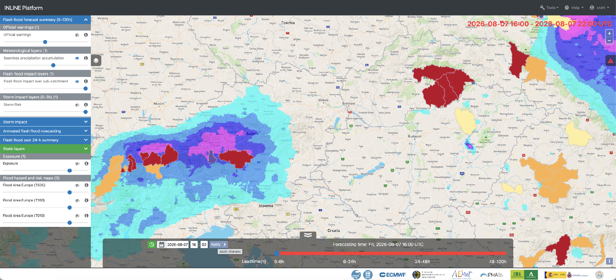
Austria + Hungary (04-08 August 2026)
07 August 2026 16:00 UTC

Slide 11
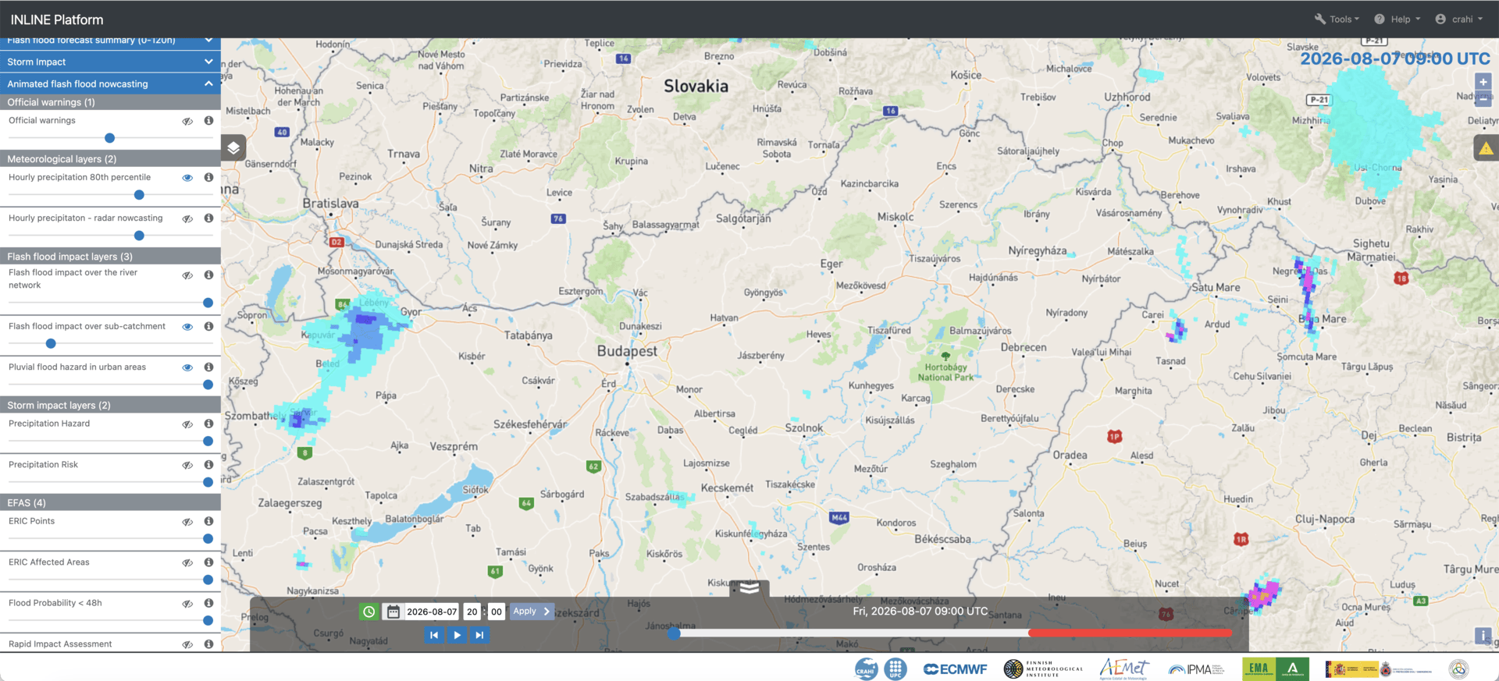
Austria + Hungary (04-08 August 2026)
Nowcasting: 07 August 2026

Slide 12
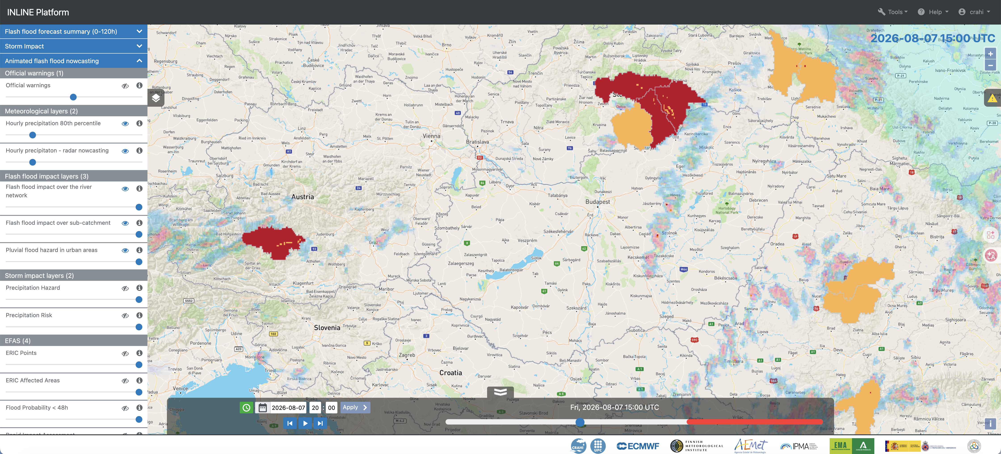
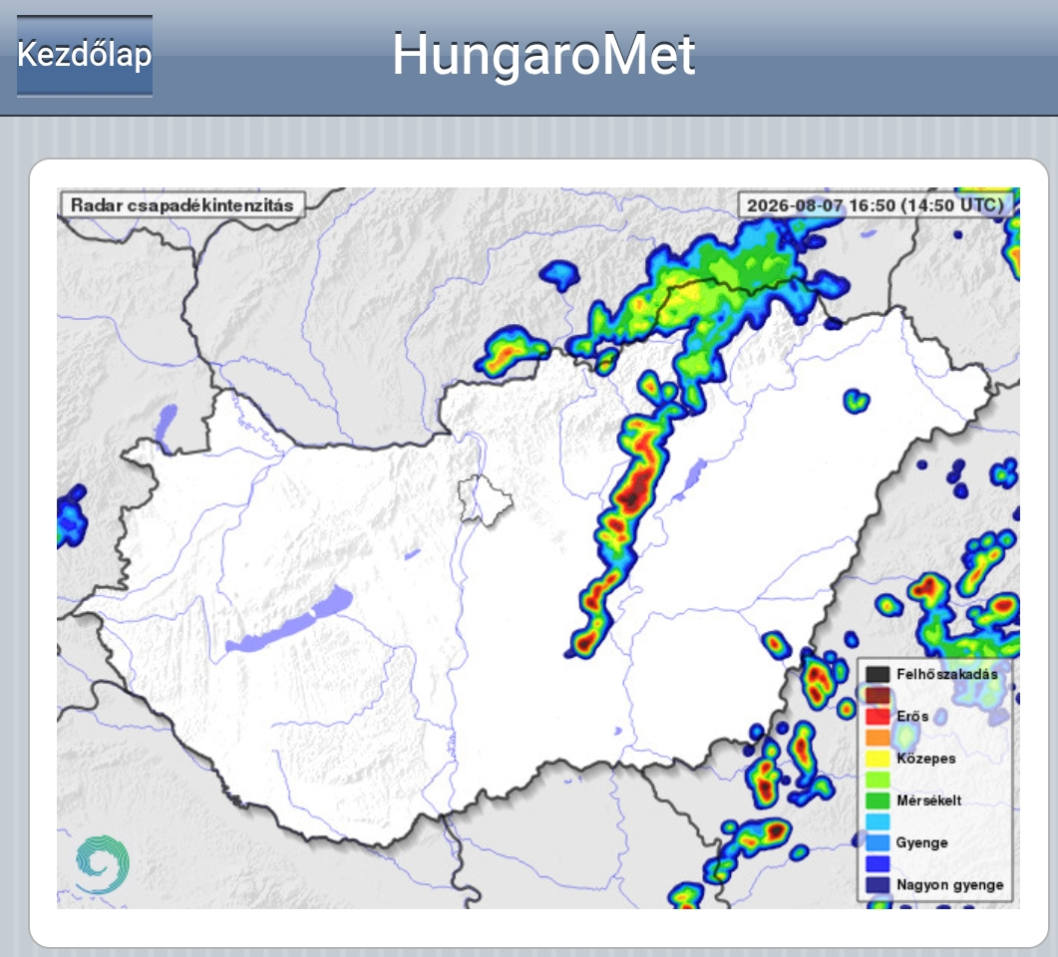
Austria + Hungary (04-08 August 2026)
Nowcasting: 07 August 2026

Slide 13
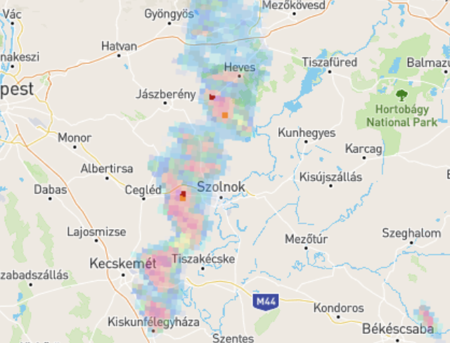
Austria + Hungary (04-08 August 2026)
Nowcasting: 07 August 2026

