Slide 1


www.anywhere-h2020.eu
High-impact weather emergencies: operational decision support tools for emergency management centres
Prof. Daniel Sempere-Torres
CRAHI
Universitat Politecnica de Catalunya

Slide 2
Storms and Floods: challenges for a better management in a changing environment
> x3 from 1980
700
200

Slide 3
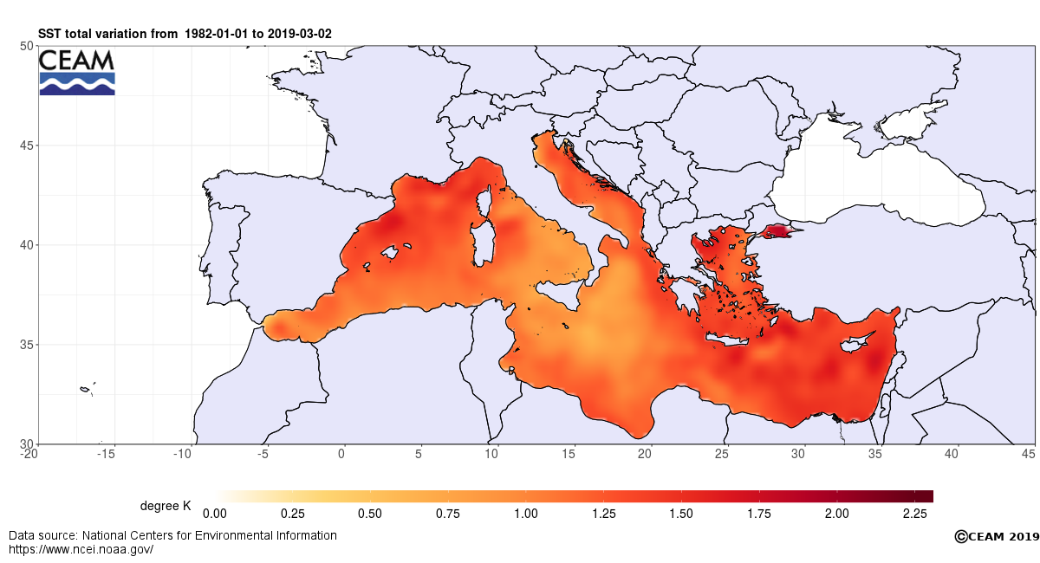
Surface Sea Temperature (SST) variation 1982-2019

Slide 4
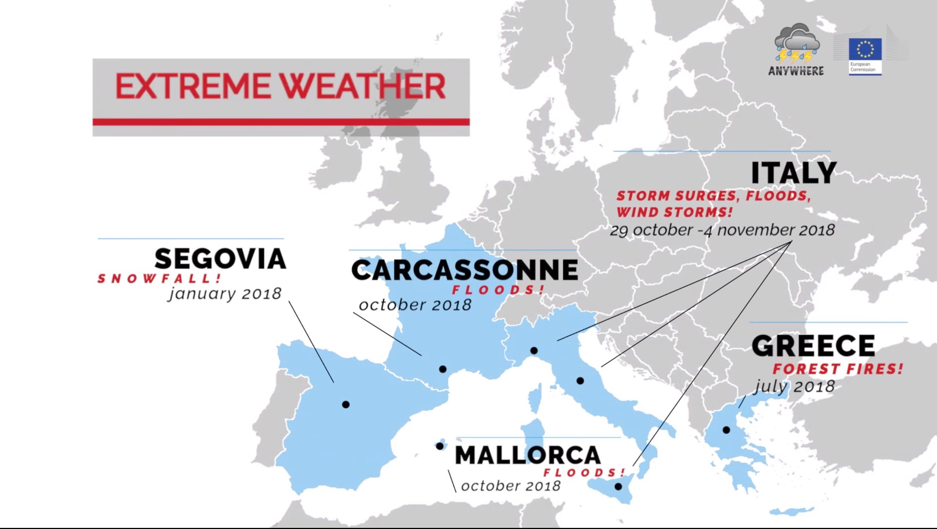
Extreme weather events in 2018
October 2018: 2 x annual rainfall in less than one month in West Mediterranean

Slide 5
Challenges to Goals
CHANGE OF PARADIGM:
From RE-ACTIVE to
PRO-ACTIVE RESPONSE
Advanced detection and response

Slide 6
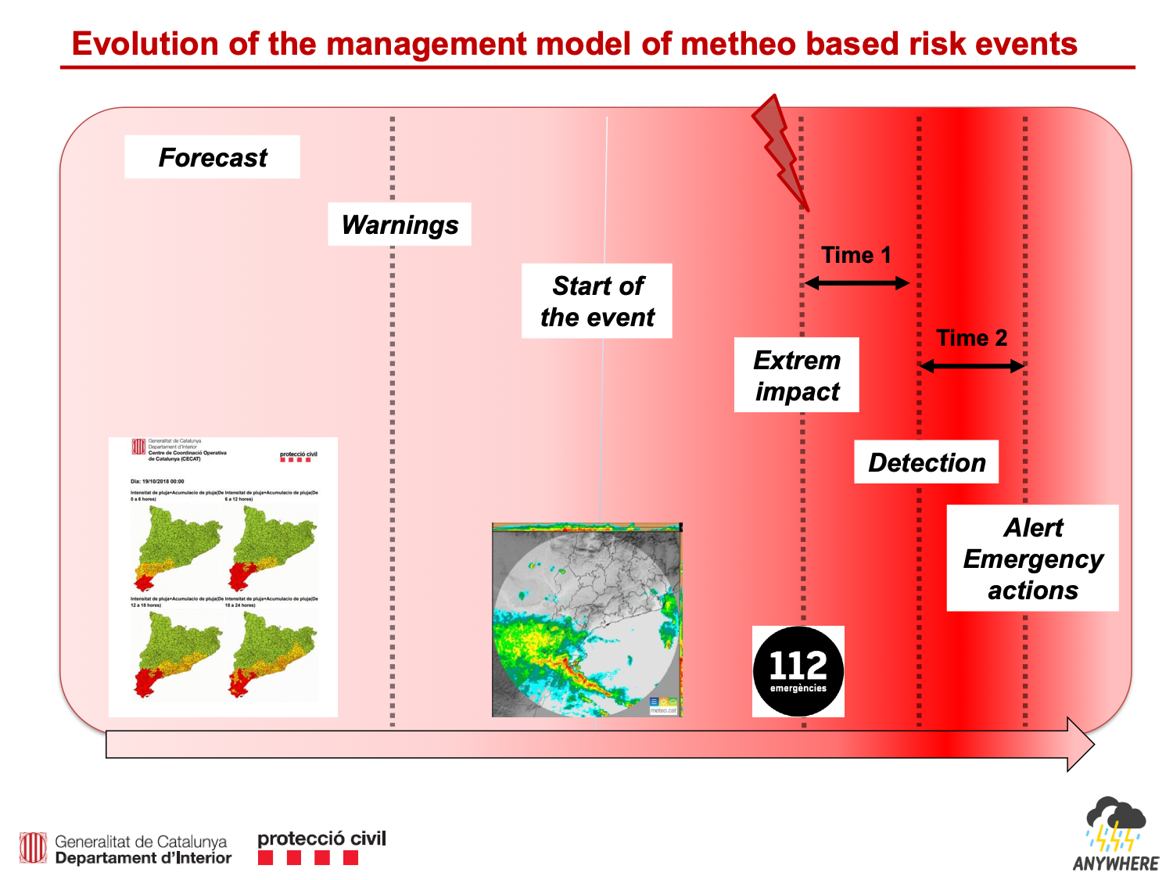
Courtesy of Sergio Delgado

Slide 7
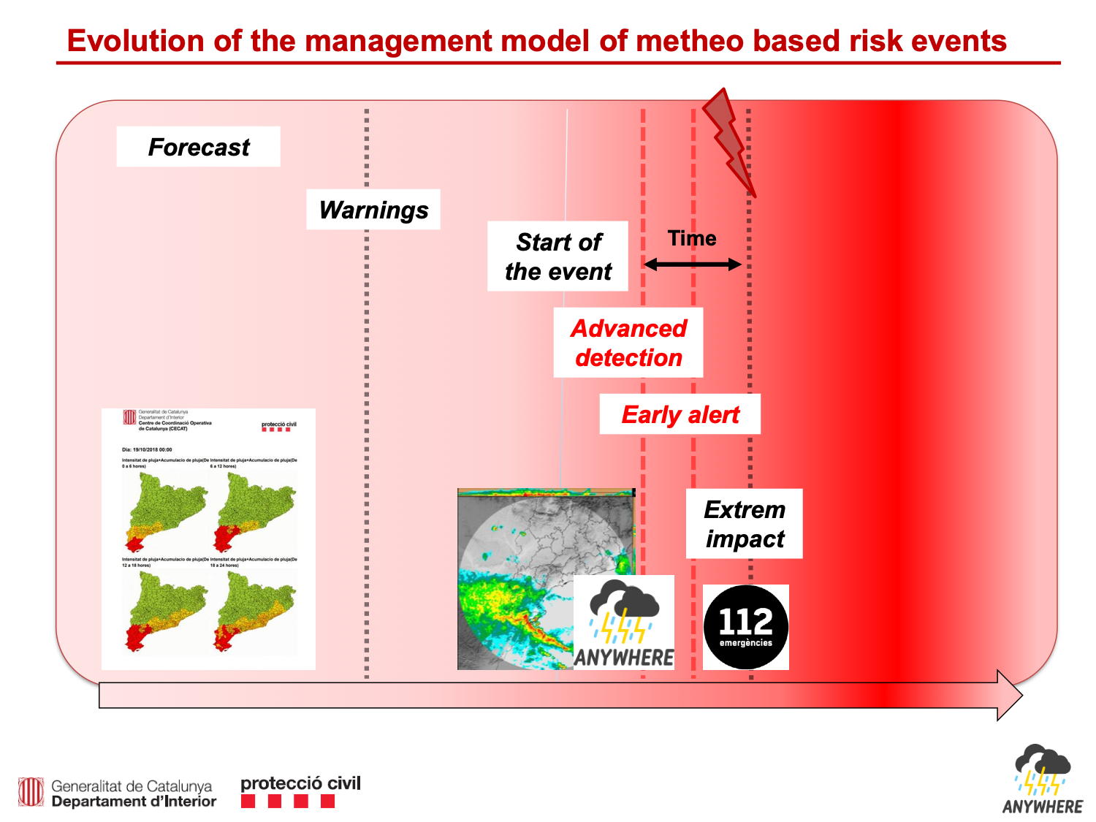
Courtesy of Sergio Delgado

Slide 8
Challenges to Goals
CHANGE OF PARADIGM:
From RE-ACTIVE to
PRO-ACTIVE RESPONSE
Advanced detection and response
Translate best adapted METEOROLOGICAL FORECASTS into IMPACT FORECASTS

Slide 9
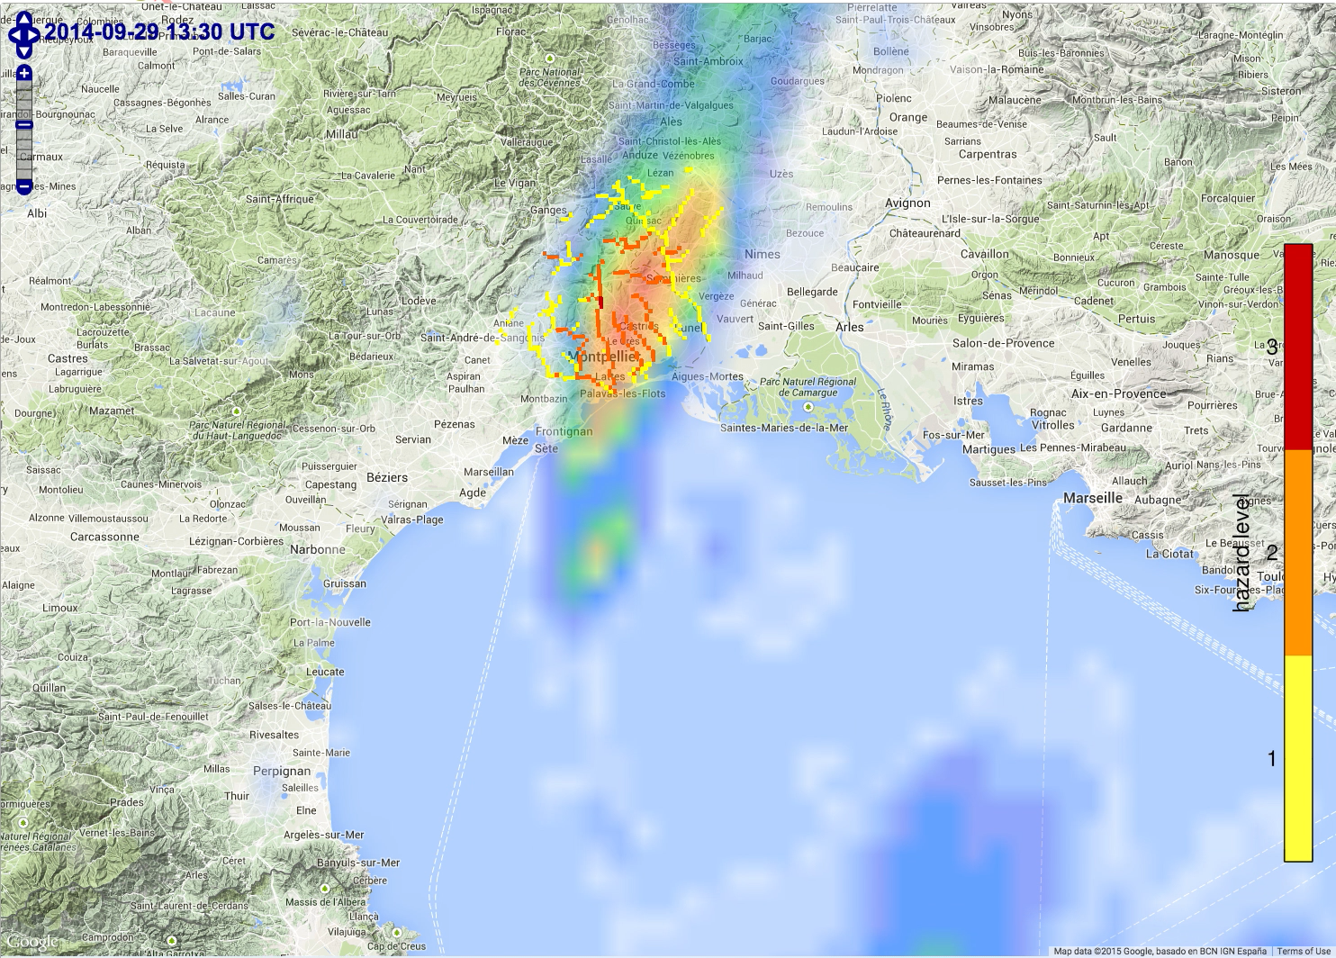
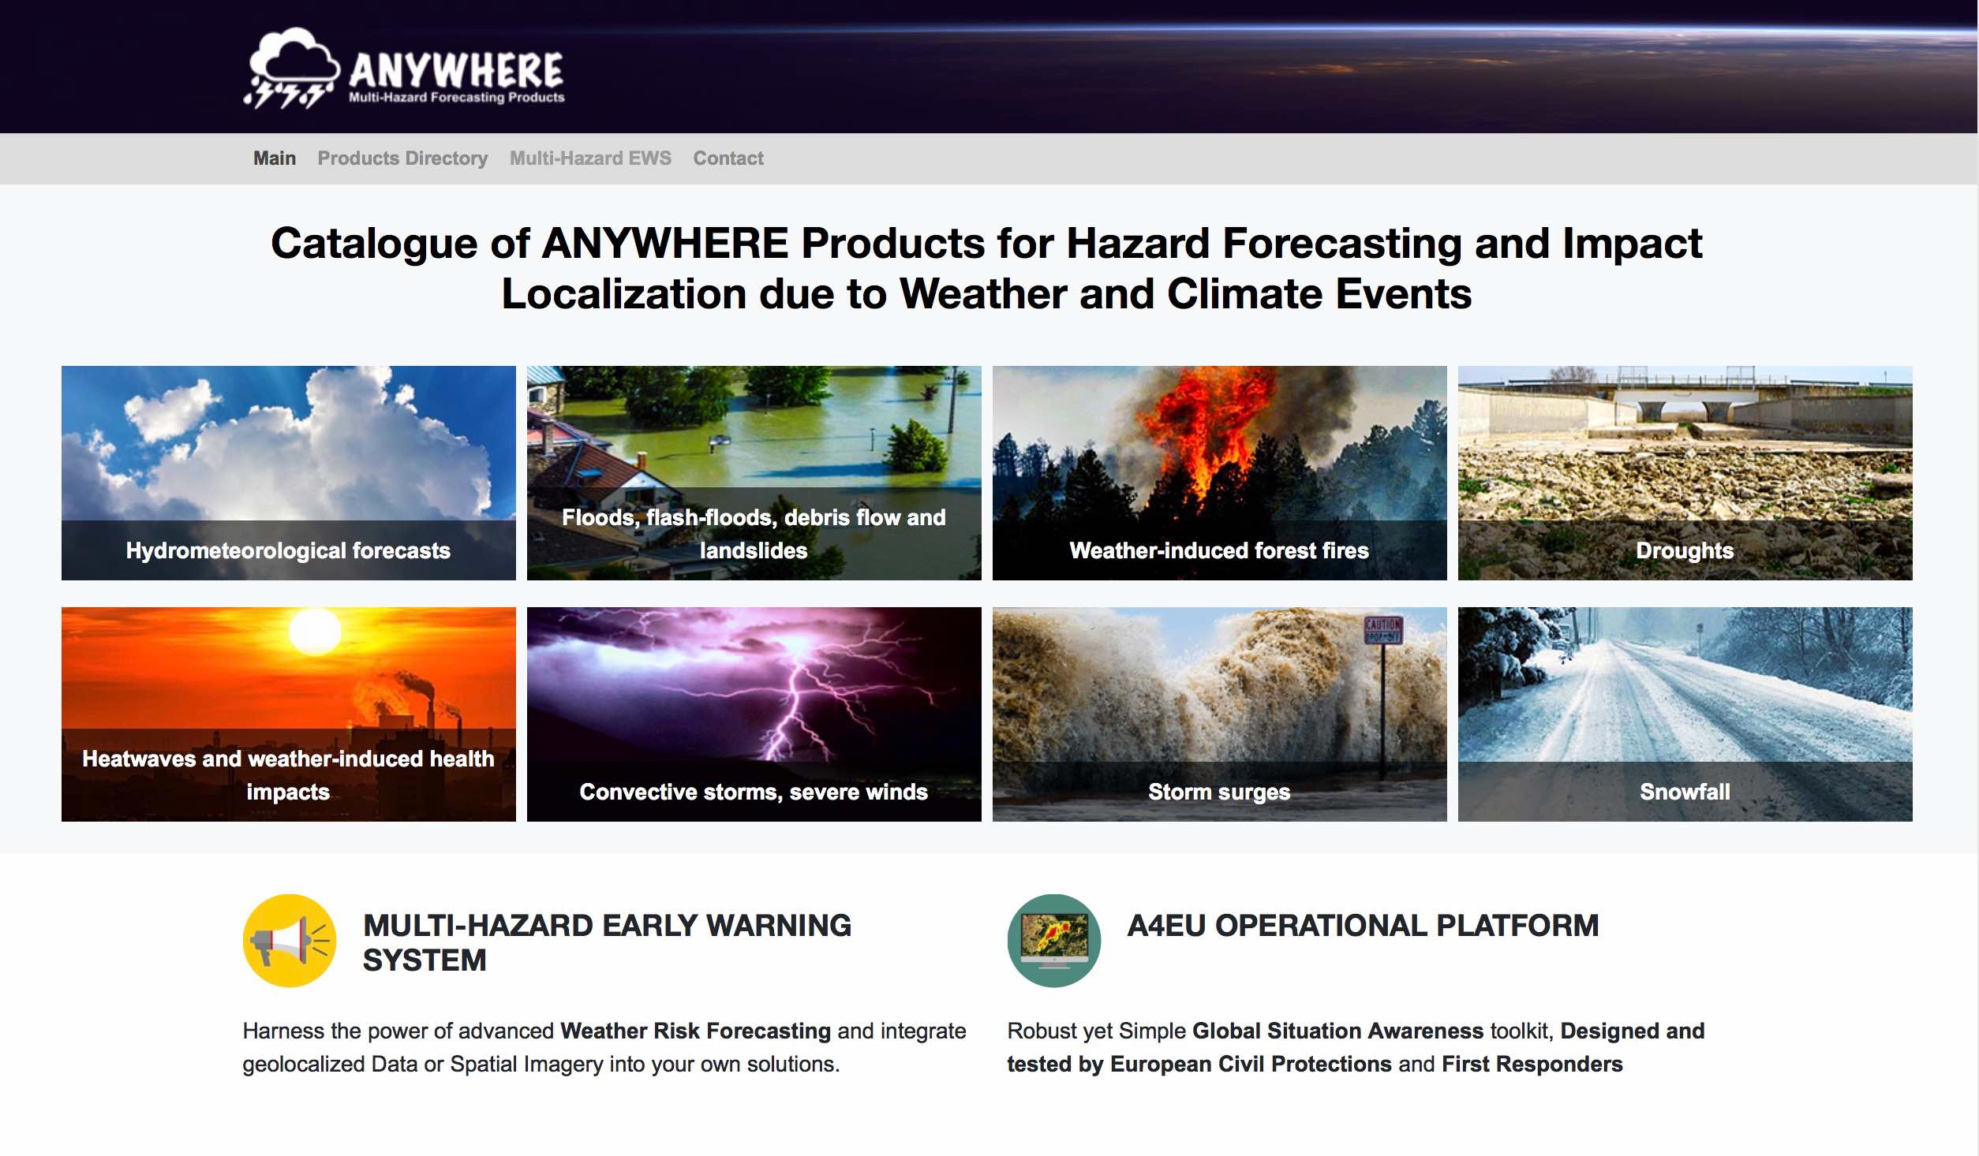
Challenges to Goals
Translate best adapted METEOROLOGICAL FORECASTS into IMPACT FORECASTS
Forecasting impacts:
Flash Flood Impacts
Flash Flood impact forecasting in any 1-km² of EU with 2h anticipation
www.anywhere-h2020.eu/catalogue
At 1km over the entire EU, at 200 m in pilot sites

Slide 10
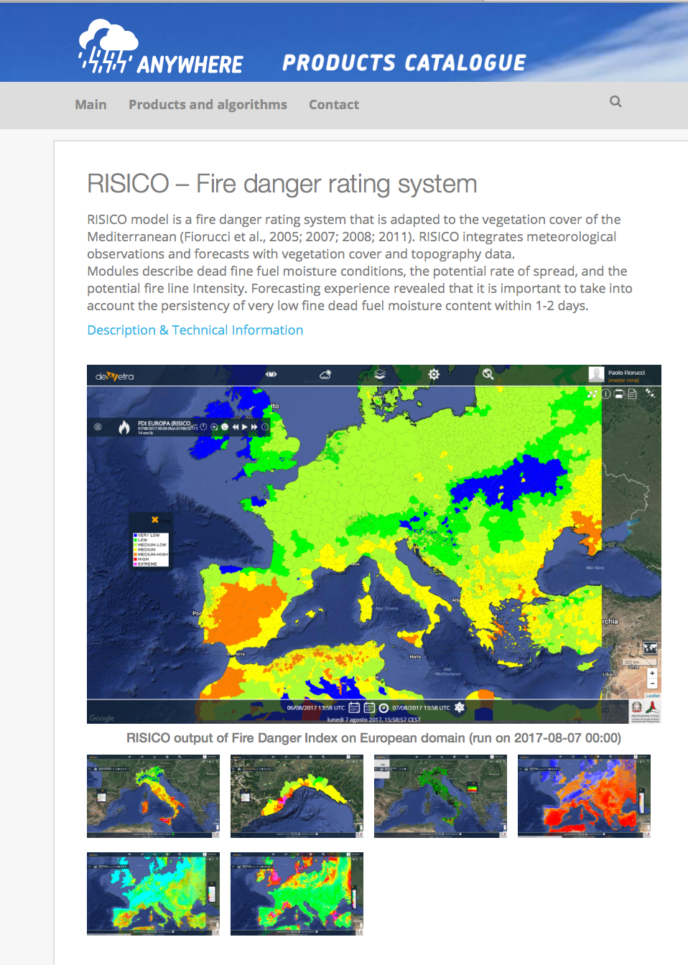
Challenges to Goals
Forecasting impacts:
Forest Fires risk
Translate best adapted METEOROLOGICAL FORECASTS into IMPACT FORECASTS
www.anywhere-h2020.eu/catalogue

Slide 11
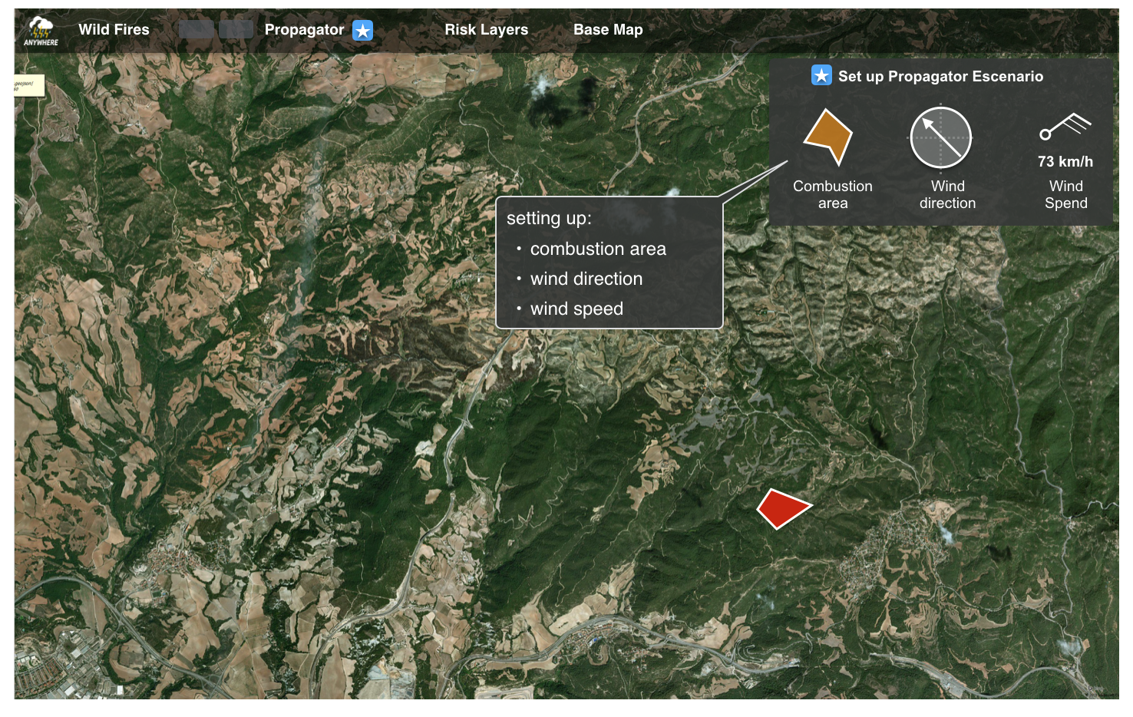
Challenges to Goals
Translate best adapted METEOROLOGICAL FORECASTS into IMPACT FORECASTS
Forecasting impacts:
Fire propagation
www.anywhere-h2020.eu/catalogue

Slide 12
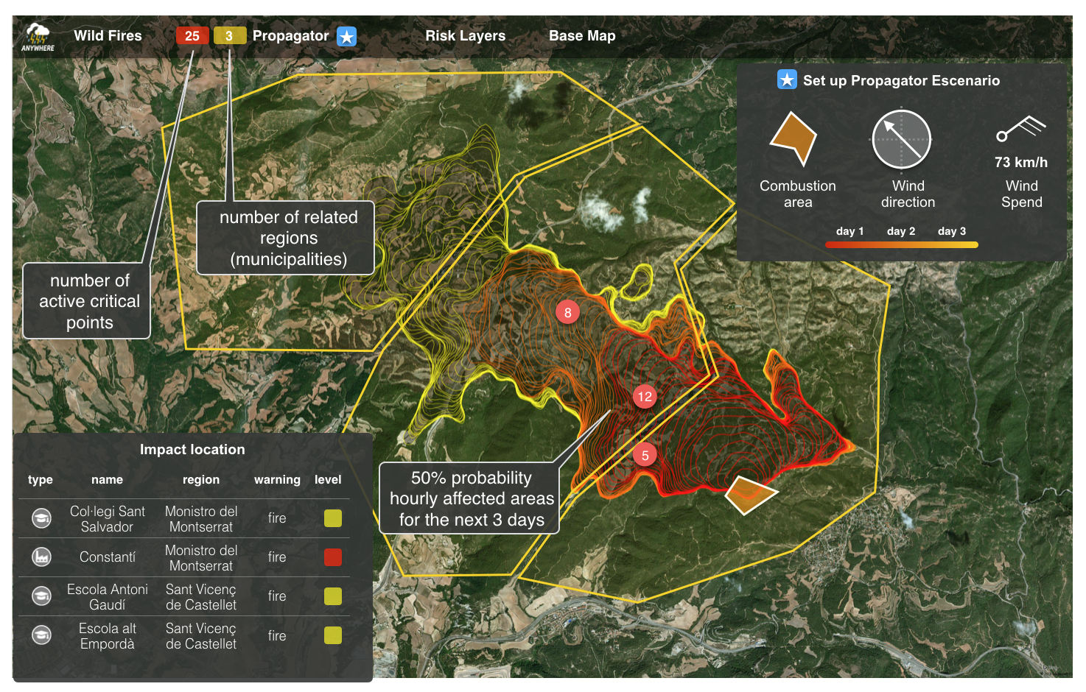
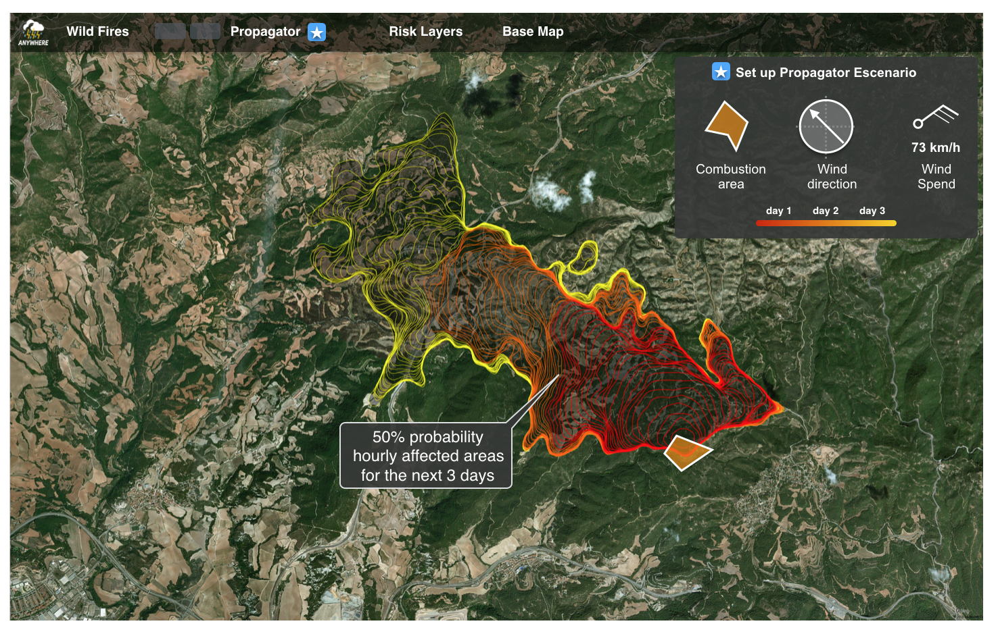
Challenges to Goals
Translate best adapted METEOROLOGICAL FORECASTS into IMPACT FORECASTS
Forecasting impacts:
Fire propagation
www.anywhere-h2020.eu/catalogue

Slide 13
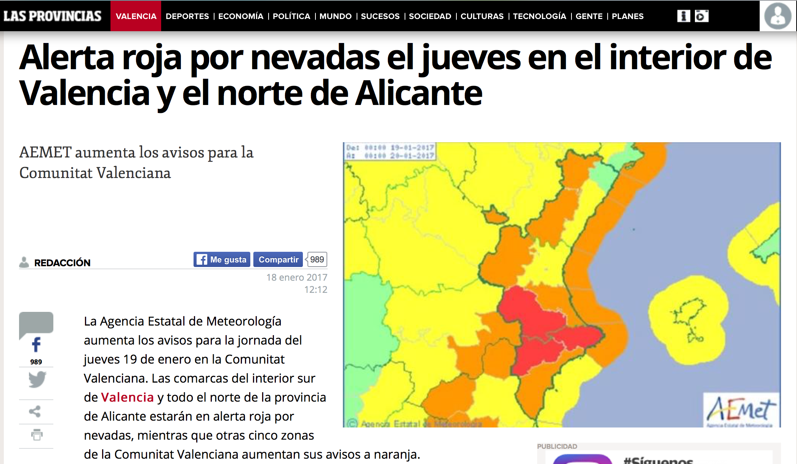
Example: Snow event in Valencia 19-20 January 2017
Good Meteorological forecast of the snow event 36h in advance
BUT: Not translation into IMPACTS located in time and space

Slide 14
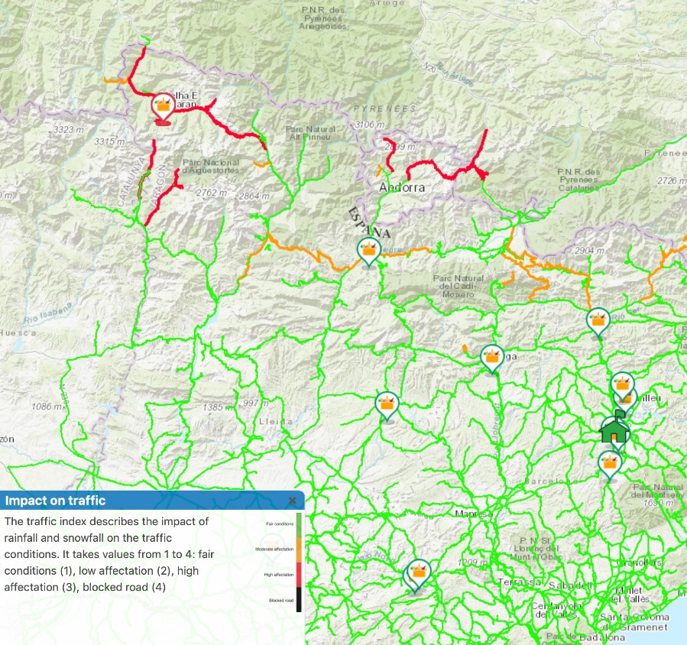


Challenges to Goals
Translate best adapted METEOROLOGICAL FORECASTS into IMPACT FORECASTS
Forecasting impacts:
Snow on roads
MH-EWS forecasts & local information
Weather impact on roads
Road
conditions
www.anywhere-h2020.eu/catalogue
Web
application
Mobile
App
i

Slide 15
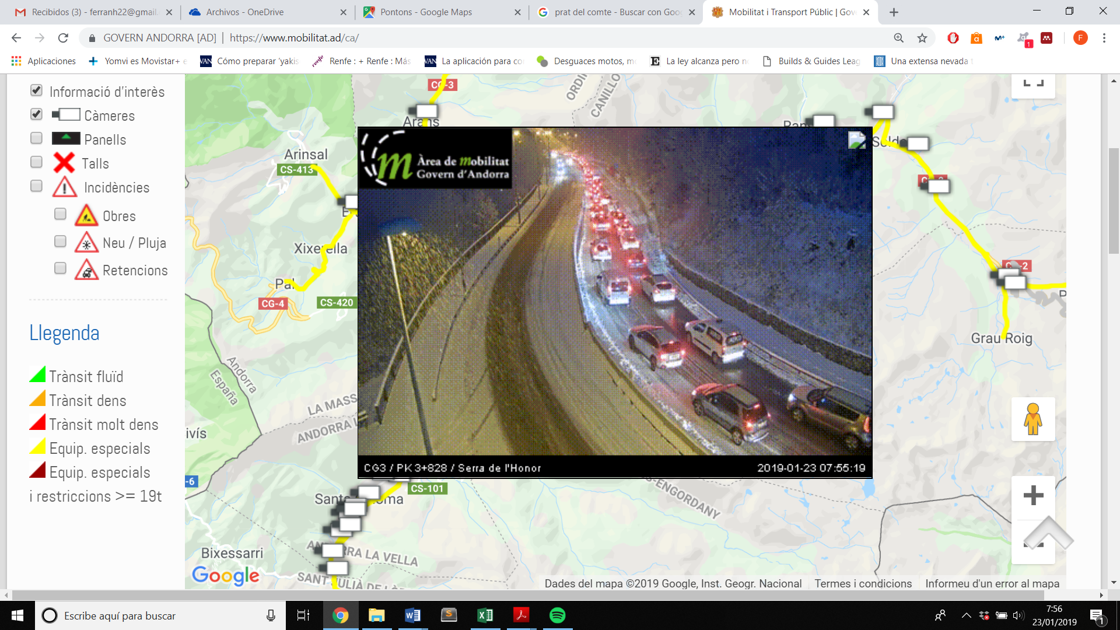
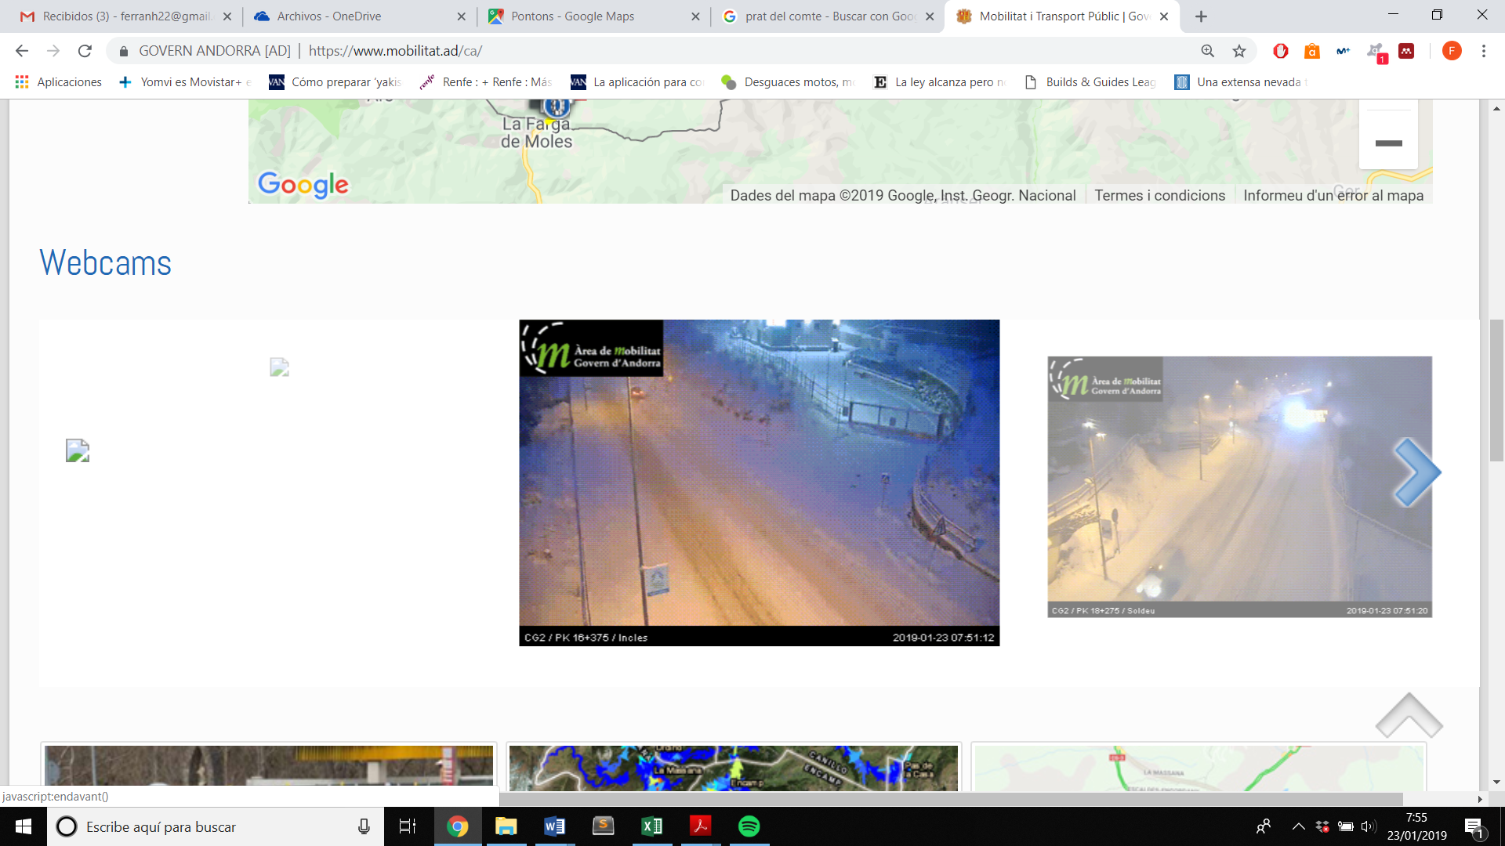
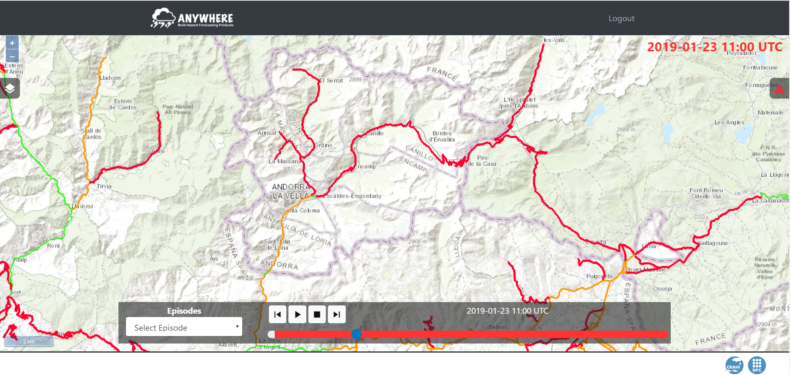
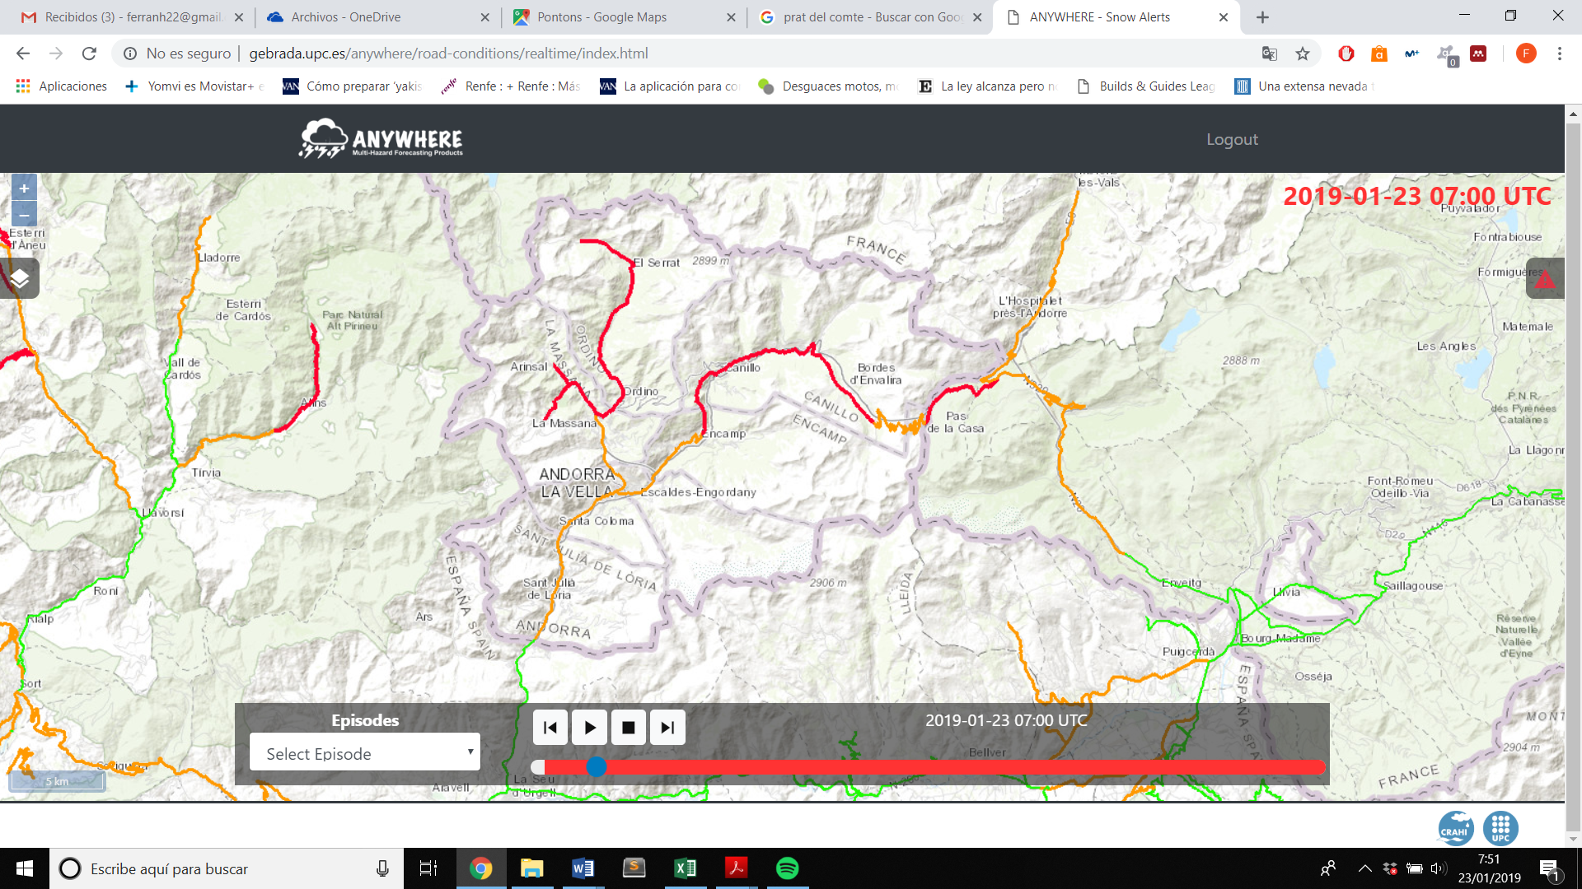

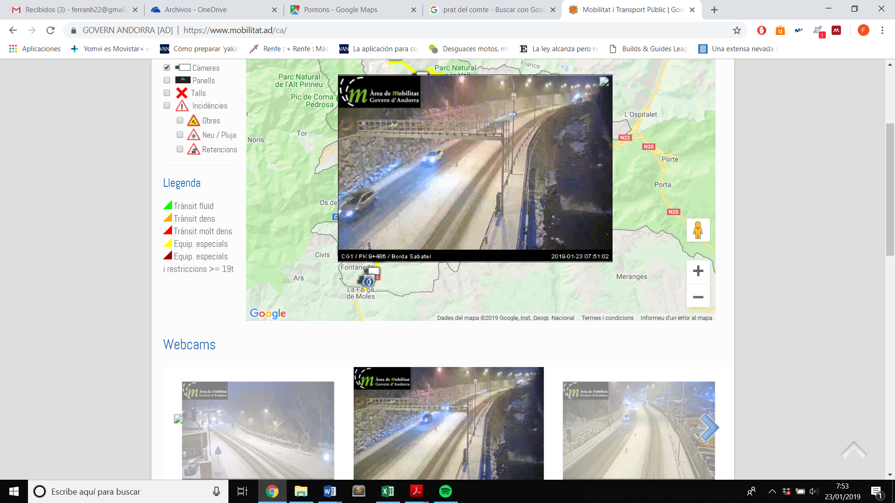
ANYWHERE product of Impact forecast of traffic conditions by snow on the road

Slide 16
Challenges to Goals
CHANGE OF PARADIGM:
From RE-ACTIVE to
PRO-ACTIVE RESPONSE
Advanced detection and response
Integrate IMPACT FORECASTS with local layers to SUPPORT DECISION MAKING in EMERGENCY COMMAND CENTRES
Translate best adapted METEOROLOGICAL FORECASTS into IMPACT FORECASTS

Slide 17

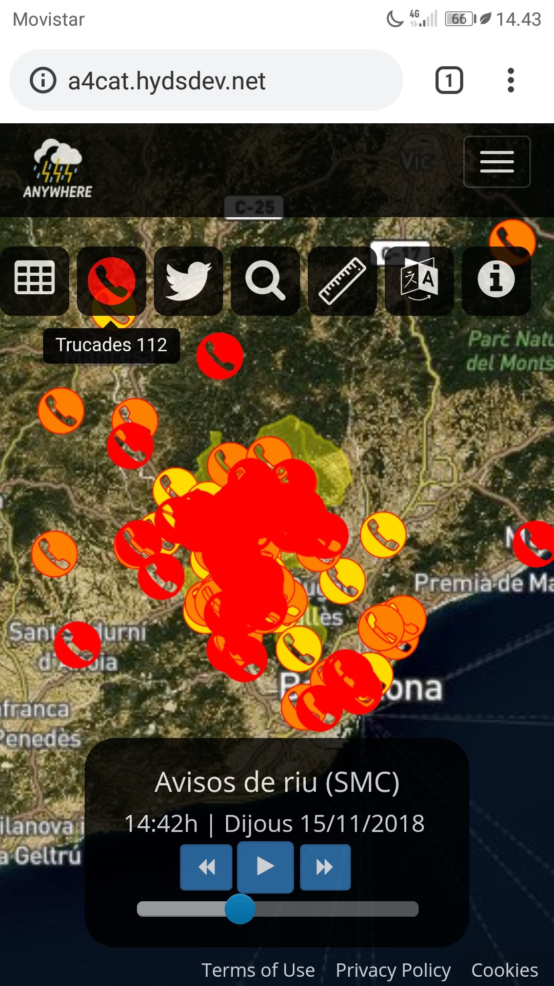



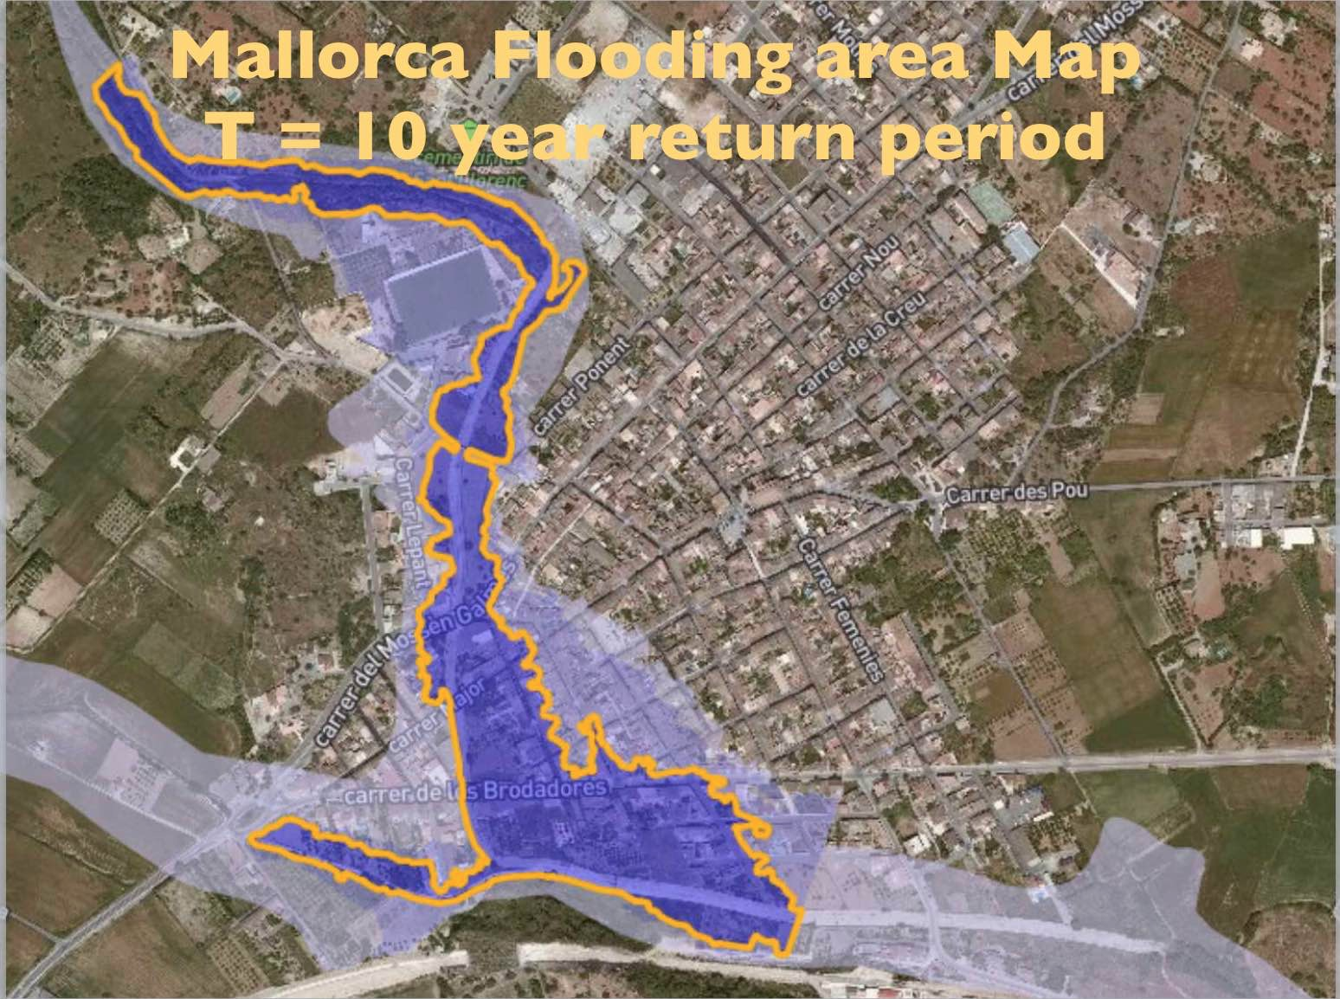
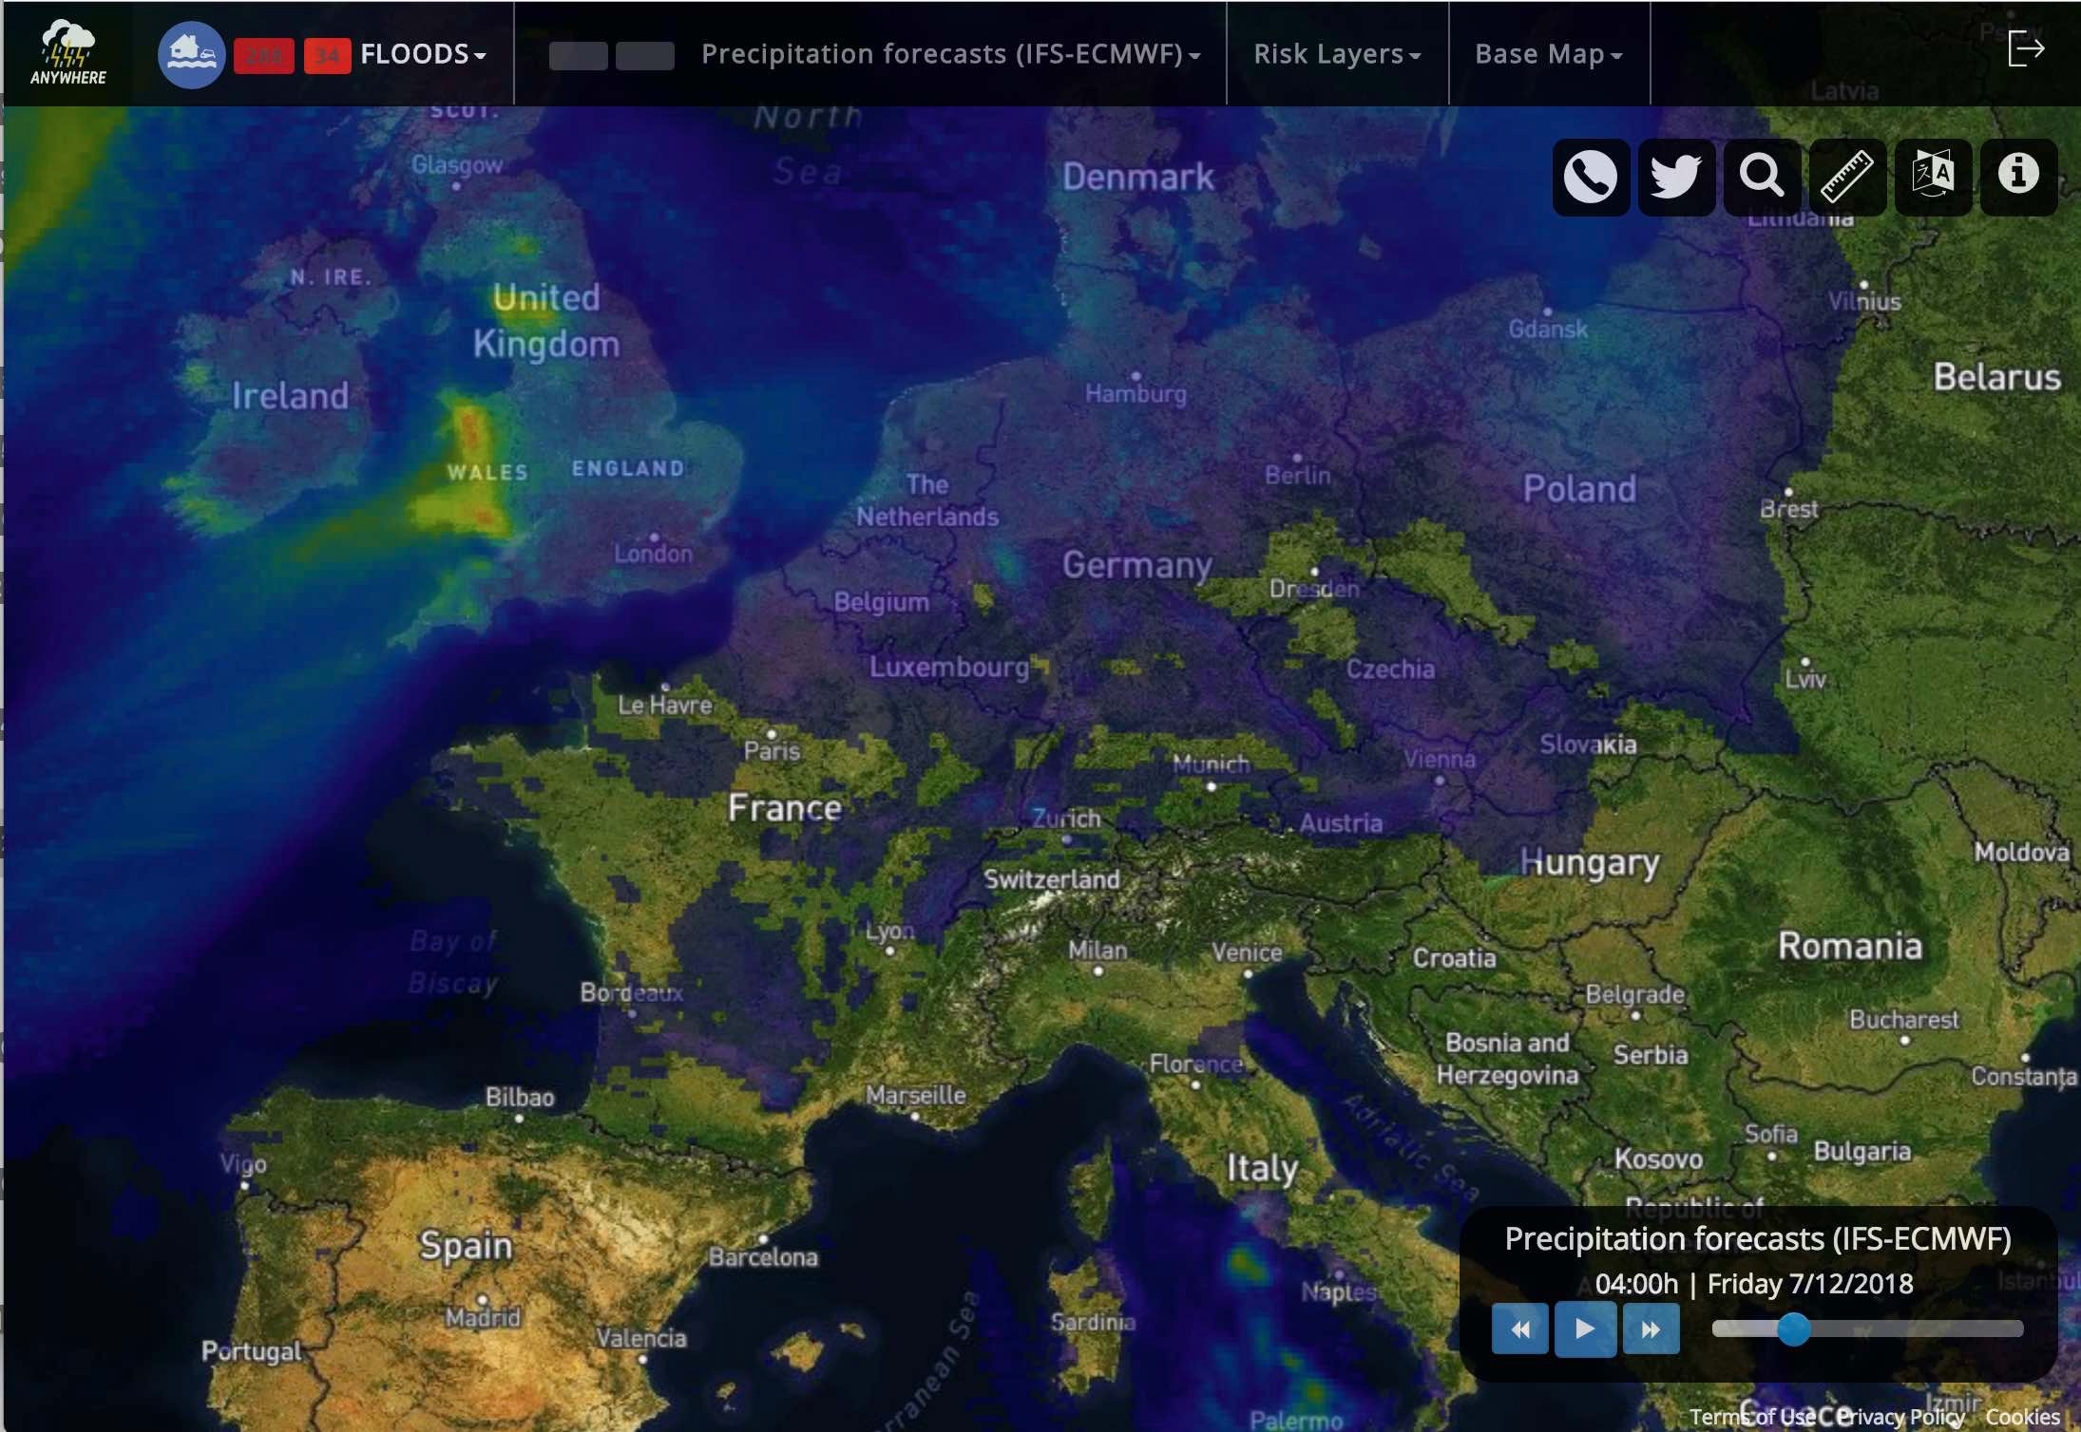
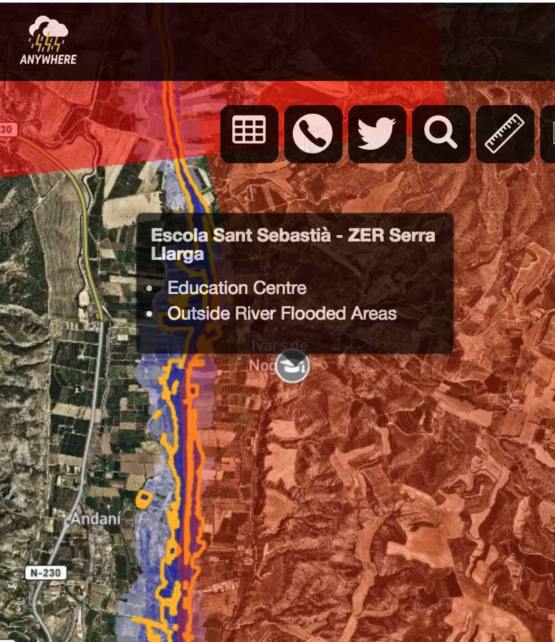
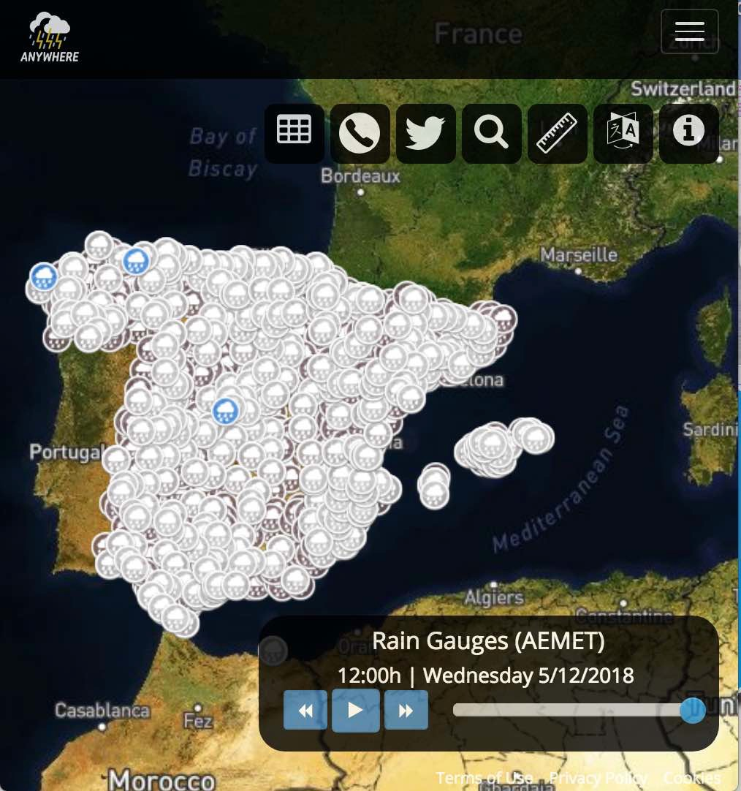
ANYWHERE A4EU capabilities
112 Calls
112 calls and crowdsourcing
Integrate IMPACT FORECASTS with local layers to SUPPORT DECISION MAKING in EMERGENCY COMMAND CENTRES
Last 30 min
(30, 60] min ago
(60, 90] min ago
EU Flood Directive Risk Maps
Automatic activation
of critical points
Local sensors
Meteorological
Forecasting

Slide 18
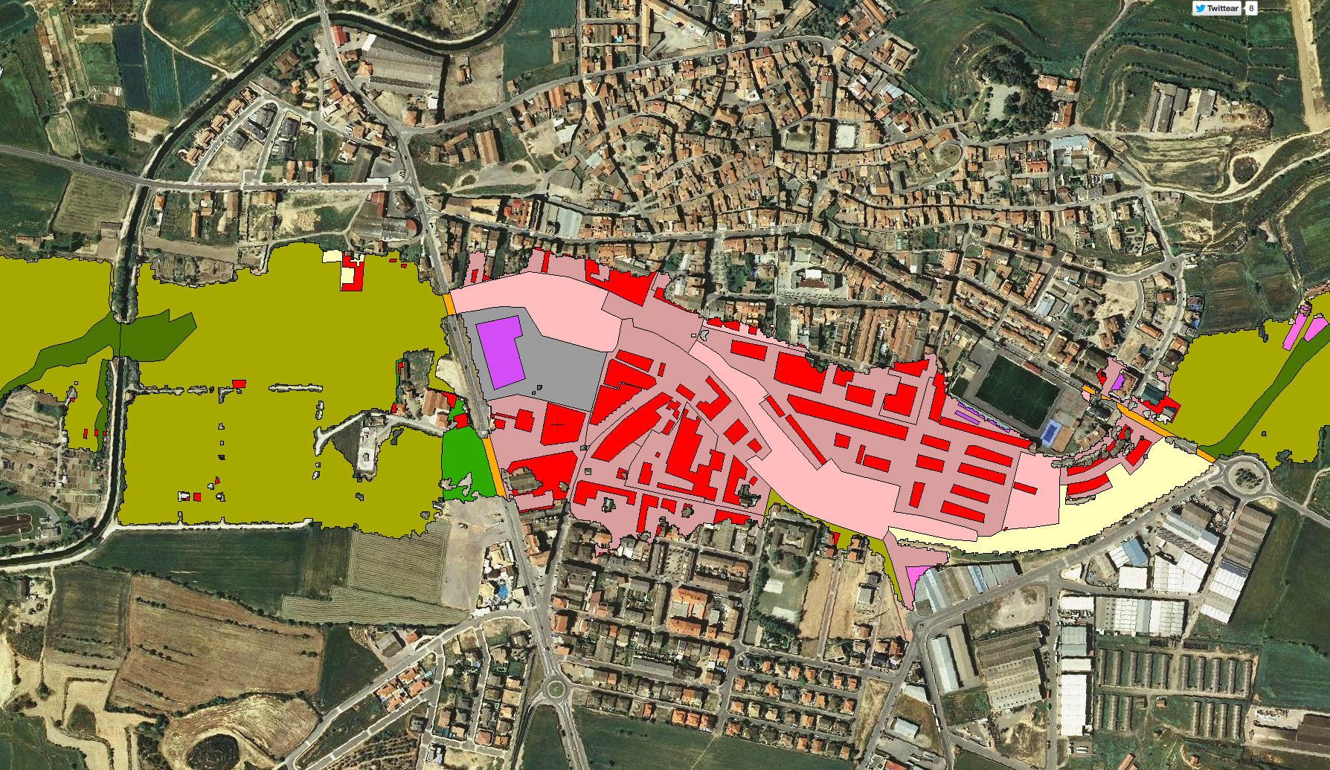
ANYWHERE A4EU capabilities
112 Calls
112 calls and crowdsourcing
Integrate IMPACT FORECASTS with local layers to SUPPORT DECISION MAKING in EMERGENCY COMMAND CENTRES
Last 30 min
(30, 60] min ago
(60, 90] min ago
EU Flood Directive Risk Maps
Vulnerability Maps
Automatic activation
of critical points
Local sensors

Slide 19
ANYWHERE A4EU capabilities
Integrate IMPACT FORECASTS with local layers to SUPPORT DECISION MAKING in EMERGENCY COMMAND CENTRES
Vulnerability Maps
From EU scale to BUILDING scale
KEY TOOL For Flood Risk Management Plans in the EU FLOOD DIRECTIVE
Meteorological
Forecasting

Slide 20

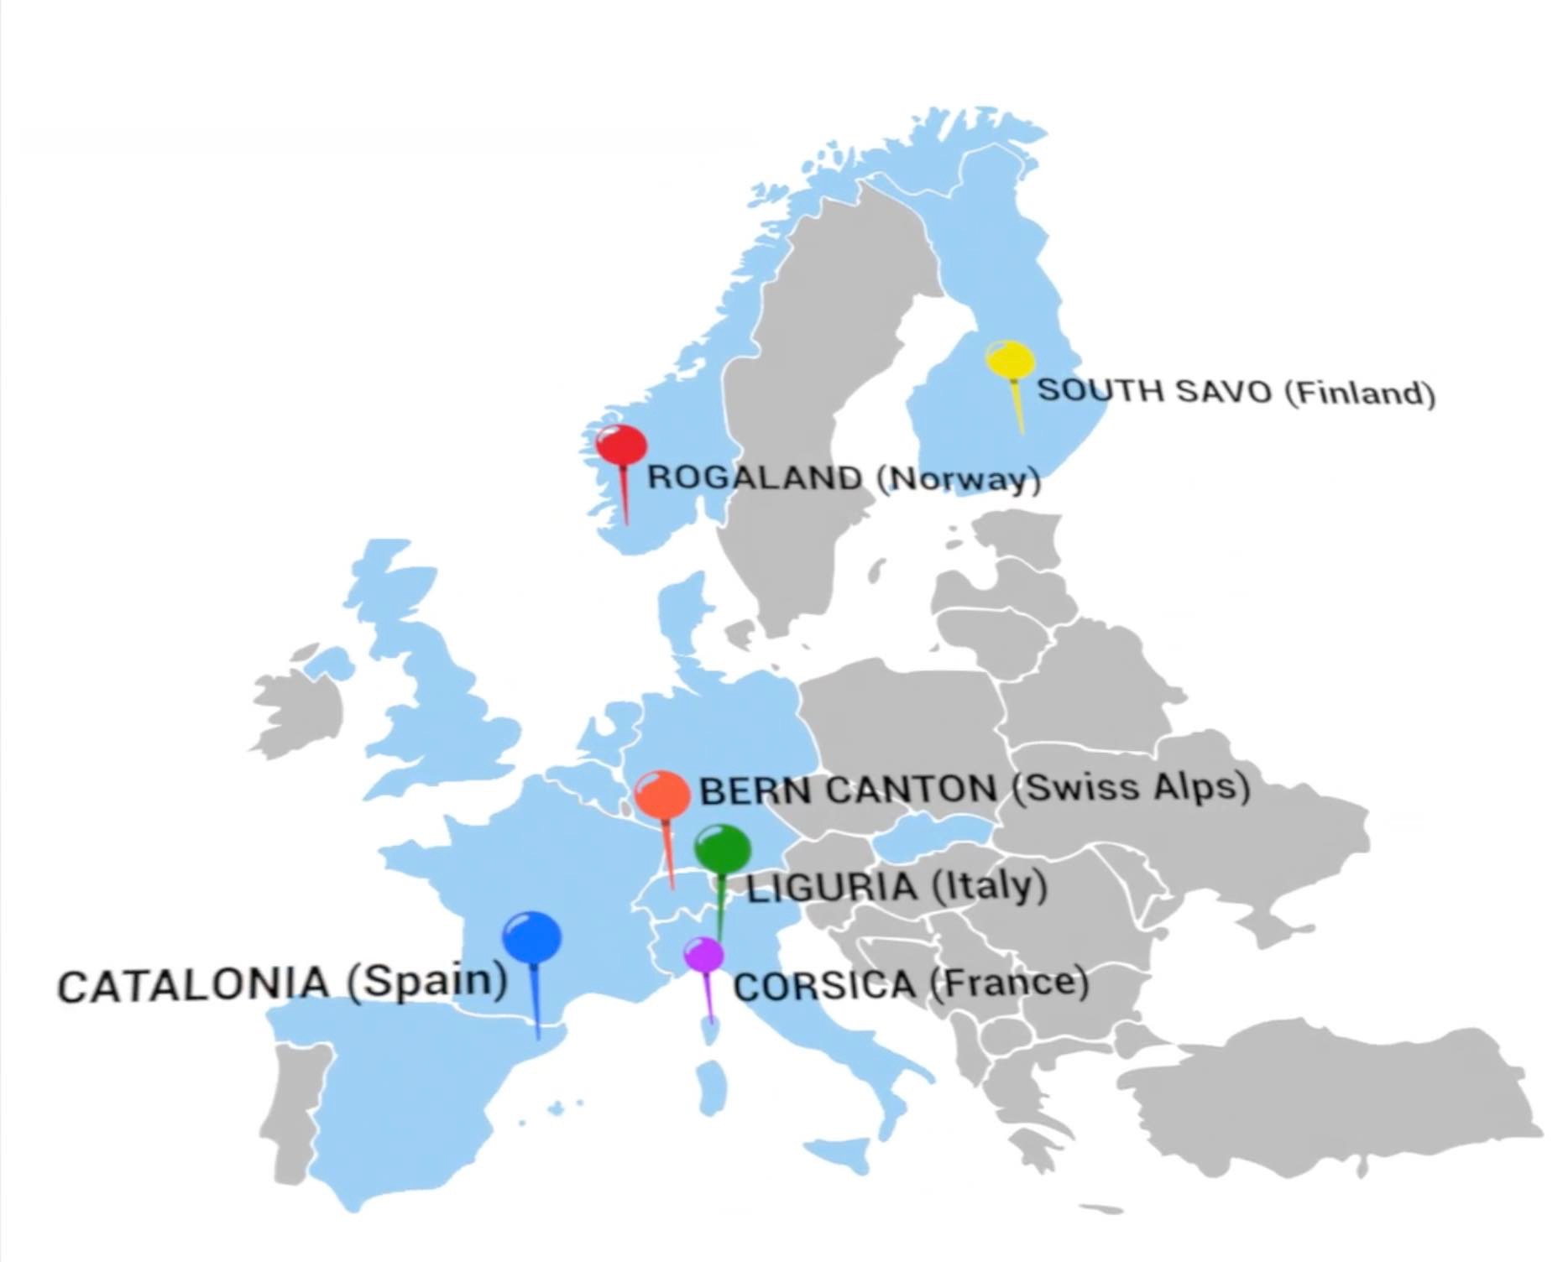
7 Pilot Sites: Operational Demonstrations
OPERATIONAL from
OCTOBER 2018
SPAIN (national)
(but also can be implemented ANYWHERE in EUROPE…)

Slide 21
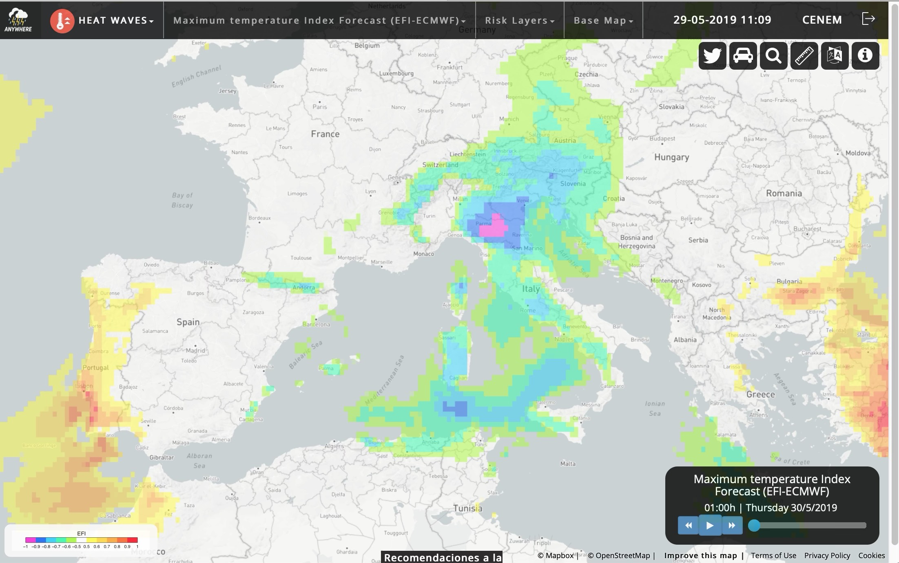

A4U
ANYCaRE
Serious Game
Get your OWN customised SERVICE
Hands-on demonstration and final workshop on
29-30 October 2019 in Brussels
www.anywhere-h2020.eu

