Slide 1


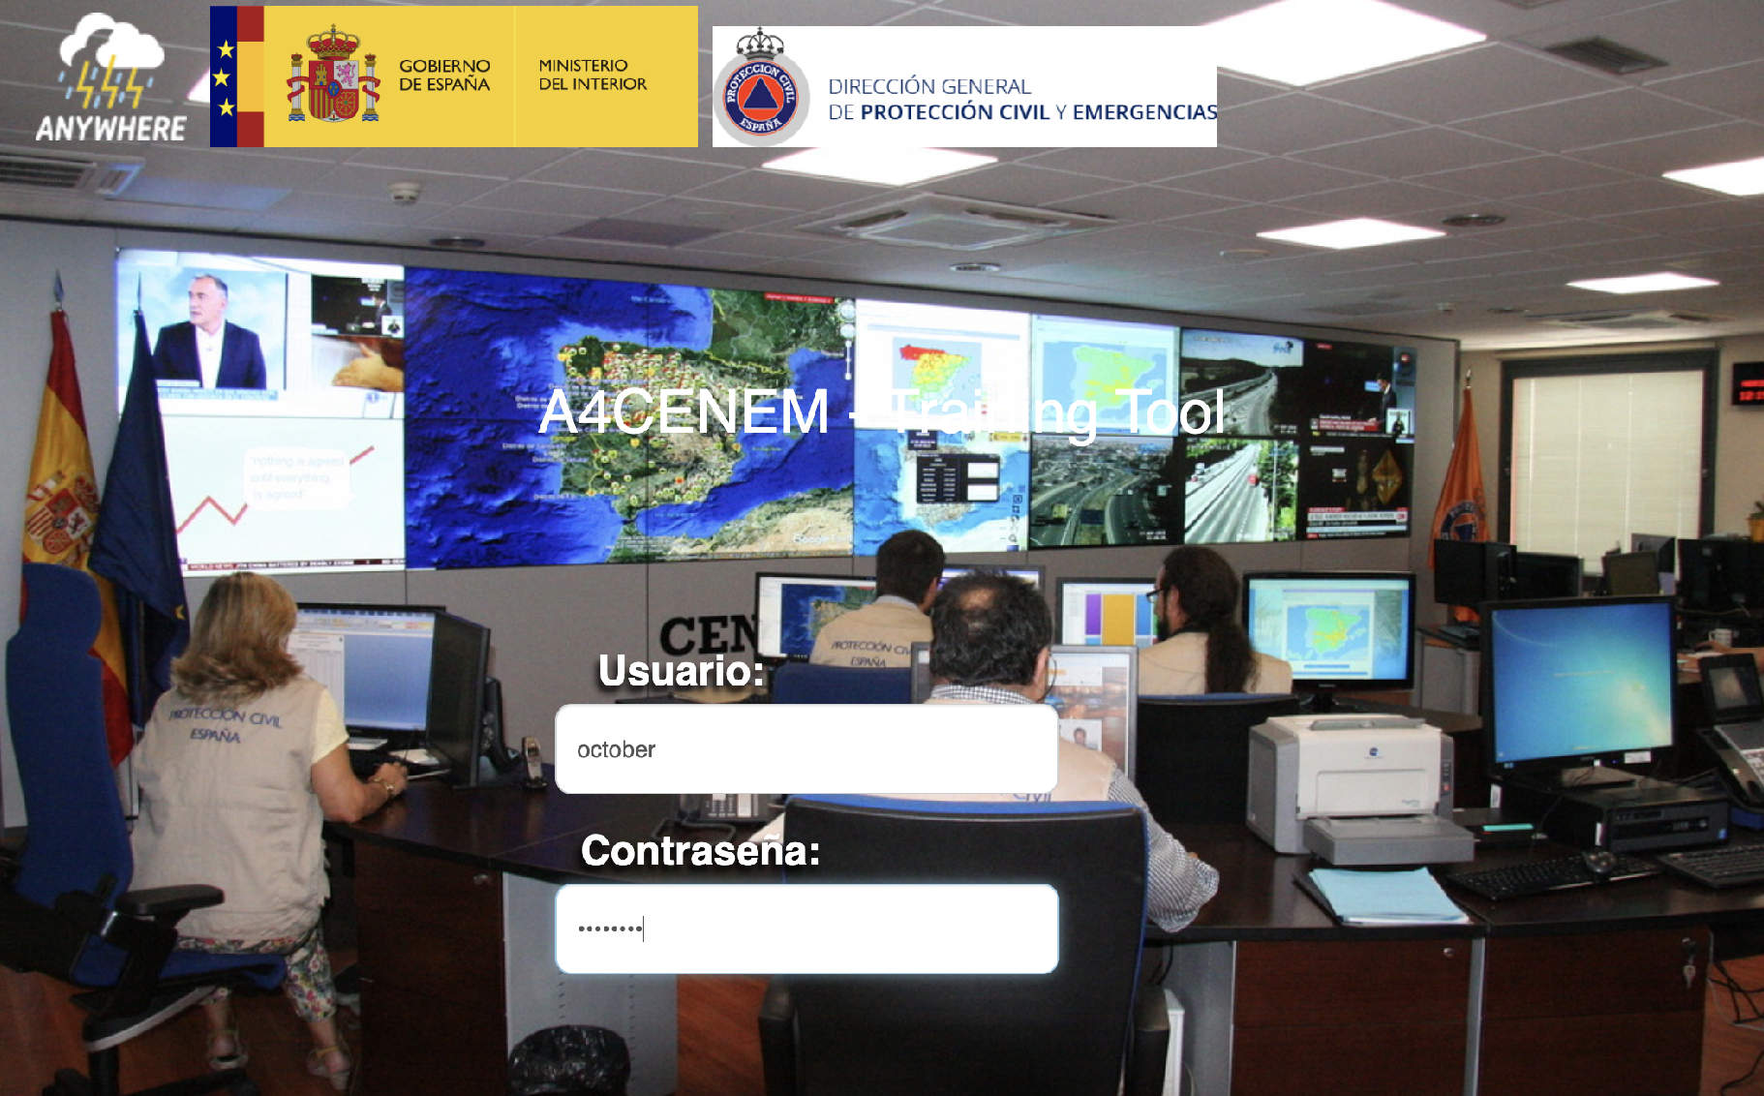
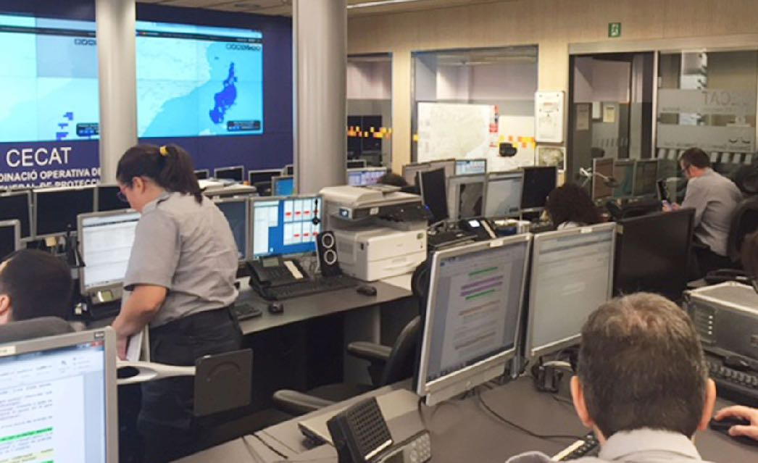
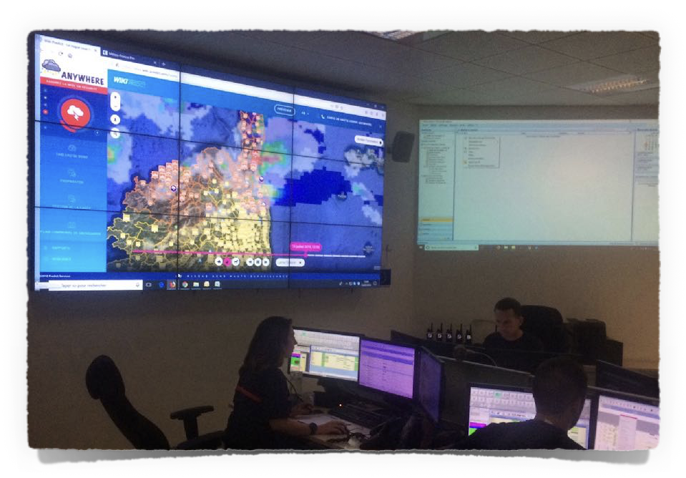
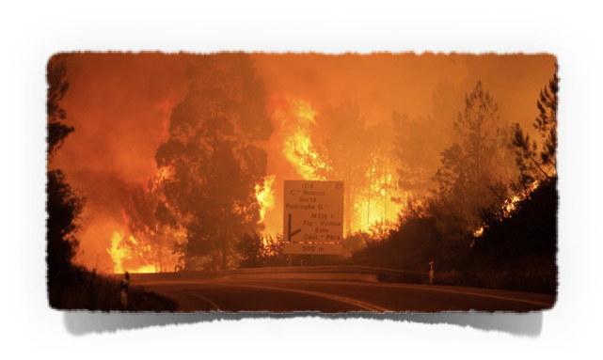
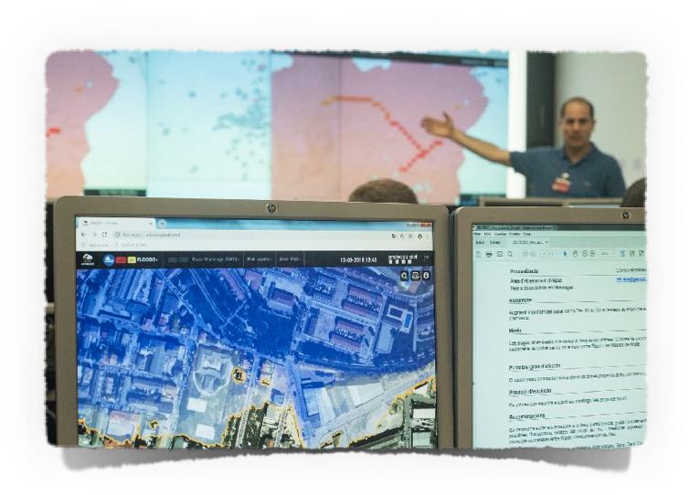
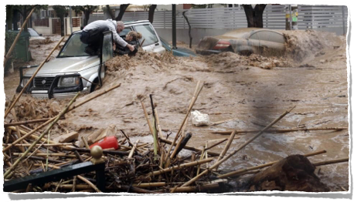
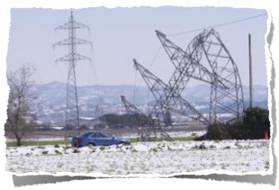
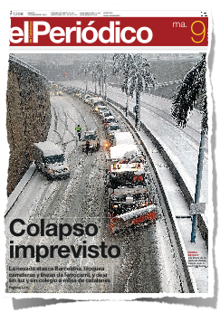

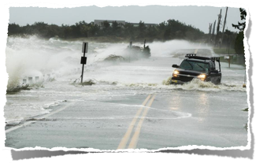


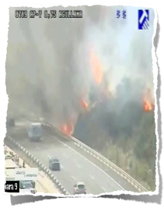
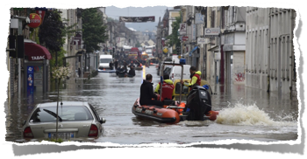
Paradigm change in Climate DRM
www.anywhere-h2020.eu
ANYWHERE Multi-Hazard Impact-based EWS: a change of paradigm in climate risk management
Prof. Daniel Sempere-Torres
sempere@crahi.upc.edu
UPC-CRAHI - Barcelona

Slide 2


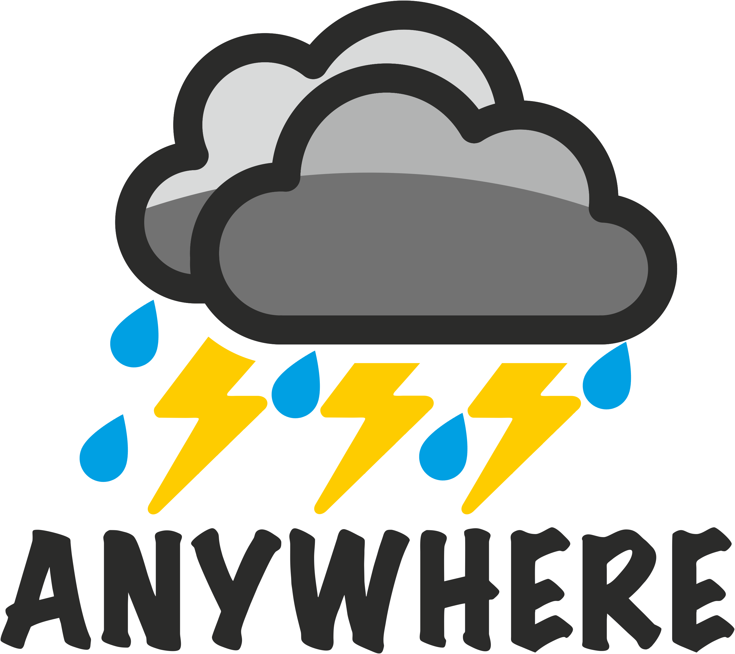
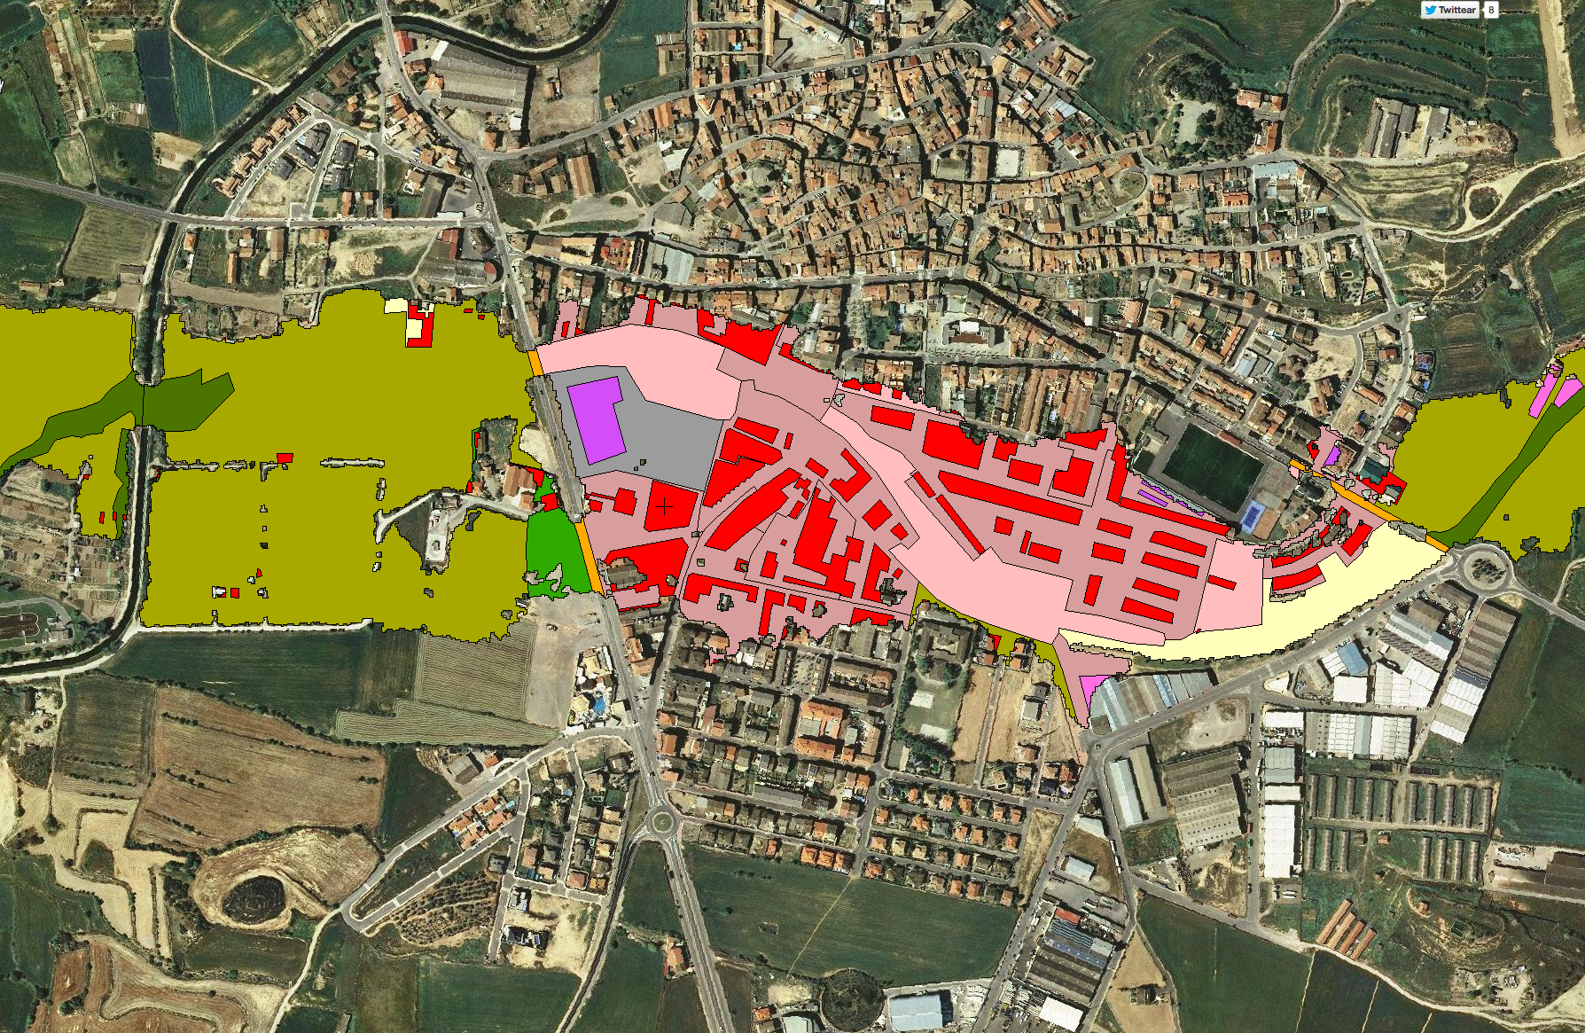
IMPACT-based EWS
MR-IEWS
Massive Adoption
Multi-Risk Impact-based Early Warnings (MR-IEWS)
Warnings using Ensemble forecasting and user agreed thresholds (EFAS…)
Weather warnings using
multi-dimensional thresholds
Impact-based Multi-Hazards Early Warnings (I-b MH-EWS)
Weather warnings with user agreed thresholds
Weather warnings based on arbitrary fixed thresholds
Includes Risk Maps
General Weather Forecast
1960s
1970s
1980s
1990s
2000s
2010s
2020s
2030

Slide 3
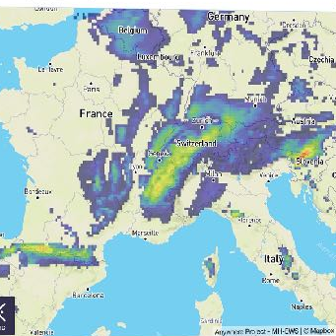
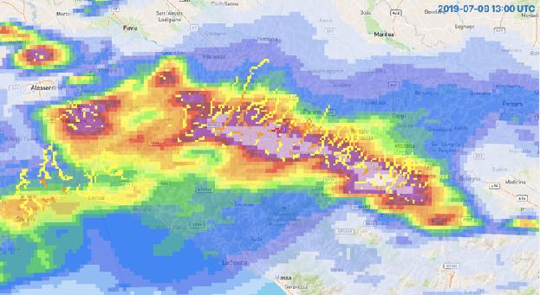
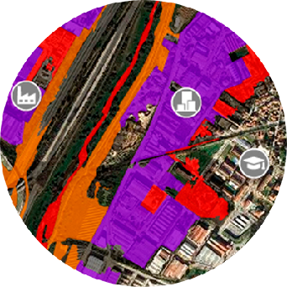
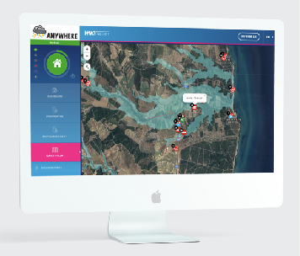
Paradigm change in Climate DRM
www.anywhere-h2020.eu
“EWSs are only as good as the actions they catalyse:
action is an essential part of any warning system. If a warning is sounded, and no one takes the action that the warning was intended to trigger, then the warning system failed.” (IFRC, 2012)
A4EU
Meteorological forecasts
Impact forecasts
Actionable decisions
Operational services
How to trigger actionable solutions at local level
using MULTI-RISK IMPACT BASED EARLY WARNING SYSTEMS
is the key challenge

Slide 4
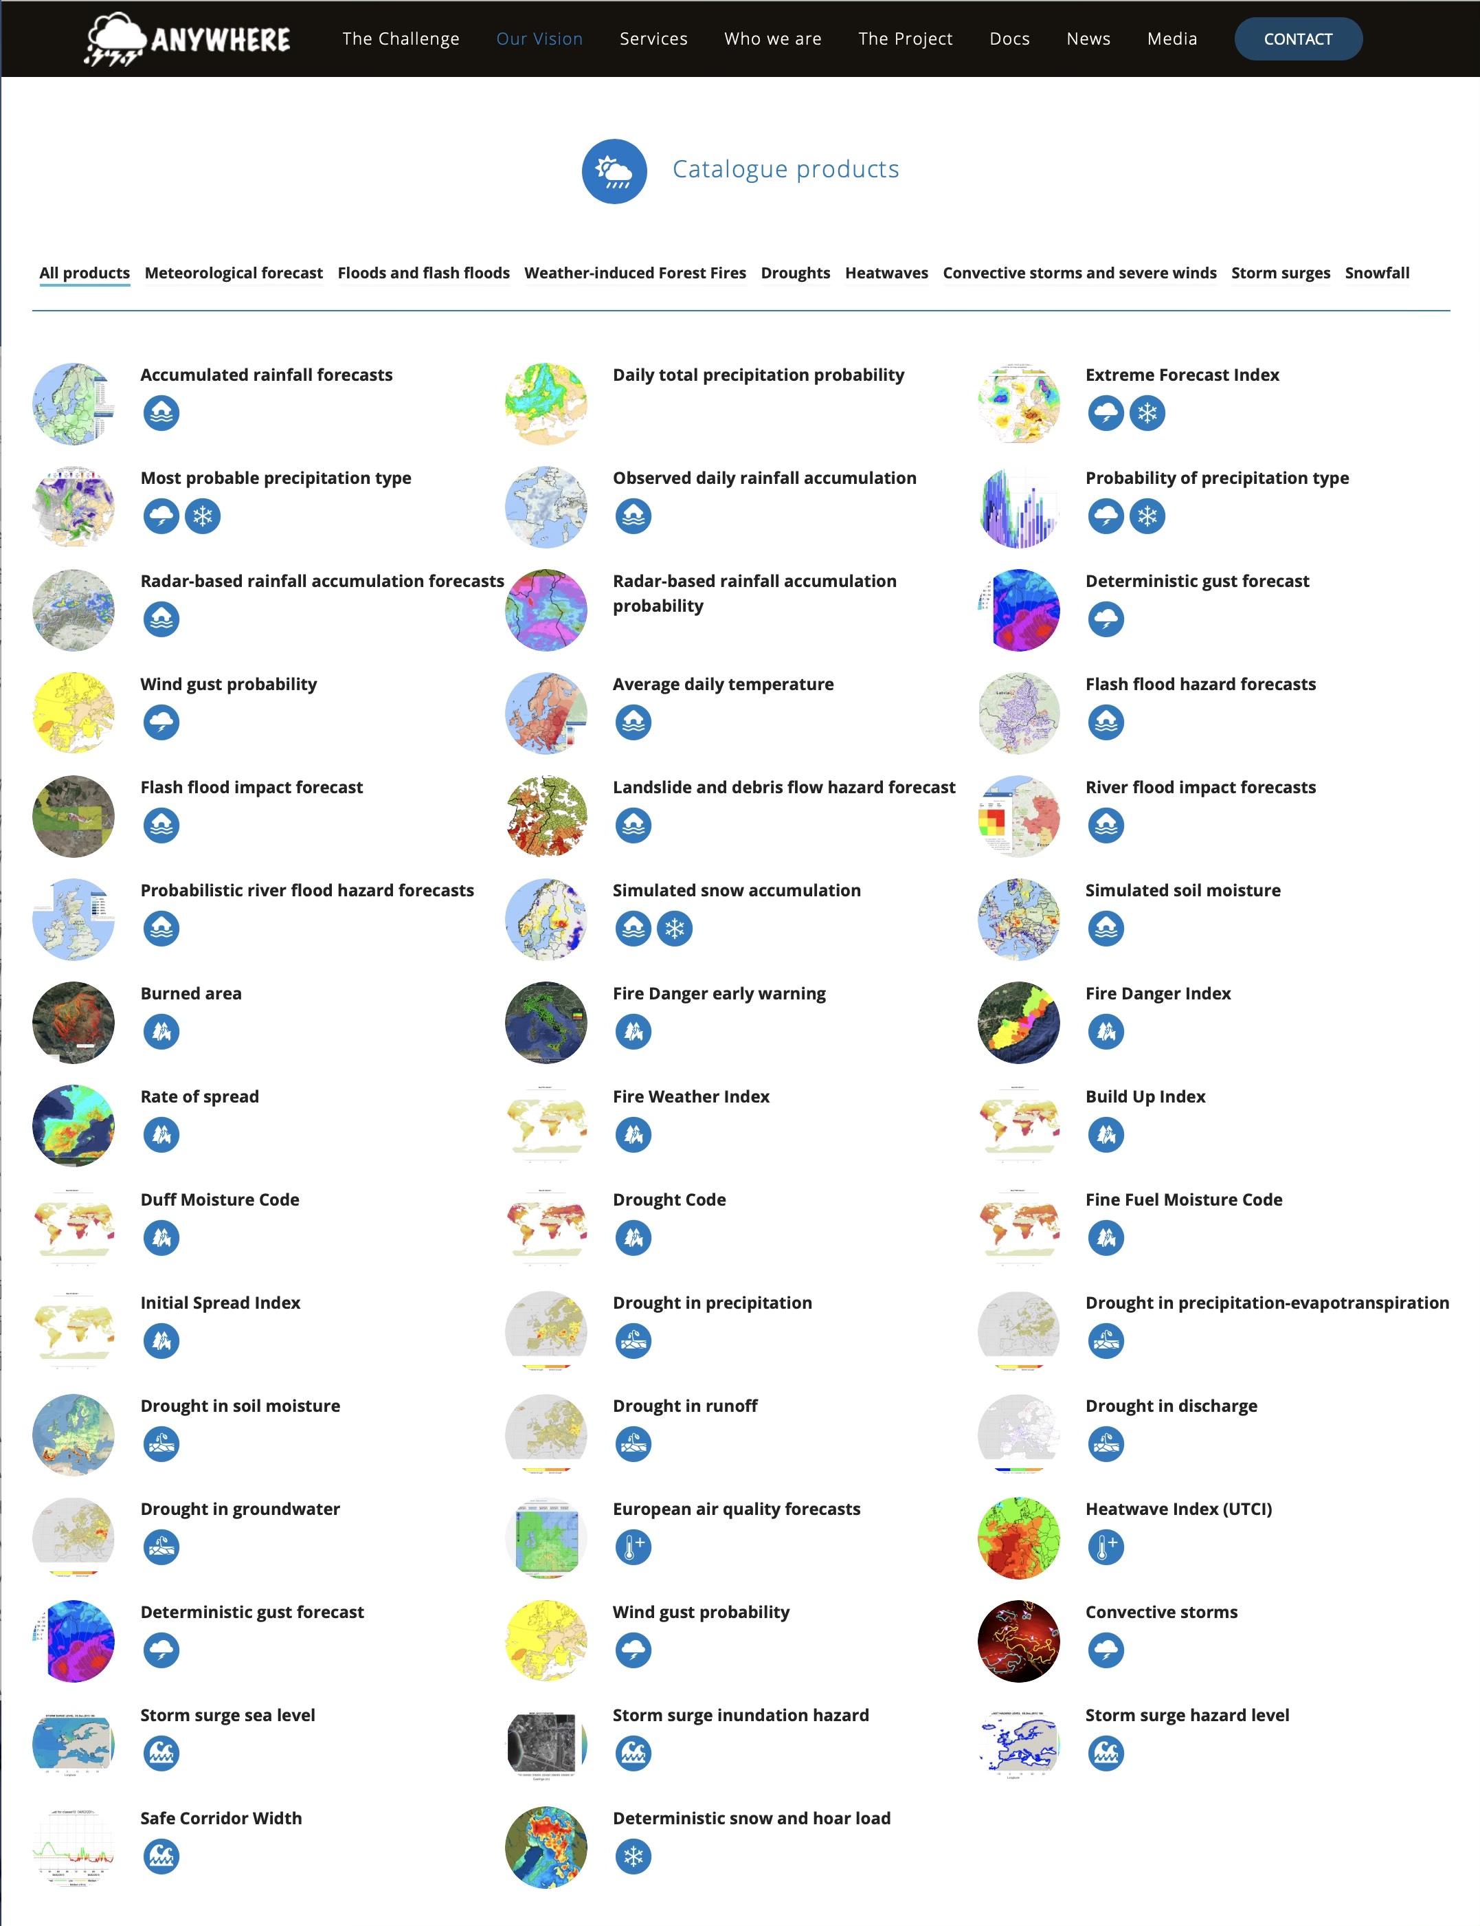
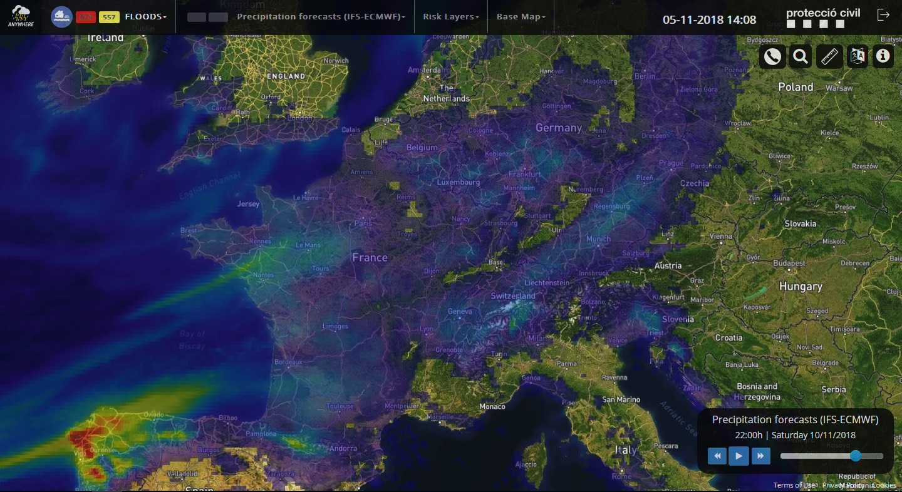
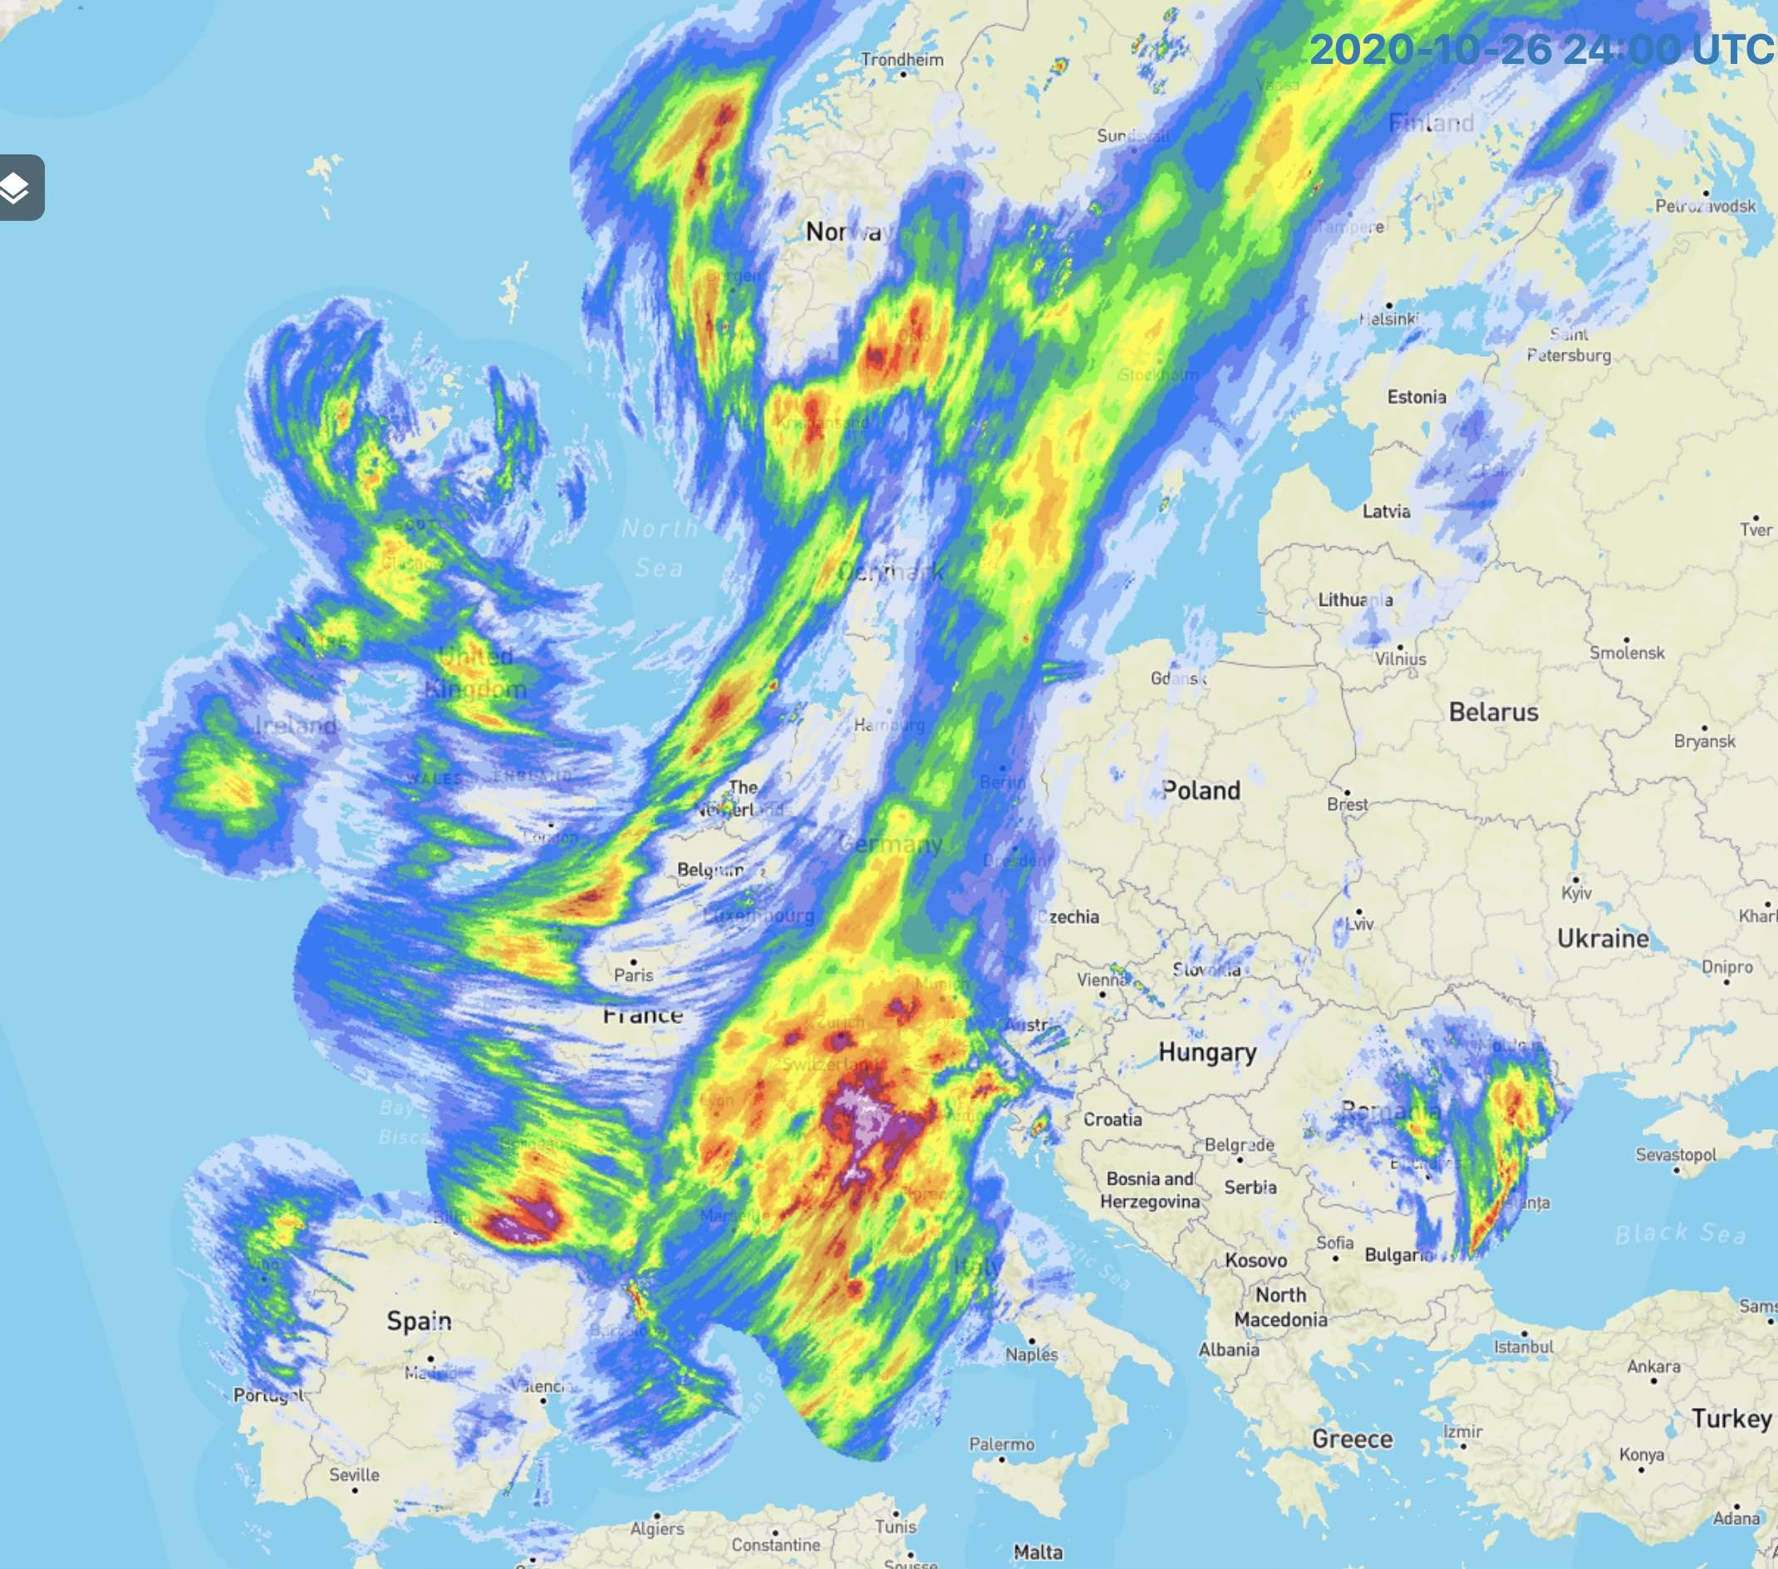
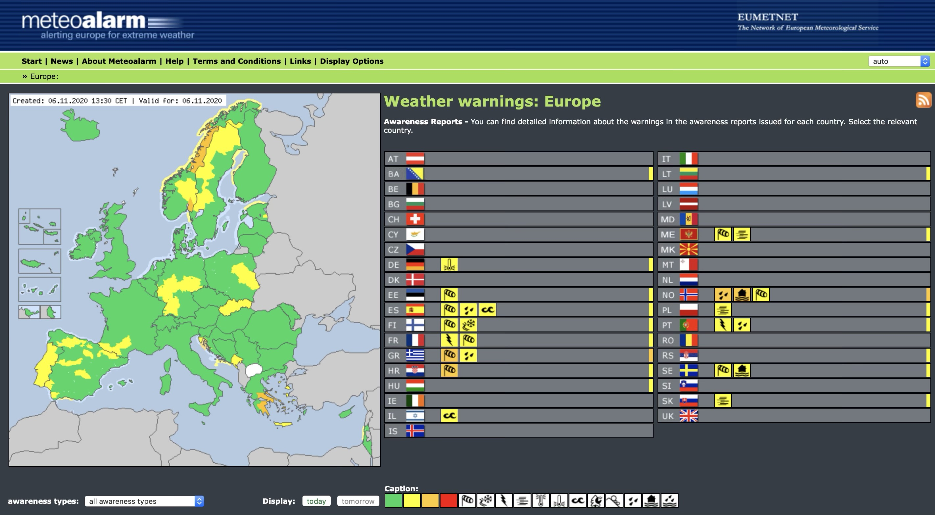
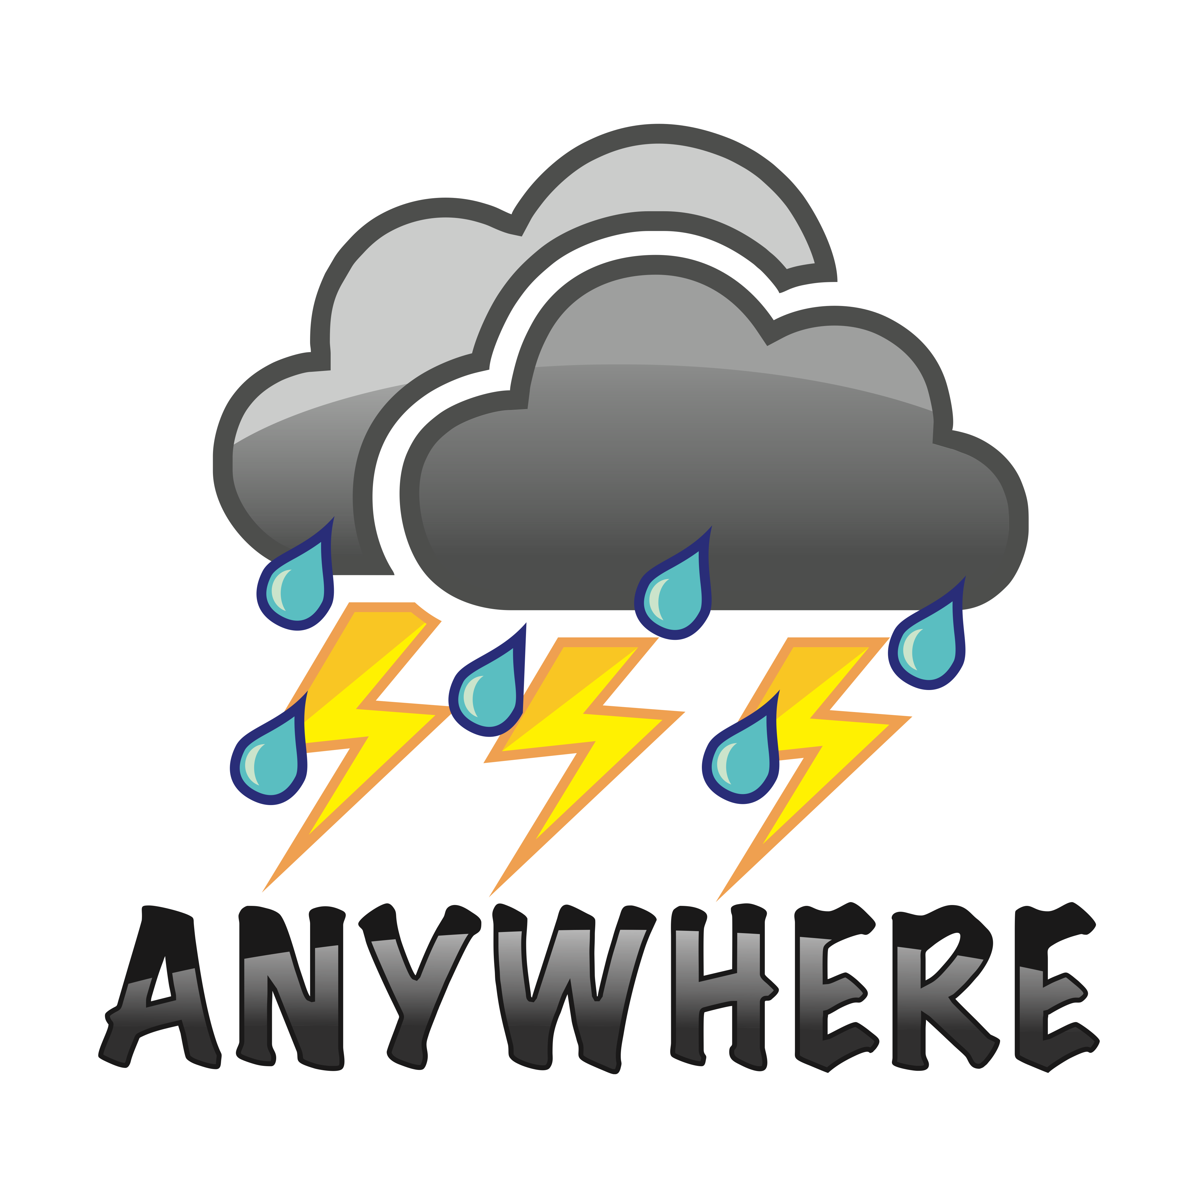
Paradigm change in Climate DRM
ANYWHERE: Multi-Hazard Impact based Early Warning Systems for regional/local DRM plans
IMPACT BASED FORECASTS
METEOROLOGICAL FORECASTS
ECMWF NWP
models
OPERA Radars
ANYWHERE Multi-Hazard EWS
MH-IEWS products
METEOALARM warnings
EUMETNET / NHMS
www.anywhere-h2020.eu/catalogue

Slide 5

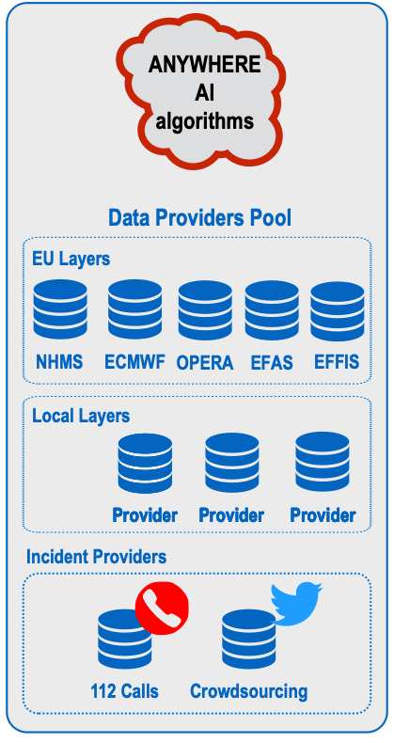

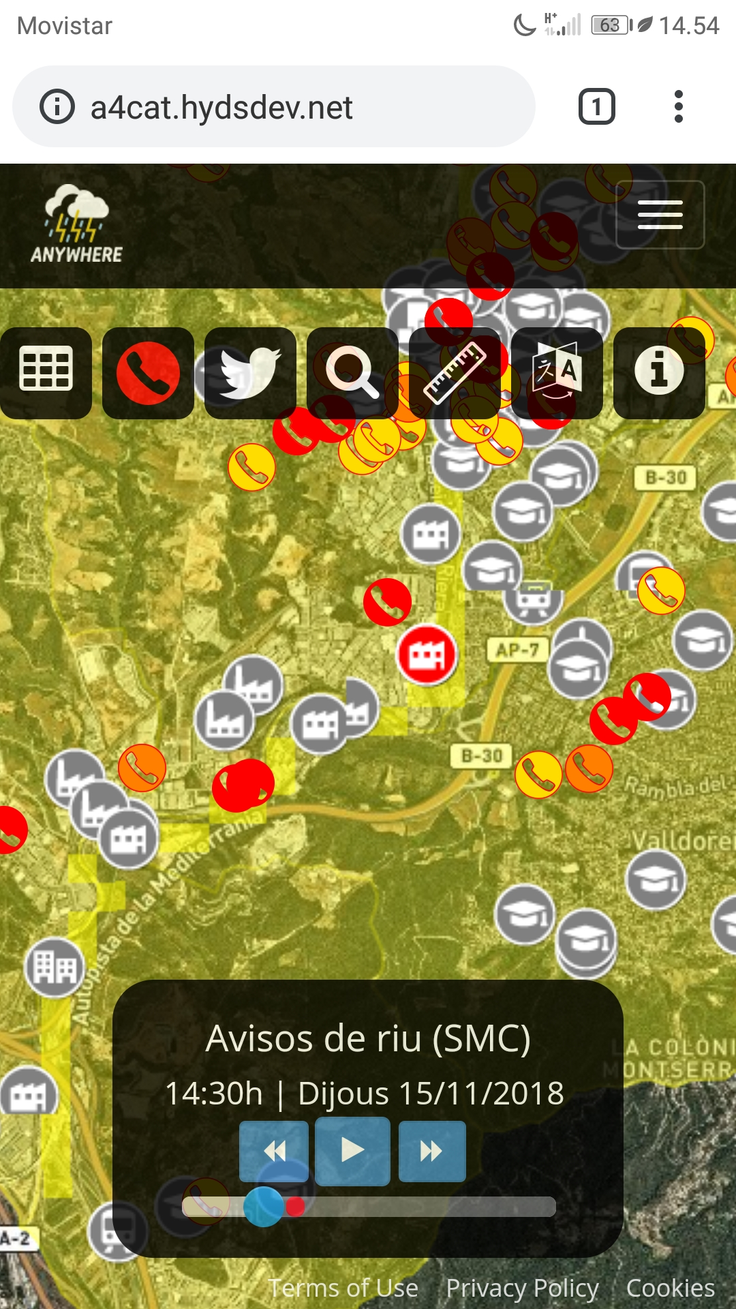

Paradigm change in Climate DRM
ANYWHERE FOR EU (A4EU): MULTI-HAZARD EARLY WARNING AND DECISION SUPPORT SYSTEM
Multi-Hazard
Impact forecasting EWS
Impact forecasting Products
Webcams
112 calls
Crowdsourcing
A4EU
DSS Platform
Traffic information
Local sensors
A4EU
Vulnerability maps
Risk maps
Priority points
Self-protection plans
EMERGENCY MANAGEMENT
Support
www.anywhere-h2020.eu/catalogue

Slide 6
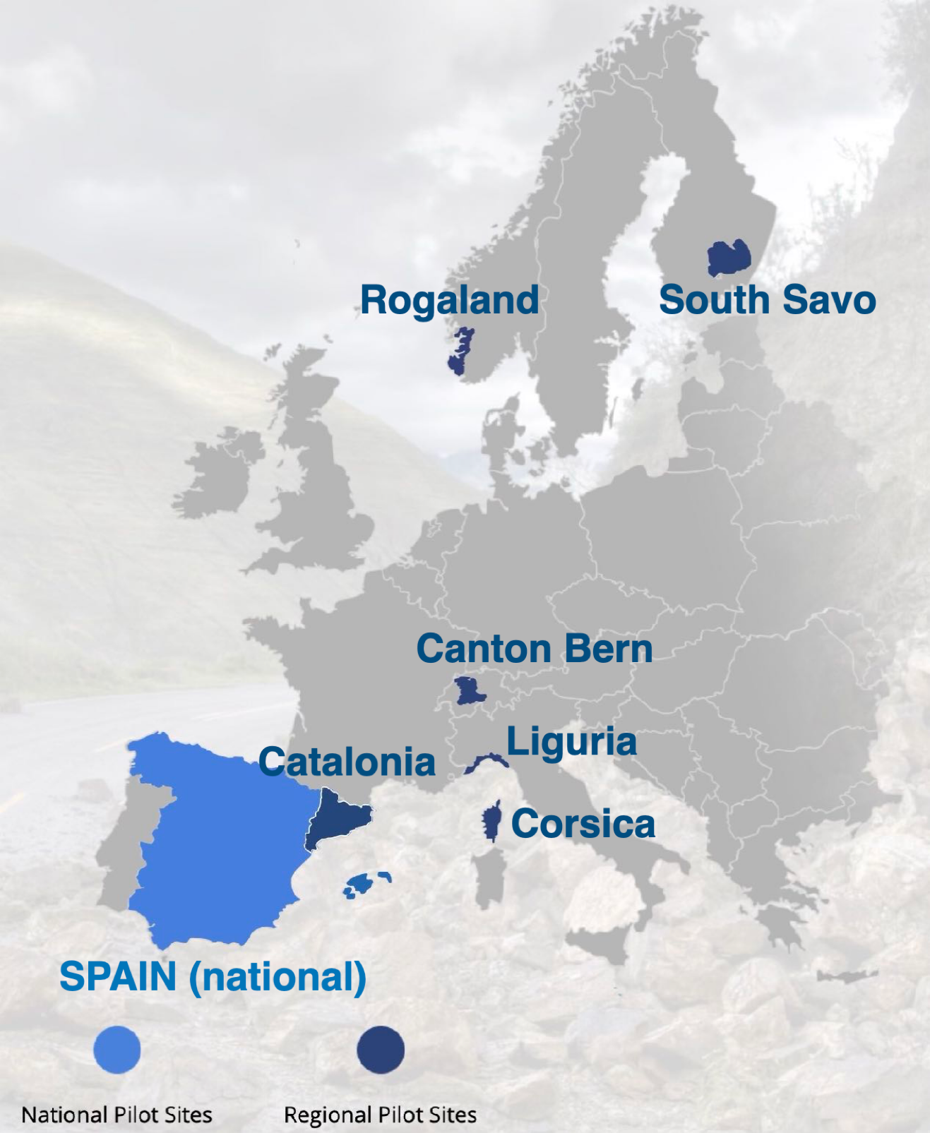

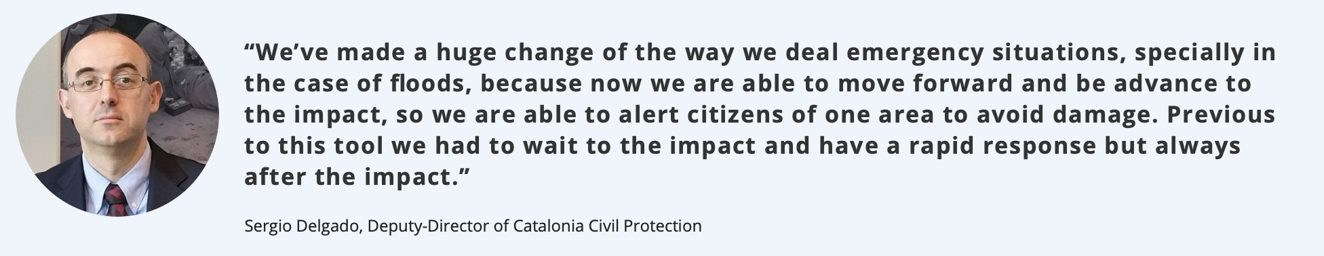
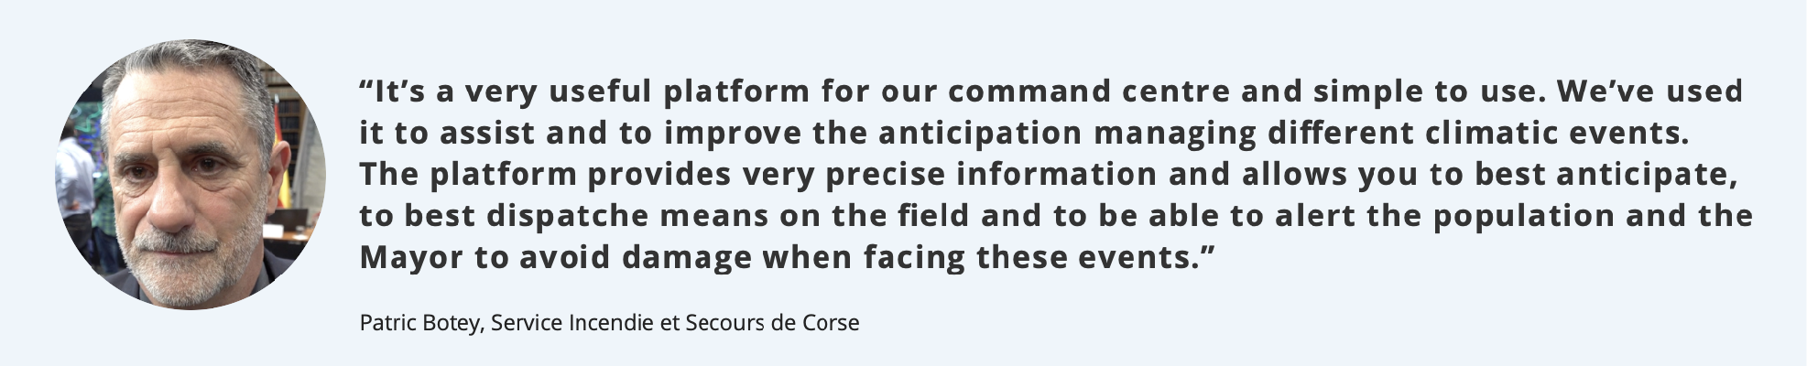

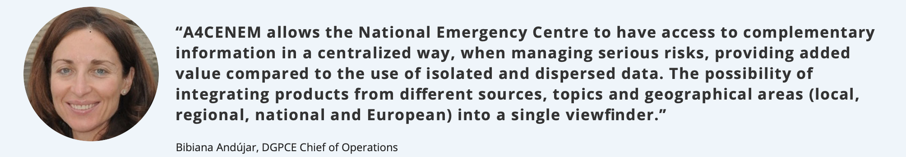
Excellent results during experienced emergencies
Catalonia
Corsica
Finland
Spain
Some of them
> 50 years return-period
(can be implemented ANYWHERE in EUROPE… and beyond)

Slide 7
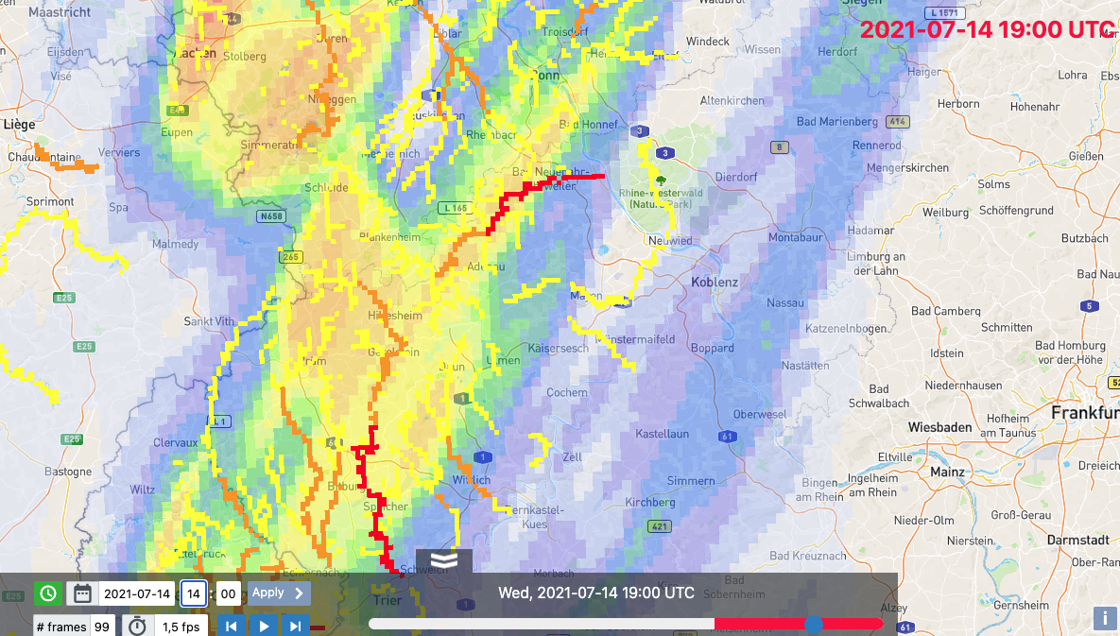
Flash Flood impact indicator over the Ahr river on
14 July 2021 at 21:00 CEST (19:00 UTC)
Nowcasted at 16:00 CEST (14:00 UTC)
Nowcasts lead time: 5 h
Ahr river

Slide 8
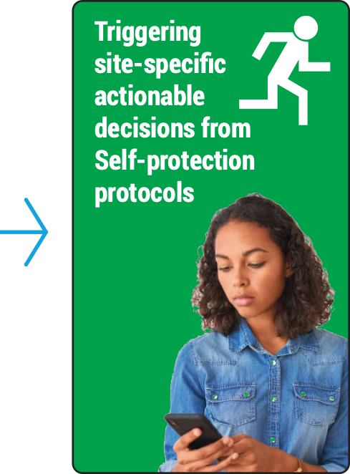




Paradigm change in Climate DRM
How to engage people living in risk areas?
How to make them aware?
How to make them react when unprecedented climate events can happen in few hours? (or few quarters…)
Flash Flood impact indicator over the Ahr river on
14 July 2021 at 21:00 CEST (19:00 UTC)
Nowcasted at 16:00 CEST (14:00 UTC), 5h in advance
Ahr river
          Warning levels based on Site-Specific impacts
          Self-protection protocols
We have the technology!
Do you want to implement it?
          Site-specific warning messages
          Use of Cell broadcast + Social Media

Slide 9
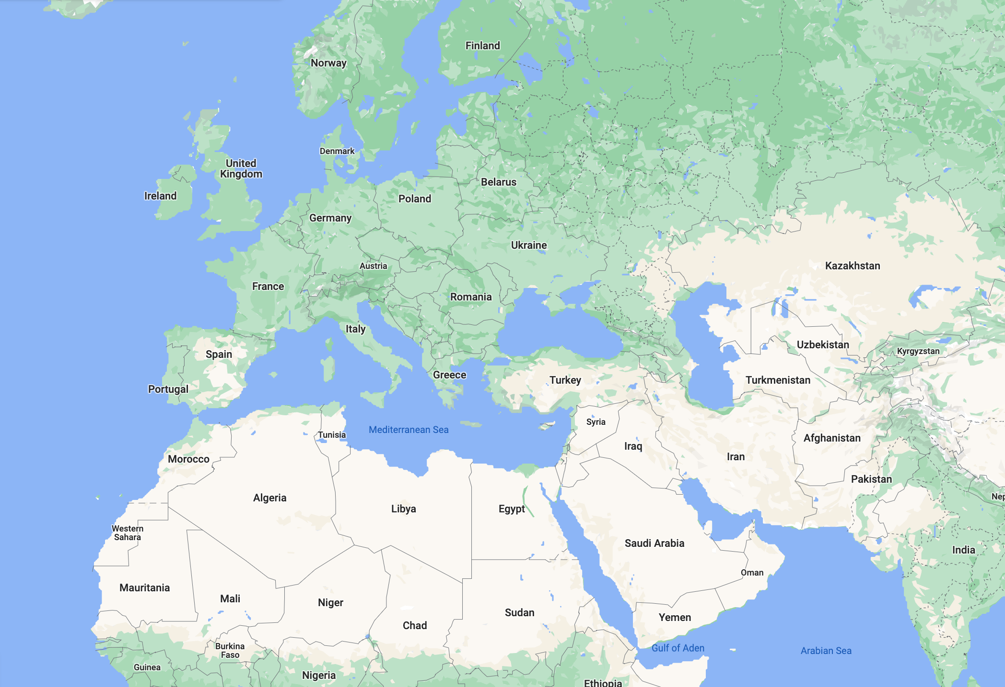















From ANYWHERE to ARGOS:
Commercial HYDS services based on the ANYWHERE exploitable results (www.hyds.es/argos/)
Met Éireann
Terrassa
RAN Backbone
17 Camp sites
Roquetas de Mar
34 Municipalities
Terrassa
Badalona

