Slide 1

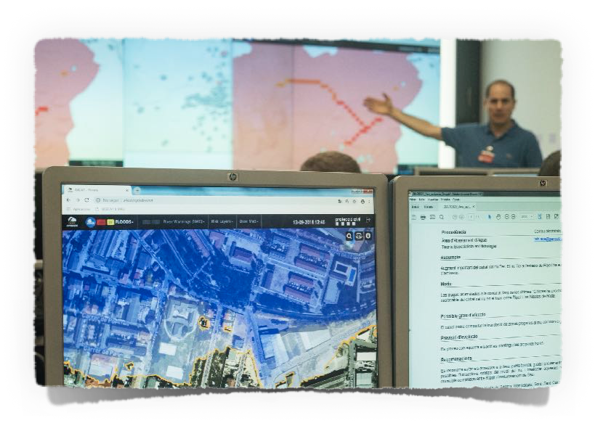

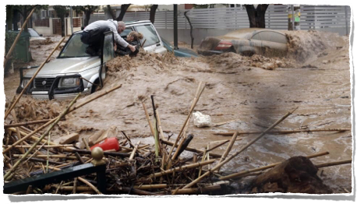
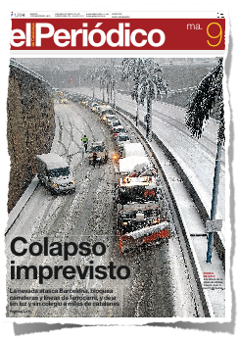
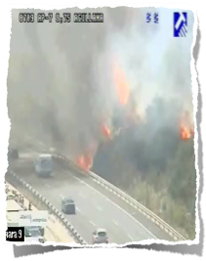

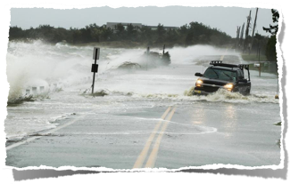
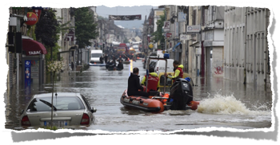
www.anywhere-h2020.eu
Climatic emergencies:
operational decision support tools for emergency management centres

Slide 2
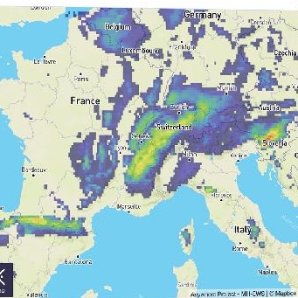
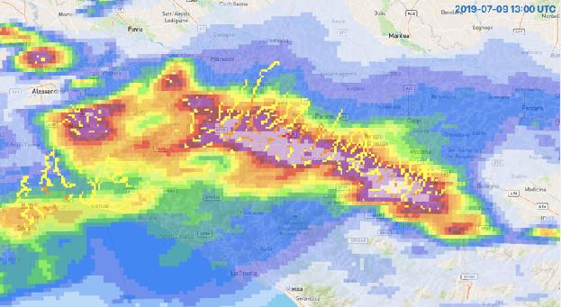
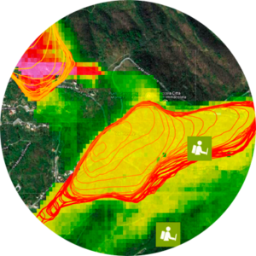
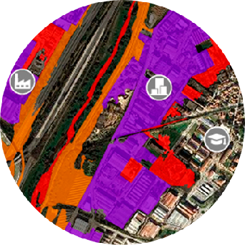
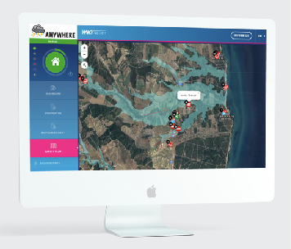


The ANYWHERE approach based on impact forecasting
represents a disruptive innovation in the field of the
climatic emergencies operational management
Meteorological forecasts
Hazard forecasts
Impact forecasts
Actionable decisions
Operational solutions
www.anywhere-h2020.eu

Slide 3
Challenges to Goals
CHANGE OF PARADIGM:
From RE-ACTIVE to
PRO-ACTIVE RESPONSE
Advanced detection and response
Connect them to the local needs to SUPPORT DECISION MAKING in EMERGENCY COMMAND CENTRES
Translate best adapted METEOROLOGICAL FORECASTS into IMPACT FORECASTS

Slide 4
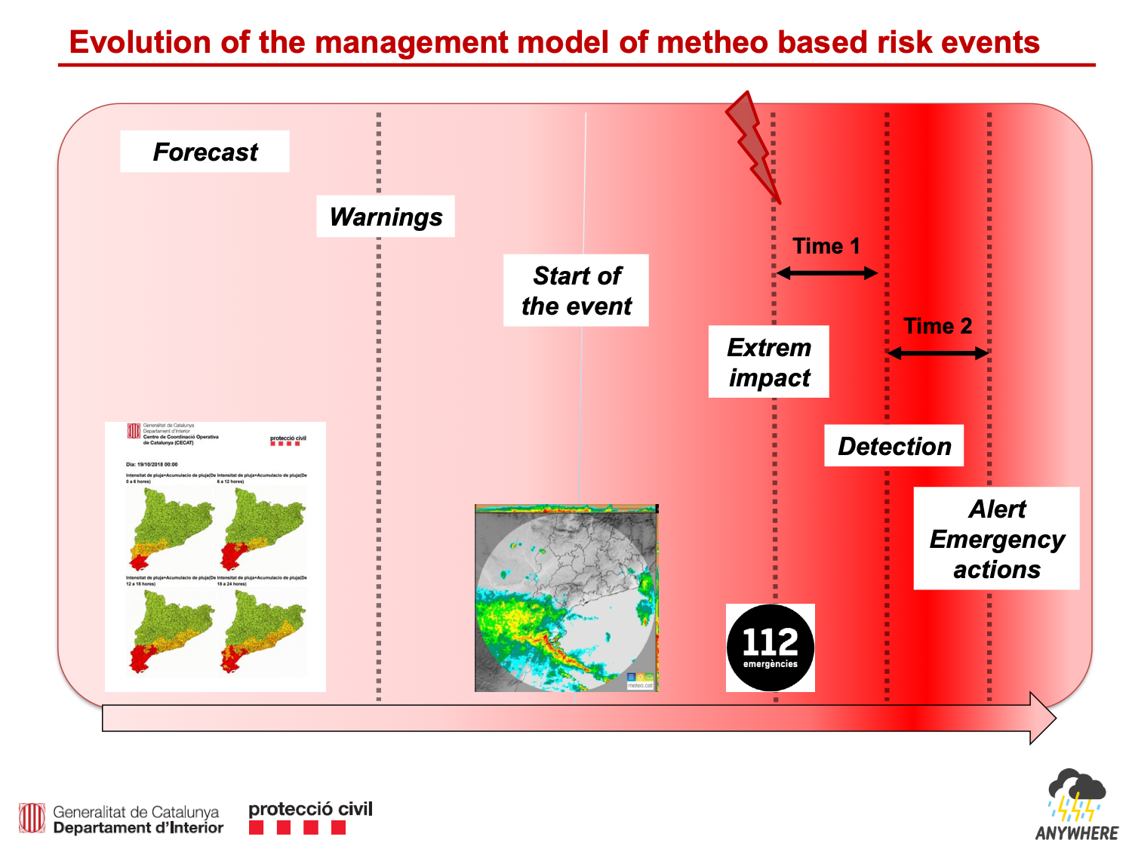
Evolution of the management model of weather and climatic emergencies
Courtesy of Sergio Delgado

Slide 5
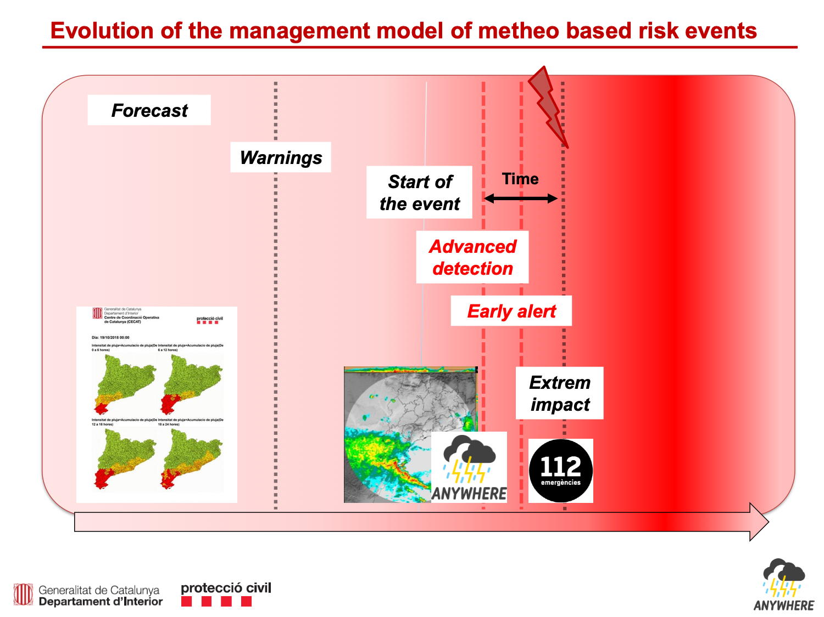
Evolution of the management model of weather and climatic emergencies
Courtesy of Sergio Delgado

Slide 6

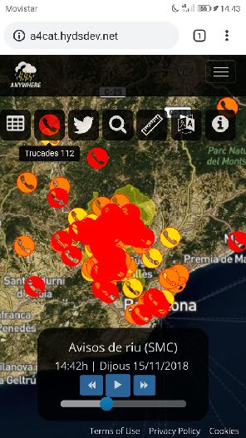



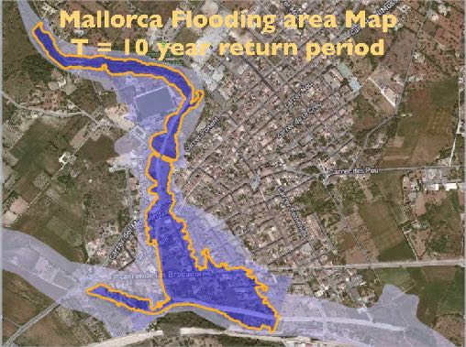
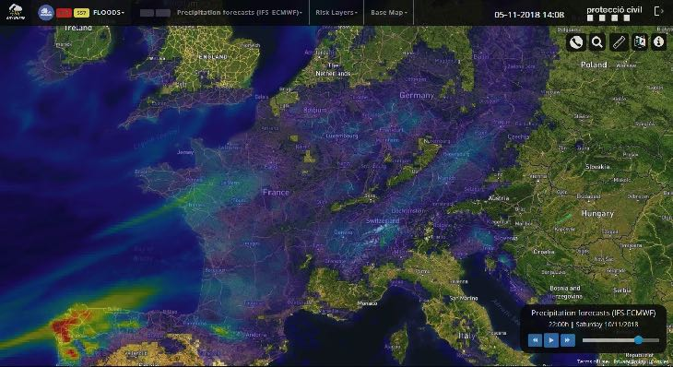
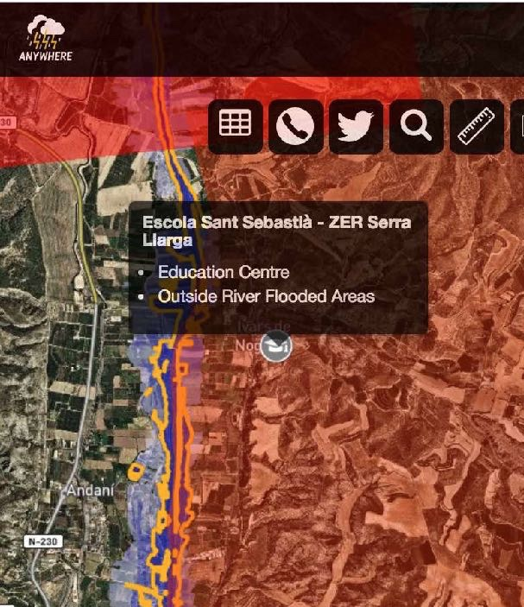
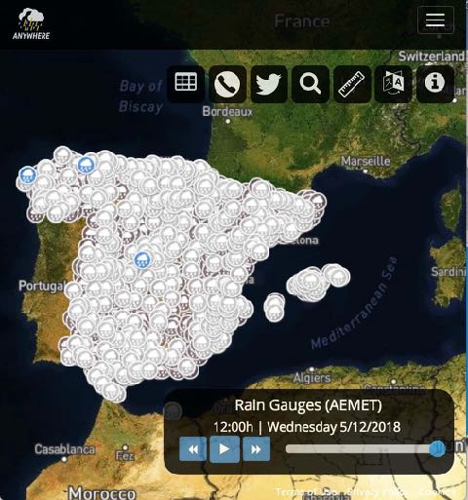
ANYWHERE A4EU capabilities
112 Calls
112 calls and crowdsourcing
Integrate IMPACT FORECASTS with local layers to SUPPORT DECISION MAKING in EMERGENCY COMMAND CENTRES
Last 30 min
(30, 60] min ago
(60, 90] min ago
EU Flood Directive Risk Maps
Automatic activation
of critical points
Local sensors
Meteorological
Forecasting

Slide 7
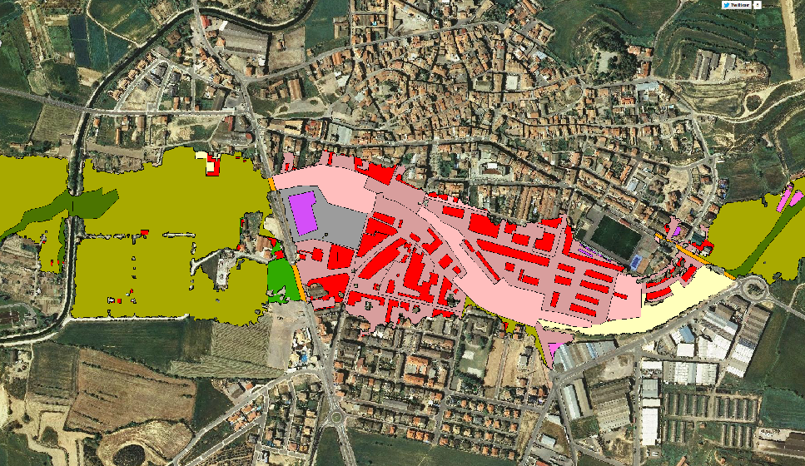
ANYWHERE A4EU capabilities
Integrate IMPACT FORECASTS with local layers to SUPPORT DECISION MAKING in EMERGENCY COMMAND CENTRES
Vulnerability Maps
From EU scale to BUILDING scale
KEY TOOL For Flood Risk Management Plans in the EU FLOOD DIRECTIVE
Meteorological
Forecasting

Slide 8
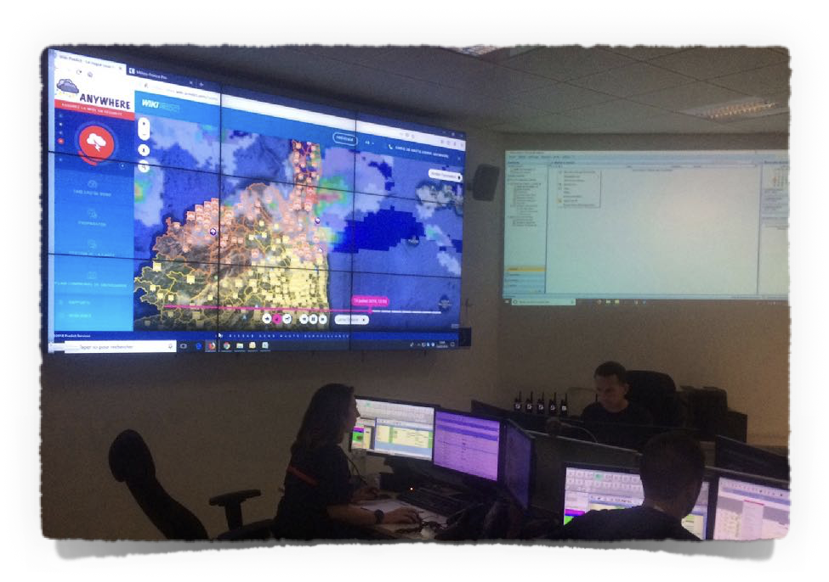
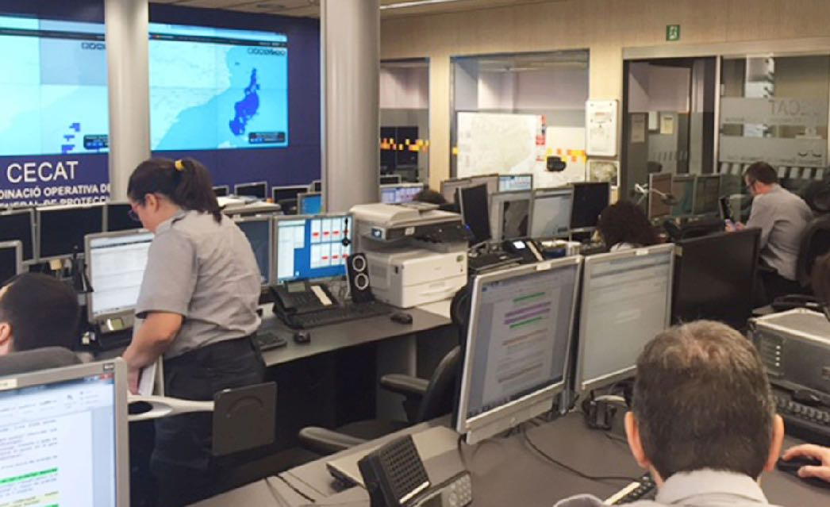
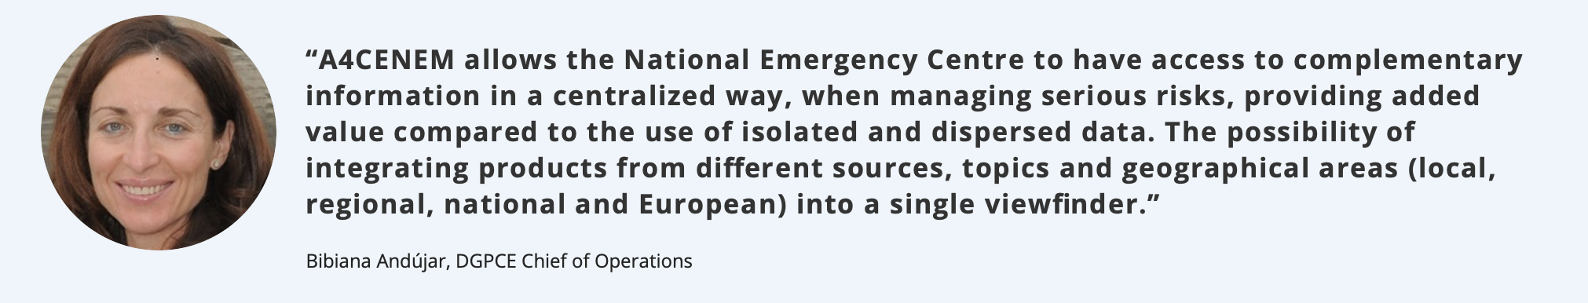
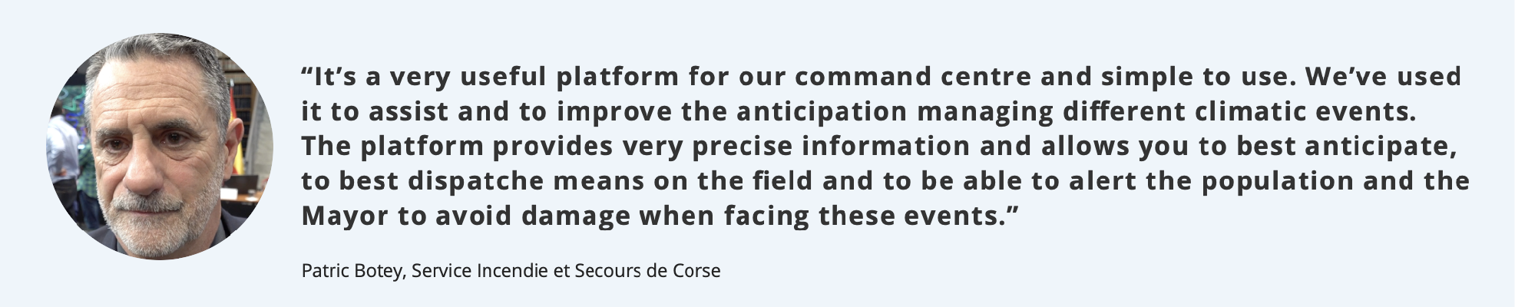


Slide 9

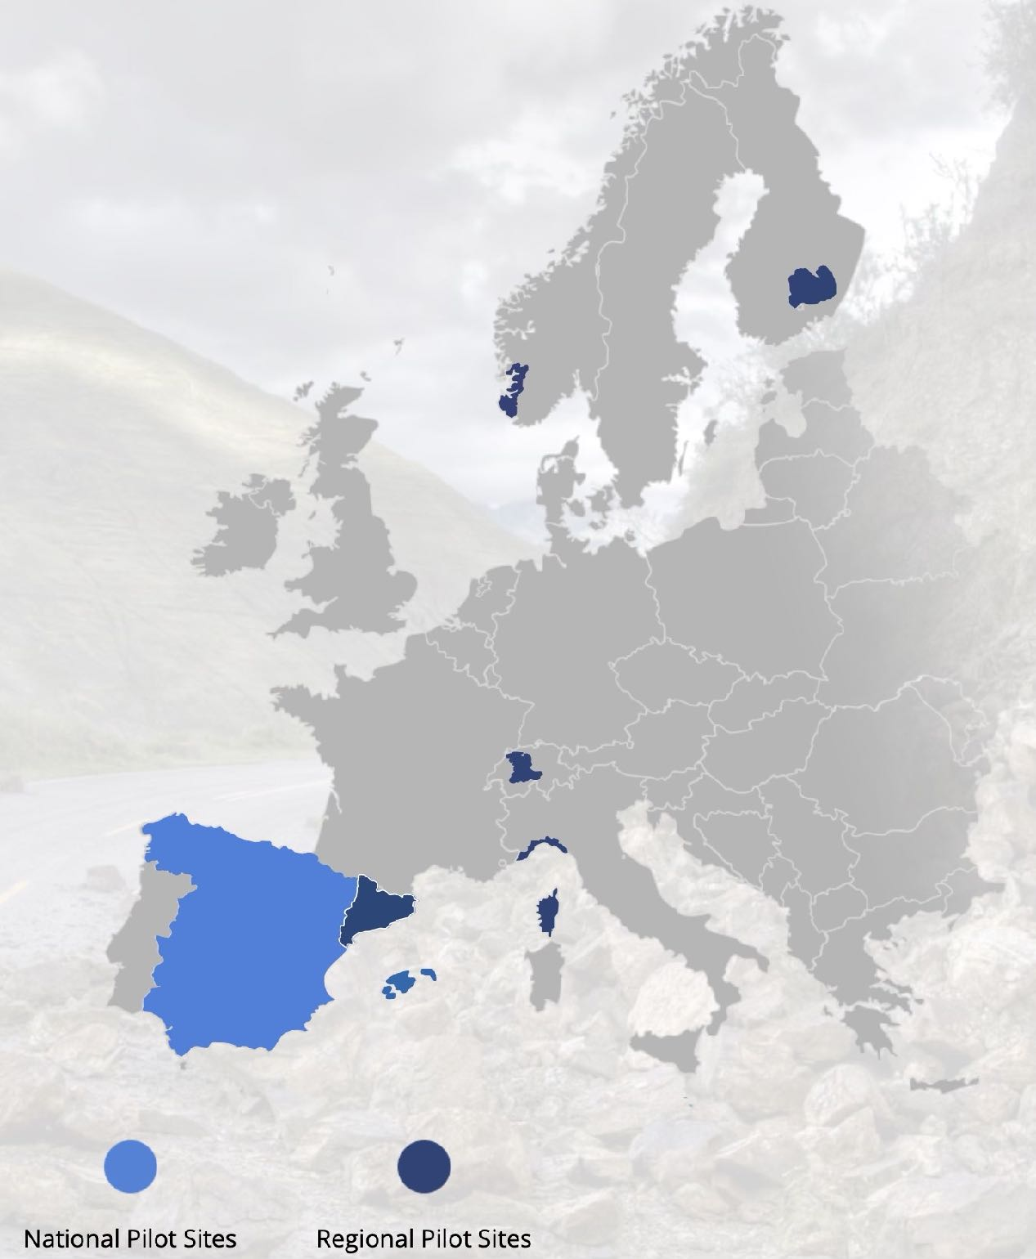
7 Pilot Sites: Operational Demonstrations
Rogaland
South Savo
OPERATIONAL
from
OCTOBER 2018
(NO)
(FI)
Canton Bern
(CH)
Catalonia
Liguria
(IT)
(ES)
Corsica
(FR)
SPAIN (national)
(but can be implemented ANYWHERE in EUROPE…)

Slide 10

www.anywhere-h2020.eu

