Slide 1

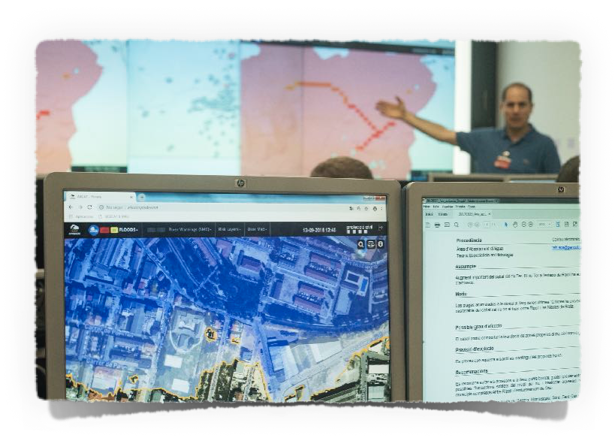
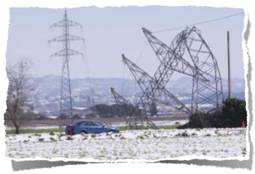
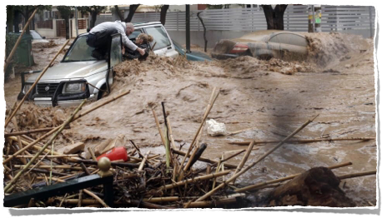
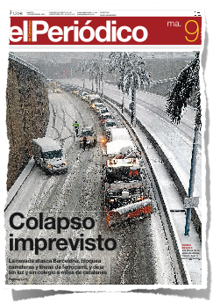
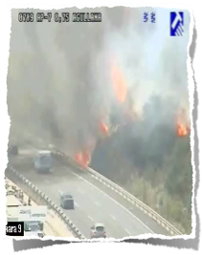

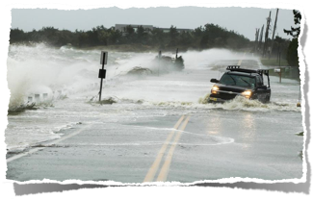
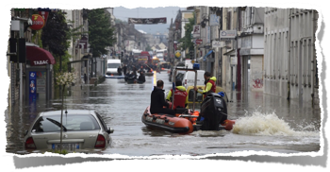
www.anywhere-h2020.eu
Climatic emergencies:
Operational decision support tools for emergency management centres

Slide 2
Storms and Floods: challenges for a better management in a changing environment
> x3 from 1980
700
200

Slide 3
Challenges to Goals
CHANGE OF PARADIGM:
From RE-ACTIVE to
PRO-ACTIVE RESPONSE
Advanced detection and response

Slide 4
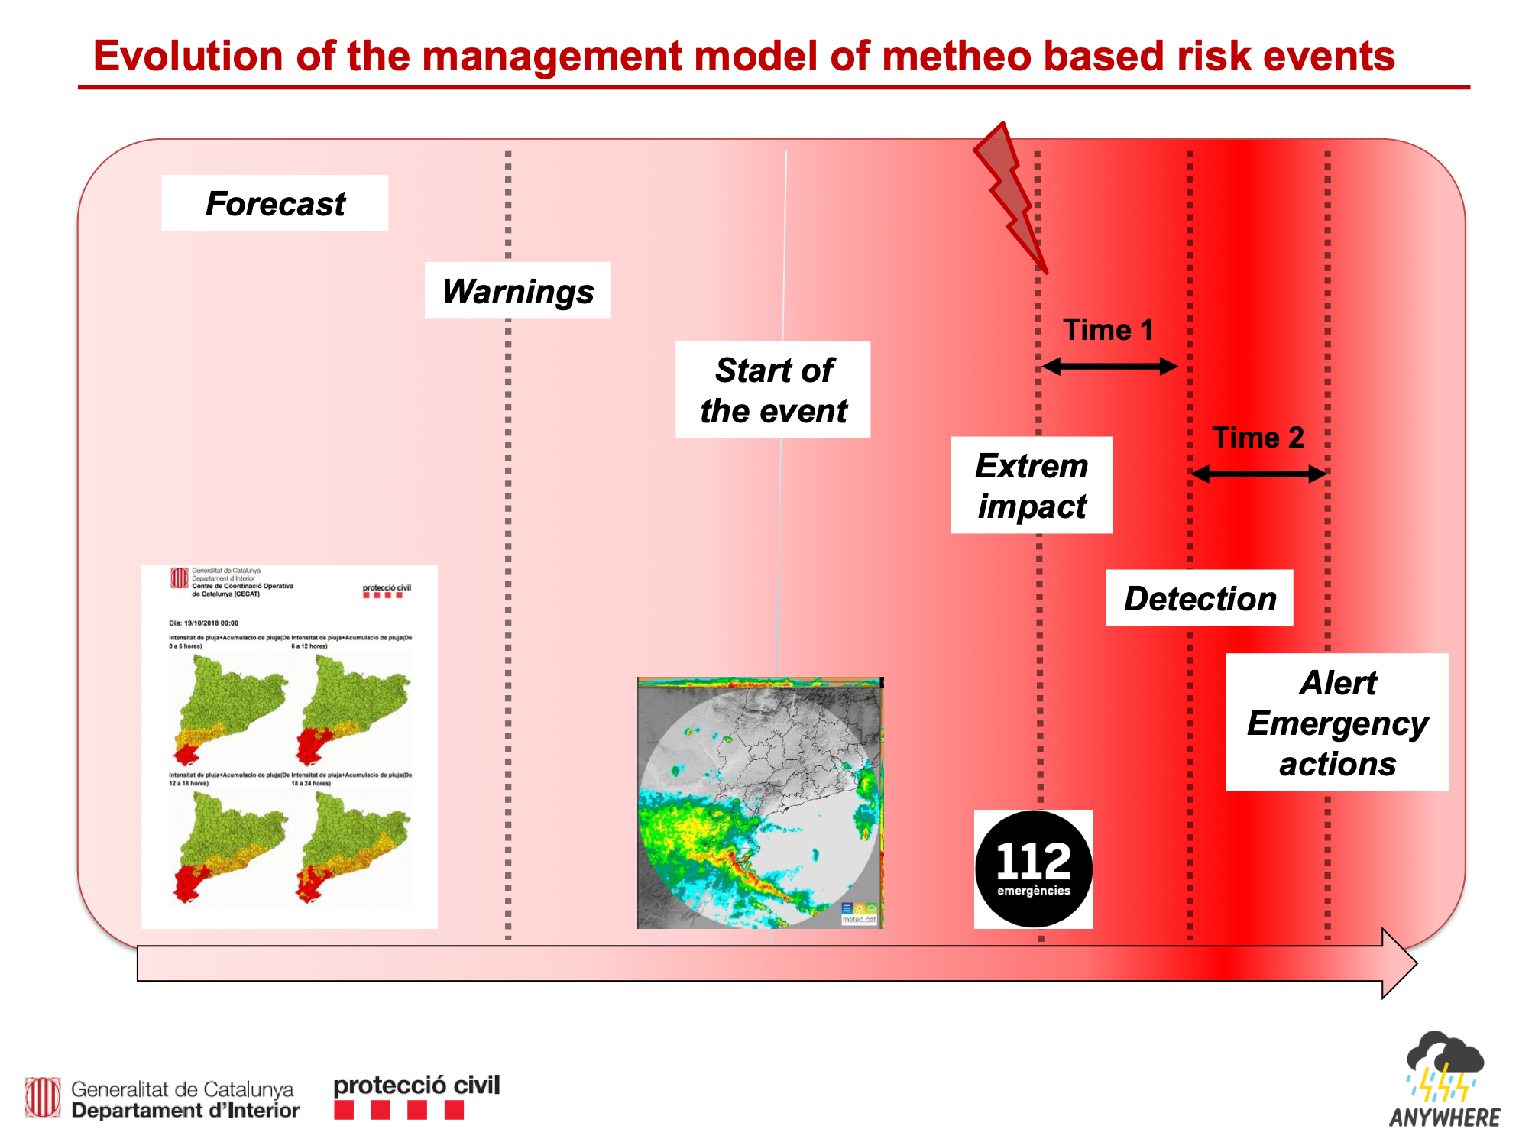
Evolution of the management model of weather and climatic emergencies
Courtesy of Sergio Delgado

Slide 5
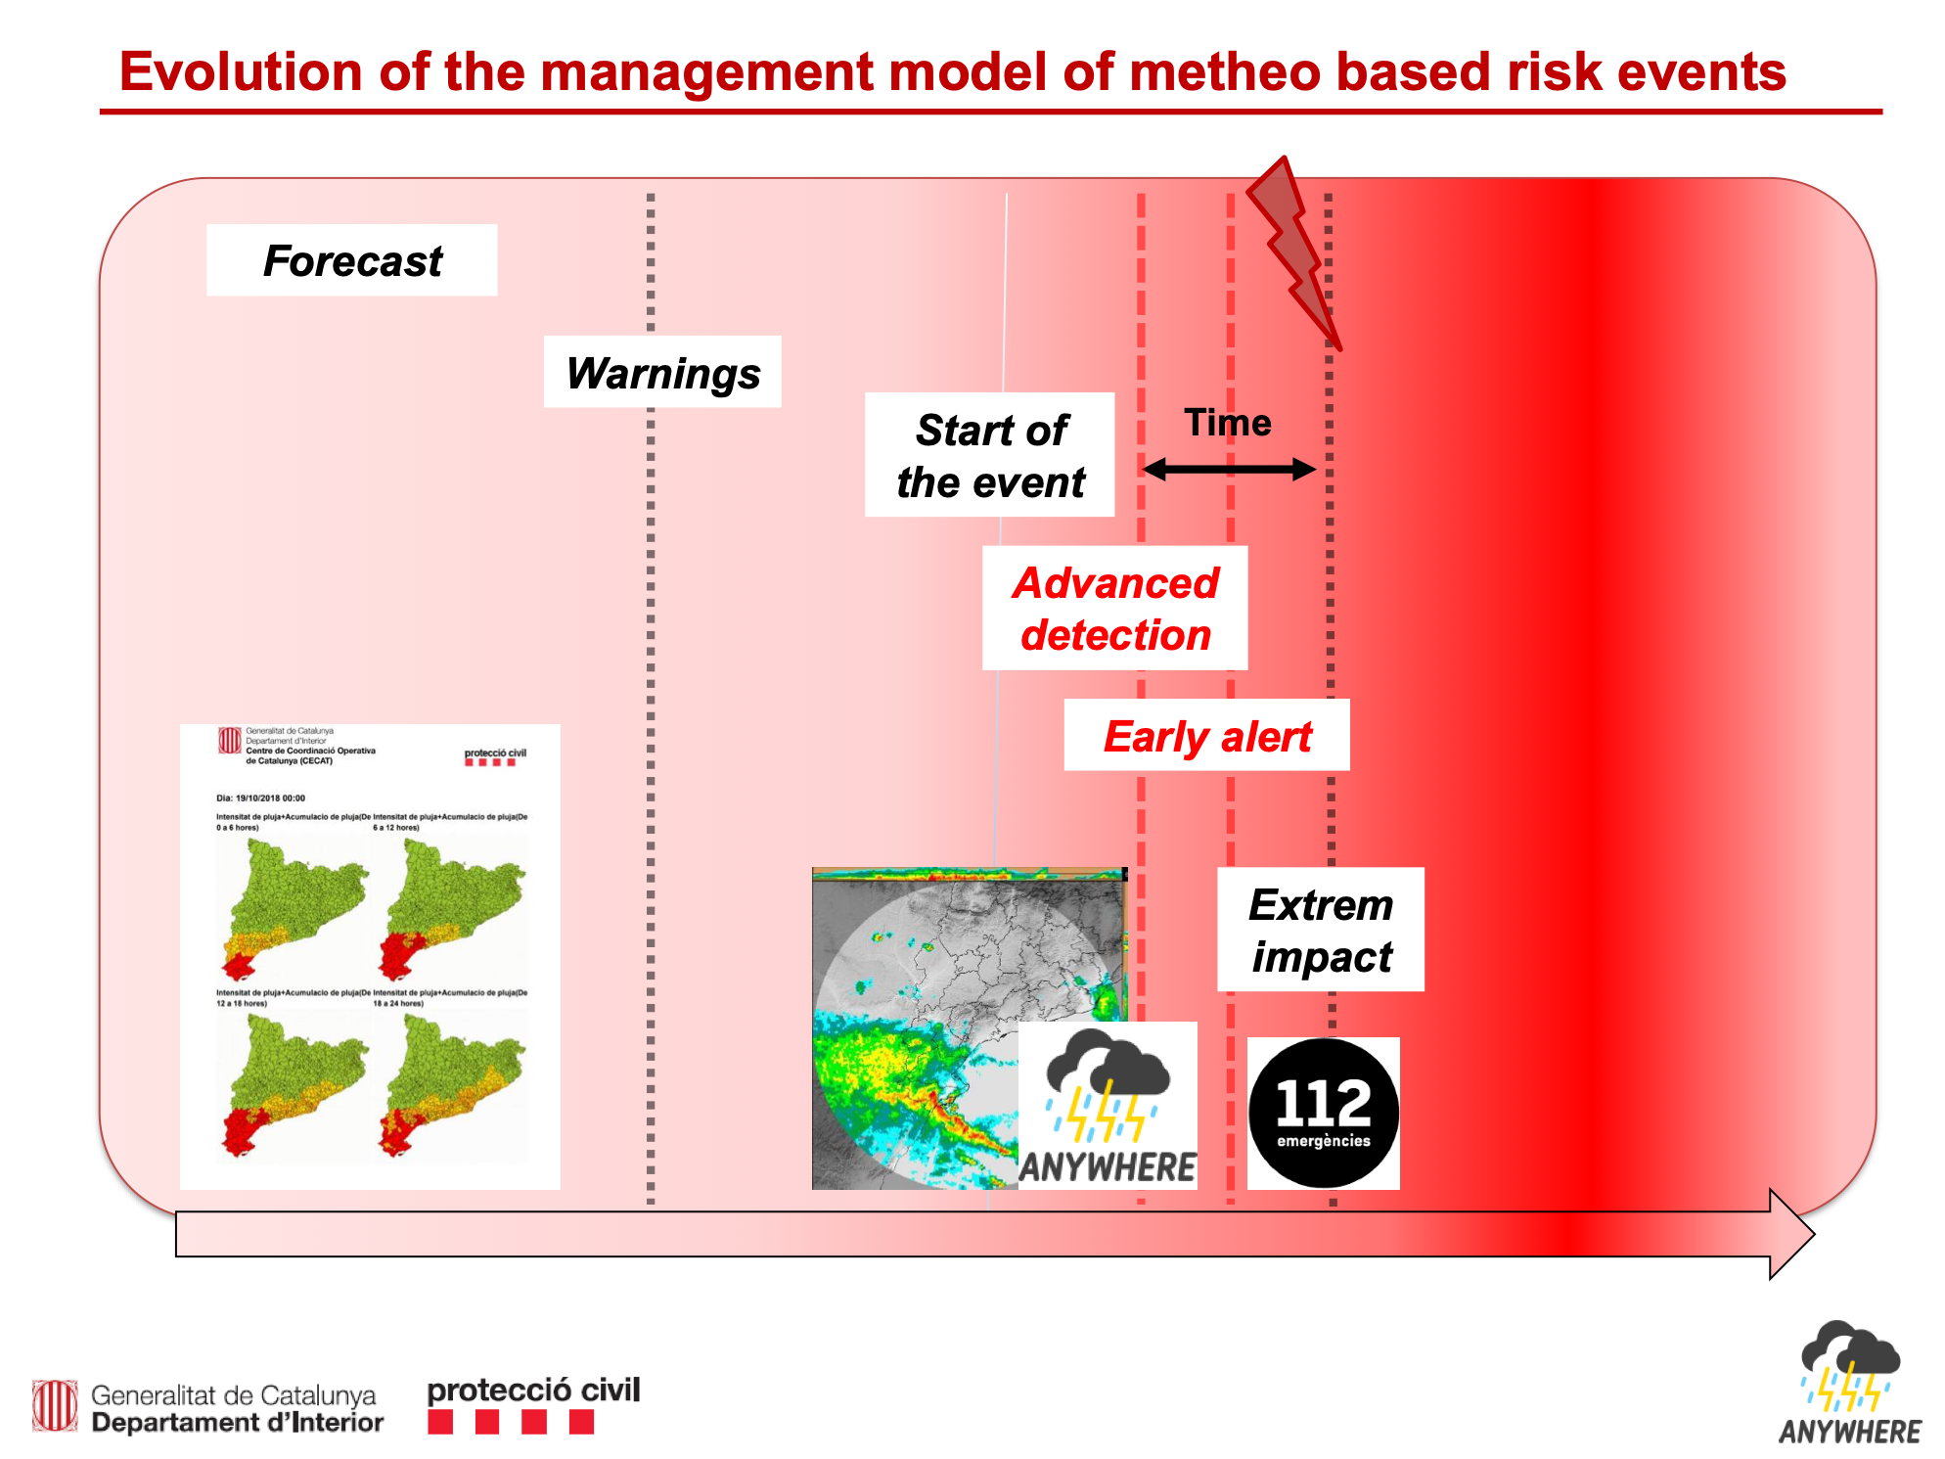
Evolution of the management model of weather and climatic emergencies
Courtesy of Sergio Delgado

Slide 6
Challenges to Goals
CHANGE OF PARADIGM:
From RE-ACTIVE to
PRO-ACTIVE RESPONSE
Advanced detection and response
Translate best adapted METEOROLOGICAL FORECASTS into IMPACT FORECASTS

Slide 7
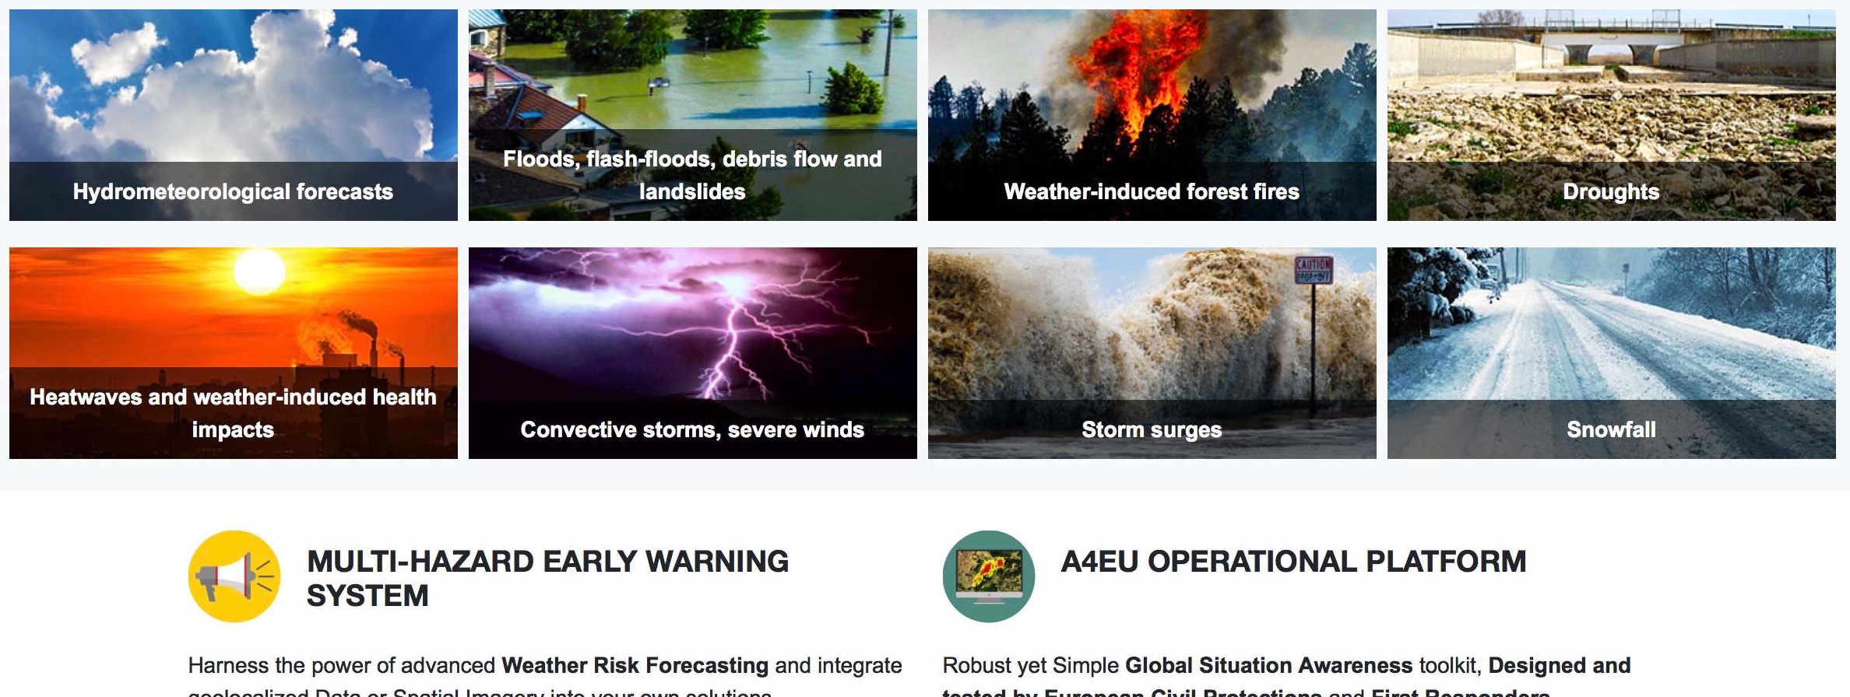
Challenges to Goals
Translate best adapted METEOROLOGICAL FORECASTS into IMPACT FORECASTS
Multi Hazard
Early Warning System
MH-EWS products
www.anywhere-h2020.eu/catalogue

Slide 8
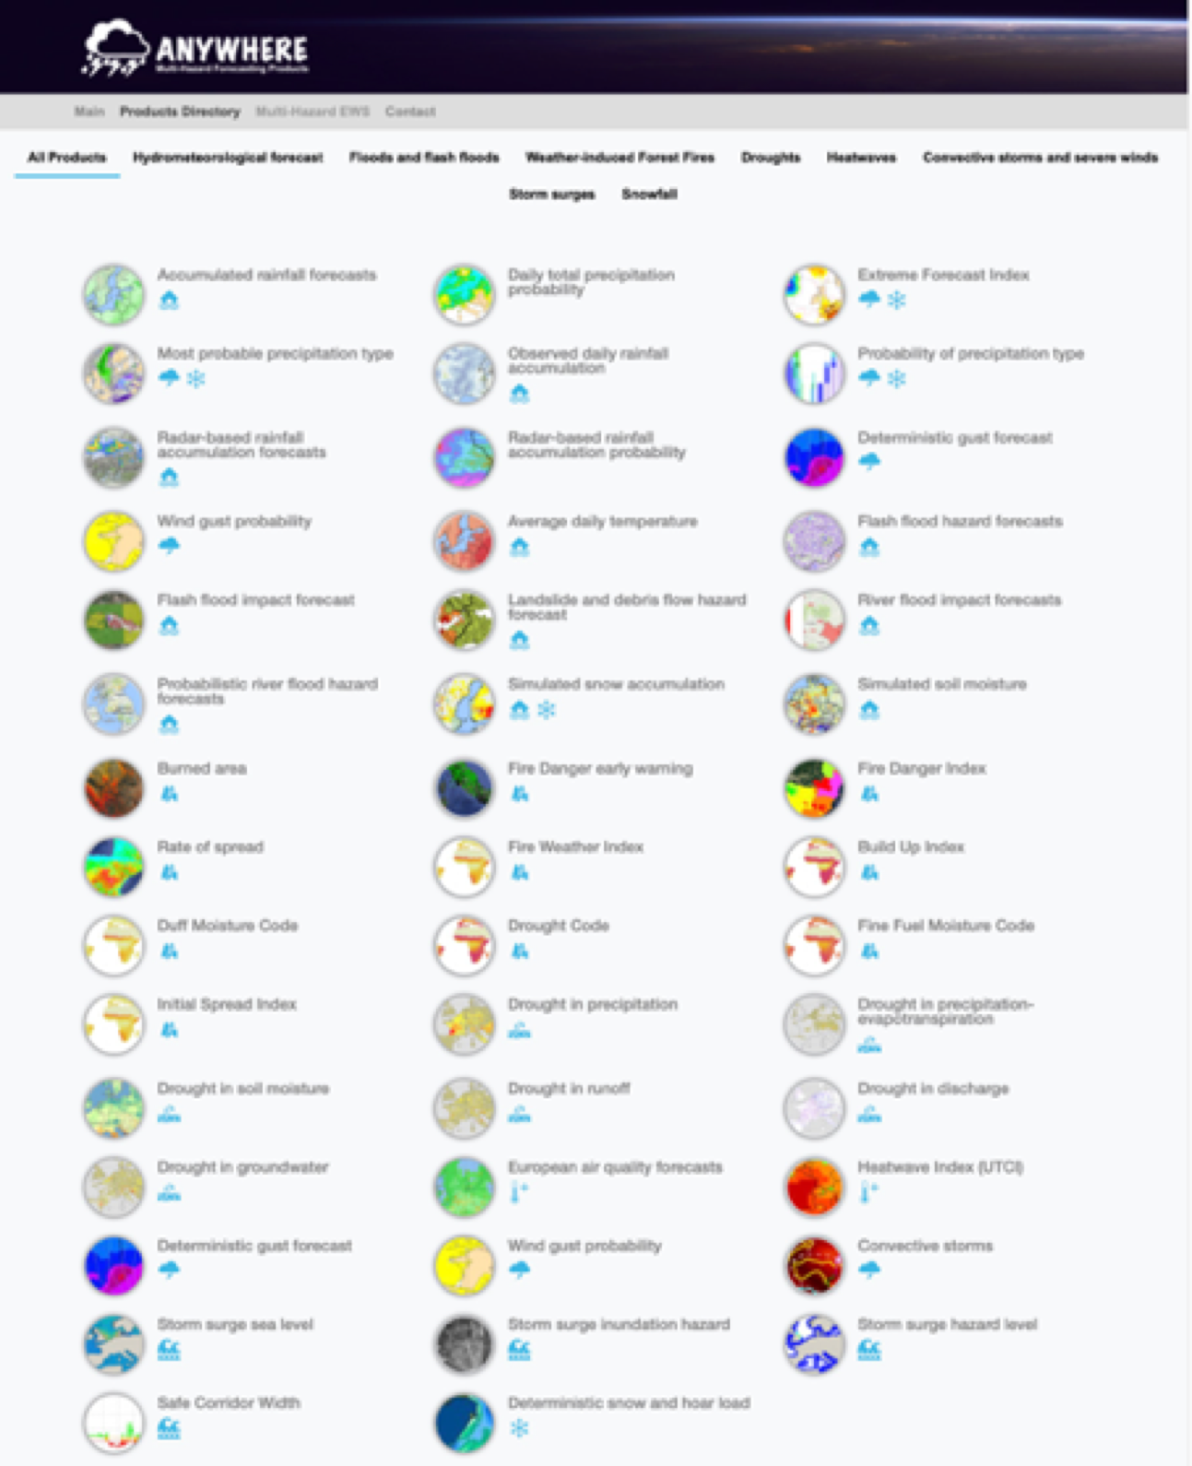
Translate best adapted METEOROLOGICAL FORECASTS into IMPACT FORECASTS
Multi Hazard
Early Warning System
MH-EWS products
www.anywhere-h2020.eu/catalogue

Slide 9
Challenges to Goals
CHANGE OF PARADIGM:
From RE-ACTIVE to
PRO-ACTIVE RESPONSE
Advanced detection and response
Connect them to the local needs to SUPPORT DECISION MAKING in EMERGENCY COMMAND CENTRES
Translate best adapted METEOROLOGICAL FORECASTS into IMPACT FORECASTS

Slide 10

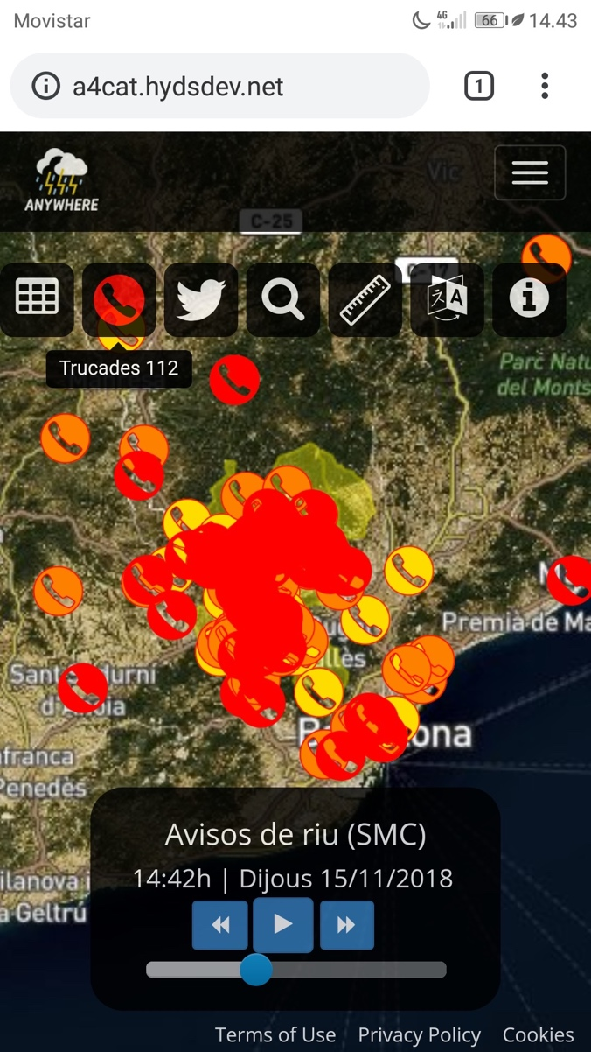



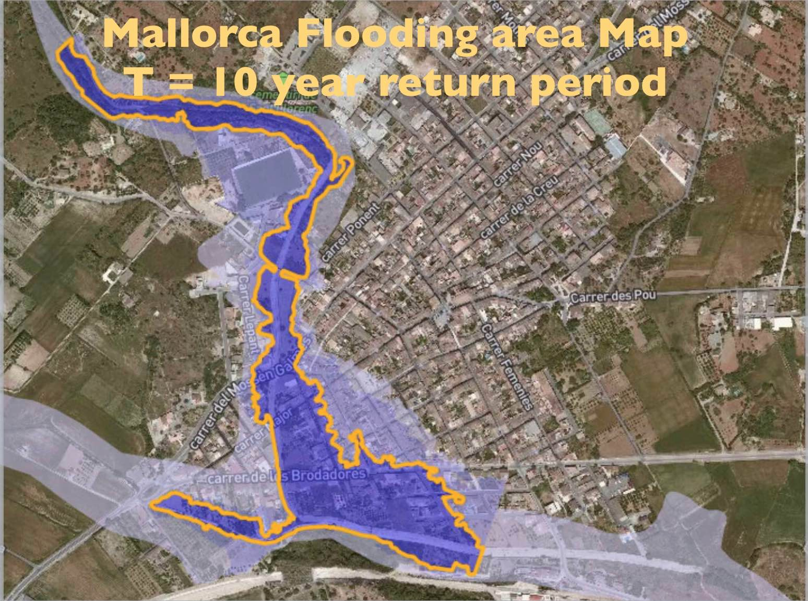
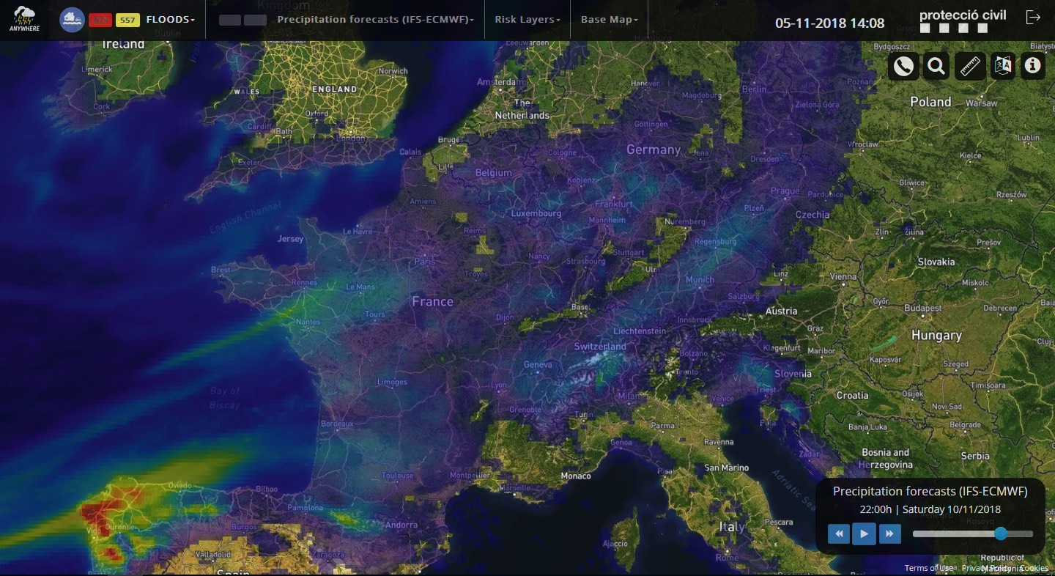
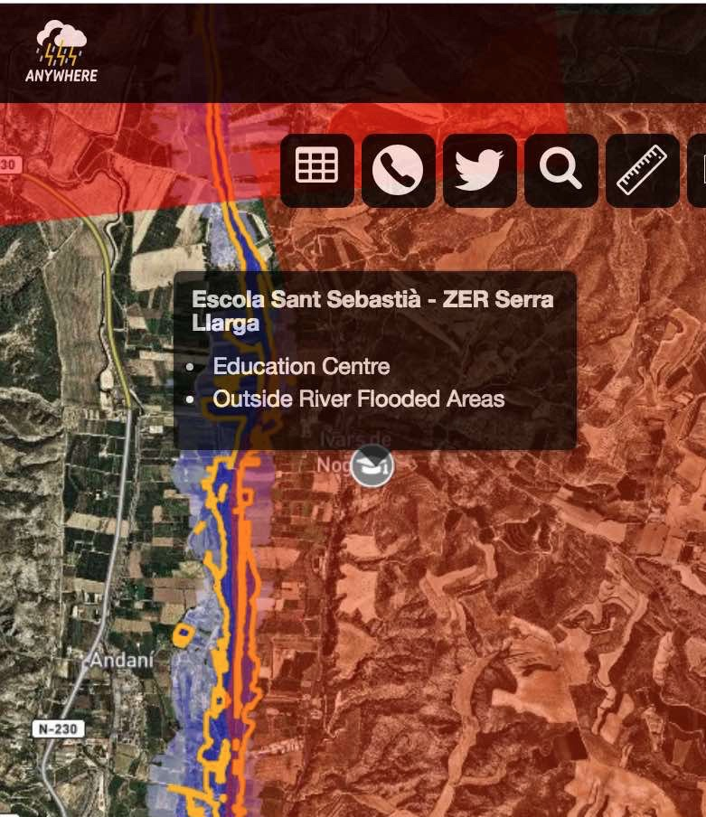
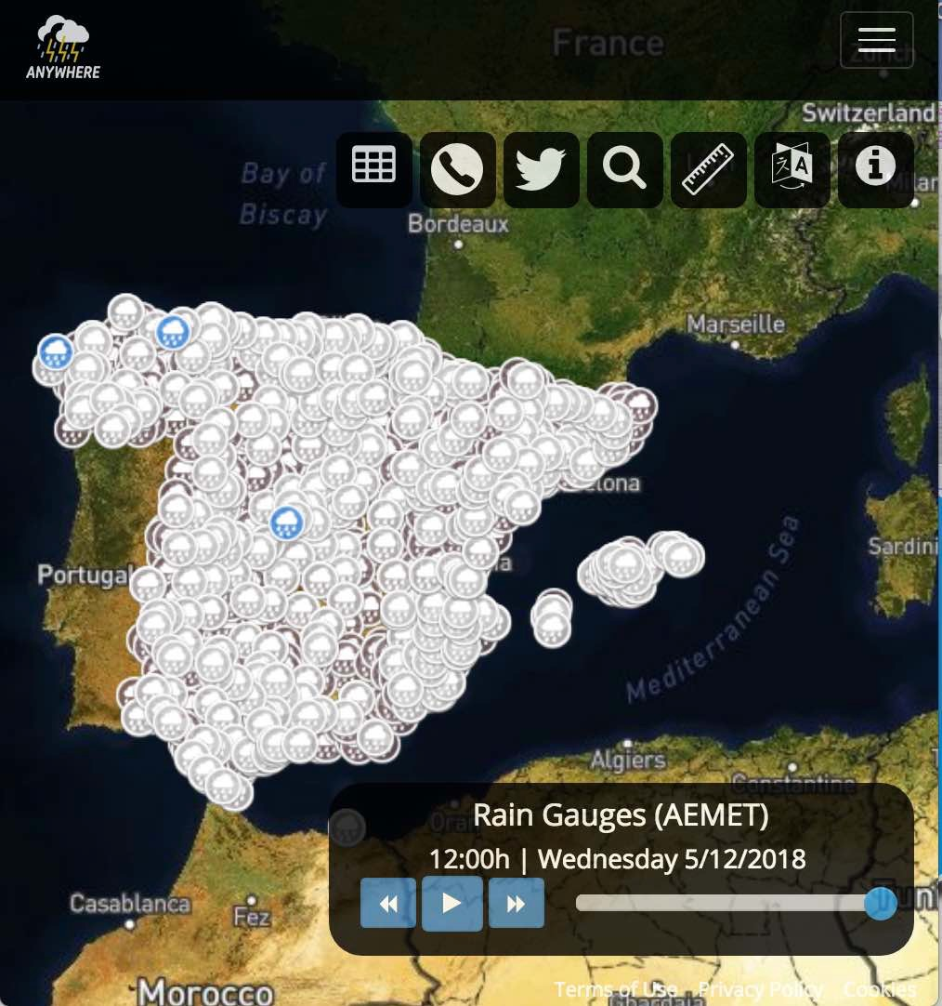
ANYWHERE A4EU capabilities
112 Calls
112 calls and crowdsourcing
Integrate IMPACT FORECASTS with local layers to SUPPORT DECISION MAKING in EMERGENCY COMMAND CENTRES
Last 30 min
(30, 60] min ago
(60, 90] min ago
EU Flood Directive Risk Maps
Automatic activation
of critical points
Local sensors
Meteorological
Forecasting

Slide 11
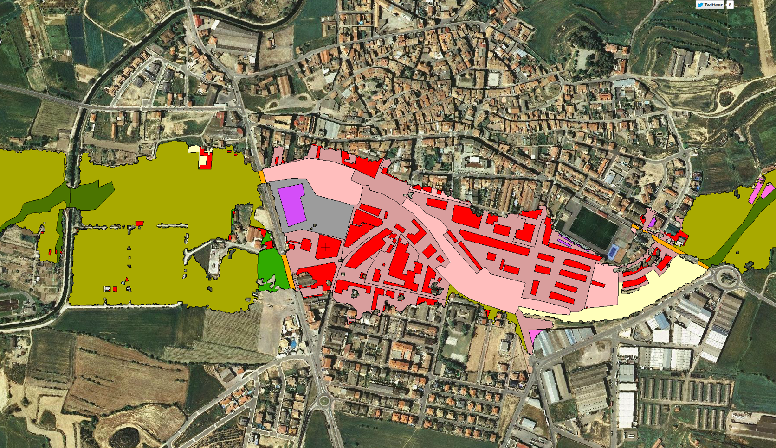
ANYWHERE A4EU capabilities
112 Calls
112 calls and crowdsourcing
Integrate IMPACT FORECASTS with local layers to SUPPORT DECISION MAKING in EMERGENCY COMMAND CENTRES
Last 30 min
(30, 60] min ago
(60, 90] min ago
EU Flood Directive Risk Maps
Automatic activation
of critical points
Vulnerability Maps
Local sensors

Slide 12

ANYWHERE A4EU capabilities
Integrate IMPACT FORECASTS with local layers to SUPPORT DECISION MAKING in EMERGENCY COMMAND CENTRES
Vulnerability Maps
From EU scale to BUILDING scale
KEY TOOL For Flood Risk Management Plans in the EU FLOOD DIRECTIVE
Meteorological
Forecasting

Slide 13
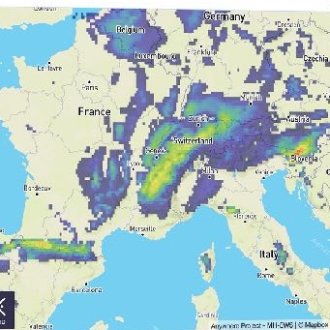
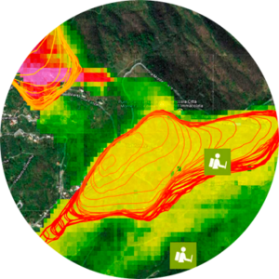
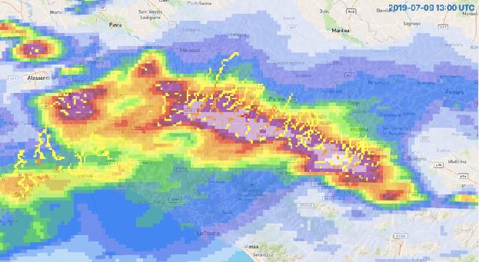
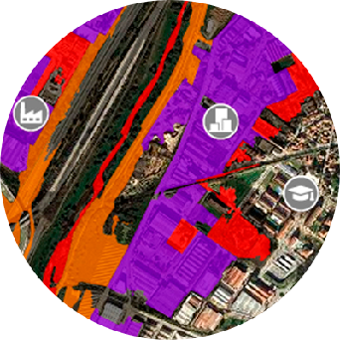
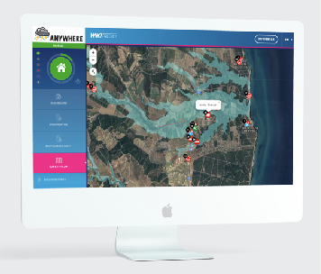


The ANYWHERE approach based on impact forecasting
represents a disruptive innovation in the field of the
climatic emergencies operational management
Meteorological forecasts
Hazard forecasts
Impact forecasts
Actionable decisions
Operational solutions
www.anywhere-h2020.eu

Slide 14

ANYWHERE FOR EU (A4EU): MULTI-HAZARD EARLY WARNING AND DECISION SUPPORT SYSTEM
Incidents
Hazard
information
Vulnerability
information
112 Calls
Transit incidents
Crowdsourcing
…
MH-EWS
Sensors
Official Warnings
Local products
…
Risk maps
Vulnerable elements
Critical points
…
Tools
Cartography
Searcher
Help Wiki
…
Impact
Elements potentially affected
CIMA
HYDS
PREDICT
AIRBUS

Slide 15

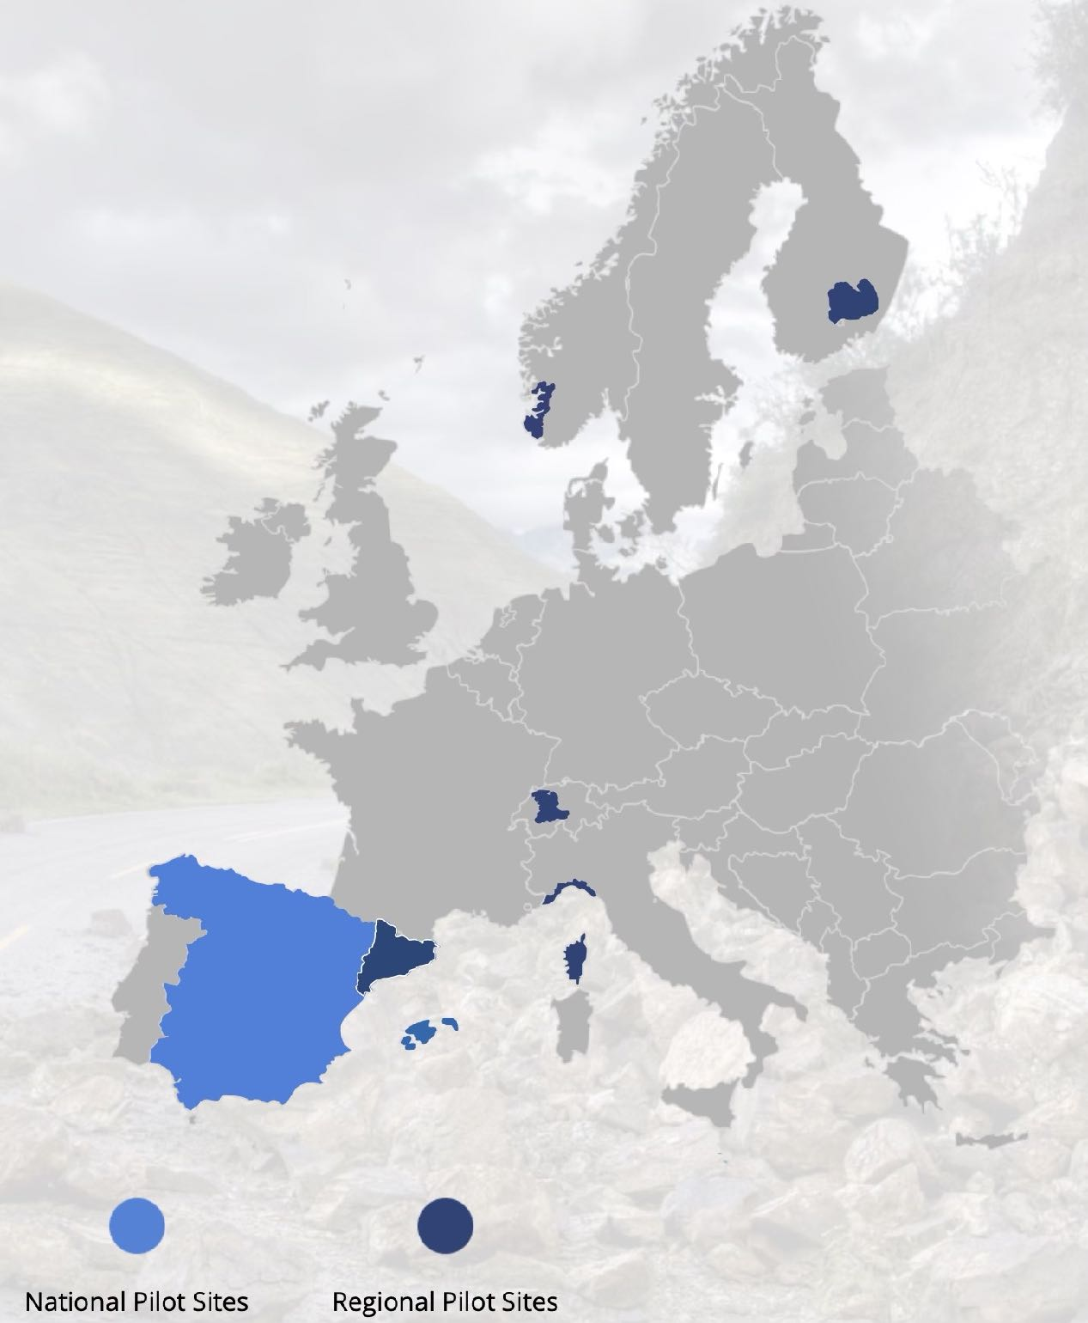
7 Pilot Sites: Operational Demonstrations
Rogaland
South Savo
OPERATIONAL
from
OCTOBER 2018
Canton Bern
Catalonia
Liguria
Corsica
SPAIN (national)
(but can be implemented ANYWHERE in EUROPE…)

Slide 16
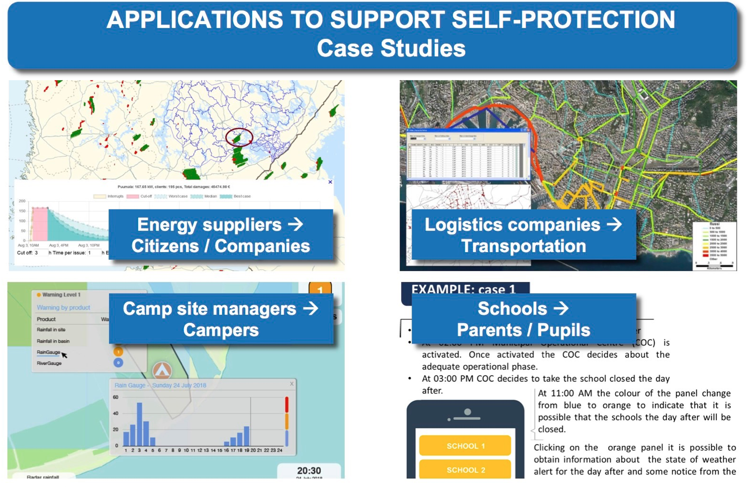
Challenges to Goals
CHANGE OF PARADIGM:
From RE-ACTIVE to
PRO-ACTIVE RESPONSE
Advanced detection and response
Services to support
SELF-PROTECTION
A4Schools
A4Campsites
A4Electricity
A4Mobility

Slide 17

Ensuring MARKET UPTAKE:
Making sustainable the maintenance of the systems and services
A4EU
A4Snow
A4Schools
A4Fire
A4Campsites
Emergency Management Control Centres
A4Industries
A4Electricity
A4Cities
A4Mobility

Slide 18
Ensuring MARKET UPTAKE:
Making sustainable the maintenance of the systems and services
A4U
Get your OWN customised SERVICE

Slide 19

Preparing ANYWHERE
Market Uptake
Ensuring MARKET UPTAKE:
Making sustainable the maintenance of the systems and services
From A4EU
(Civil Protections) TO
A4U
FOUNDATION

Slide 20
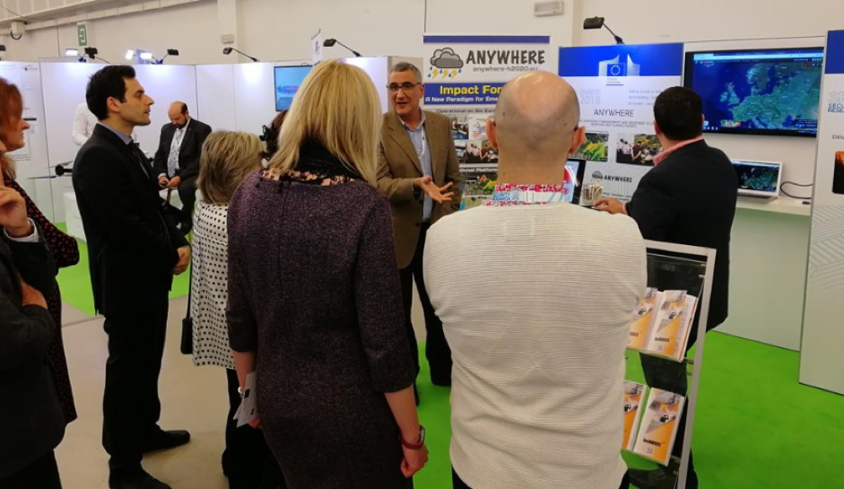
More details at the
LIVE EXHIBITS and Posters

