Slide 1
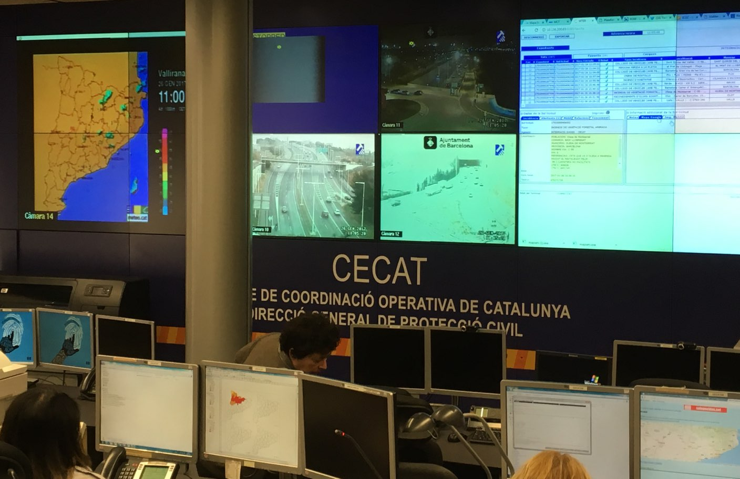
How we can support decision making at operational control centres during climate induced emergencies?

Slide 2
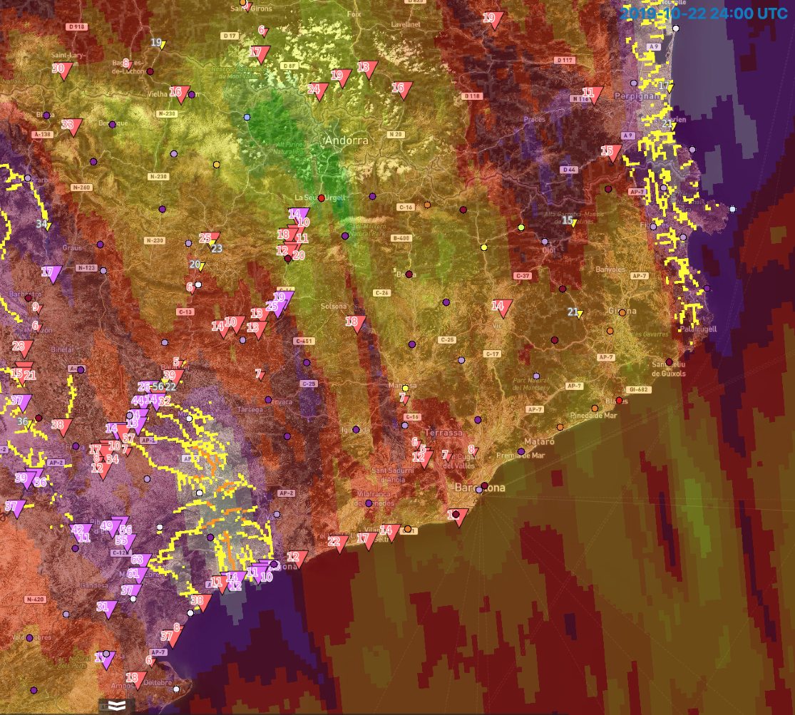
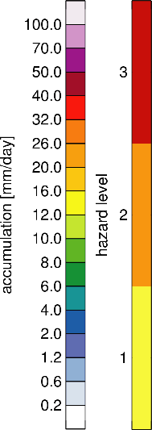
Francolí (Spain) 22-23 Oct 2019
ERICHA flood hazard superimposed on OPERA rainfall accumulation
Park et al. (Journal of Hydology 2019)
Corral et al. (Journal of Hydrology 2019)

Slide 3
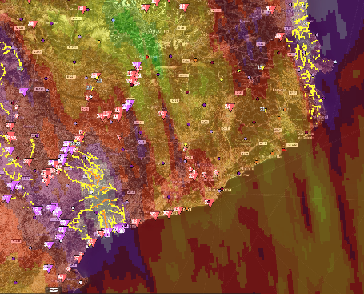
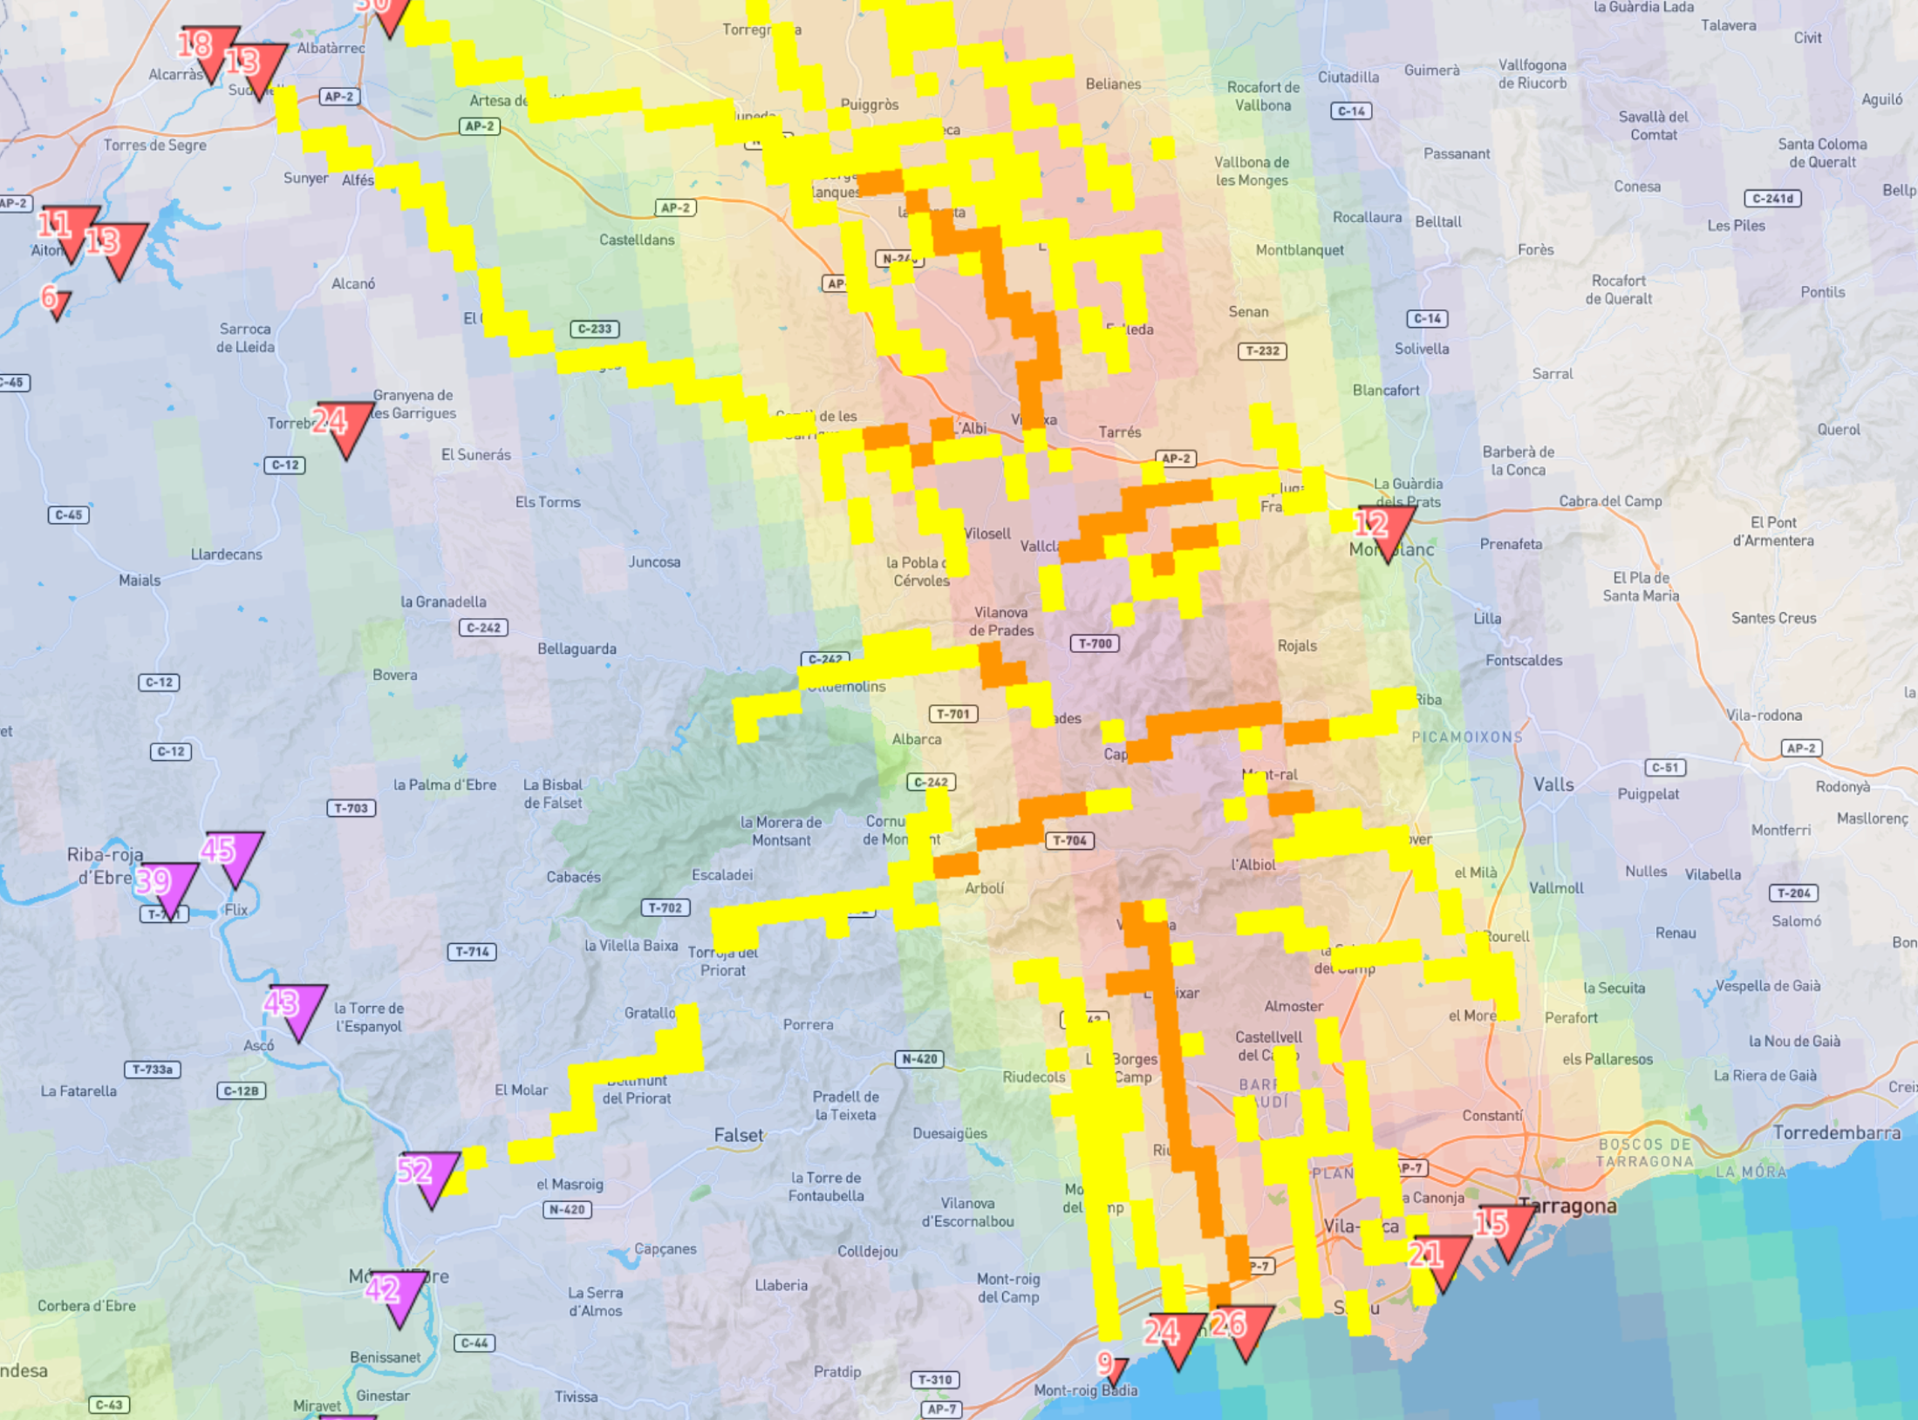
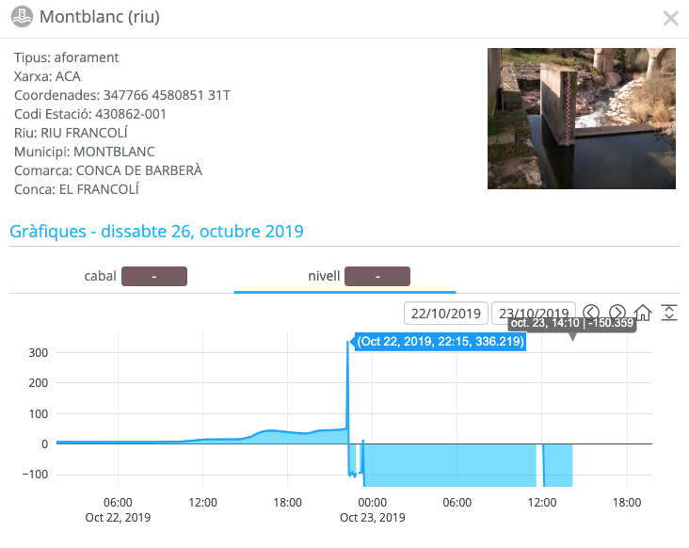


ANYWHERE flash flood hazard products
ERICHA
22 Oct 2019 @1930
Tarragona, 22 Oct 2019

Slide 4

22 Oct 2019 @22:15 UTC
ACA stream gauge at Montblanc (destroyed at 22h30 UTC)

Slide 5
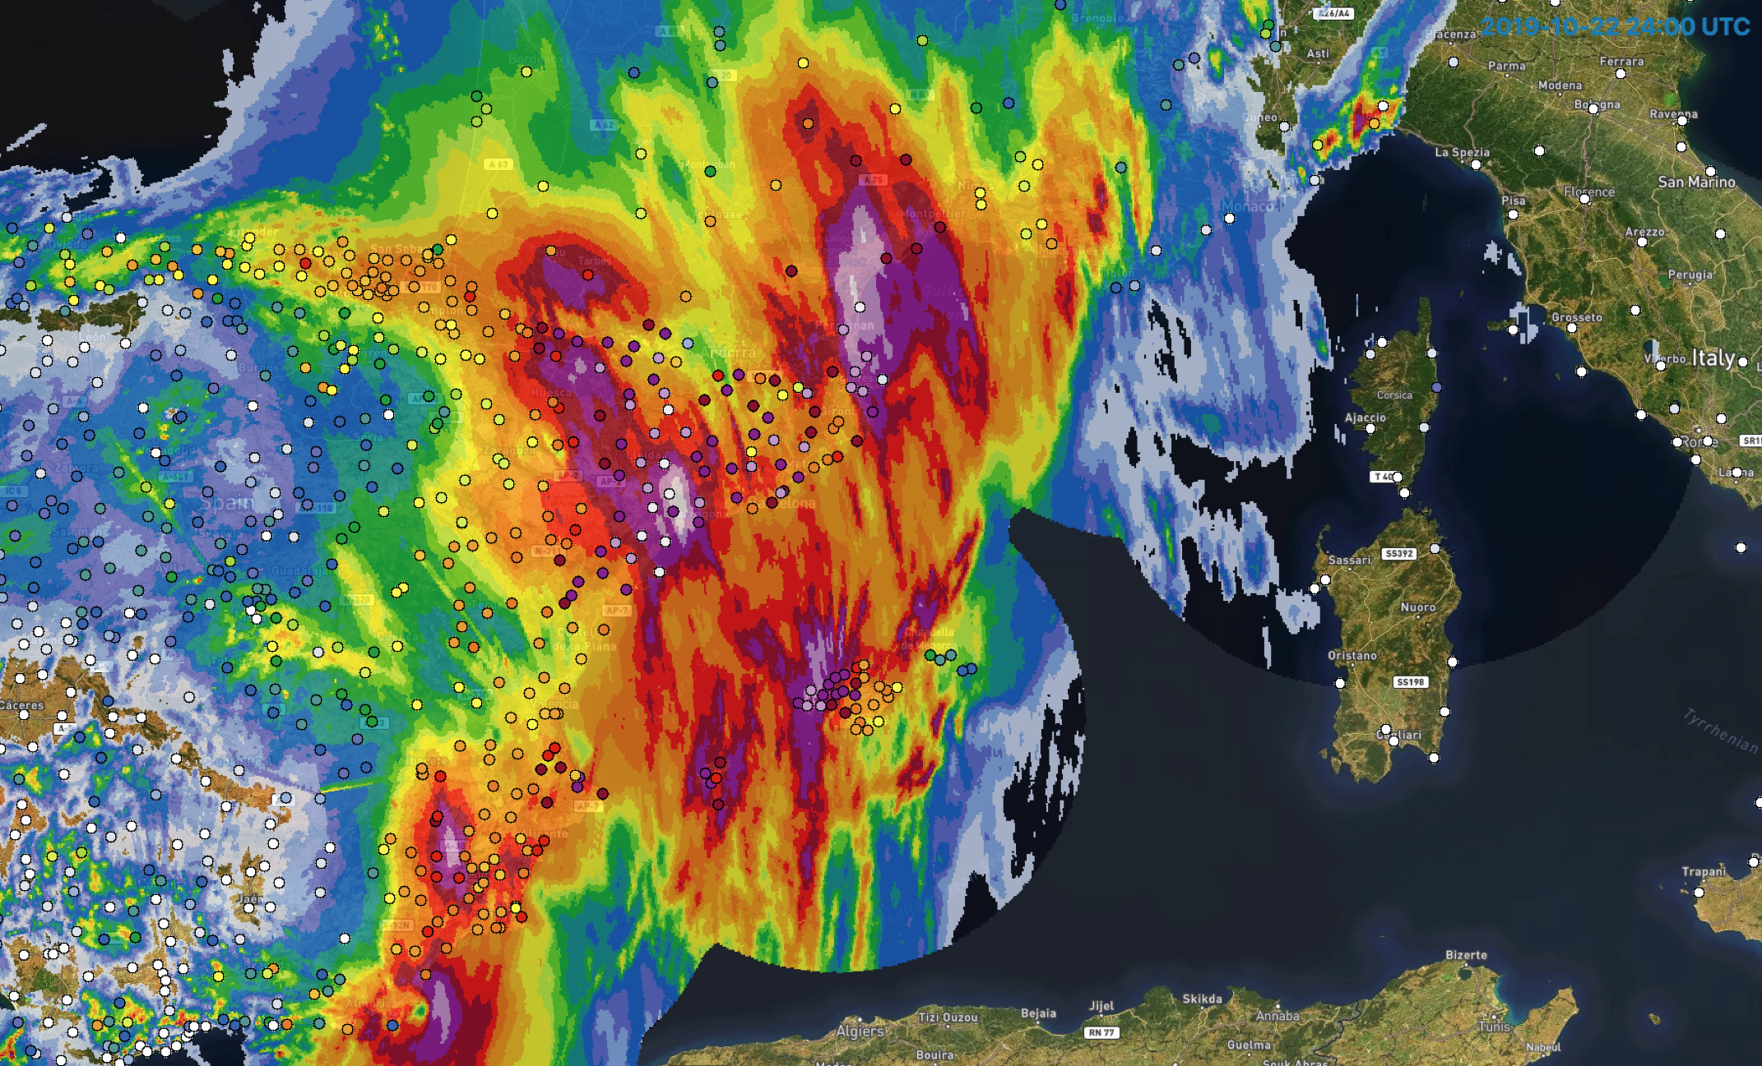
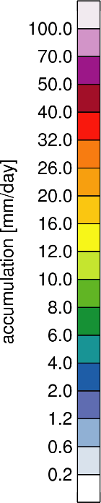
Francolí (Spain) 22-23 Oct 2019
OPERA radar rainfall and rain gauge accumulations

Slide 6
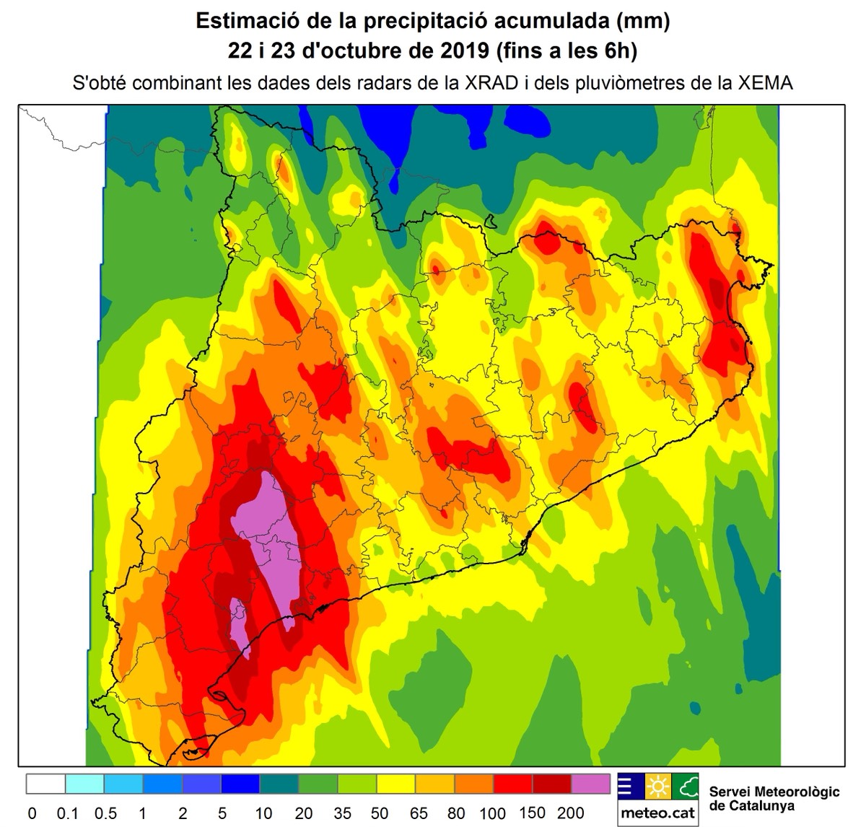
22-23 October 2019 Catalonia Event accumulated rainfall
(combination of SMC radars and raingauges after the event)

Slide 7
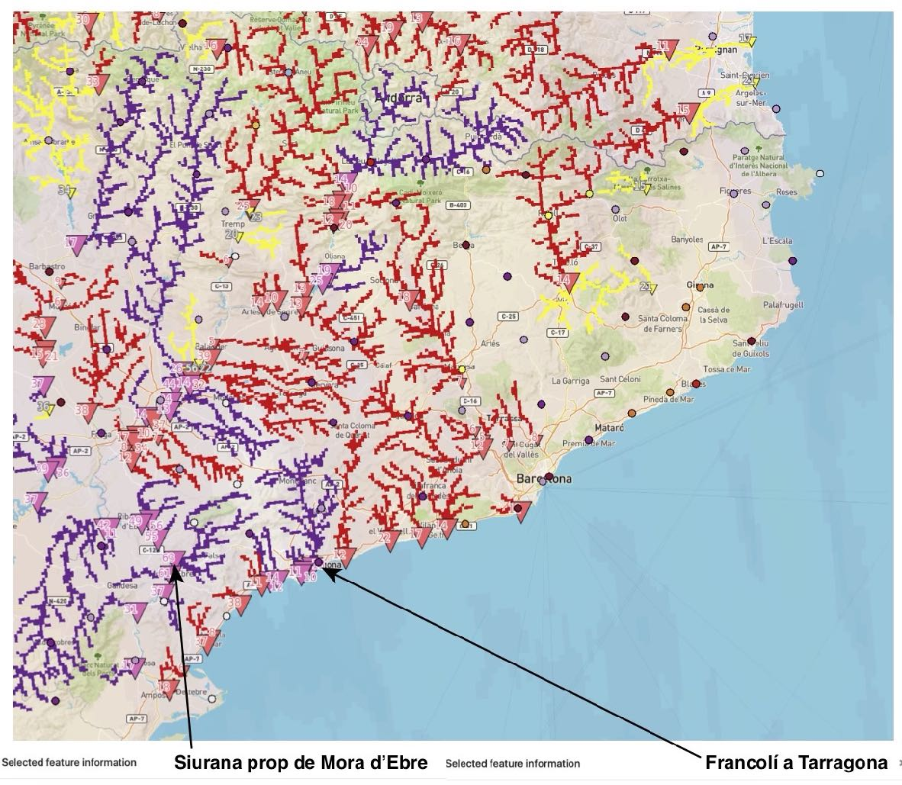
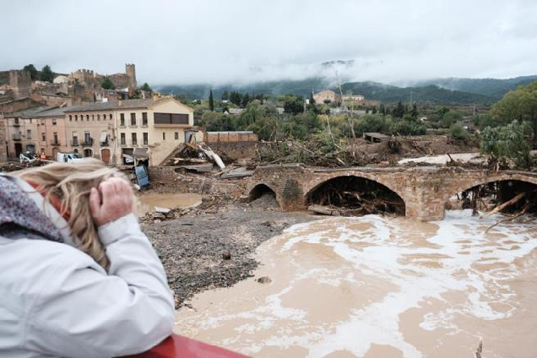
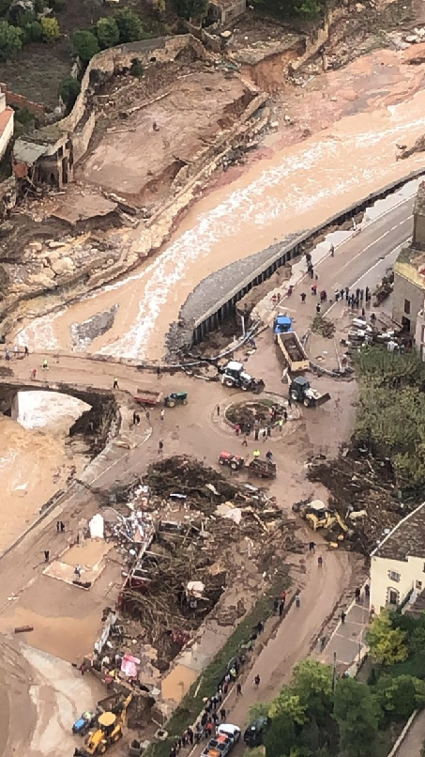
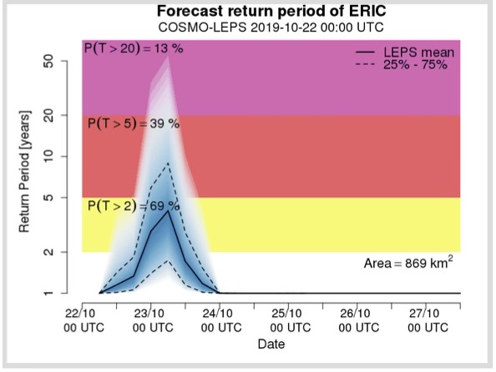
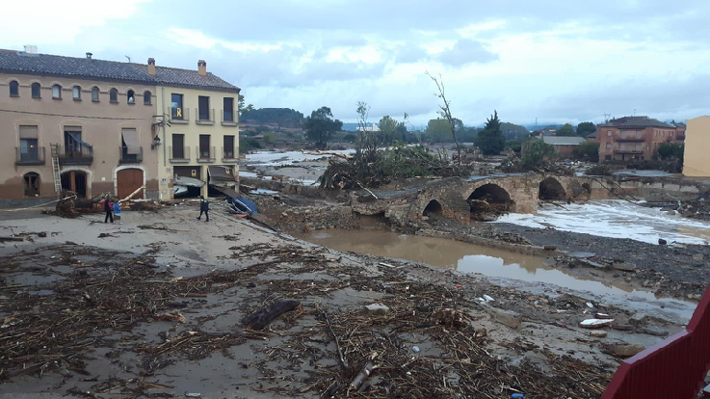
ERIC @0000 UTC
Tarragona, 22 Oct 2019

Slide 8
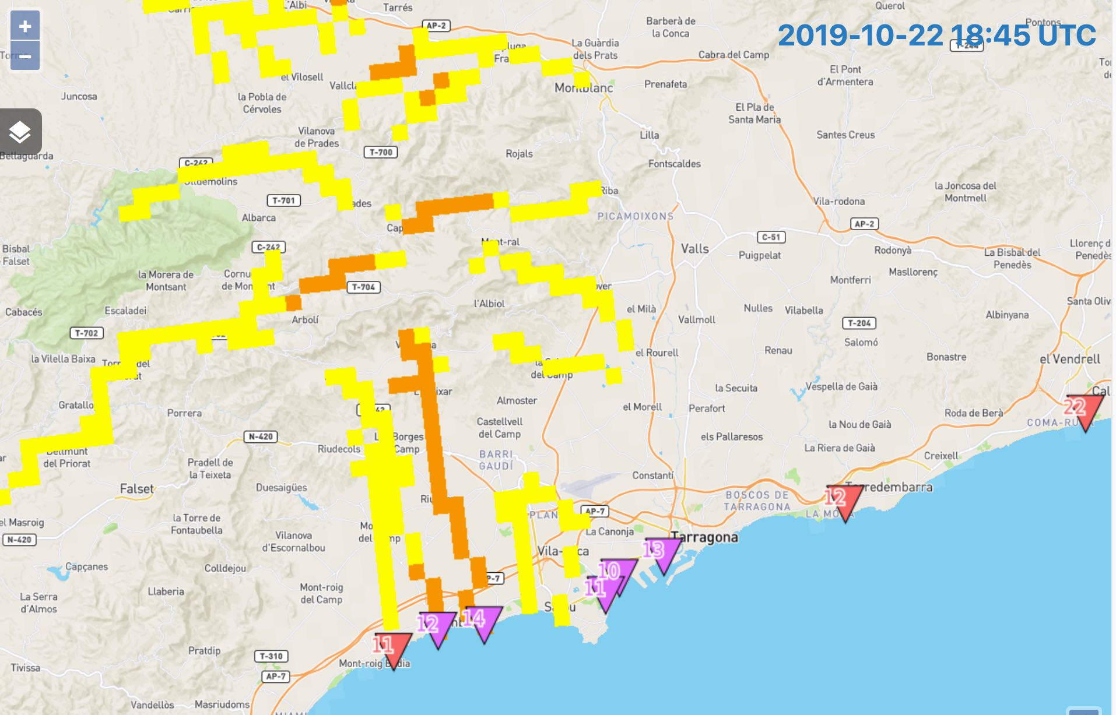
22 October 2019 Flash Flood ANYWHERE warnings: ERIC (available at 10h) and ERICHA (orange warning issued at 22h45, 1h30 in advance)

Slide 9
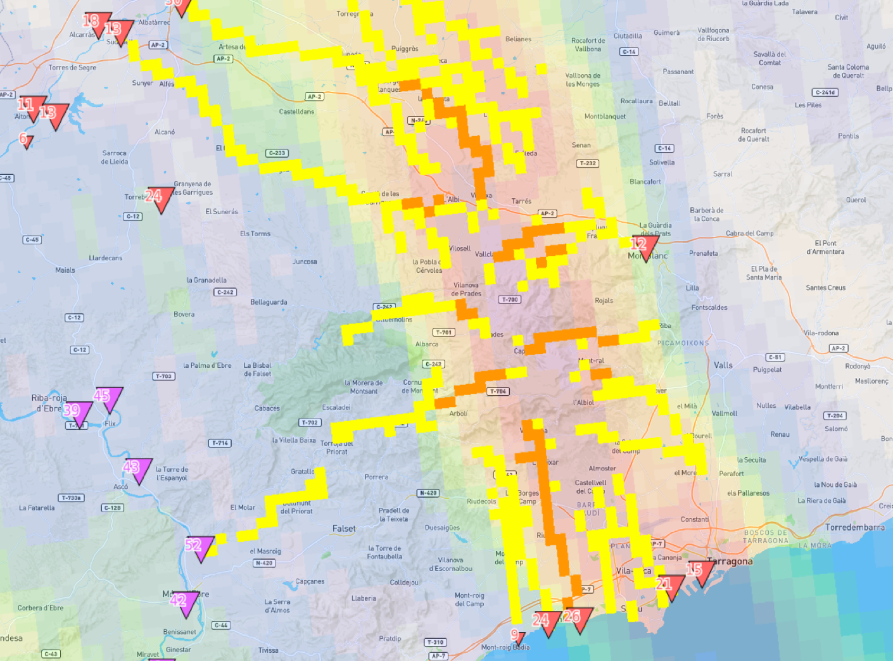
22 Oct 2019 @21:30 UTC
Tarragona, 22 Oct 2019

Slide 10
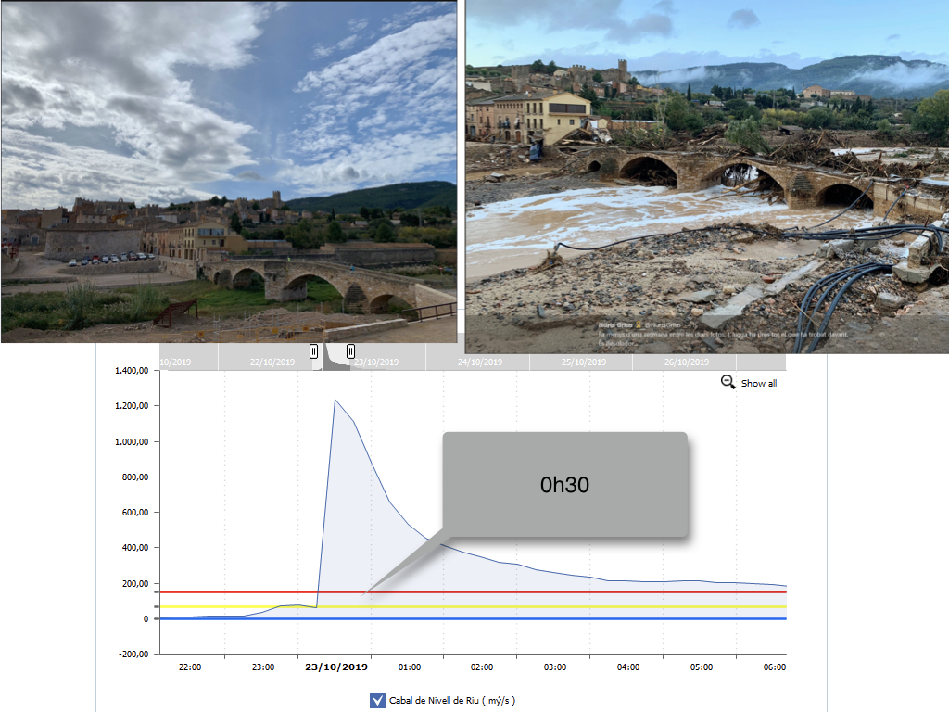
22 Oct 2019
23 Oct 2019
Francoli river flows at Montblanc (reconstructed after the event, legal time)

Slide 11
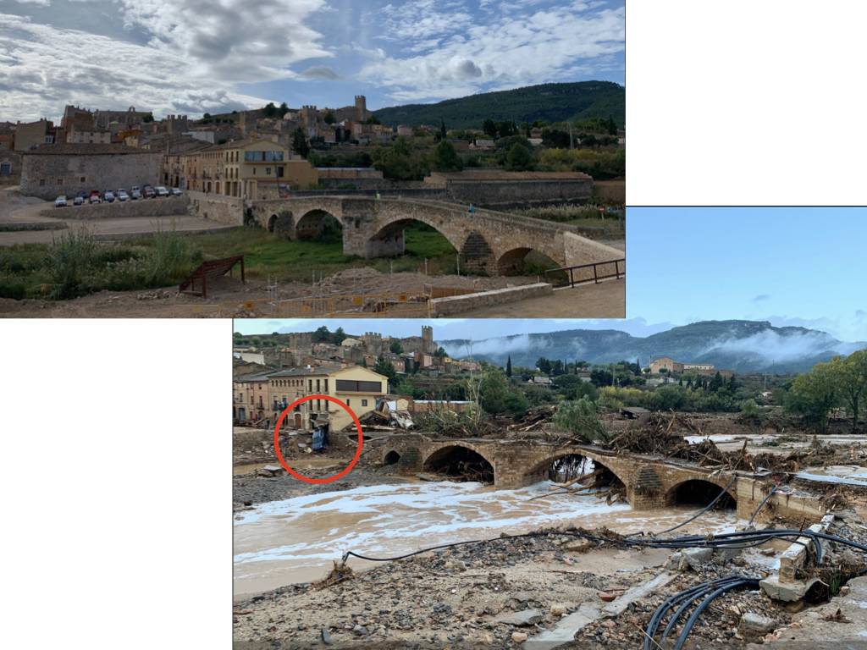
22 Oct 2019 @22:15
Tarragona, 22 Oct 2019

Slide 12
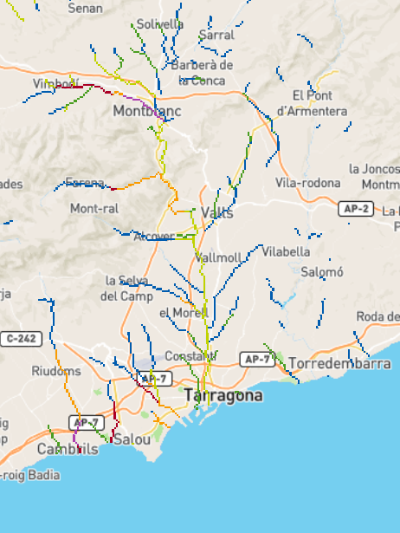
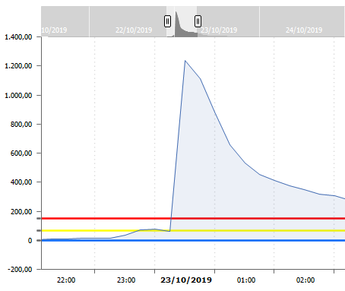
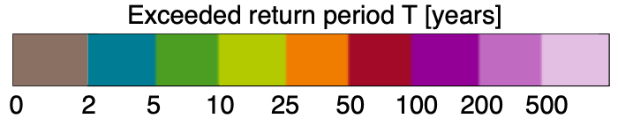
ERICHA flash flood hazard (22.10.2019 22:00 CEST)
Two victims in Espluga de Francolí
Bridge collapse in Montblanc
Two victims in Vilaverd
One victim in La Pobla da Mafumet
Hydrograph Francolí
00:30 CEST
Flood
SMC radar data corrected with raingauge data and ERICHA recalculated, and River flows reconstructed after the event

