Slide 1

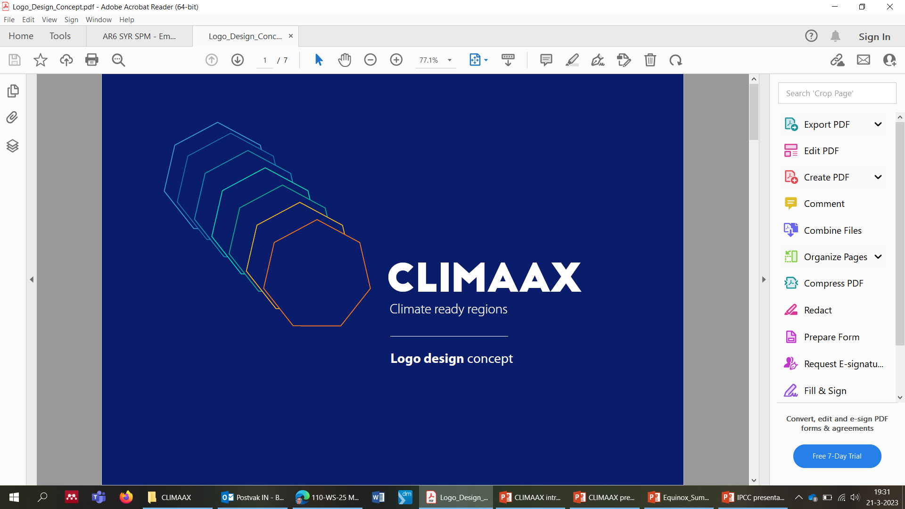


CLIMAAX
CLIMate risk And vulnerability Assessment framework and toolboX
Regional Risk Assessments for Civil Protection and Climate Adaptation
Daniel Sempere
Bart van den Hurk

Slide 2


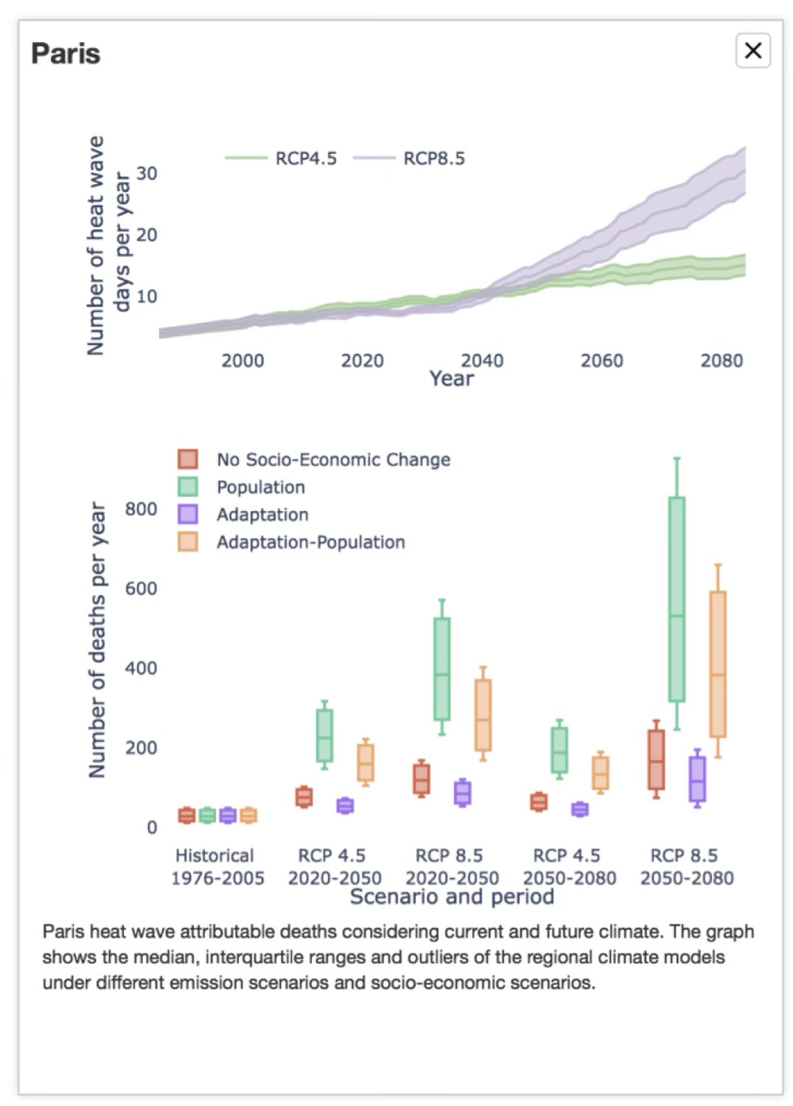
https://www.climaax.eu/
FUTURE
RISKS
INCREASE OF IMPACTS DUE TO CLIMATE CHANGE
PRESENT
RISKS
METHODOLOGICAL APPROACH for REGIONAL/LOCAL SCALE
ADAPTATION strategies to increase regional Resilience and
Improve local Risk Management Plans

Slide 3
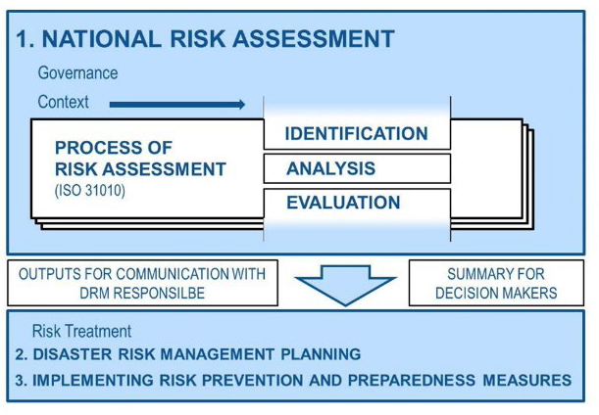
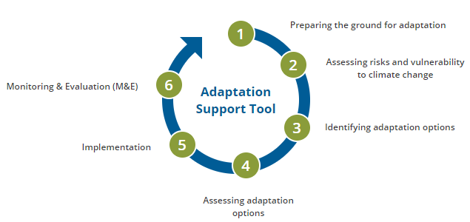
Adapted Risk Management Planning for Civil Protections
Climate Adaptation
Support Tool
https://climate-adapt.eea.europa.eu

Slide 4

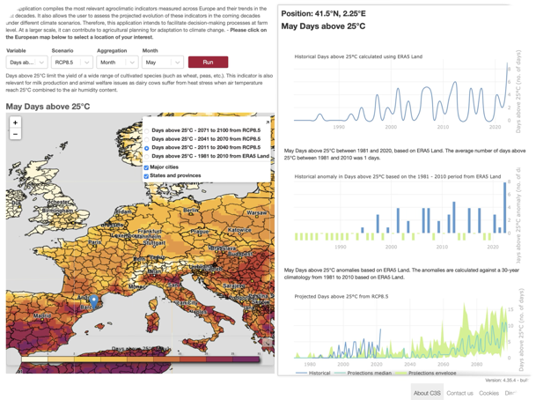
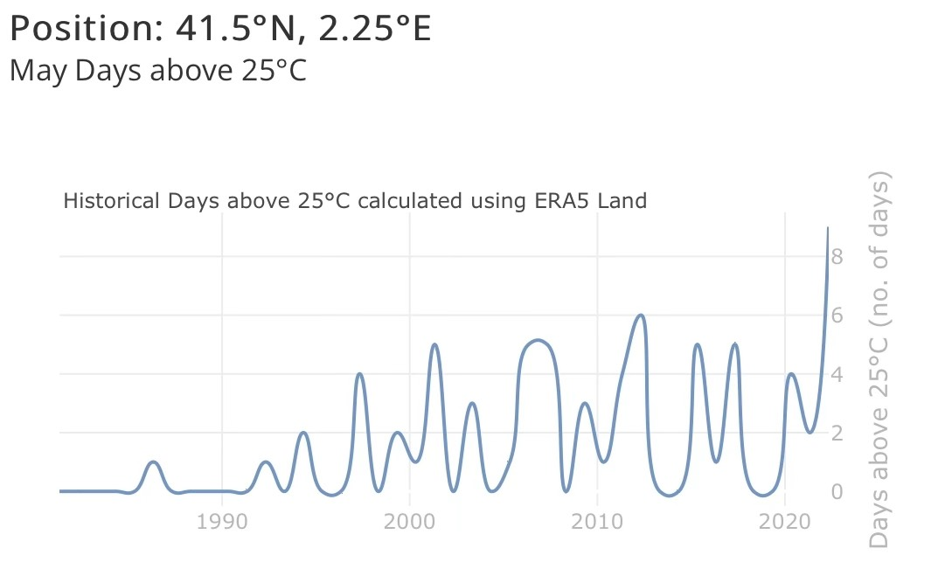
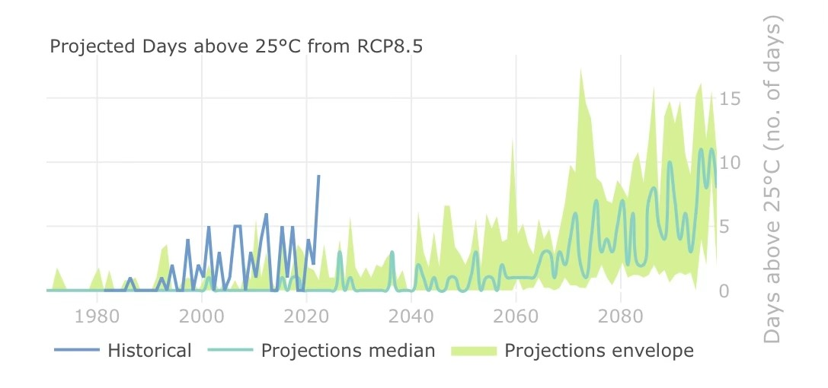

Floods
Flash floods
Landslides
Wildfires
Heatwaves
Coldwaves
Droughts
Wind storms
Snow falls…
METHODOLOGIES to assess the Increase of Impacts
Define a set of Climatic Indicators related to the variables triggering the different hazards
Be able to calculate them in the PAST
And in the FUTURE (projections)
Pre-calculate these Indicators thoroughly => NON BIASED projections
Be able to easy extract and represent them at any location
PAST
ERA5 reanalysis
FOR ANY HAZARD
FUTURE
NON-BIASED EURO-CORDEX dataset on different RCPs

Slide 5
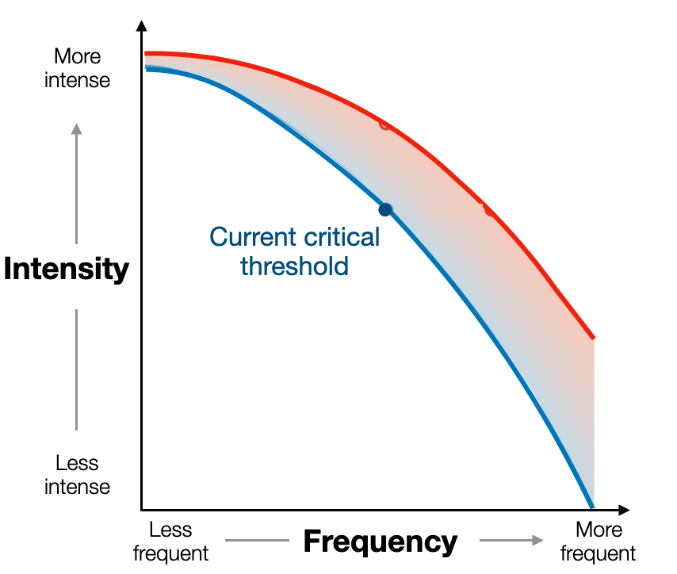
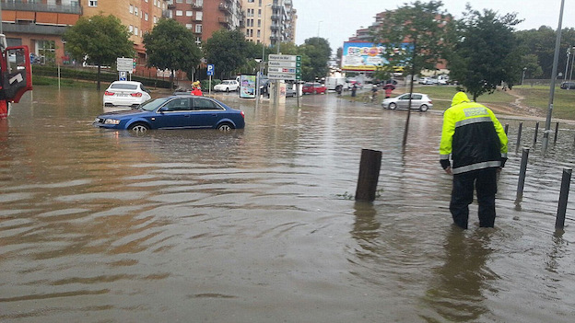

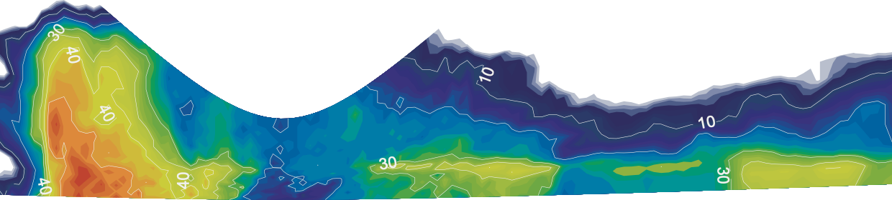
High Intensity Rainfall Floods
How do we manage the expected
change in frequency and magnitude?
T > 10 years
  30
  mm/ 30 min
Same intensity but more frequent
T > 2 years
  30
  mm/ 30 min

Slide 6
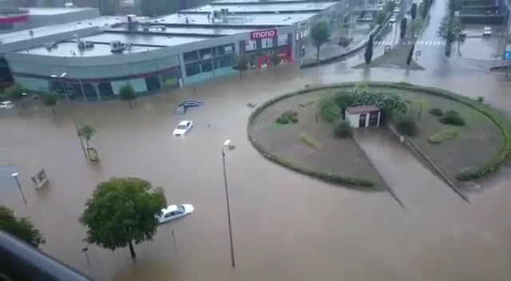
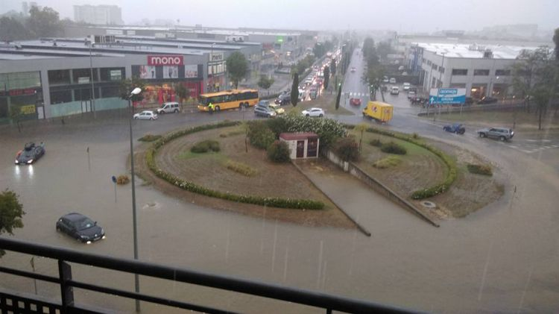
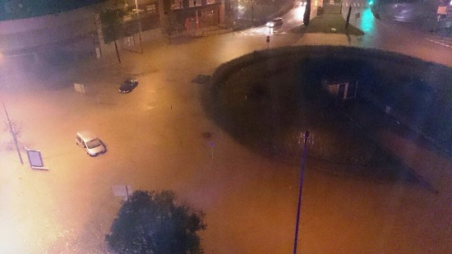
High Intensity Rainfall Floods
How do we manage the expected
change in frequency and magnitude?
T > 10 years
Same frequency but more intense
  30
  mm/ 30 min
T > 10 years
  45
  mm/ 30 min

Slide 7
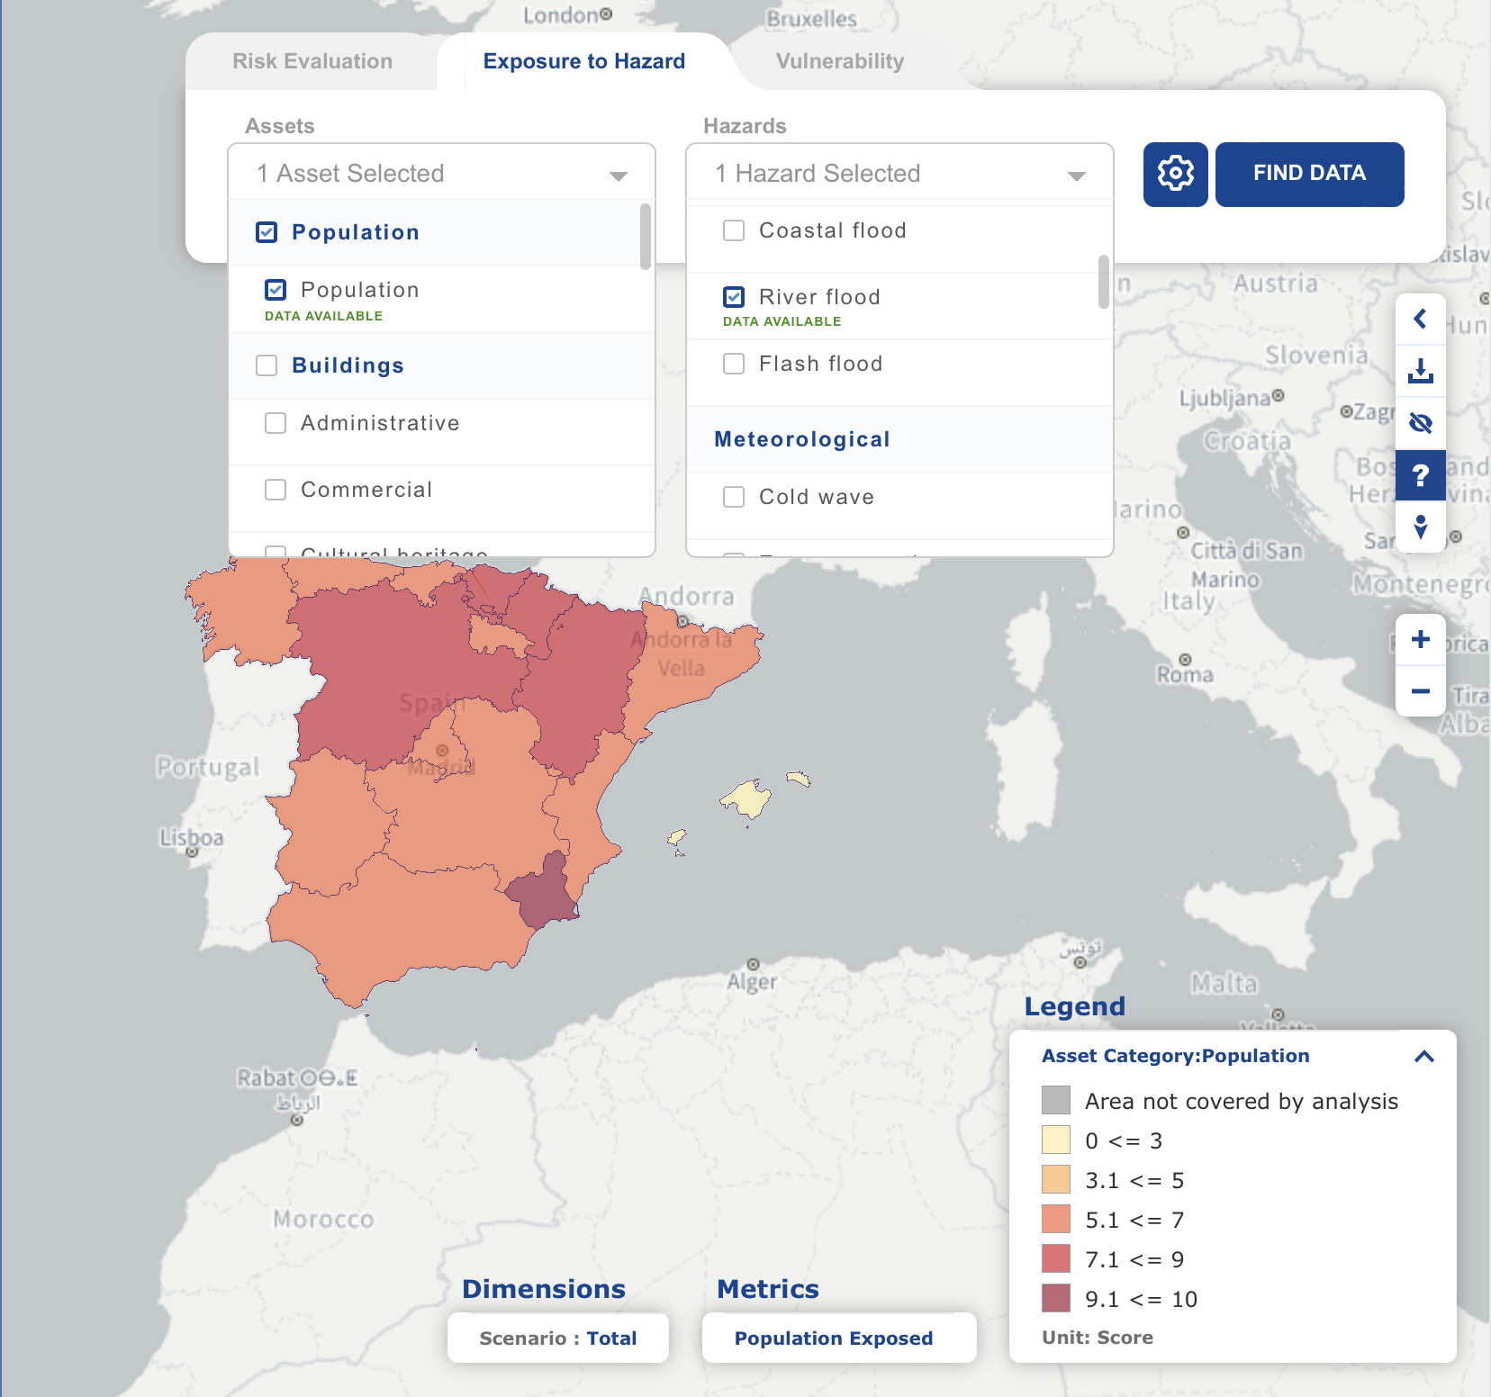
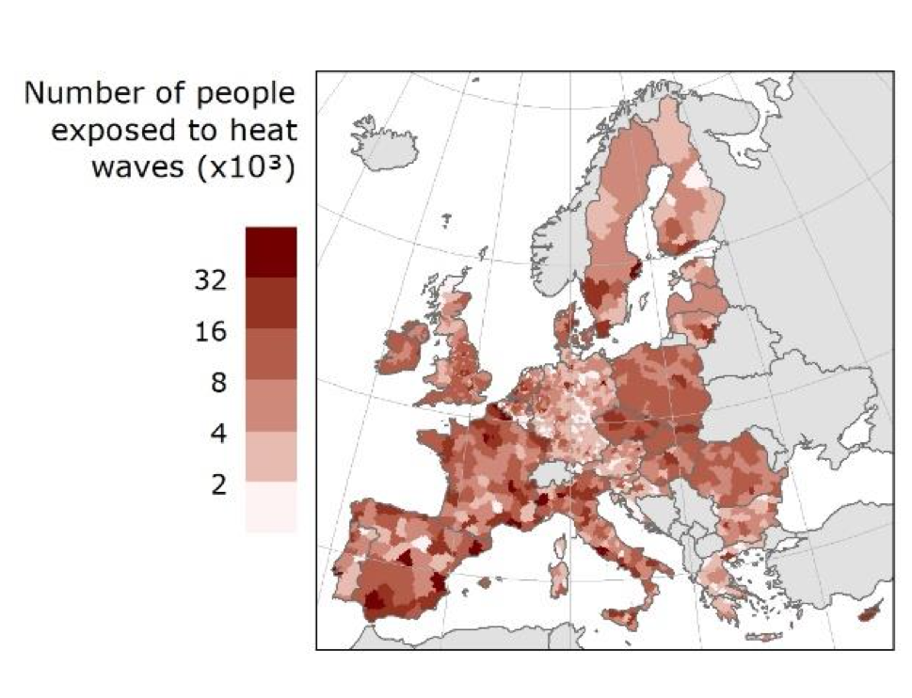
EXPOSURE
Peseta IV / TRACE
Risk Data Hub
EU Reference Scenario from LUISA modelling platform
NUTS-2 (population exposed)
VEGETATION

Slide 8
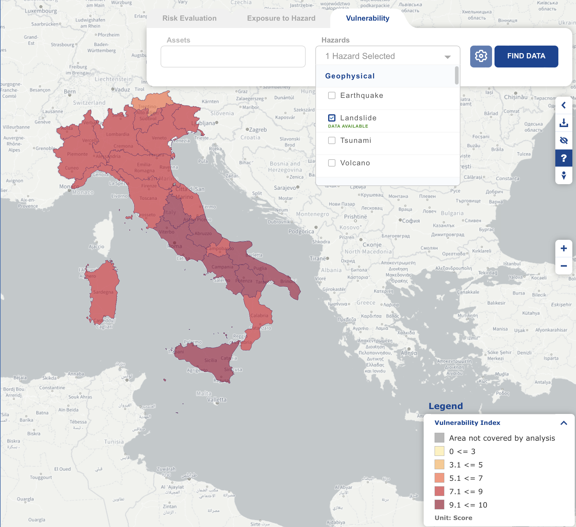
VULNERABILITY
Risk Data Hub
NUTS-2 (vulnerability index)
VEGETATION

Slide 9
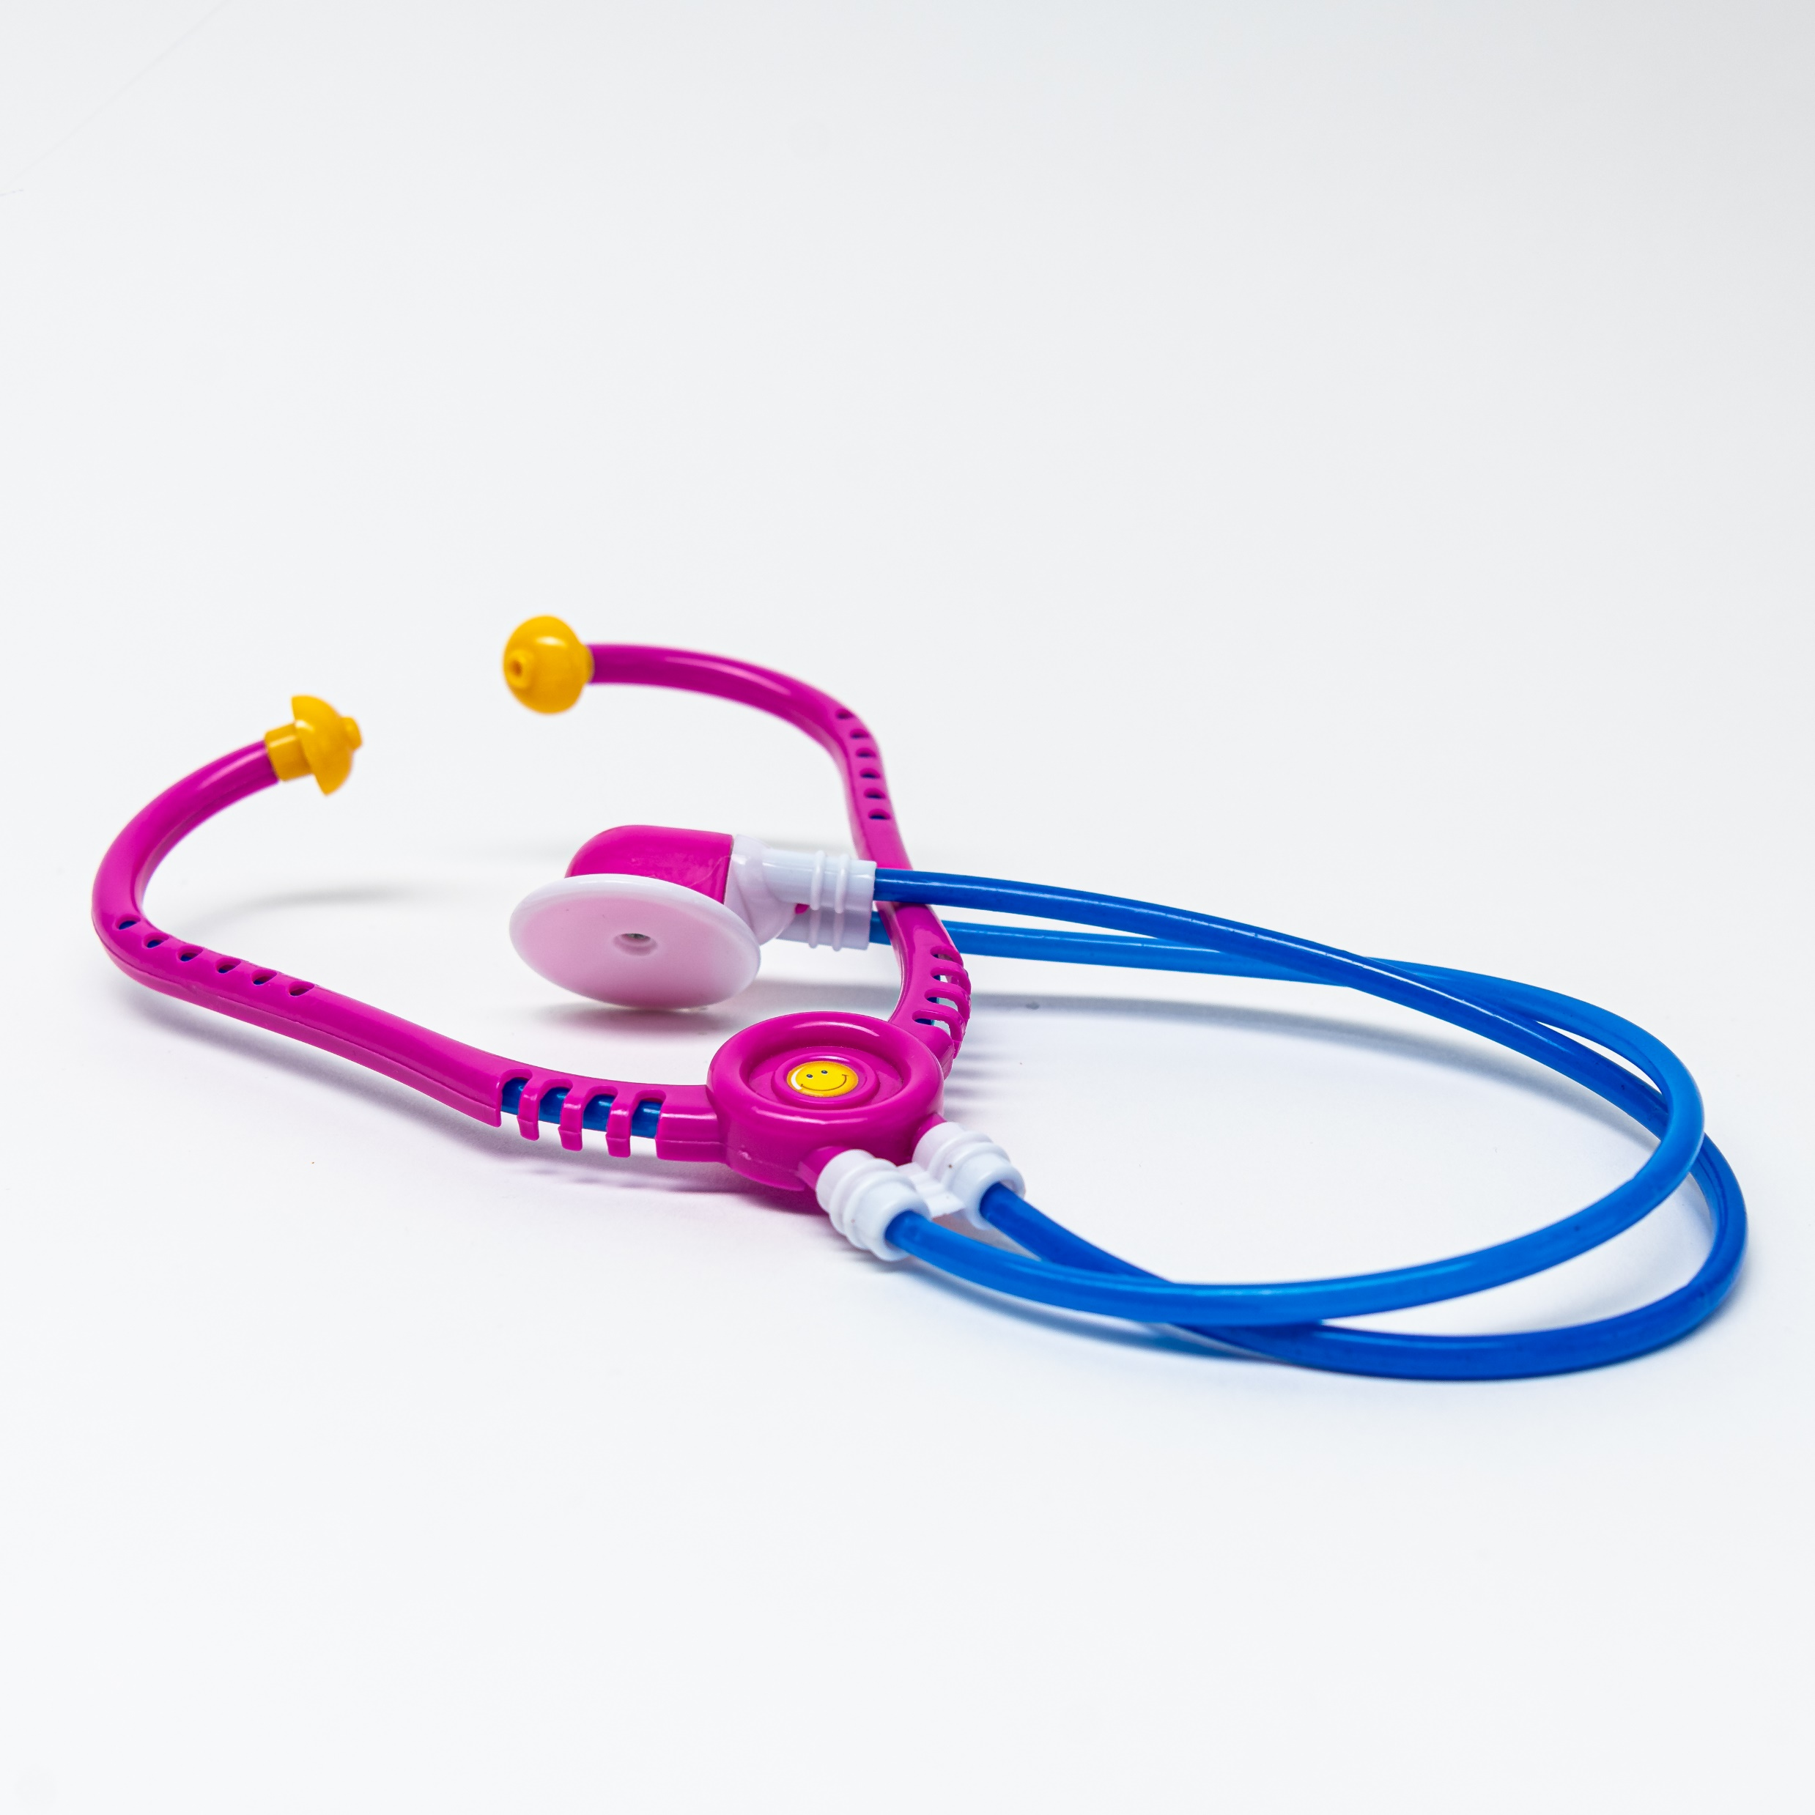
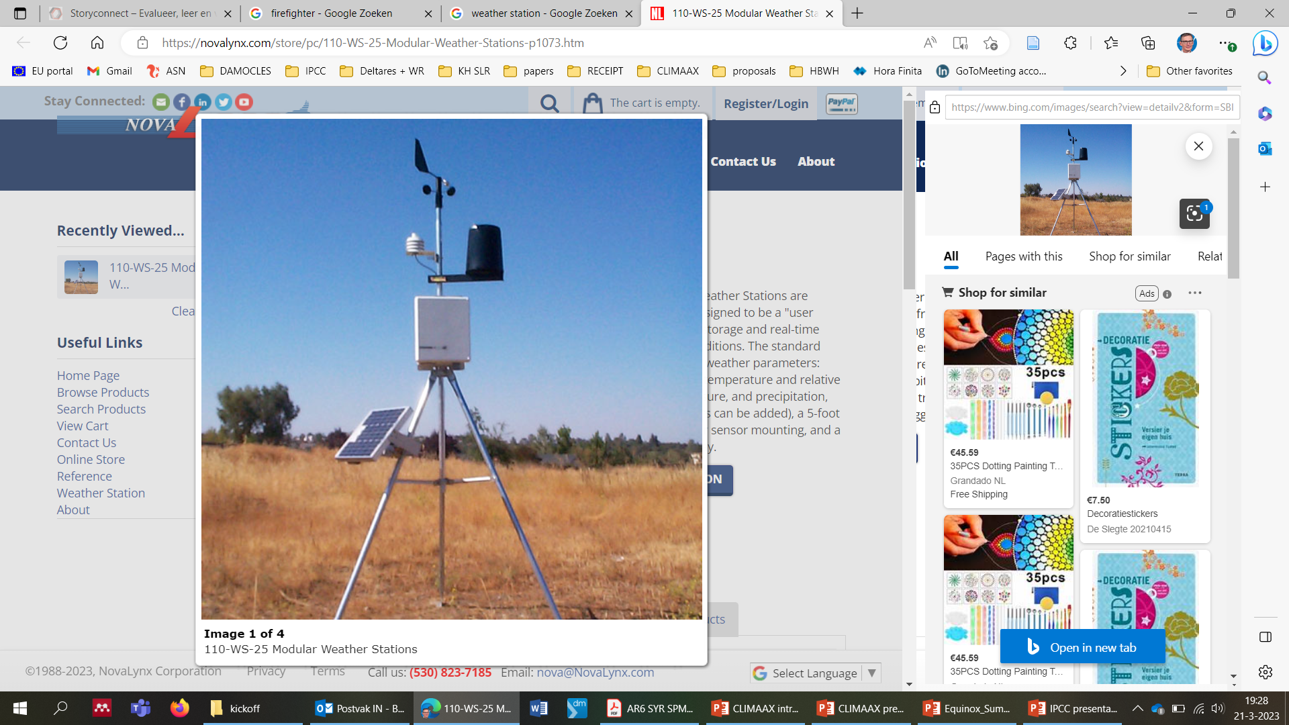
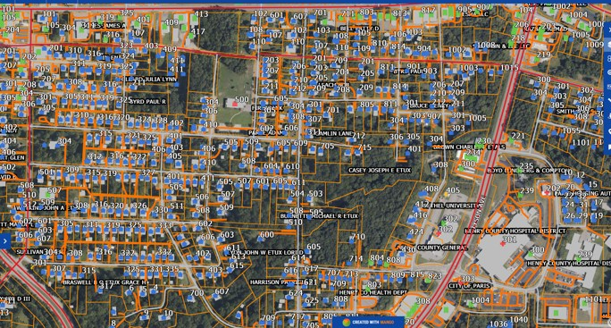
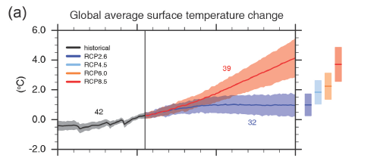

Requirements for a regional CRA
Represent local characteristics (at high resolution)
Represent local climate variability
  Regional climate trends
  Local weather characteristics
Forward looking for hazard, exposure and vulnerability
→ Regional data and expertise is required

Slide 10
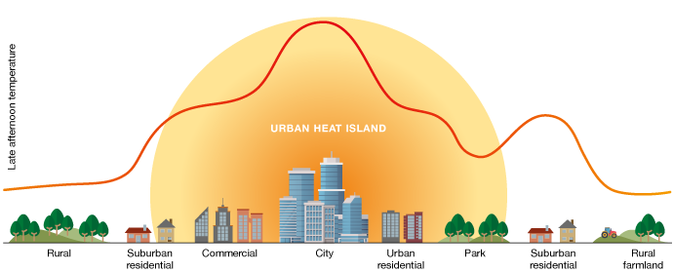
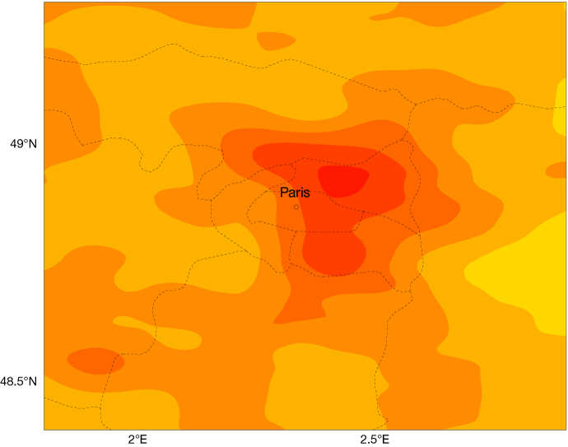
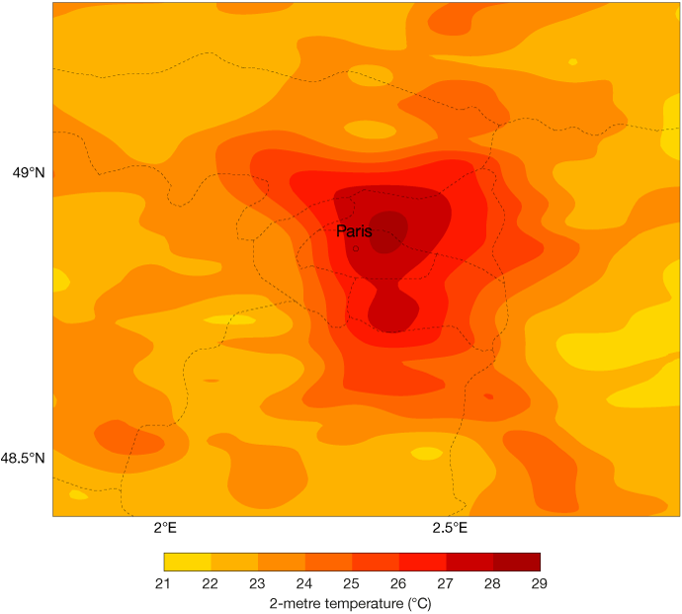
Heat Waves: Critical to take into account Urban Heat Island Effects

Slide 11
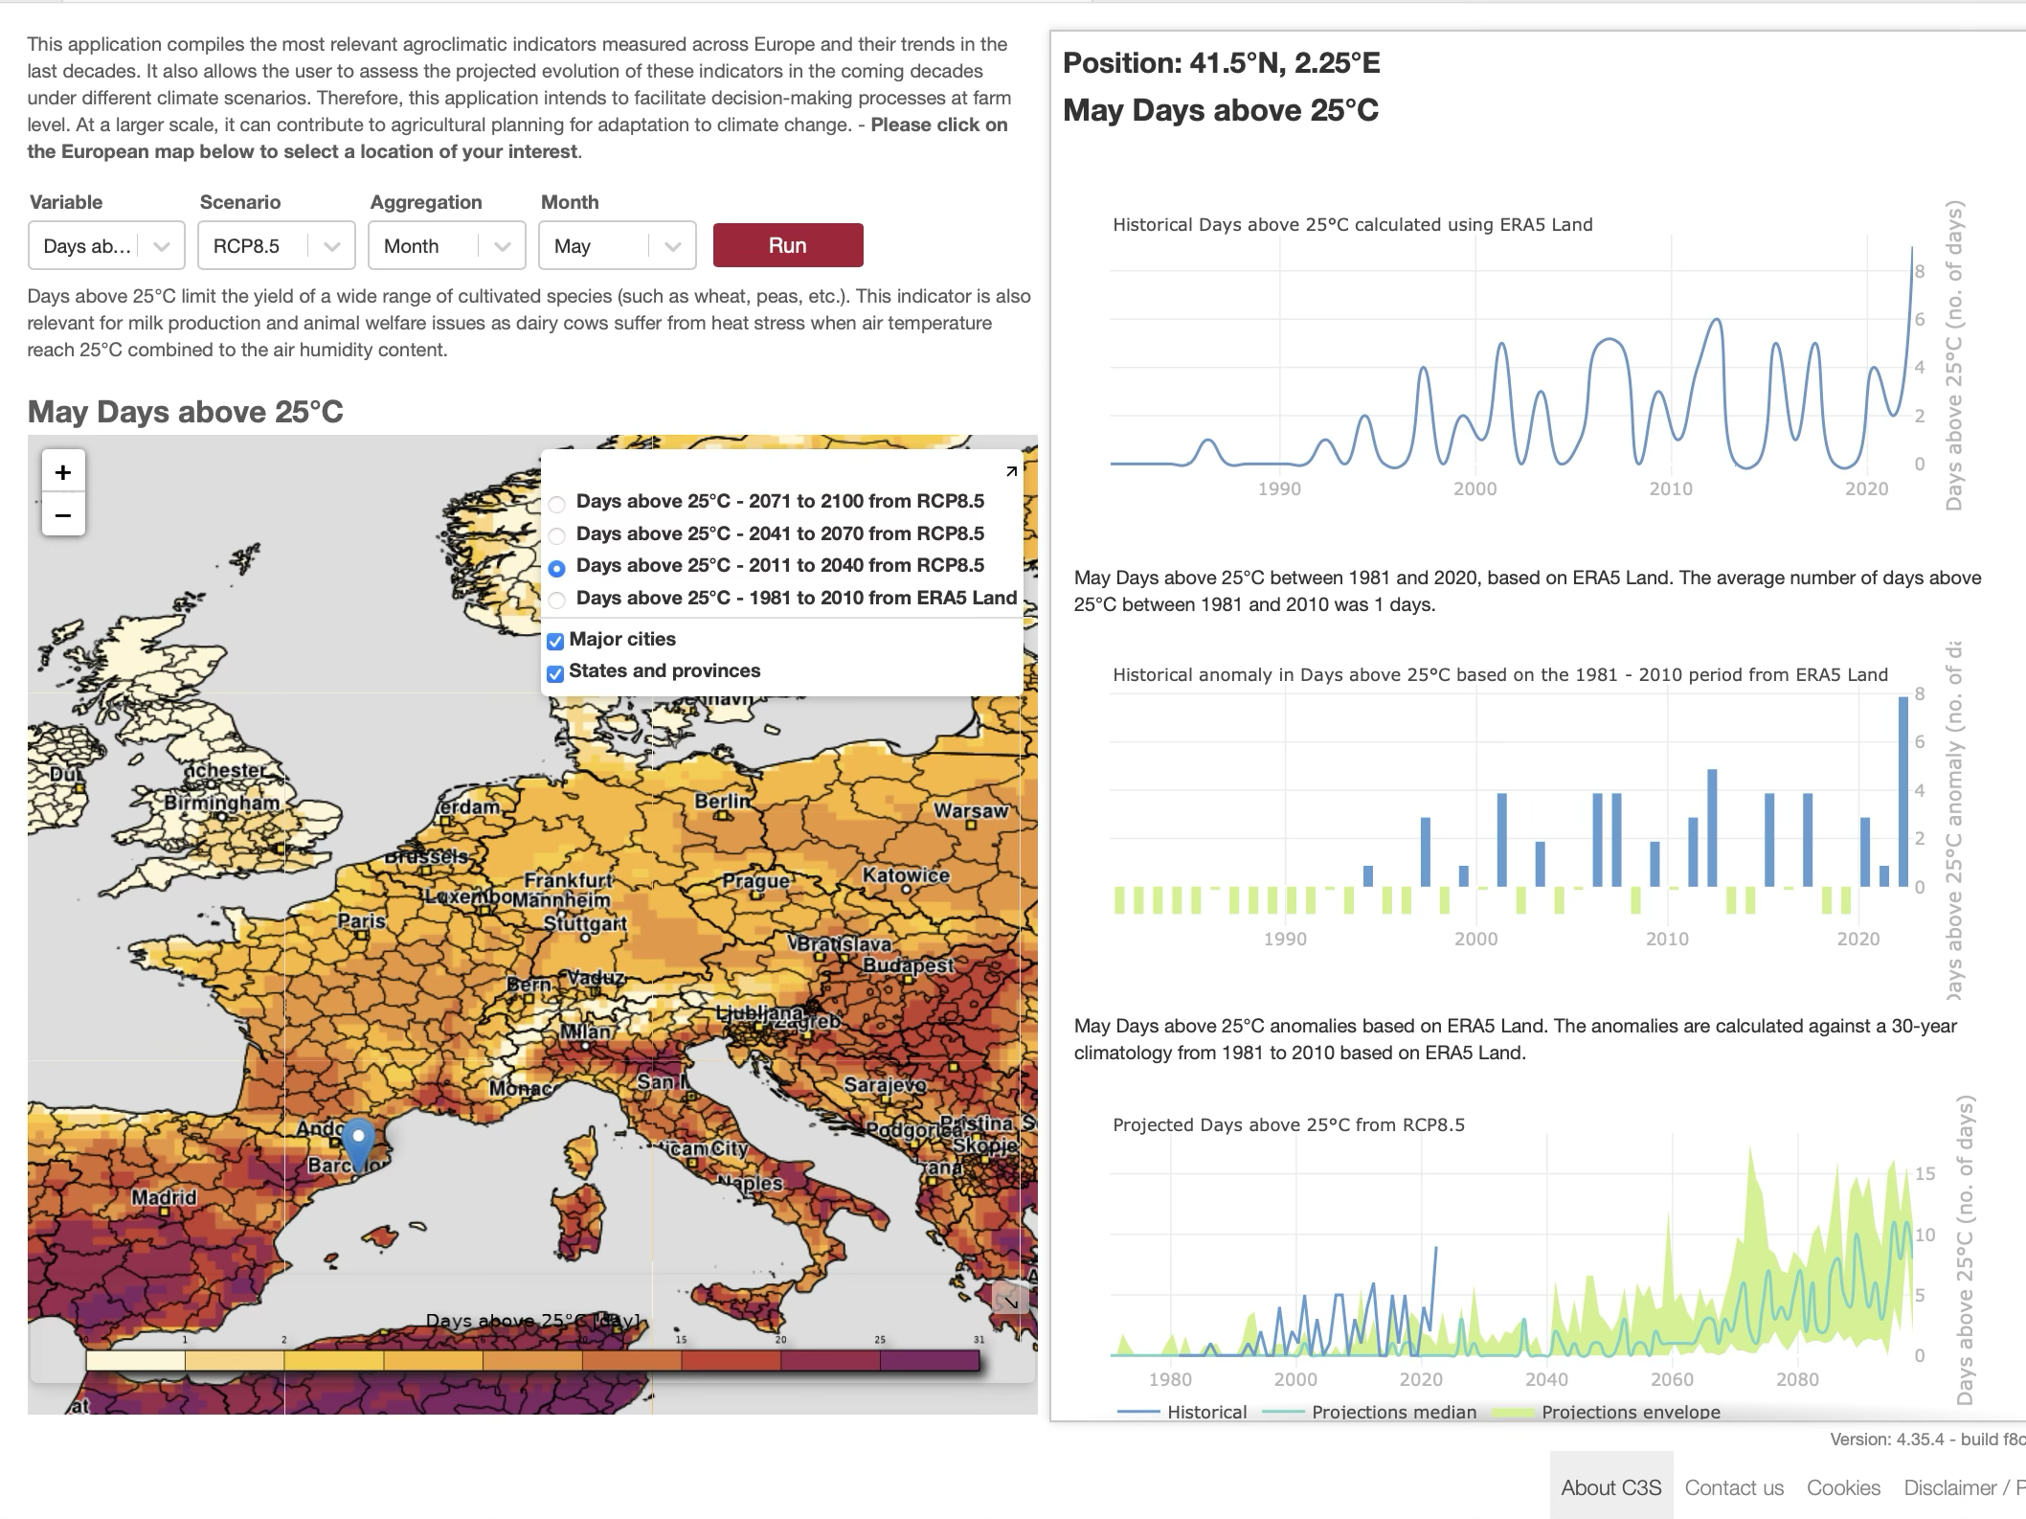
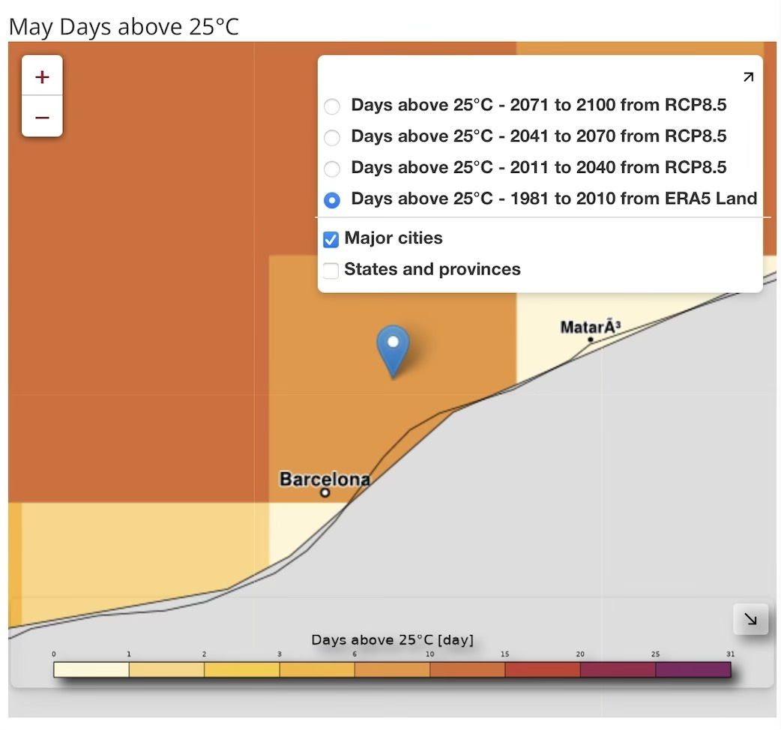
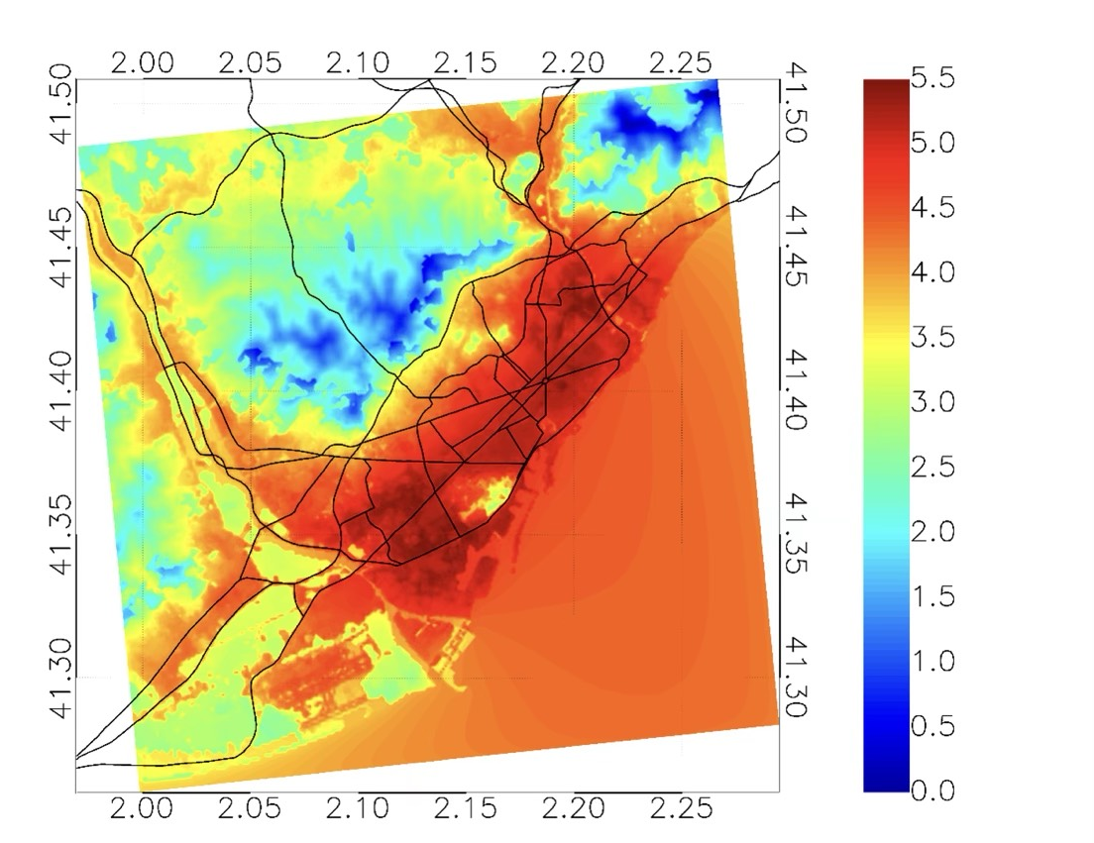
Need of downscaling and include local data
EURO-CORDEX pixel
0.11º resolution
Need to support local downscaling and data integration at local/city level

Slide 12
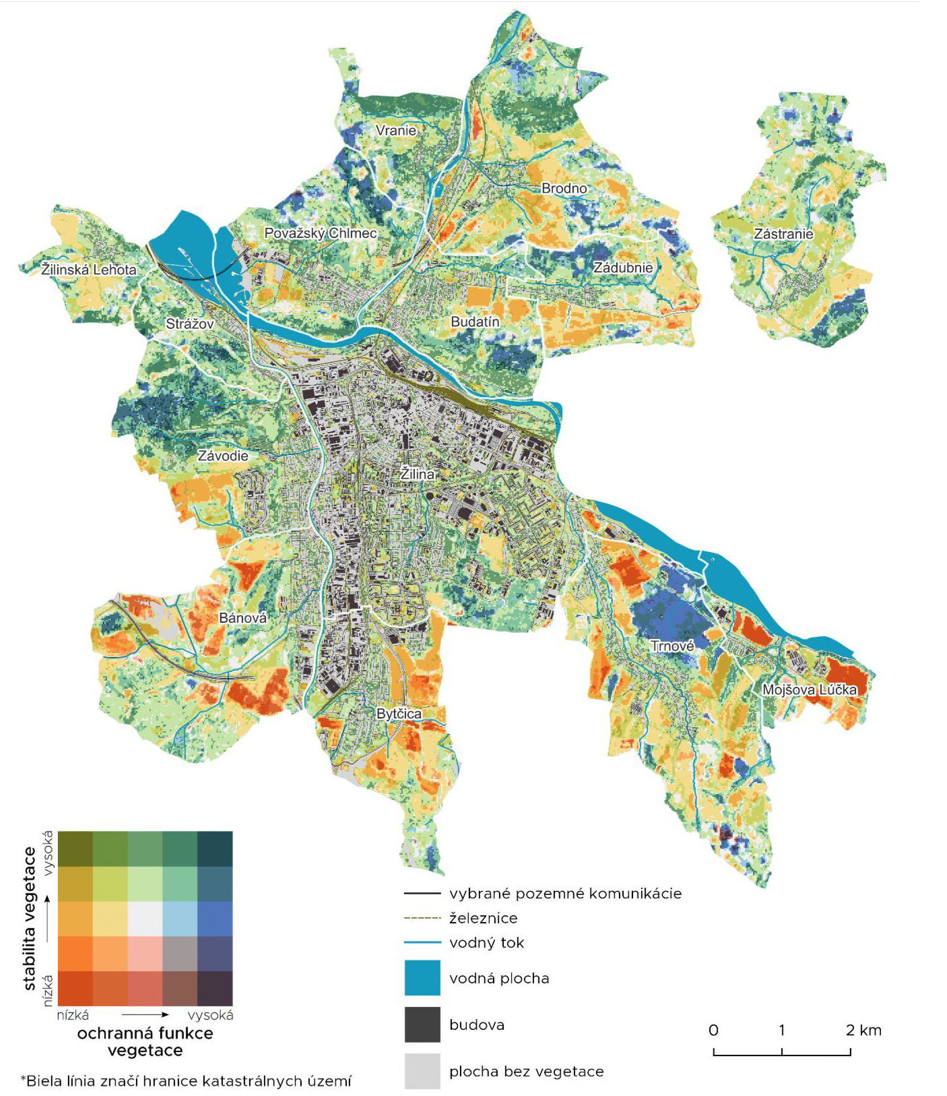
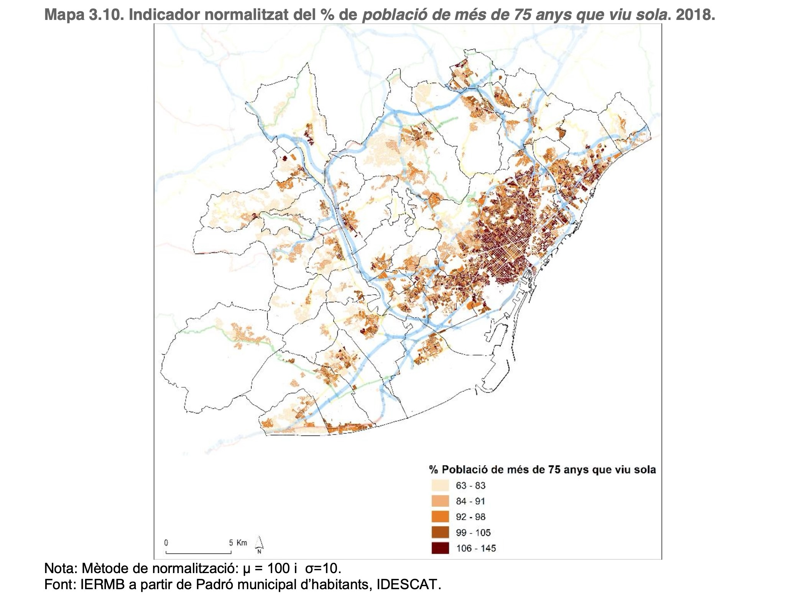
% of Population over 75 years that lives alone in Barcelona Metropolitan Area (2018): IERMB from IDESCAT
Use of local data ENCOURAGED
Žilina city vegetation
VEGETATION

Slide 13
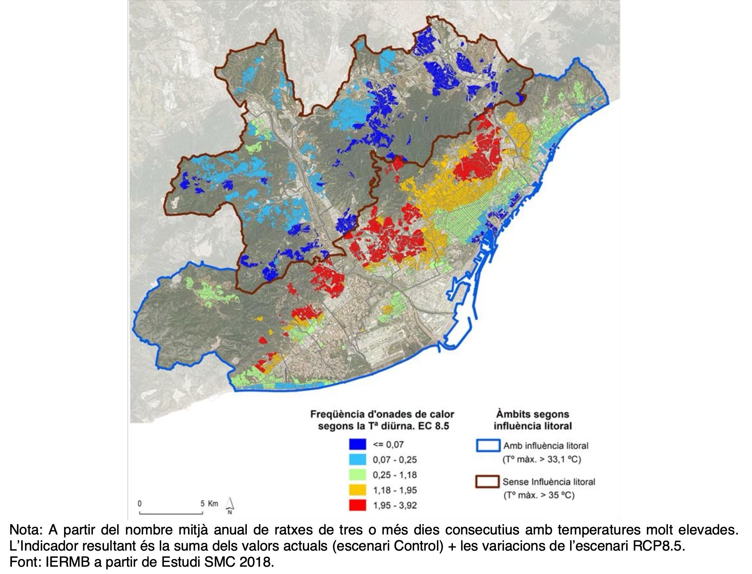
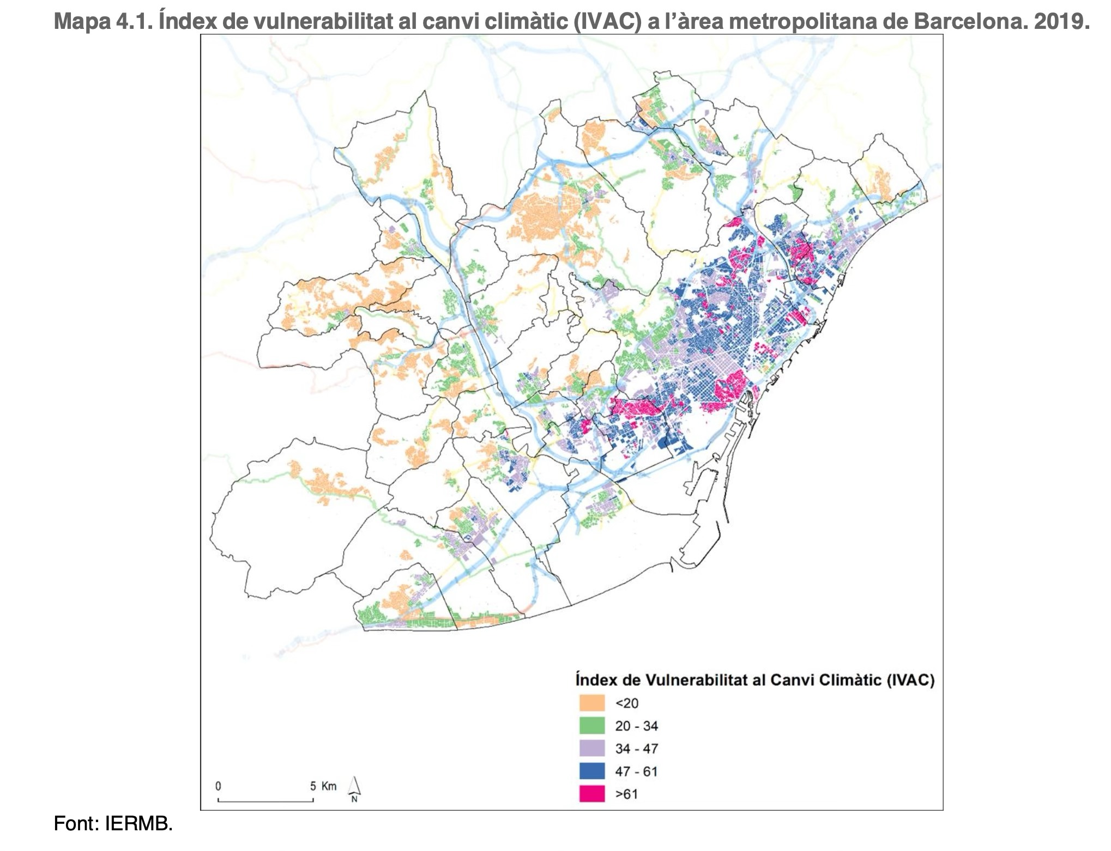
Vulnerability index to Climate Change in Barcelona Metropolitan Area (2019): IERMB
Climatic Indicator of Heat Waves annual frequencies in the Barcelona Metropolitan Area (2011-2040): IERMB
VEGETATION

Slide 14
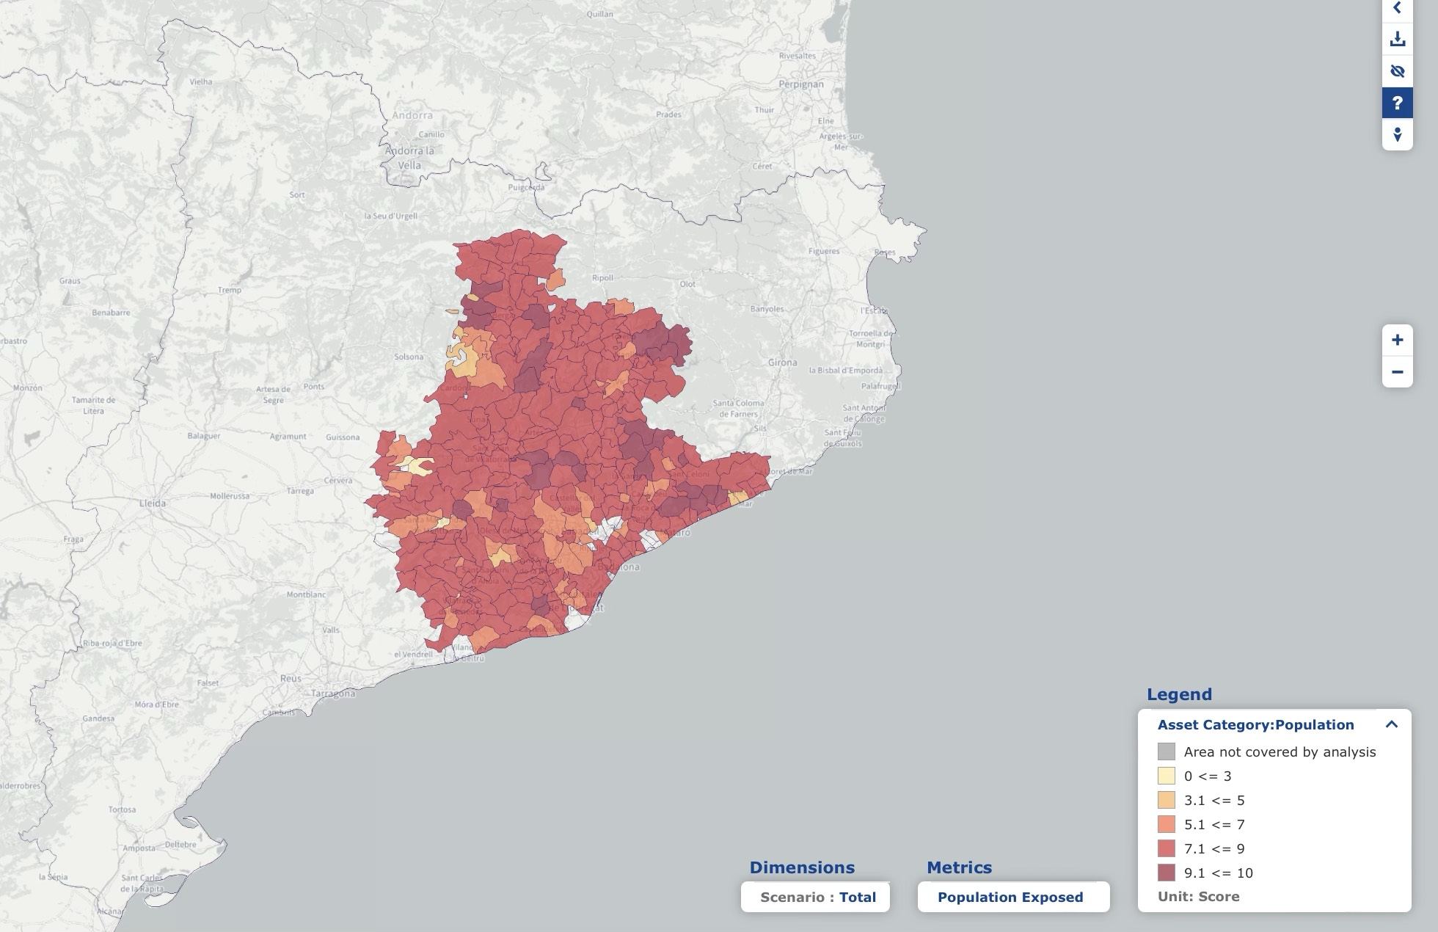
CLIMAAX cannot do local studies…
… but can support third parties to do it at their regional/local scale
CHALLENGE: How to adapt the methodology to extend it to a maximum number of regions/municipalities in Europe
also for wildfires, flash floods, landslides, droughts…

Slide 15
The pillars of CLIMAAX
Framework for regional CRA
→ supporting civil protection and climate adaptation
Toolbox and pilots
→ testing data needs and diversity of requests
Cascading fund
→ Financial support for >60 regions
28 november 2019

Slide 16

The CLIMAAX framework
Norms & principles
Inventory of experience, best practices
Consultation in regions & sectors
Practical guidance
Past and future trends
Risk indicators & viewpoints
Follow-up
uptake into DRM and climate adaptation strategy

Slide 17

The CRA toolbox principles
Base layer: similar to Risk Data Hub (regional climate/exposure/vulnerability data from pan-European datasets) (non-expert user)
Dashboard layer: online risk assessment tool with local data (local user)
Download layer: local manipulation of all scripts and data (advanced user)

Slide 18
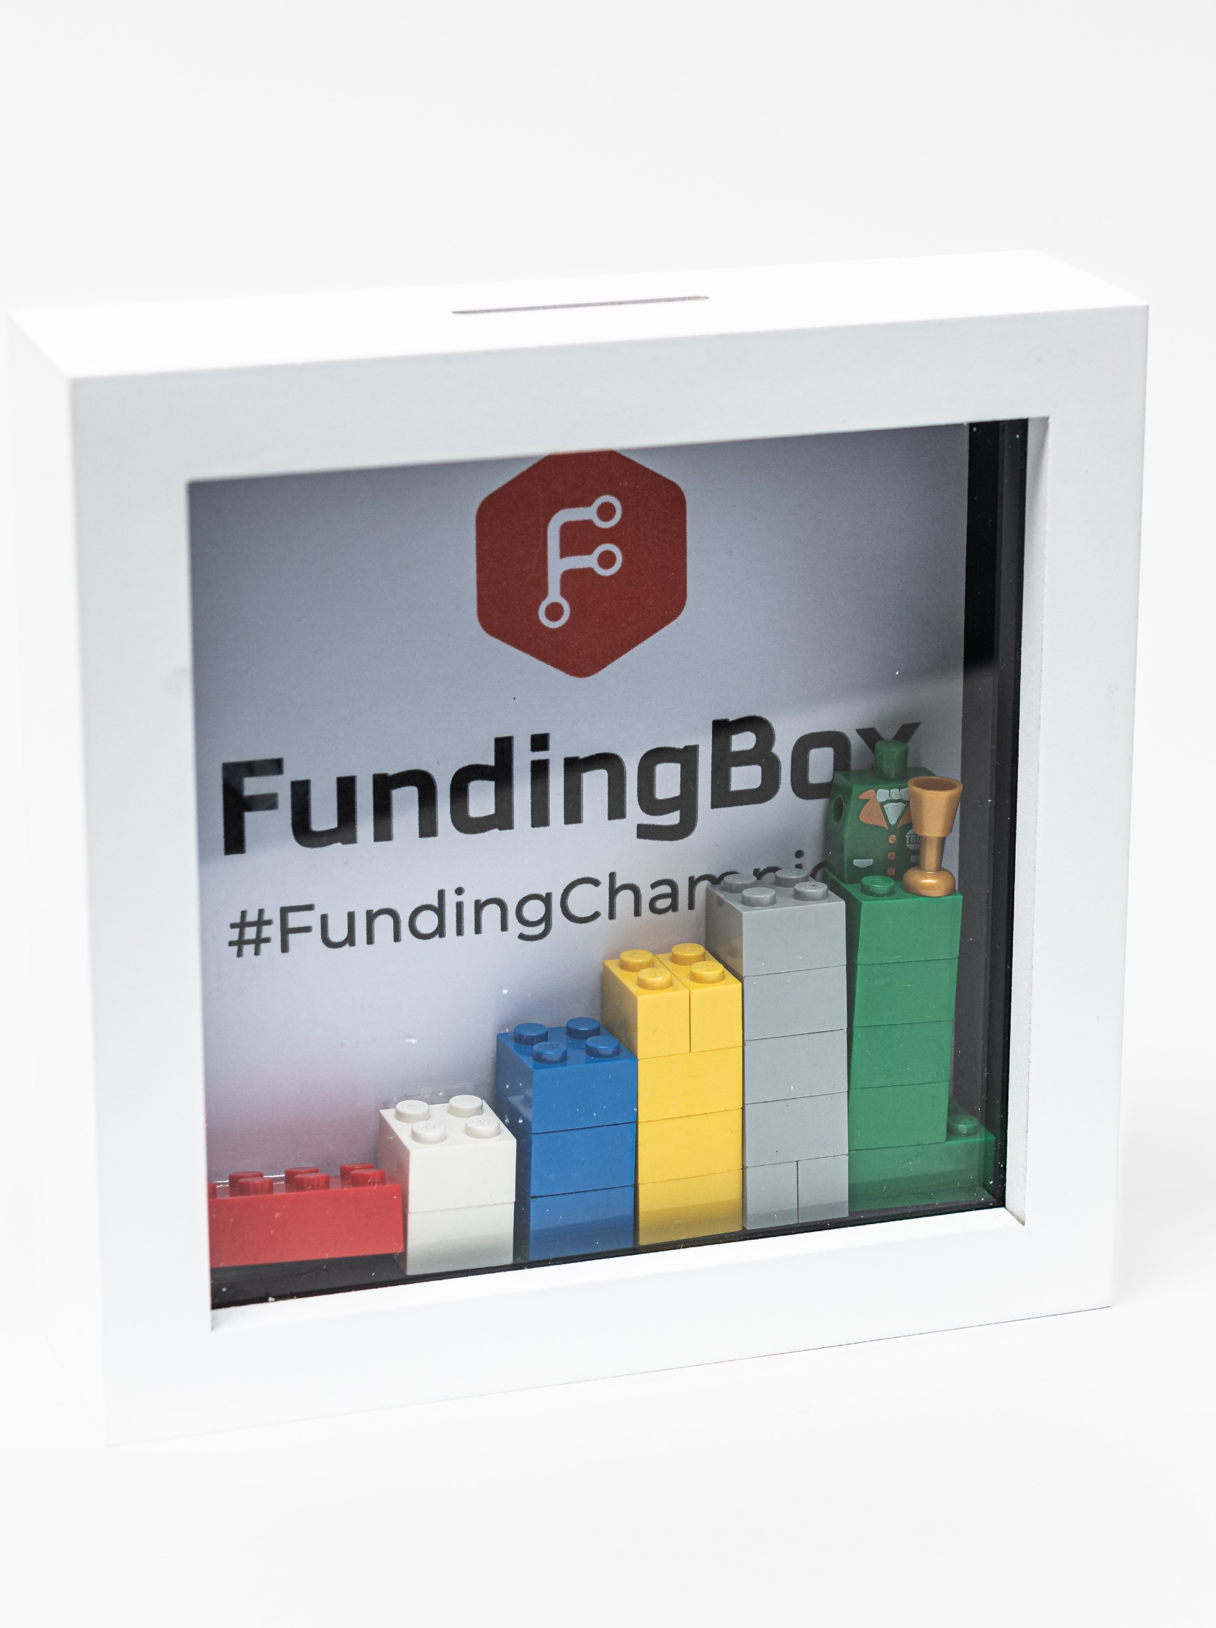
The cascading fund
Financial support for regions
At least 60 regions & communities
Criteria include diversity and needs
Formal call procedure
Selection procedure & criteria
1st Call open
8 December 2023 – 8 March 2024
2 rounds
2yr projects finalize autumn 2026
28 november 2019
https://climaax-call4regions.fundingbox.com/

Slide 19
Financial Support for Third Parties
M6
M18
M24
STEP 1: COMMON METHODOLOGY applicable at regional/local scale in Europe
STEP 3: BETTER REGIONAL/LOCAL ADAPTATION STRATEGIES AND RISK MANAGEMENT PLANS
STEP 2: REFINED REGIONAL/LOCAL HR ANALYSIS AND RISK ASSESSMENT
Multi-risk
Applicable in any interested region/municipality/community
Able to establish a common Risk Assessment benchmark across Europe
Using as much as possible the information already available
Applicable in any location in EU
Using local data /downscaling of the projected climate indicators by third parties
Capable to integrate local high-resolution data and approaches
Able to enhance regional/local risk assessments
Applicable by third parties to any location in EU
Uptake into regional/local adaptation strategies and RMPs in the region/community
Produce technical documents to support the look for funding to implement the adaptation strategies
Examples of best practices
IMPLEMENTATION IN 60-100 regions/municipalities/communities

Slide 20
What do we want to learn from this?
Framework for regional CRA
→ supporting civil protection and climate adaptation
Toolbox and pilots
→ testing data needs and diversity of requests
Cascading fund
→ Financial support for >50 regions
28 november 2019

Slide 21
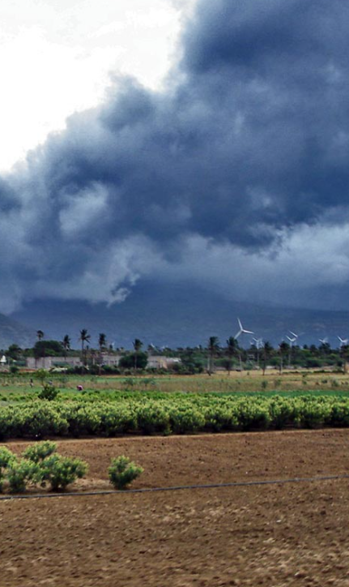
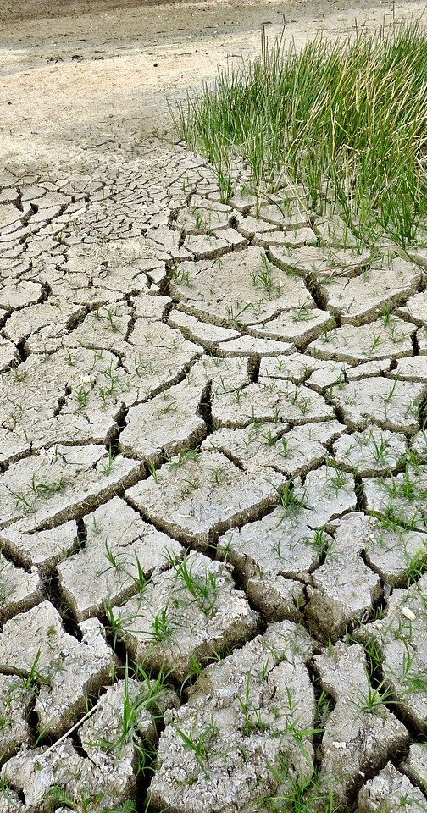
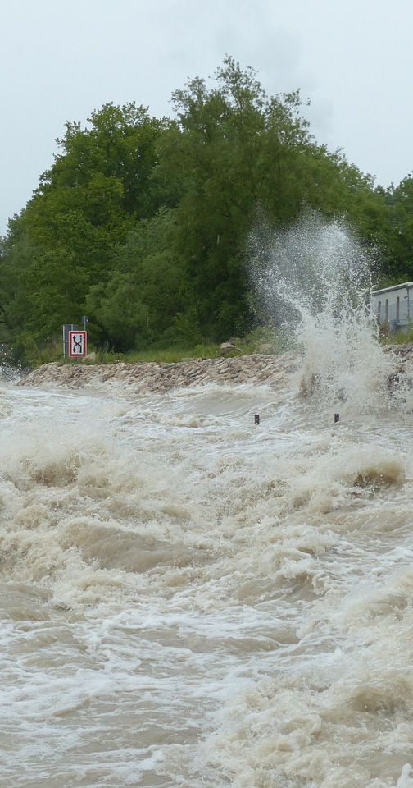
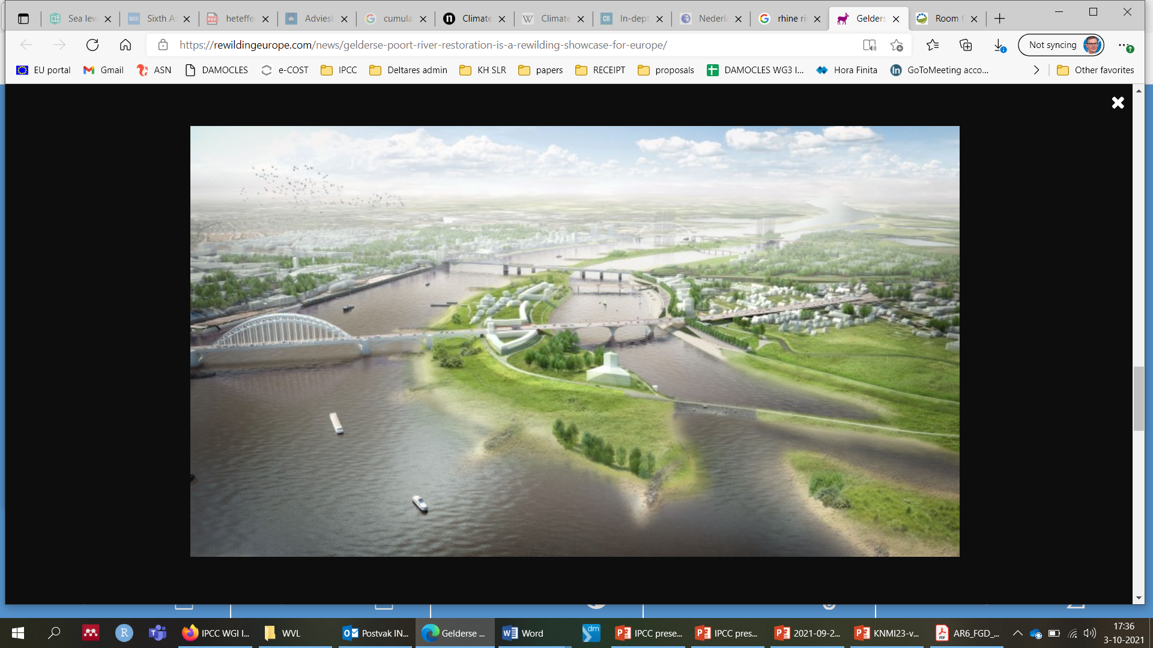
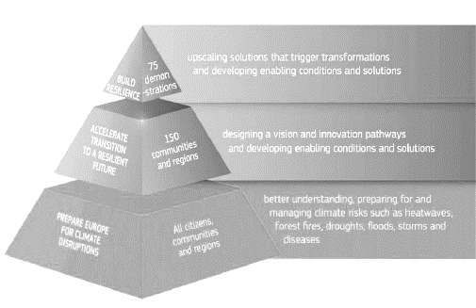
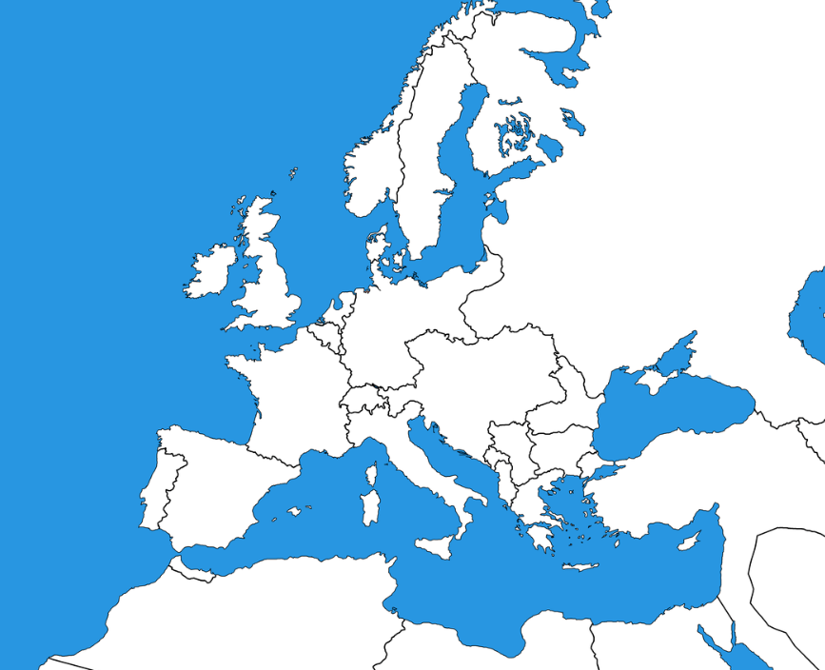
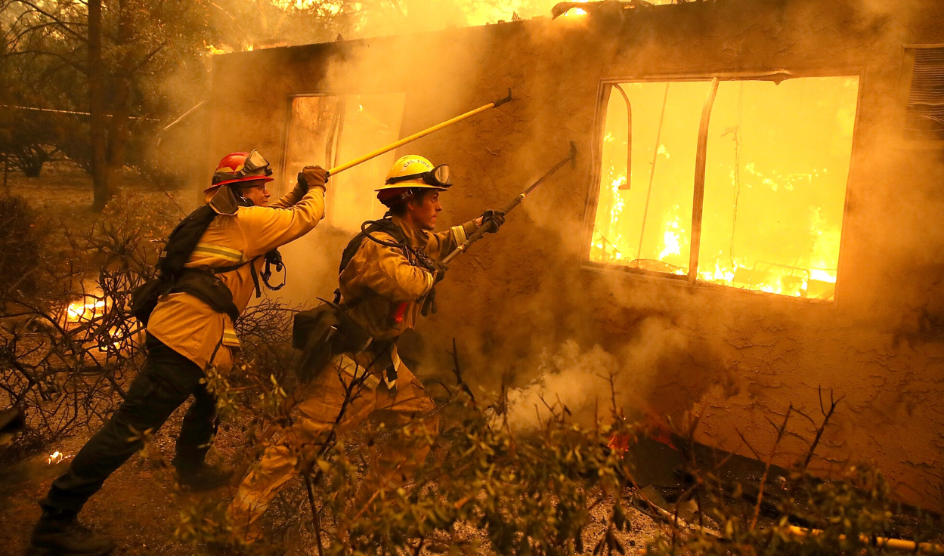
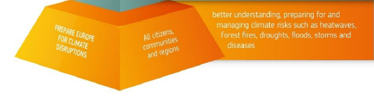
Regional Climate Risk Assessments are very diverse
Many challenges
Multiple data sources
Our motto:
standardized flexibility
Many regions
Climate adaptation and civil protection

Slide 22

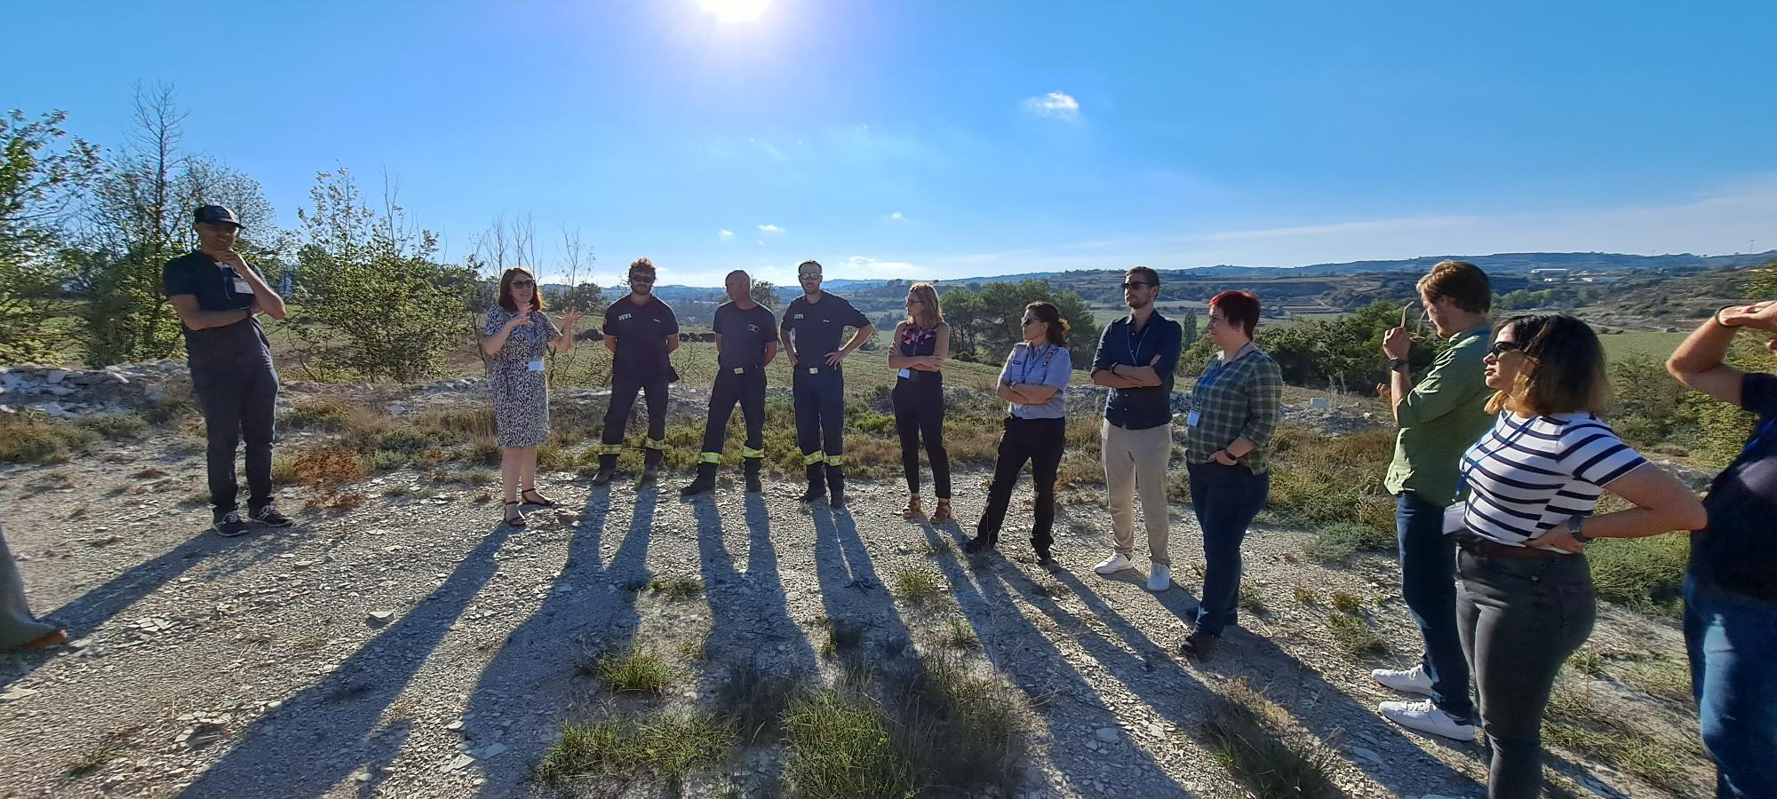
Learning by doing
5 Pilot regions
Site visits revealed key issues
Helping with shaping toolbox & application
28 november 2019

Slide 23
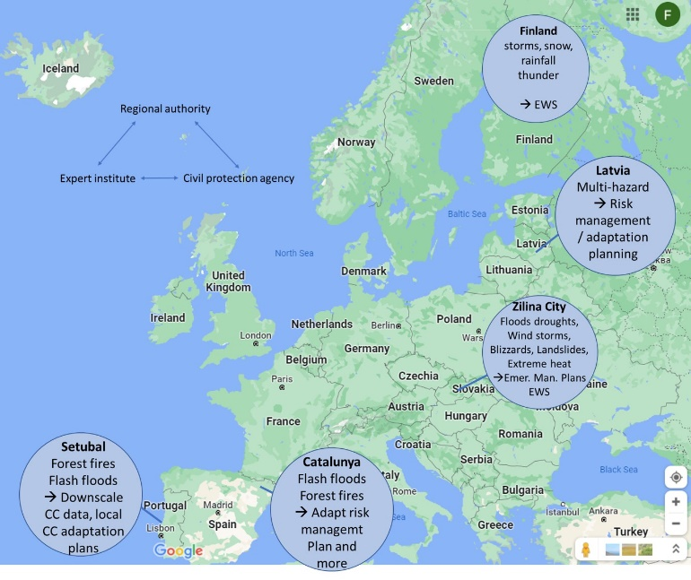
Learning by doing
5 Pilot regions
Demo for applicants
Demo workshop
~29-31 January Setubal (PT) + online
28 november 2019

Slide 24

Synthesis of regional CRAs
Lessons to be learned
Fine tuning the regional support service
Exploit the market potential
CRA standardisation and connection to European policies
Actions
Monitoring the implementation
European Synthesis
Connect to follow-up project on policy implementation
28 november 2019

Slide 25
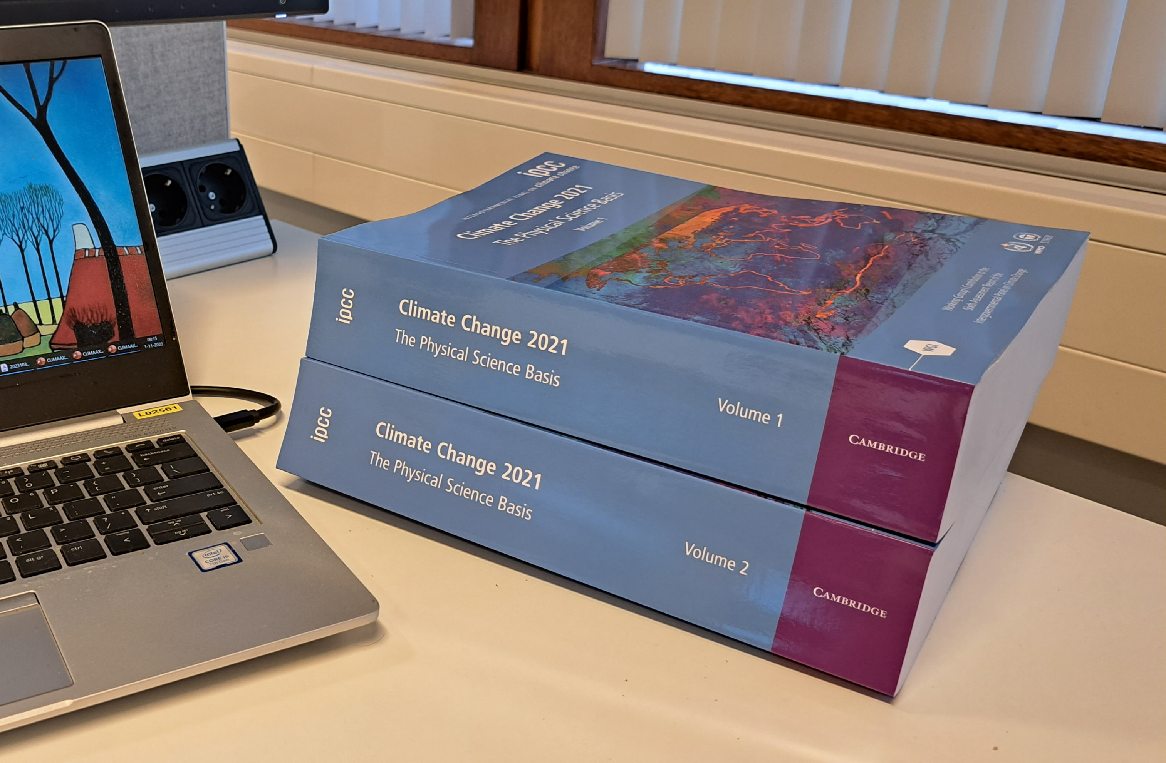

Legacy for my role in IPCC
Co-chair Working group 2
Action holders could recognize themselves better
→ Assessment via a set of decision archetypes
Reports could be thinner
→ focus on the knowledge that makes a difference in decision taking
28 november 2019

Slide 26
Contact info
https://www.climaax.eu
info@climaax.eu
28 november 2019

