Slide 1



CLIMAAX
CLIMate risk And vulnerability Assessment framework and toolboX
Regional Risk Assessments
for Civil Protection and Climate Adaptation
Daniel Sempere-Torres
UPC-CRAHI

Slide 2

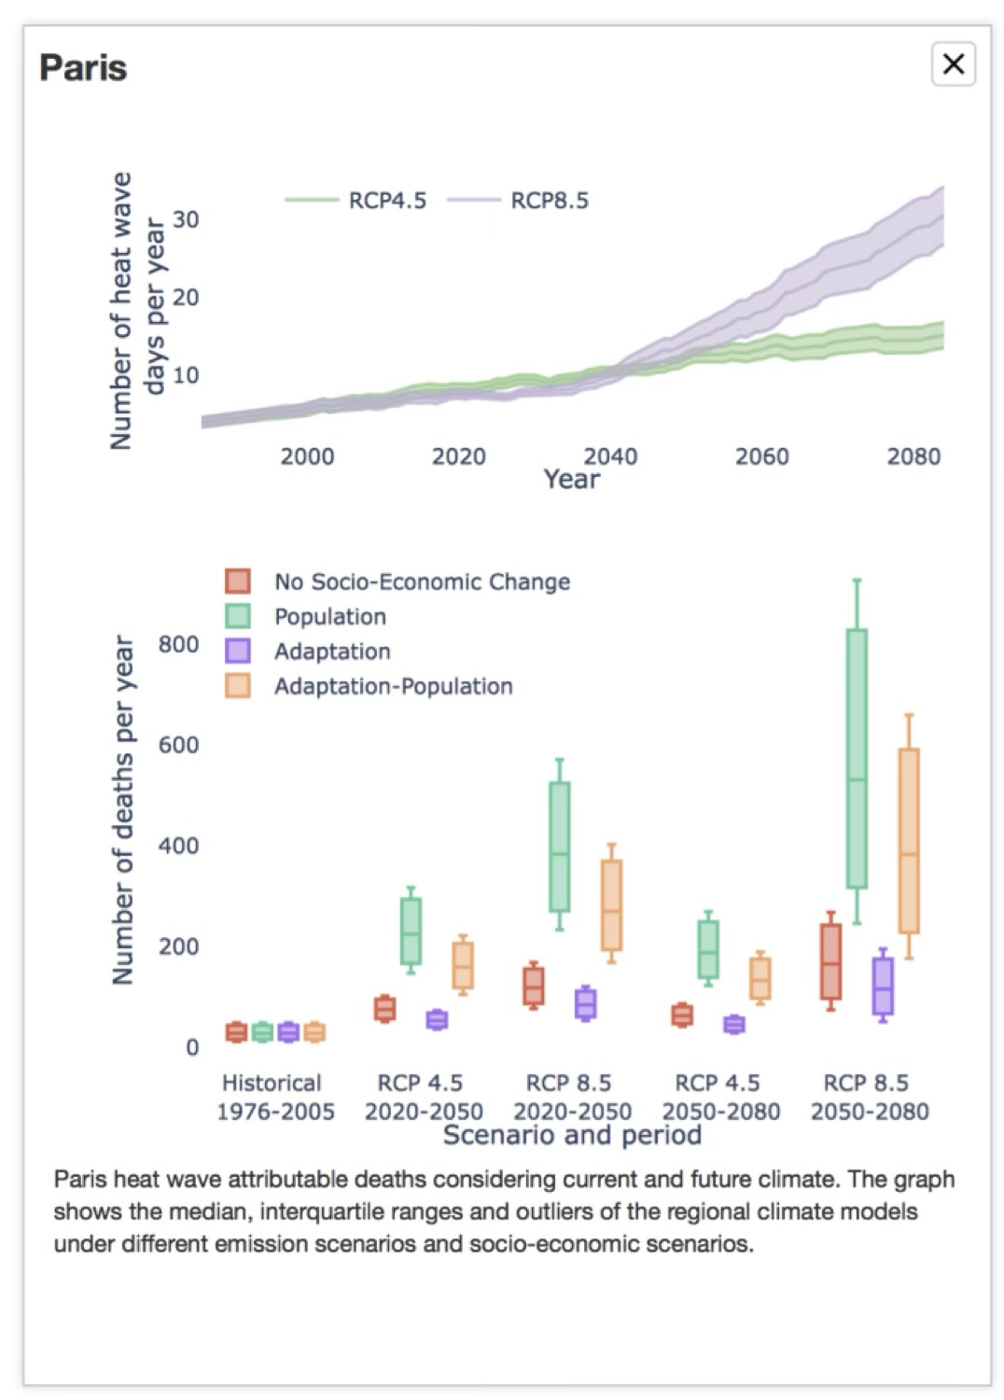
https://www.climaax.eu/
FUTURE
RISKS
INCREASE OF IMPACTS DUE TO CLIMATE CHANGE
PRESENT
RISKS
METHODOLOGICAL APPROACH for REGIONAL/LOCAL SCALE
Climate Risk Assessment to increase regional Resilience and
Improve local Risk Management Plans

Slide 3
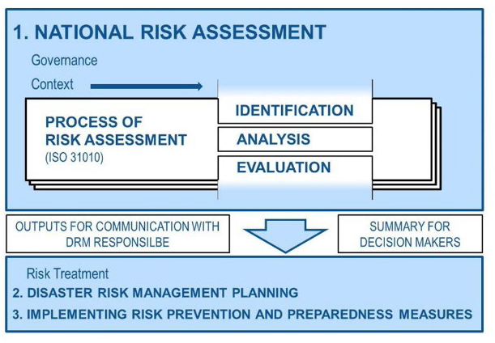
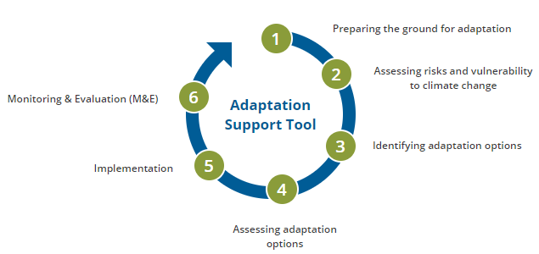
Adapted Risk Management Planning for Civil Protections
Climate Adaptation
Support Tool
https://climate-adapt.eea.europa.eu

Slide 4
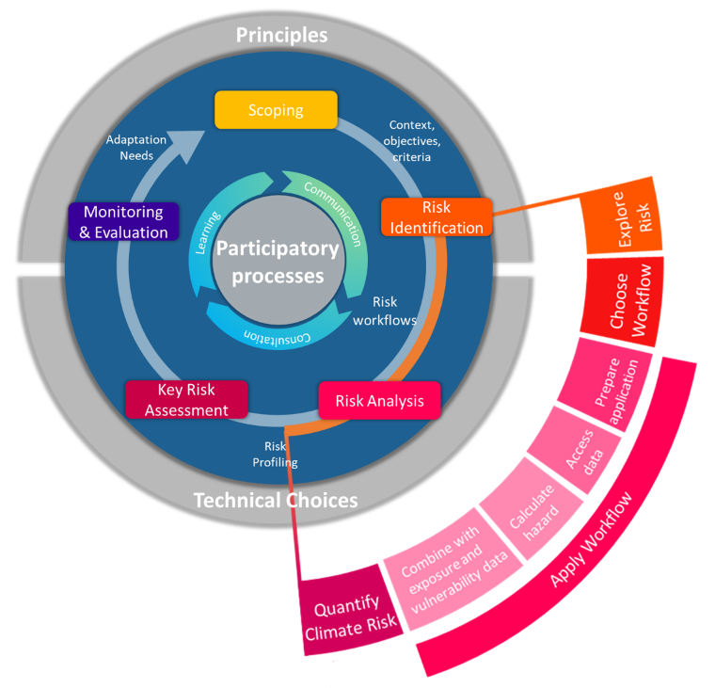
Climate Adaptation
28 november 2019
CLIMAAX methodological Framework for Climate Risk Assessment

Slide 5

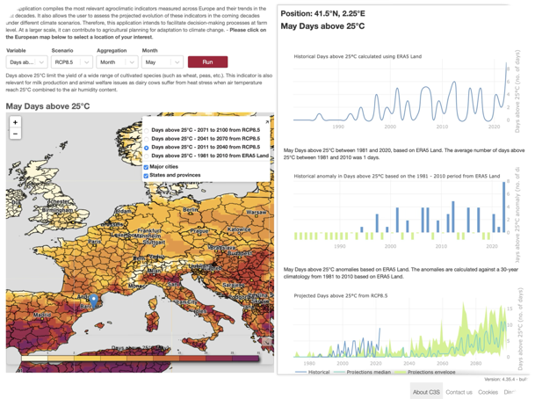
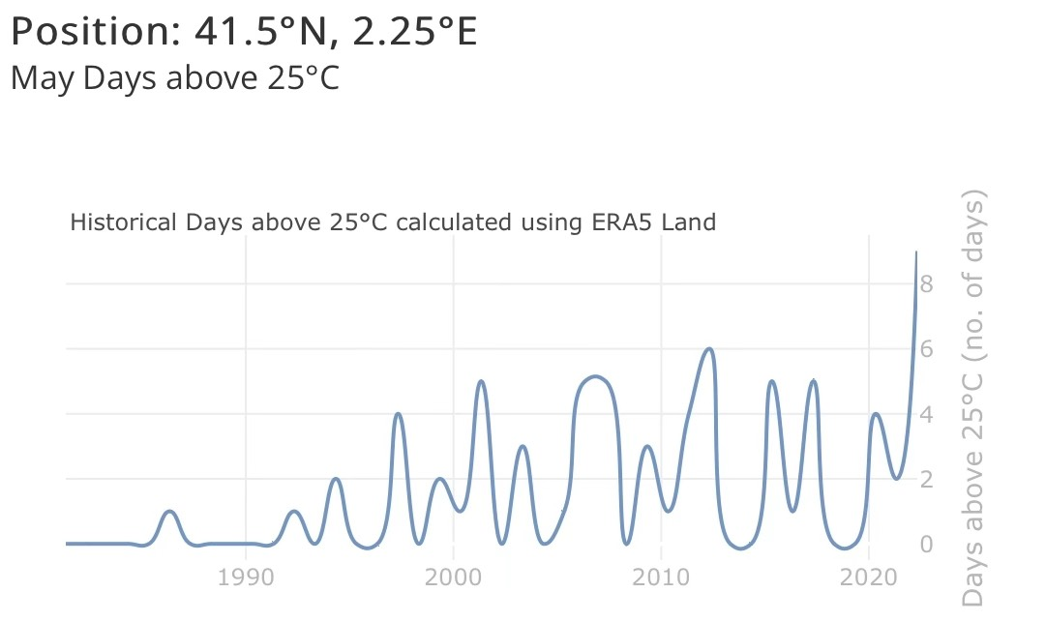
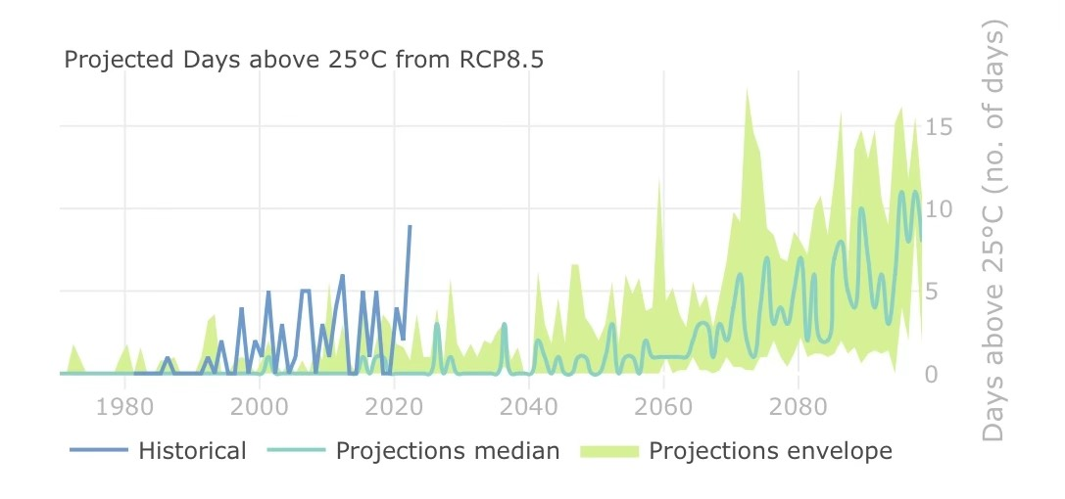

Floods
Flash floods
Landslides
Wildfires
Heatwaves
Coldwaves
Droughts
Wind storms
Snow falls…
METHODOLOGIES to assess the Increase of Impacts
Define a set of Climatic Indicators related to the variables triggering the different hazards
Be able to calculate them in the PAST
And in the FUTURE (projections)
Pre-calculate these Indicators thoroughly => NON BIASED projections
Be able to easy extract and represent them at any location
PAST
ERA5 reanalysis
FOR ANY HAZARD
FUTURE
NON-BIASED EURO-CORDEX dataset on different RCPs

Slide 6
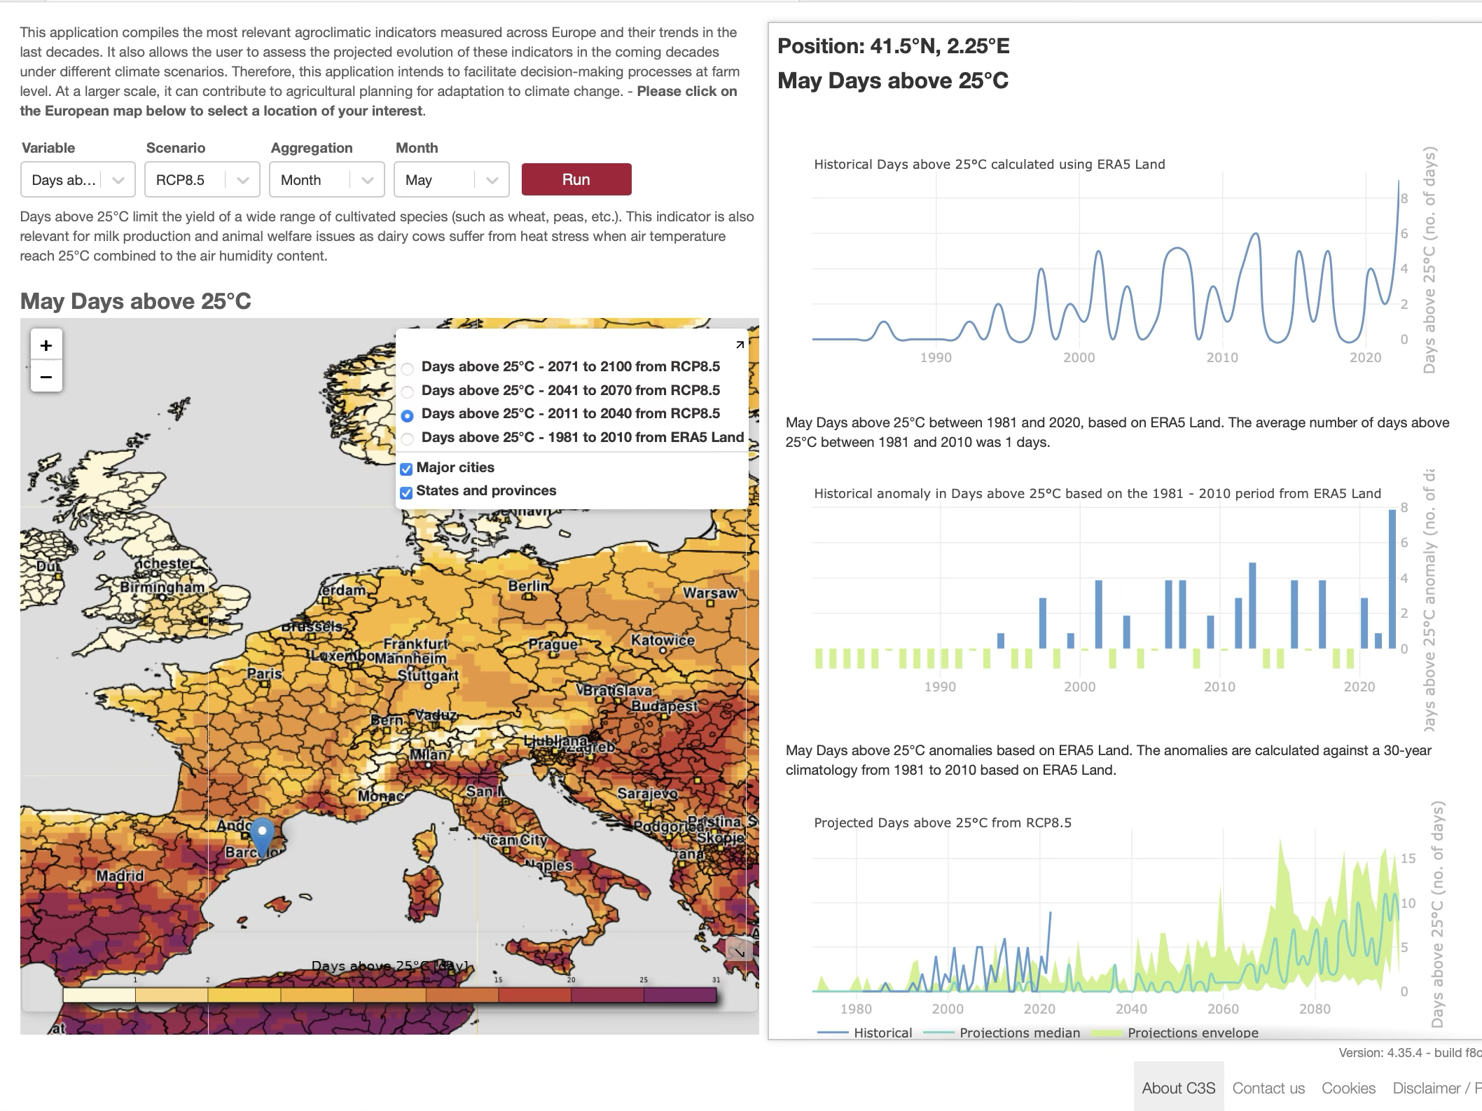
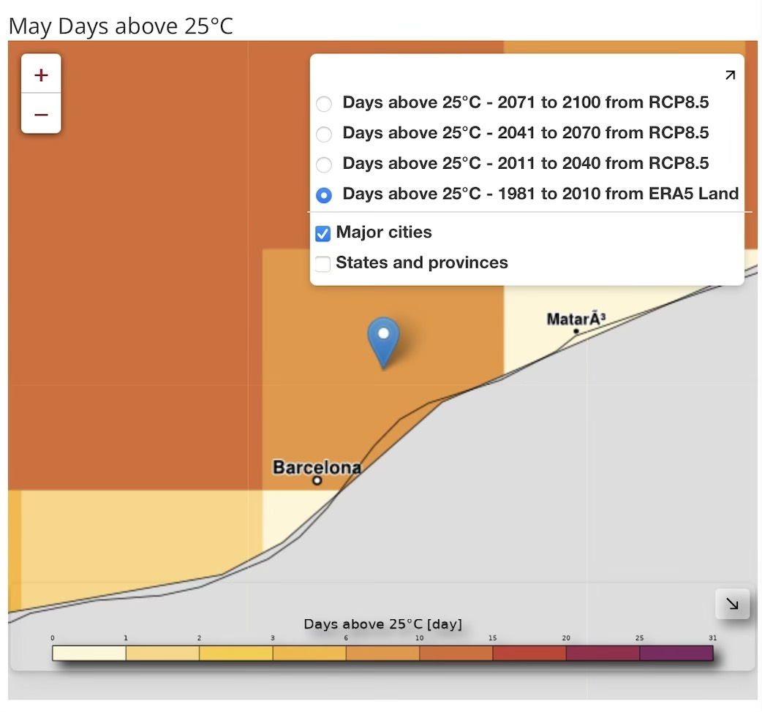
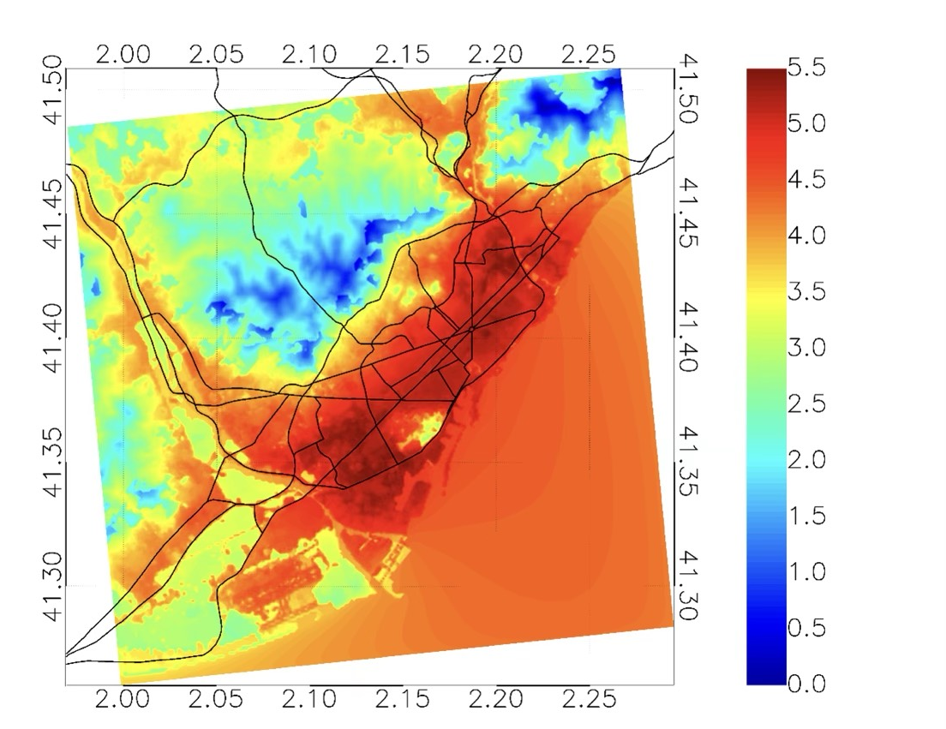
Need of downscaling and include local data
EURO-CORDEX pixel
0.11º resolution
Need to support local downscaling and data integration at local/city level

Slide 7
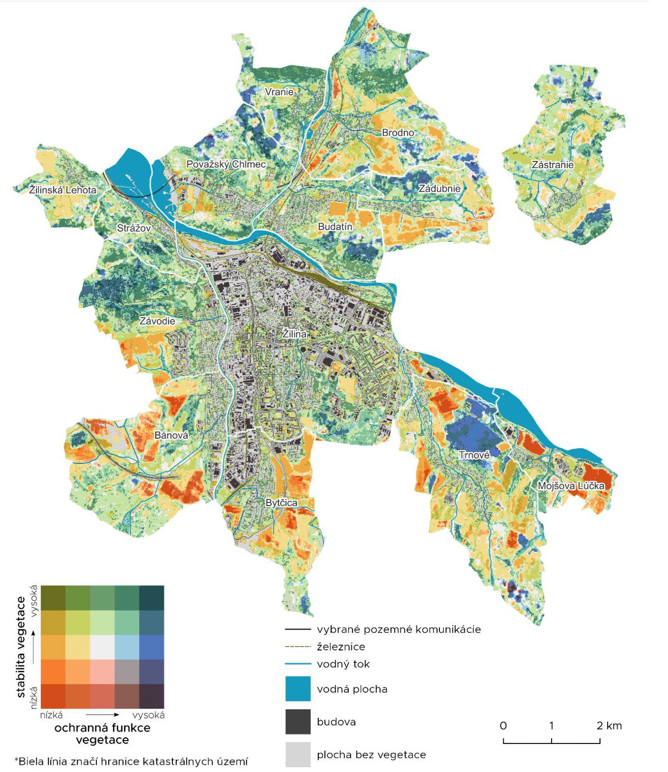
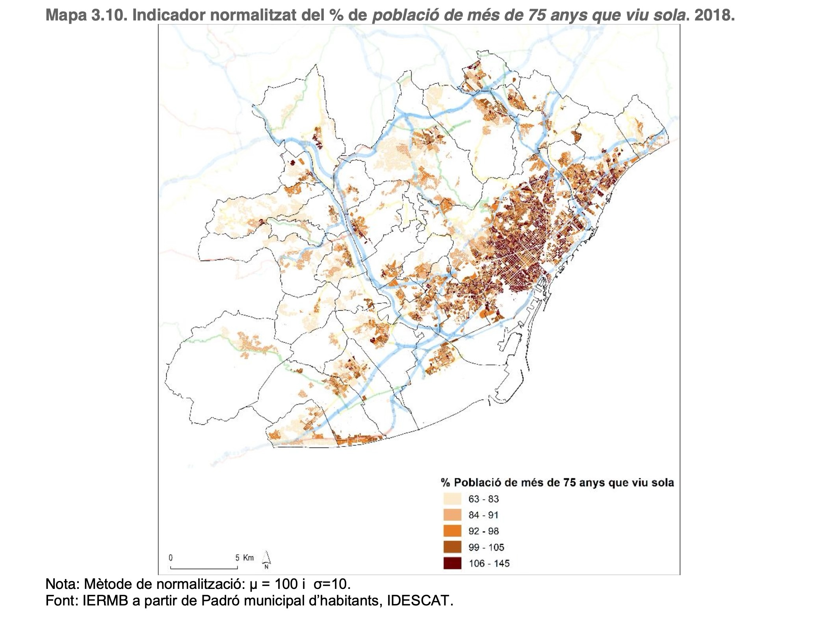
% of Population over 75 years that lives alone in Barcelona Metropolitan Area (2018): IERMB from IDESCAT
Use of local data ENCOURAGED
Žilina city vegetation
VEGETATION

Slide 8
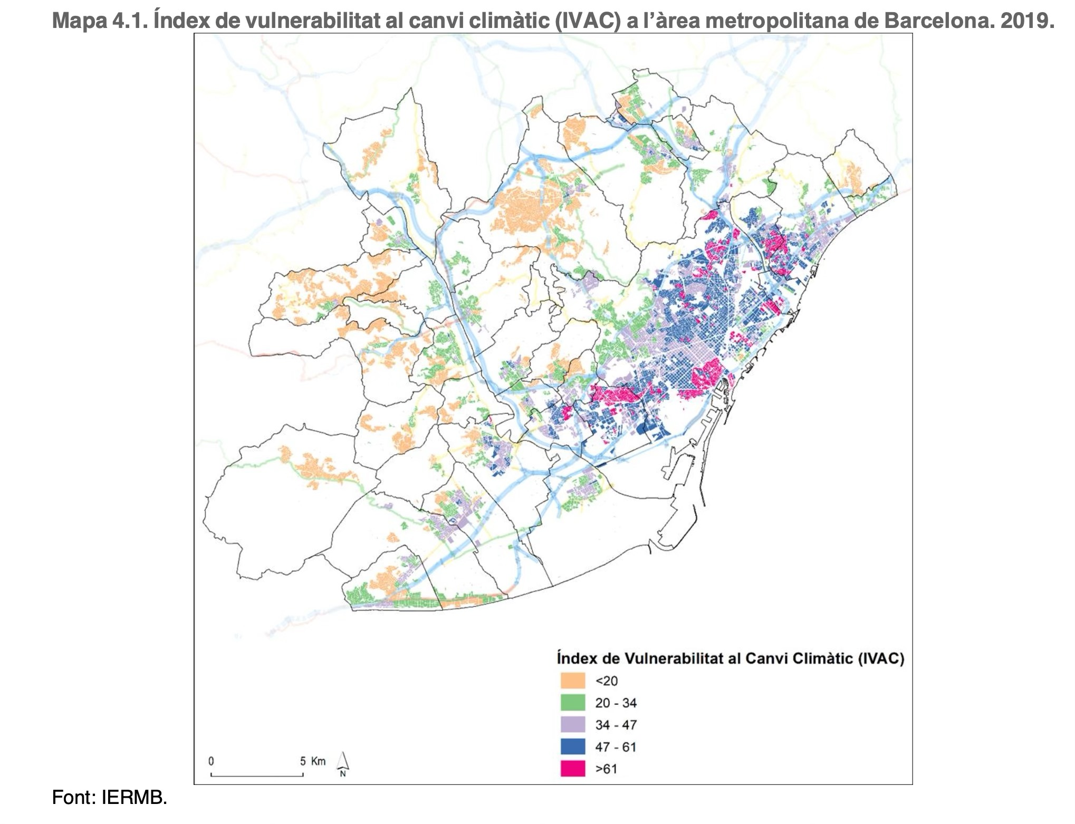
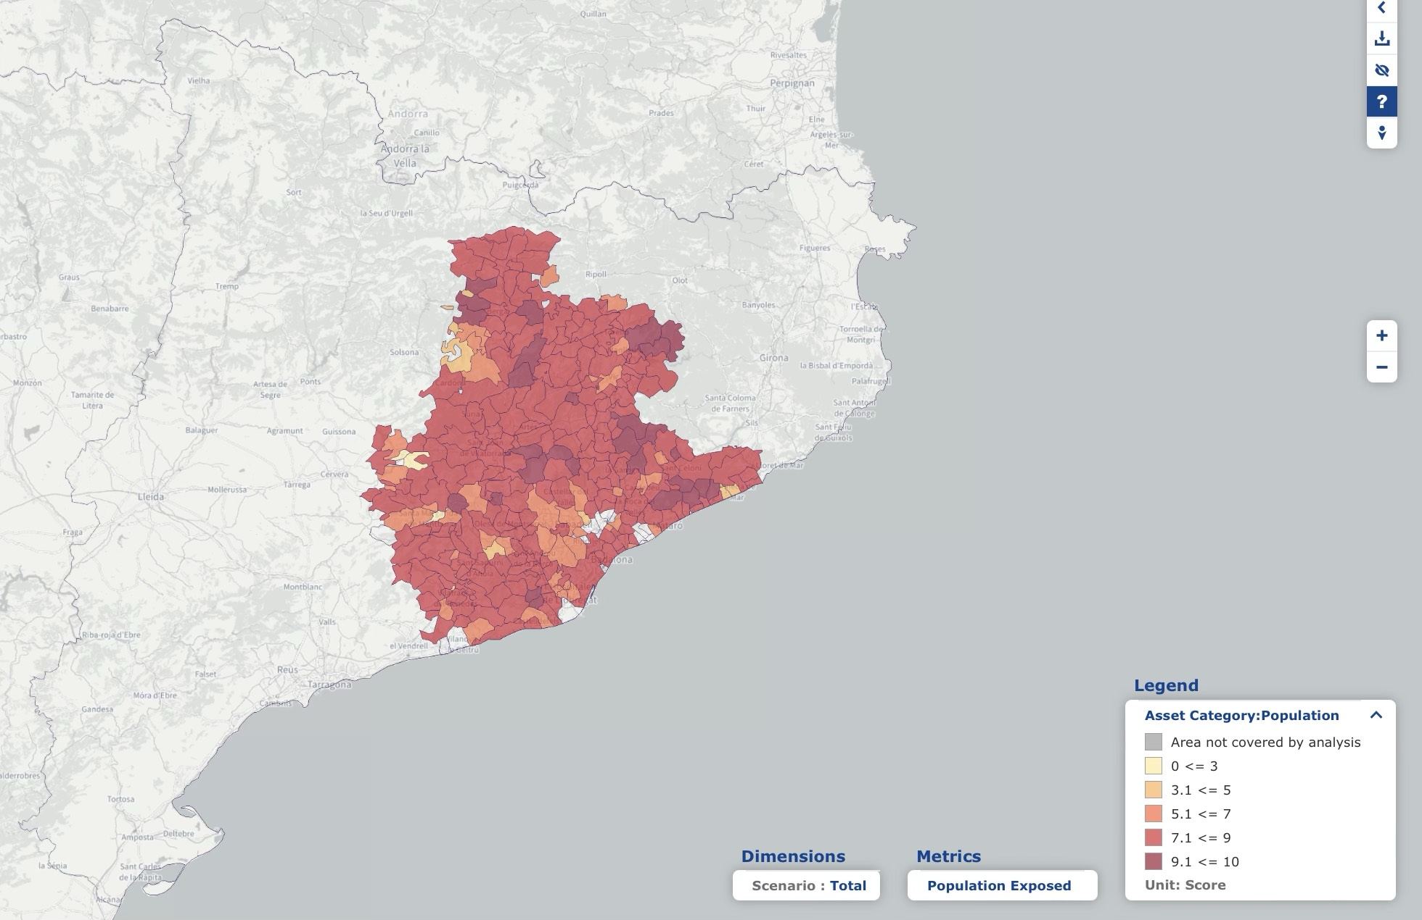

CLIMAAX cannot do local studies…
… but can support third parties to do it at their regional/local scale
CHALLENGE: How to adapt the methodology to extend it to a
maximum number of regions/municipalities in Europe
heatwaves, wildfires, flash floods, landslides, droughts…

Slide 9
PHASE 1: COMMON METHODOLOGY applicable at regional/local scale in Europe
PHASE 3: EXPLORATION OF LOCAL ADAPTATION STRATEGIES and improved Risk Management Plans
PHASE 2: REFINED REGIONAL/LOCAL HR ANALYSIS AND RISK ASSESSMENT
Refinement of the multi-risk assessment carried out in Phase 1
Using local data / local downscaling of the large scale climate indicators
Capable to integrate local high-resolution data and approaches
Enabling to enhance regional /local risk assessments
Multi-risk
Applicable at any interested region/municipality/community
Enabling to establish a common Risk Assessment benchmark across Europe
Using as much as possible the common information already available
Explore potential adaptation options and helps to identify relevant actions at local scale to address the risk and vulnerabilities identified
Analysis of local adaptation options and strategies and improved RMPs
Guidance on examples of best practices

Slide 10



CLIMAAX
CLIMate risk and vulnerAbility
Assessment framework and toolboX
1st Open CALL
for REGIONS and COMMUNITIES
33 regional and local
applicants selected
(average grant of 160 k€)

Slide 11

HOW TO APPLY?
SECOND OPEN CALL
About to OPEN on 1st July 2024
https://www.climaax.eu/fstp-open-call/
28 november 2019
Notes:
CLIMAte risk and vulnerability Assessment framework and toolboX (CLIMAAX) is a 4-year Horizon Europe project that will provide financial, analytical, and practical support to improve regional climate and emergency risk management plans. CLIMAAX is designed to contribute to the harmonization and consolidation of the practice of climate risk assessment, leaving a legacy for upcoming European initiatives. The project started in January 2023 and runs until December 2026.

