Slide 1
On demand wildfire risk assessment workflow at Pan-European scale
CLIMAAX

Slide 2
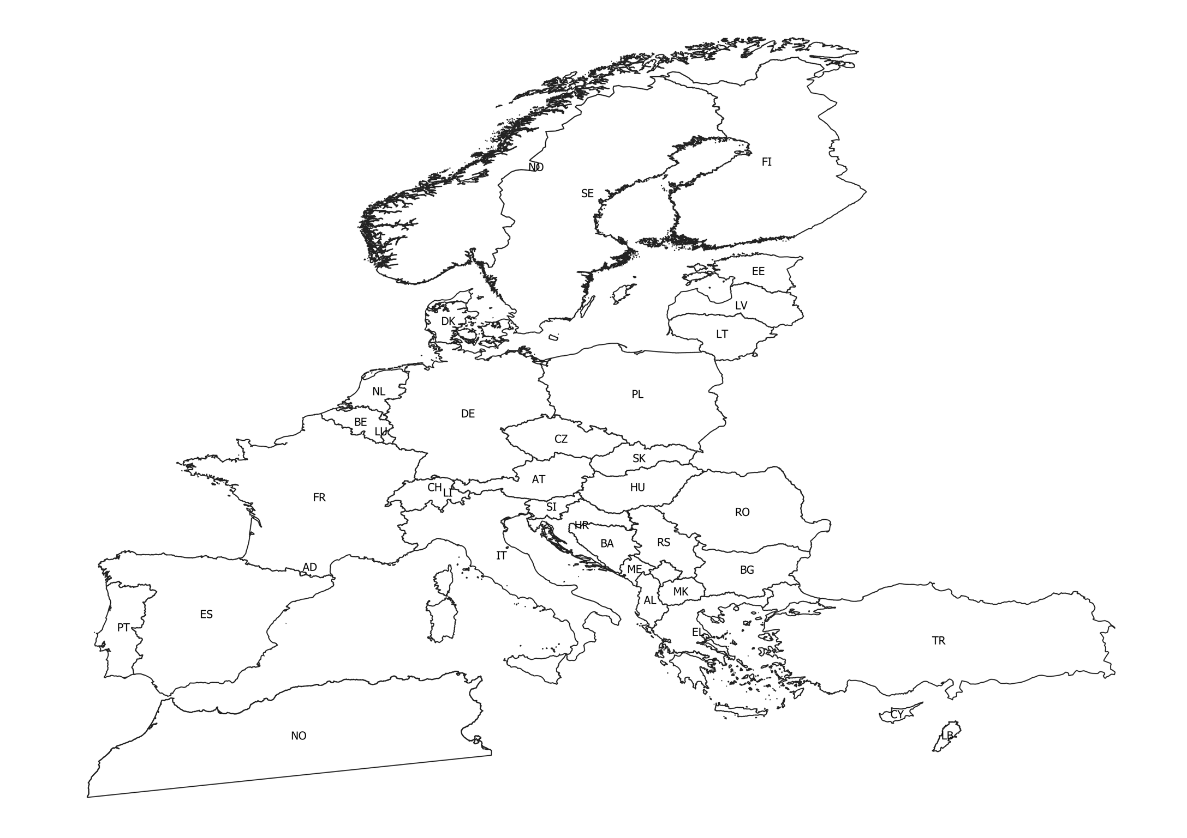
Wildfire Susceptibility and Hazard – model’s domain
A machine learning model based on a Random Forest Classifier is trained in order to asses the wildfire susceptibility:
National datasets as well as a Pan-European dataset can be built for training the model.
Wildfire susceptibility identifies the areas in which wildfires are more likely to occur and propagate due to geo-topographic and climatic conditions
It is one of the input for the wildfire hazard assessment

Slide 3
Input data – present climate conditions
Susceptibility - Hazard data
DEM
Slope
Aspect
Global Land cover
or
CORINE land cover
Risk data
Point of interest
Roads
Type of vegetation
Urban interface
Population density
MERIT DEM 100m
Open Street Map
Land cover maps
Copernicus (Land service)
Daily mean temperature [C]
Daily precipitation [mm]
Daily mean wind speed [m/h]
Daily mean relative humidity [%]
Global Human
Settlement (2020)
ISIMIP - E5W5 dataset
Retreiving climate indices (yearly data and 40 years average data) such as maximum average daily temperature, max consecutive dry/wet days, annual cumulative precipitation

Slide 4
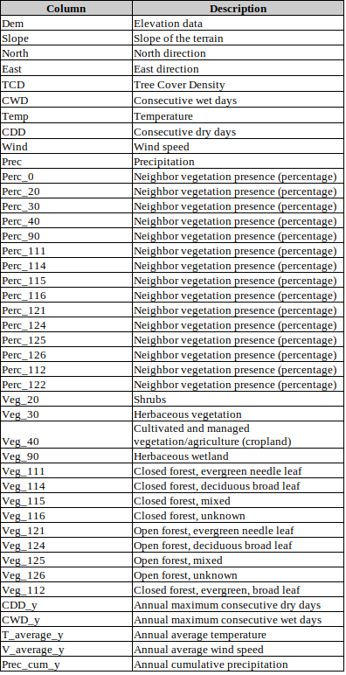
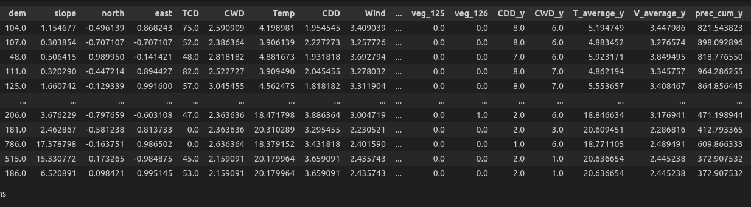
Example of dataset
The dataset for training the model contains several rows (pixel at the working resolution) associated with a set of features encompassing topographic, land cover and climatic variables.
The label to predict is 0 or 1:
0 – the pixel has not experienced a wildfire (for a specific year)
1 – the pixel has experienced a wildfire (for a specific year)
Climate of 40 years
Annual climate conditions
Topographic variables
land cover

Slide 5
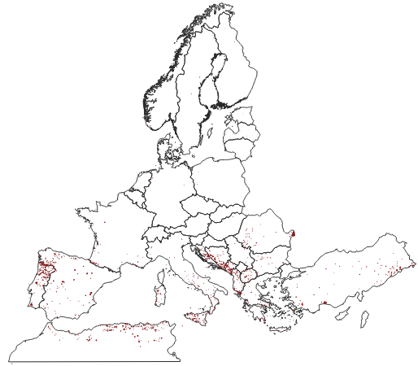
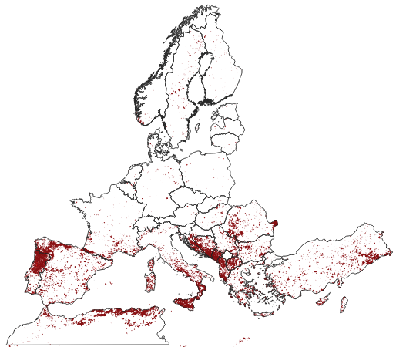
The wildfire dataset
Wildfire data are retrieved from EFFIS and encompass burned scars from 2008 to 2022
Sample of wildfires left out for validation purposes
Sampling of 10% of fires greater than 100 ha per country
Wildfires taking part in the analysis
For each country a random sampling ill be applied in order to build a mixed dataset of presences/absences

Slide 6
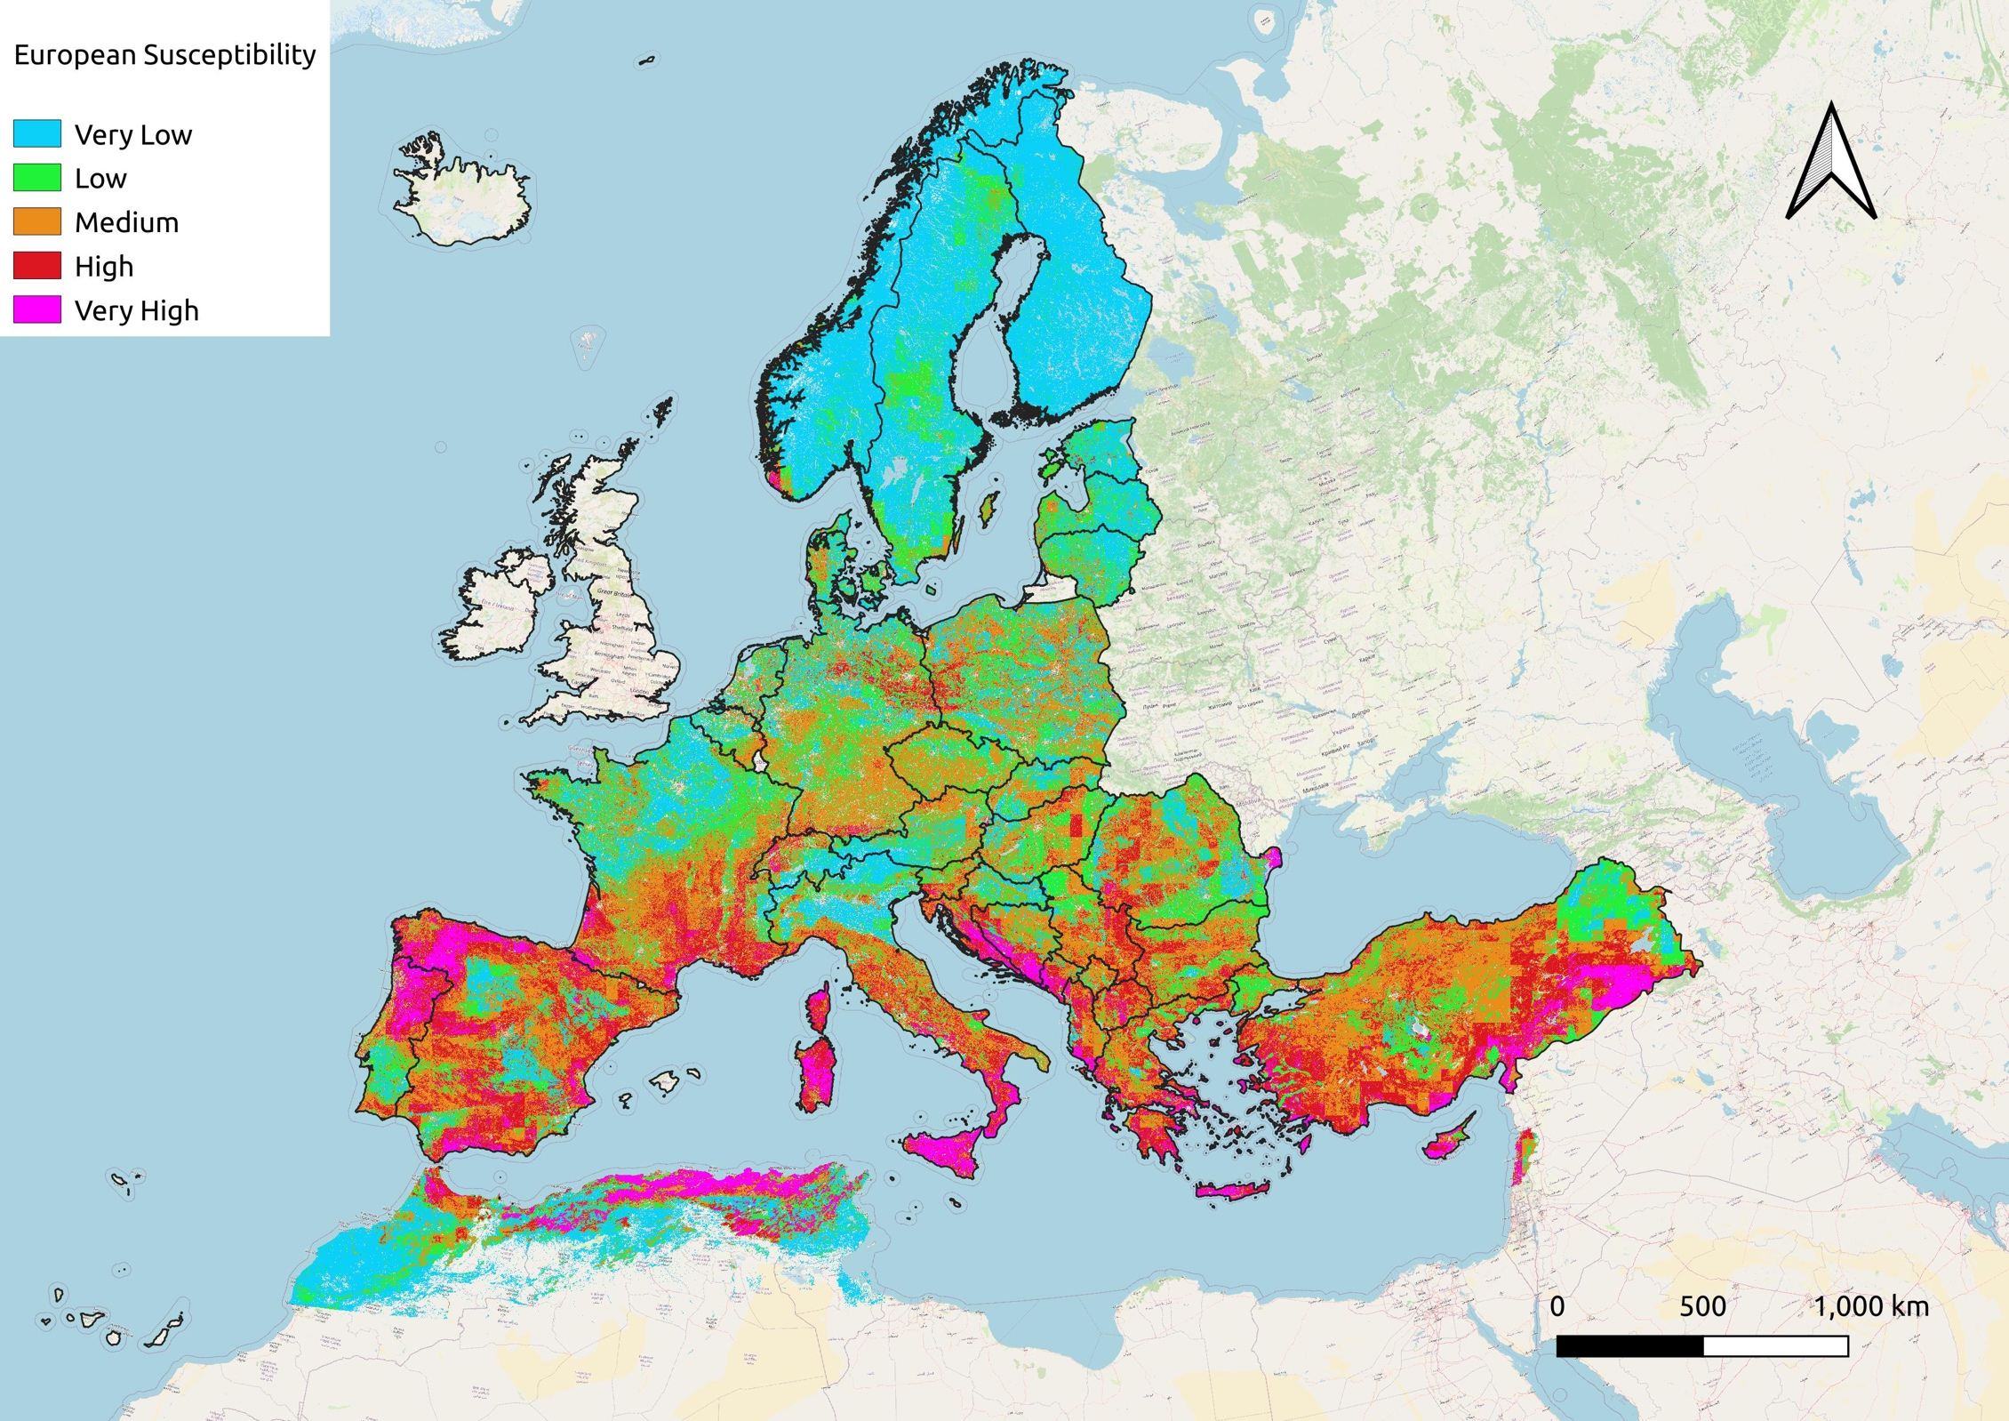

Slide 7
Hazard maps – the methodology
Main fuel types aggregated from input land cover map
Wildfire hazard map identifies the aeras in which severe wildfire are likely to occur, the severity level is linked with the fuel type while the propensity to develop a fire is due to the susceptibility
S / Fuel | Grassland | Low Flammable Forest | Shrub land | High Flammable Forest
Low Susc. | 1 | 2 | 3 | 4
Med. Susc. | 2 | 3 | 4 | 5
High Susc. | 3 | 4 | 5 | 6
National/Regional wildfire susceptibility
Very low intensity grassland fire | Low intensity surface fire | Medium intensity surface fire | High intensity surface fire | Very high intensity fire | Extreme intensity crown fire

Slide 8
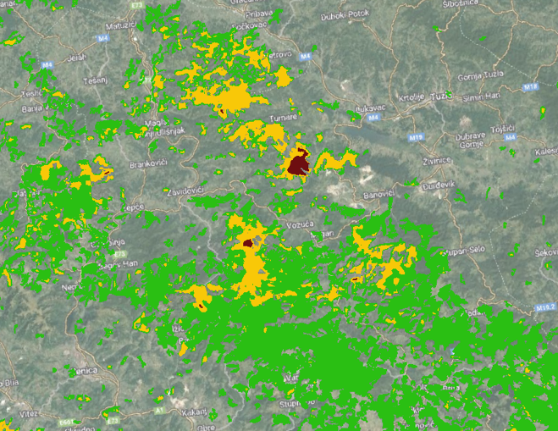

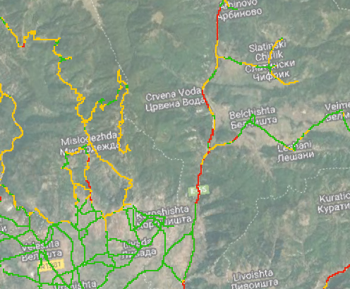
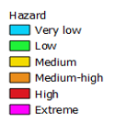
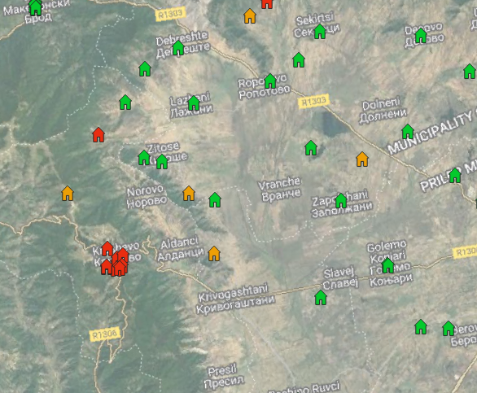
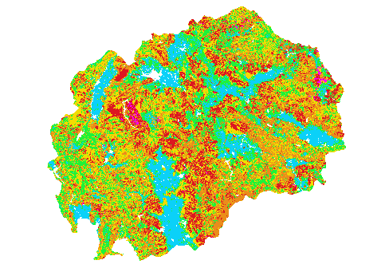
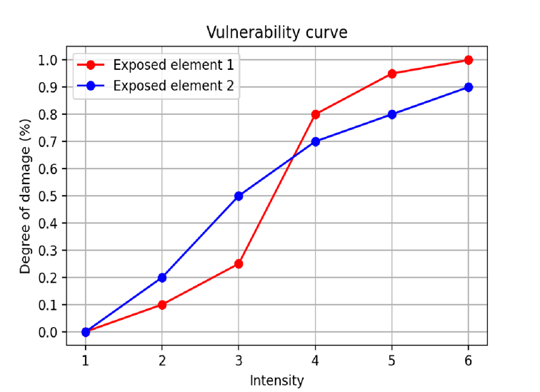
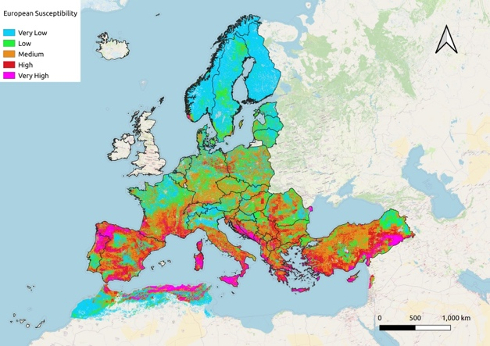
Workflow
S / Fuel | Grassland | Low F. Forest | Shrub land | High F. Forest
Low Susc. | 1 | 2 | 3 | 4
Med. Susc. | 2 | 3 | 4 | 5
High Susc. | 3 | 4 | 5 | 6
Conifer forest
RISK
The susceptibility discriminate the type of fuel (from low to high flammability) identifying the easiness to develop fires
…to Hazard on request for study area
R
= H x
E x
V(I)
From Pan-European susceptibility…
Roads
Exposed element | Value
Waste treatment | 70
Schools | 100
Hospitals | 100
Primary roads | 80
Secondary roads | 70
Crops | 90
Shrubs | 60
Broadleaves | 80
Conifers | 80
Agro-turistic structures | 100
Point of Interest
For present climate conditions…

Slide 9
Input data – future climate conditions
Susceptibility - Hazard data
DEM
Slope
Aspect
Land cover projected maps based on SSP-RCP climate change scenarios
Risk data
Point of interest
Roads
Type of vegetation
Urban interface
Population density
Merit DEM 100m
Open Street Map
Land cover maps
Daily mean temperature [C]
Daily precipitation [mm]
Daily mean wind speed [m/h]
Daily mean relative humidity [%]
Global Human
Settlement
Future projection (2070)
ISIMIP Data
different model and scenarios (SSP-RCP) will be taken into account
Future climate conditions will be used for building the dataset in which the machine learning model trained on historical data runs in order to assess the projections of wildfire Susceptibility and Hazard maps

Slide 10
Input data – future climate conditions
Susceptibility - Hazard
ISIMIP data
Daily mean temperature [C]
Daily precipitation [mm]
Daily mean wind speed [m/h]
Daily mean relative humidity [%]
Indices
Models
Annual average temperature
Annual cumulative precipitation
Annual average wind speed
Annual maximum number of consecutive dry days (CDD)
Annual maximum number of consecutive wet days (CWD)
MPI-ESM1-2HR
GFDL-ESM4
MRI_ESM2-0
IPSL-CM6A-LR
UKESM1-0-LL
Scenarios: SSP-1-RCP-2.6 SSP-2-RCP-4.5 SSP-5-RCP-8.5

Slide 11
Input data – future climate conditions
Model selection
Selection of an ensamble of 5 models considered as primary models available in the ISIMIP database. Primary models are in fact suggested to be considered in climate change analyses as mandatory models despite a secondary set of models which is available but won’t be considered in the current study.
ISIMIP database – why?
ISIMIP project offers a database of climatic data already bias corrected. A bias adjustment function has been calibrated with historical trends from 1979 to 2016 of several variables, thanks to the combination of model data with meteorological observations and reanalysis datasets (i.e. ERA5). Then the bias correction function has been applied to the future projection data.
Type of variables
The climate variables refers to daily average values (such as temperature and wind speed) while daily cumulative values are available for what concern the precipitation [mm]. Indices such as the maximum number of consecutive dry/wet days will be evaluated starting from these variables.

Slide 12
Future climate data - References
E5W5 historical dataset
https://doi.org/10.48364/ISIMIP.342217
https://essd.copernicus.org/articles/12/2097/2020/#bib1.bibx50
ISIMIP biased adjusted fact sheet
https://www.isimip.org/documents/413/ISIMIP3b_bias_adjustment_fact_sheet_Gnsz7CO.pdf

Slide 13
Workflow
S / Fuel | Grassland | Low F. Forest | Shrub land | High F. Forest
Low Susc. | 1 | 2 | 3 | 4
Med. Susc. | 2 | 3 | 4 | 5
High Susc. | 3 | 4 | 5 | 6
Conifer forest
RISK
The susceptibility discriminate the type of fuel (from low to high flammability) identifying the easiness to develop fires
…to Hazard on request for study area
R
= H x
E x
V(I)
From Pan-European susceptibility…
Roads
Exposed element | Value
Waste treatment | 70
Schools | 100
Hospitals | 100
Primary roads | 80
Secondary roads | 70
Crops | 90
Shrubs | 60
Broadleaves | 80
Conifers | 80
Agro-turistic structures | 100
Point of Interest
…And for future climate condition

Slide 14
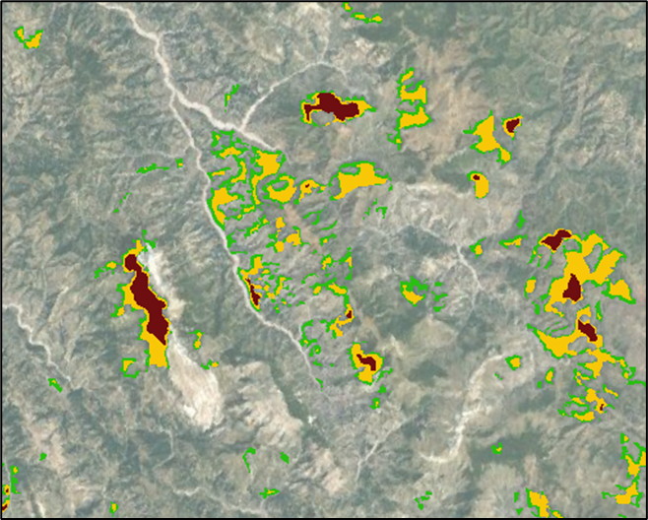
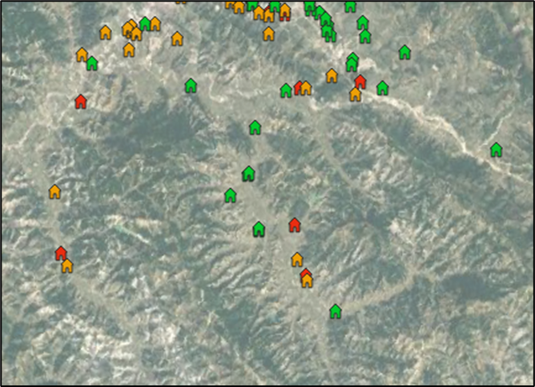
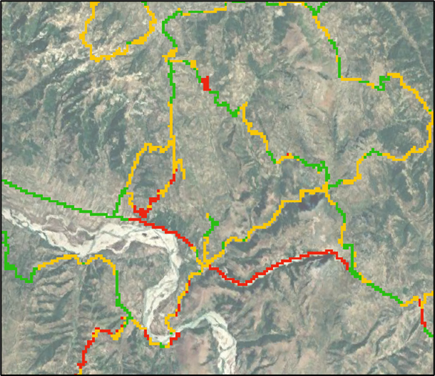
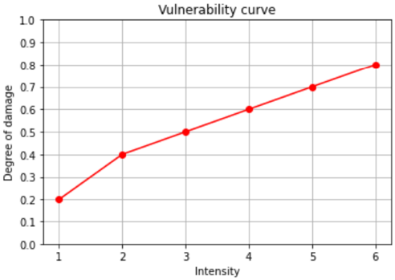
Asset damage
Conifer forest
Damage (kEUR)
The potential damage is associated to each exposed element combining its value (exposure) with the vulnerability
Point of Interest
D = E * V
Exposed element | Value (or importance)
Education | 100
Healthcare | 100
Commercial | 90
Broadleaves | 90
Conifers | 90
Crops | 80
Shrubs | 50
Primary roads | 70
Secondary roads | 60
Roads

Slide 15
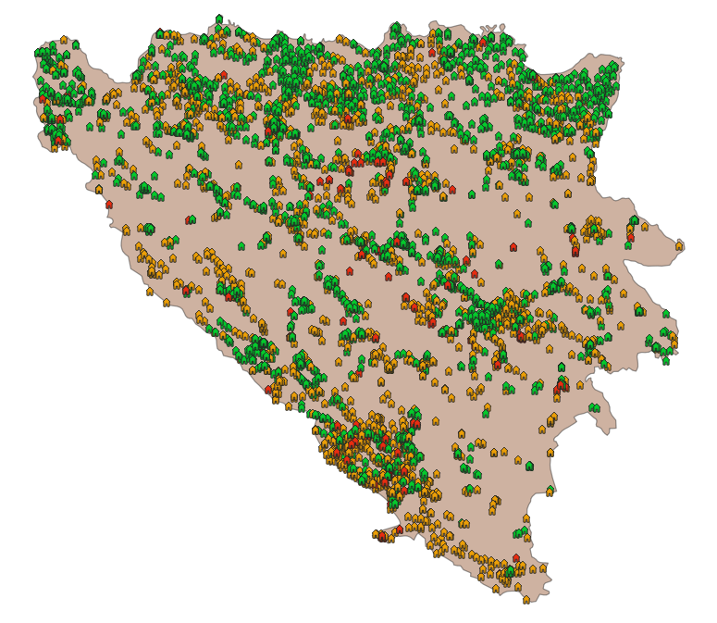

From Damage to Risk
Risk​
The static wildfire risk is defined as the potential damage expected to each asset, classified according to thresholds
Potential damage of element
Risk level | Damage thresholds
Low | < 25
Medium | 25 < x < 50
High | 50 < x < 75
Very High | > 75
The risk is assessed at national scale for each asset
In our example, the maximum value of exposed element is 100, a loss value of 75 it is then considered very high

Slide 16
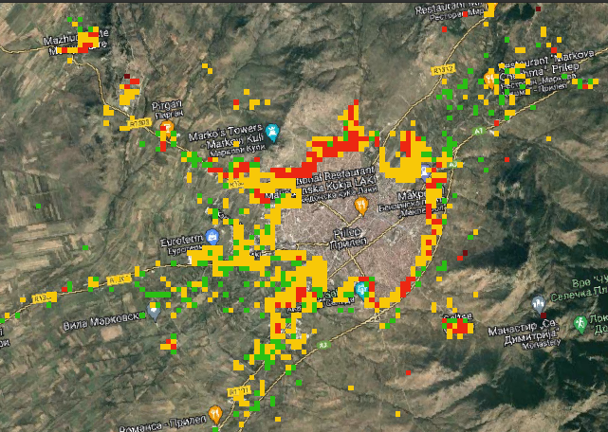
Population at Risk
Population density class | POP (num/km2)
1 | 10 - 500
2 | 500 . 1500
3 | 1500 - 3000
4 | > 3000
Population at risk
Population density classes
I / POP | 1 | 2 | 3 | 4
1 | 1 | 1 | 1 | 1
2 | 1 | 1 | 2 | 2
3 | 1 | 2 | 3 | 3
4 | 2 | 3 | 3 | 4
5 | 3 | 4 | 4 | 4
6 | 4 | 4 | 4 | 4
wildfire hazard
Population at risk is evaluated through a contingency matrix between the wildfire hazard and the population density

Slide 17
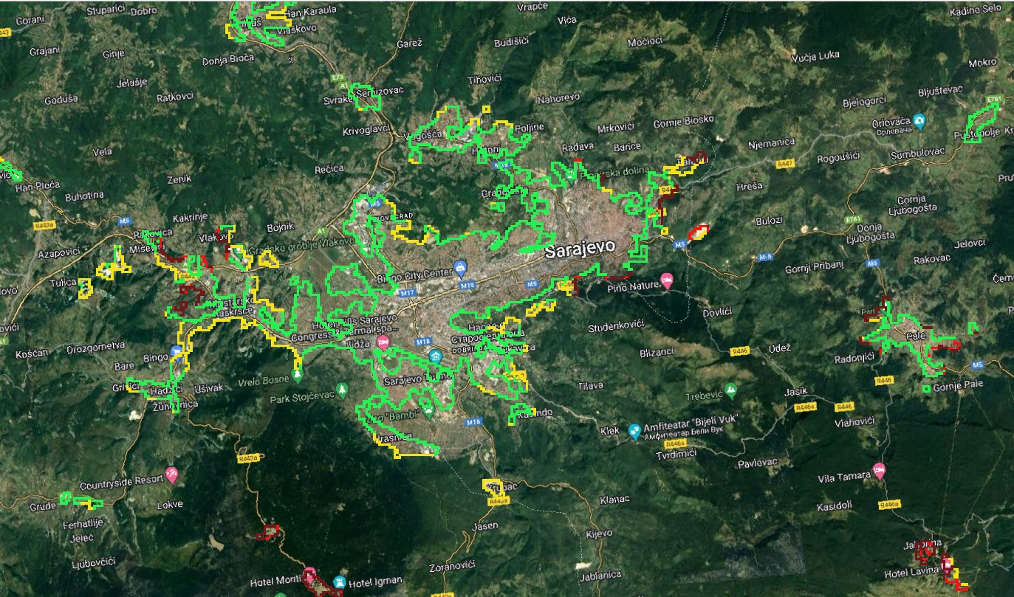
Urban interface Risk
The urban interface risk provides information on the wildland urban interface more prone to the occurrence of high intensity wildfires (high level of hazard).
It is evaluated by applying a maximum sliding windows on the wildfire hazard map, then aggregating the result in 4 risk classes

